Slide 1
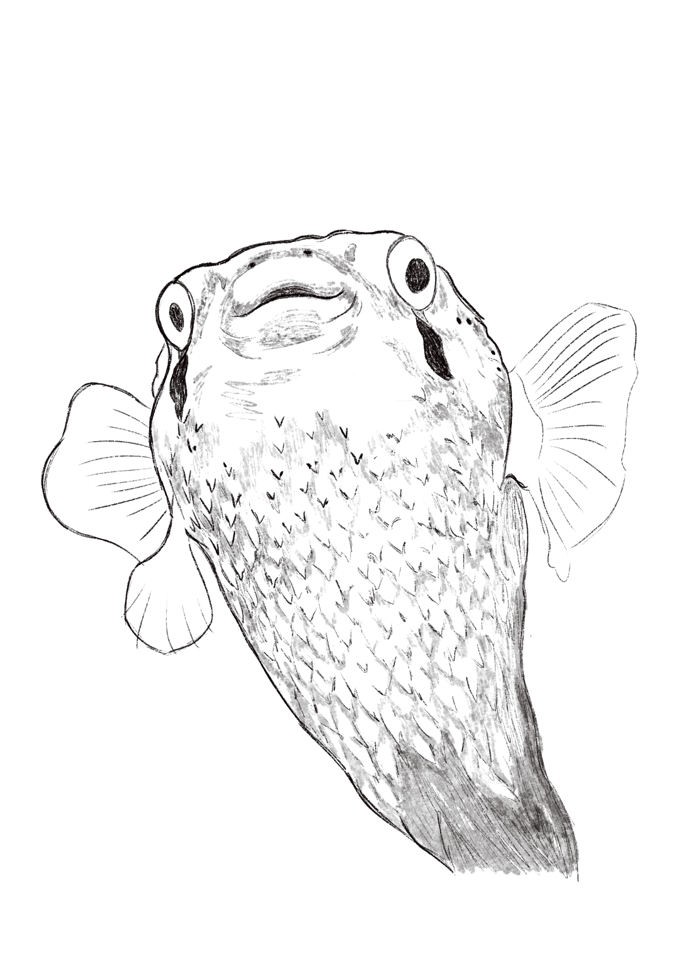
Want to make information “stick” with guests?
Introduce animals as unique individuals!
Using simple empathy practices can boost how we teach about species biology and encourage more caring behavior on site and at home that supports animal wellbeing. Here’s one example of how an aquarist approached talking about Sugar Puff the porcupine fish.

Slide 2


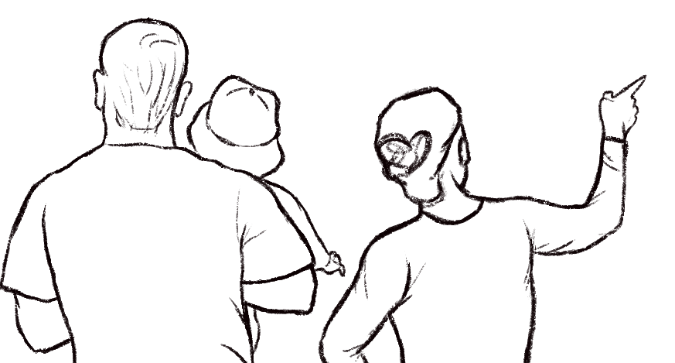


Do you pet it?
I would never touch Sugar Puff’s body, even though she is just the best and has this habit of wiggling when she swims that reminds me of a dog wagging their tail. Touching can make her feel unsafe, and porcupine fish inflate their spines with water to puff up when they’re stressed.

Slide 3
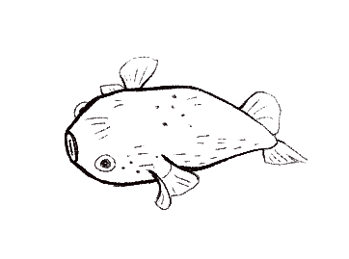




Oh, that’s cool!
Can we make her do it?
It’s an amazing natural defense mechanism, but it’s also how we know Sugar Puff is afraid. If someone was banging their hand on your car window, it might feel scary, right? That’s why we ask that folks don’t touch the glass, because we want animals to have a good quality of life here – and your visit can be part of that.

Slide 4
How it works
When we introduce the animal, framing them as unique individuals while we share species biology, we are transforming how people perceive animals. Research shows that using these empathy practices can help guests see animals as worthy of care and respect.

Slide 5
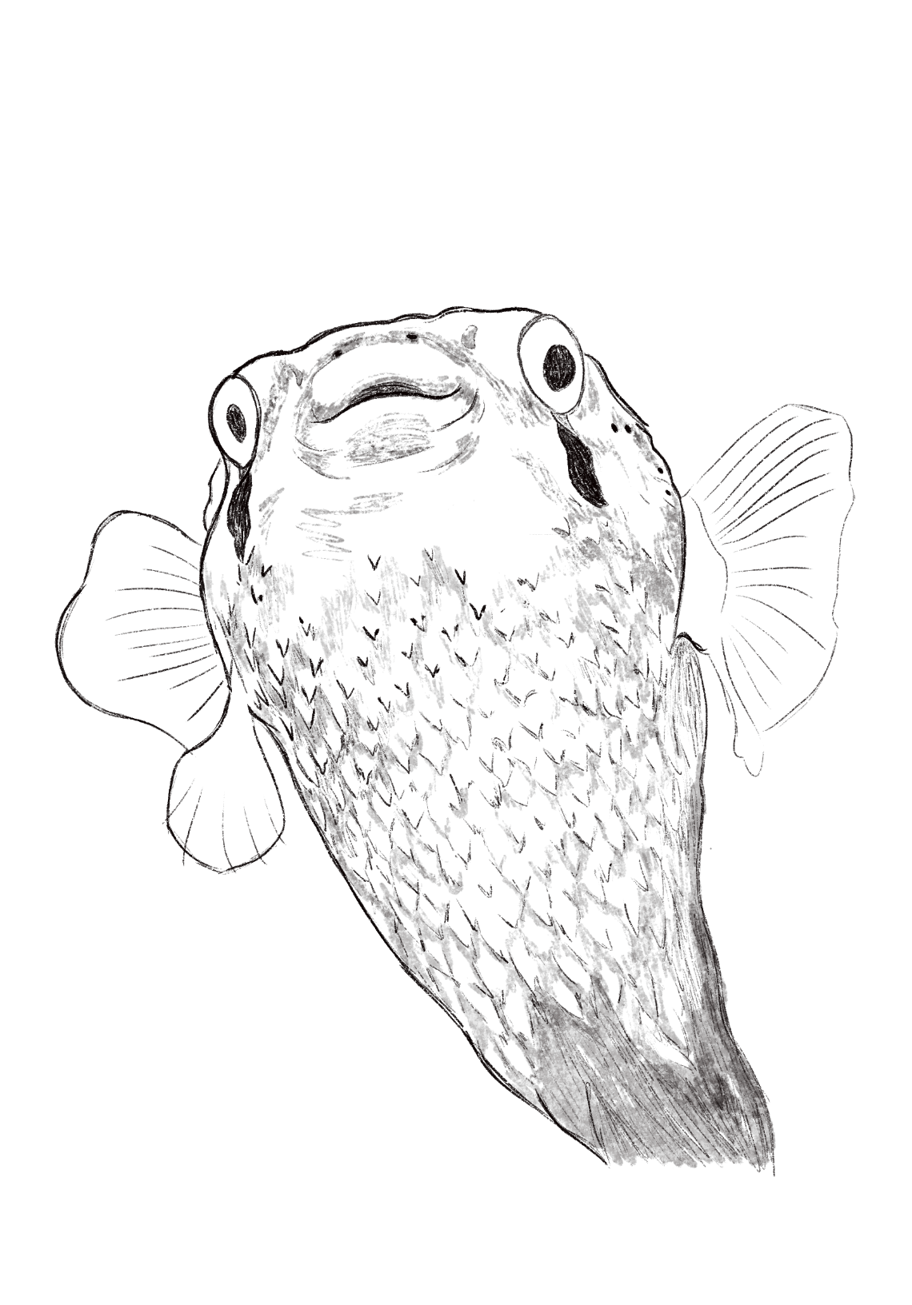
How it works
Using animal names and saying “he,” “she,” or “they” instead of “it” can highlight that animals are living, breathing beings like ourselves and not inanimate objects.
Describing personality traits or telling stories that put a spotlight on an animal’s choice and agency can be effectively combined with teaching about natural history to really stick with guests long after their visit.
This staying power can help people better remember what they’re learning and motivate caring behavior (like not banging on glass), giving both our animals and our guests a better day.

Slide 6

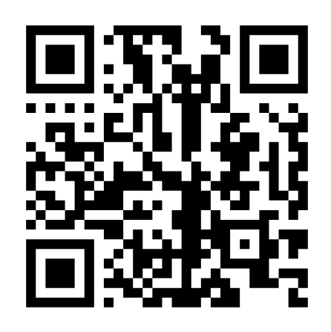

To learn more about effective empathy practices that support guest engagement, and the research behind them, visit introduction.aceforwildlife.org.
aceforwildlife.org

