Slide 1



Fostering empathy through exhibit design and interpretation
Tierney Ball, Director of Education

Slide 2

Exhibit Design

Slide 3
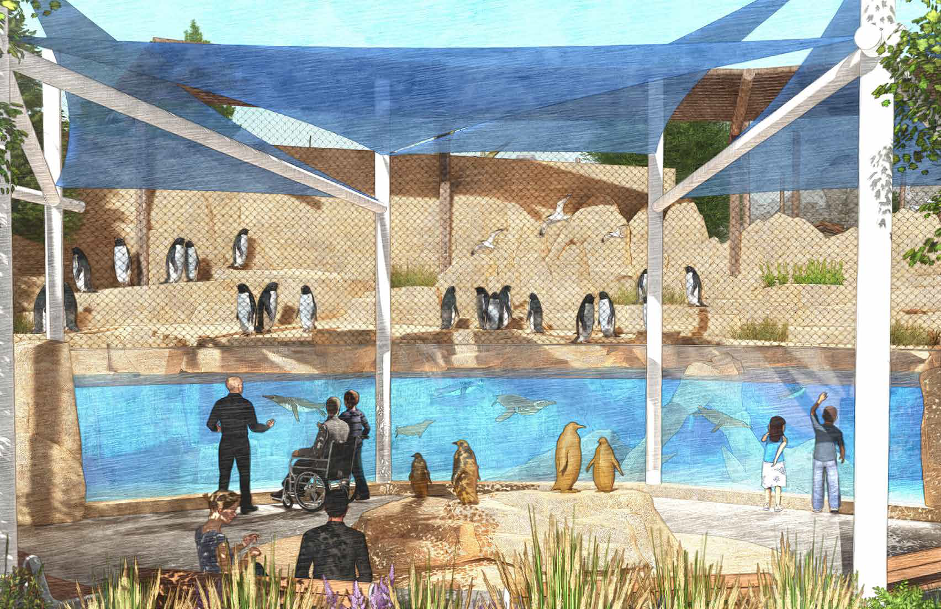
Master Plan 2021
Notes:
• Opened Gorongosa in 2019, first process using empathy work
• Wanted to deepen connection and integrate more completely
• Began master plan in February 2020, finalized in June 2021

Slide 4
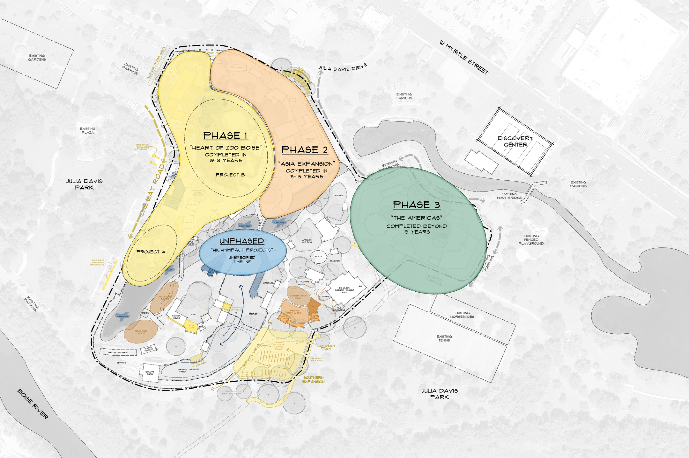
Notes:
• Identified constructions projects in 3 phases, looking at what is most critical for animals and guests and also what makes sense as a puzzle (phases)

Slide 5
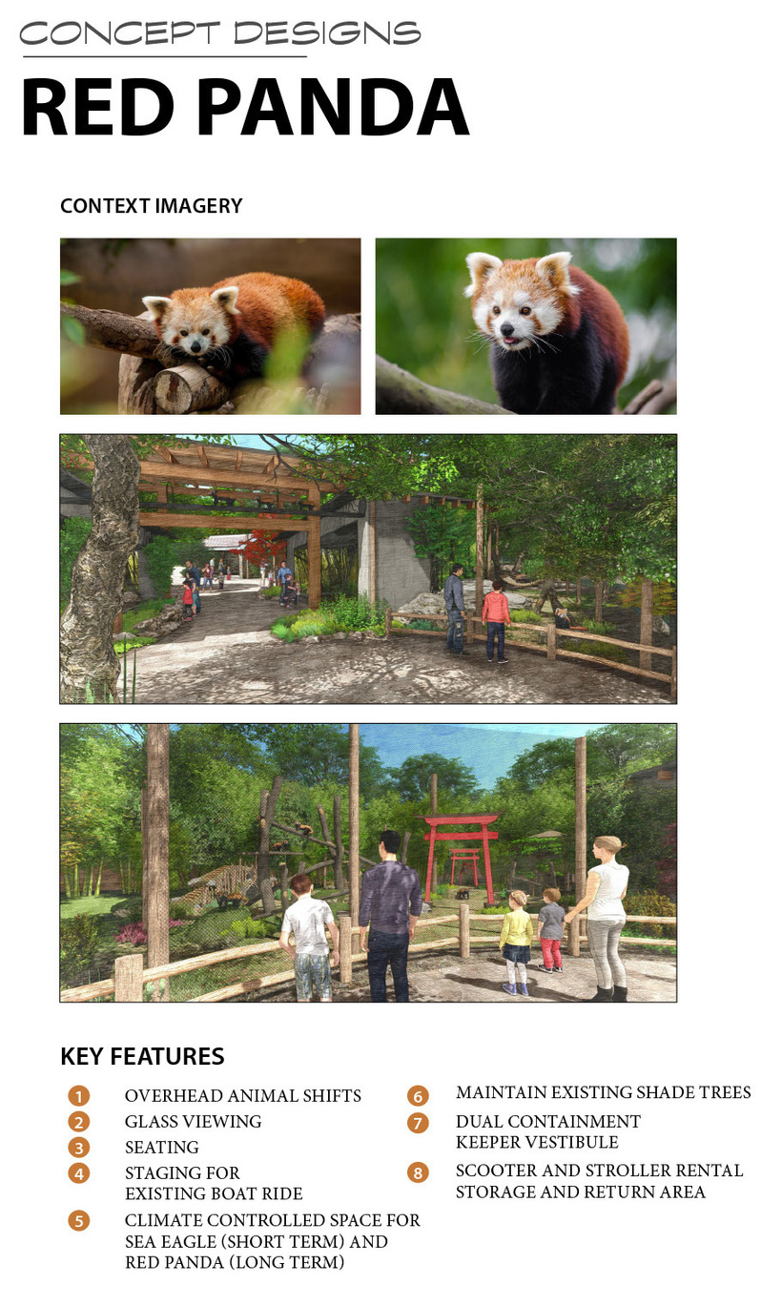
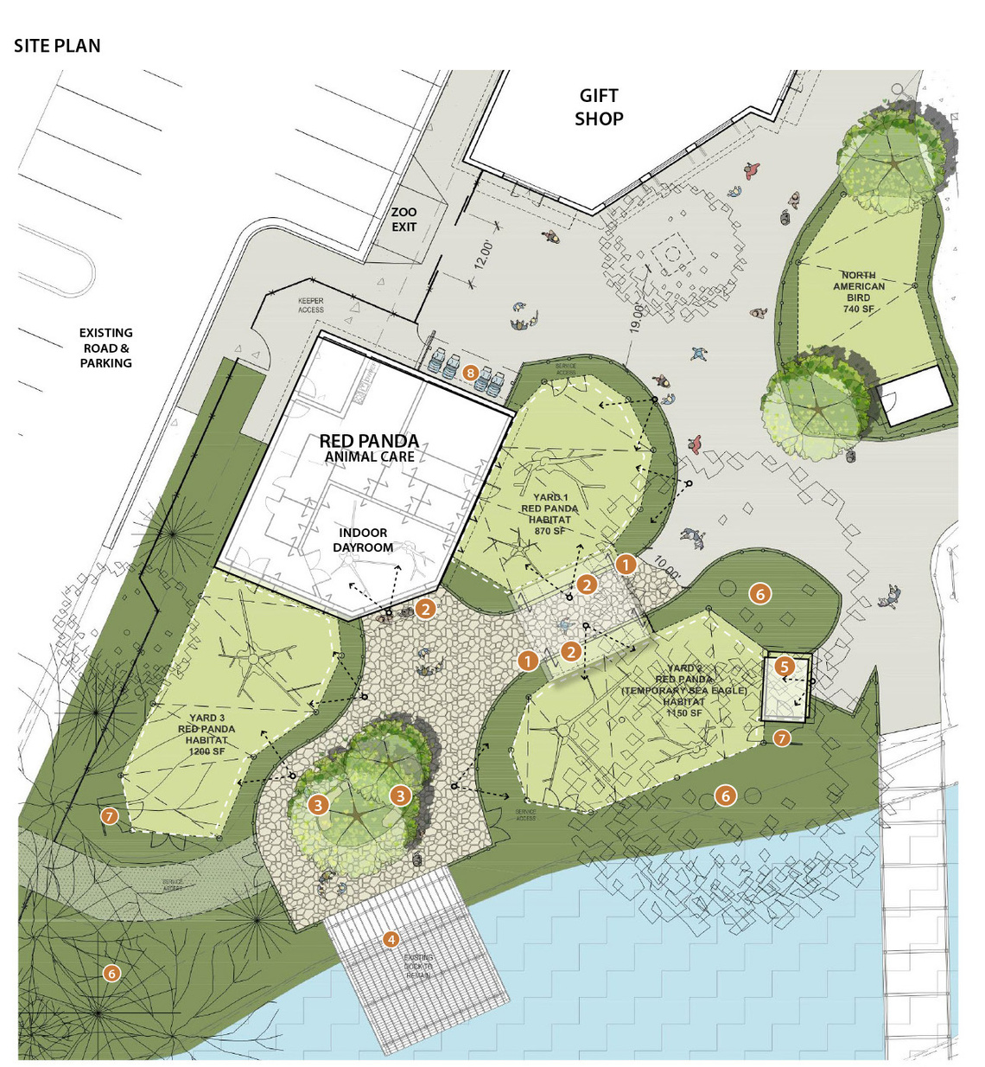
Notes:
• Advancing Empathy Grant Program Tier 1 grant-concept designs- First stage of process was concept designs-

Slide 6
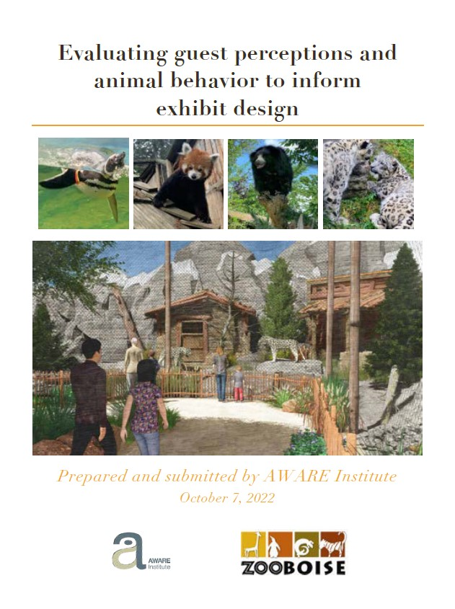
Notes:
• use empathy components on high level, and begin to pull data and research (visitor surveys, animal studies, AWARE/GLMV partnership)

Slide 7
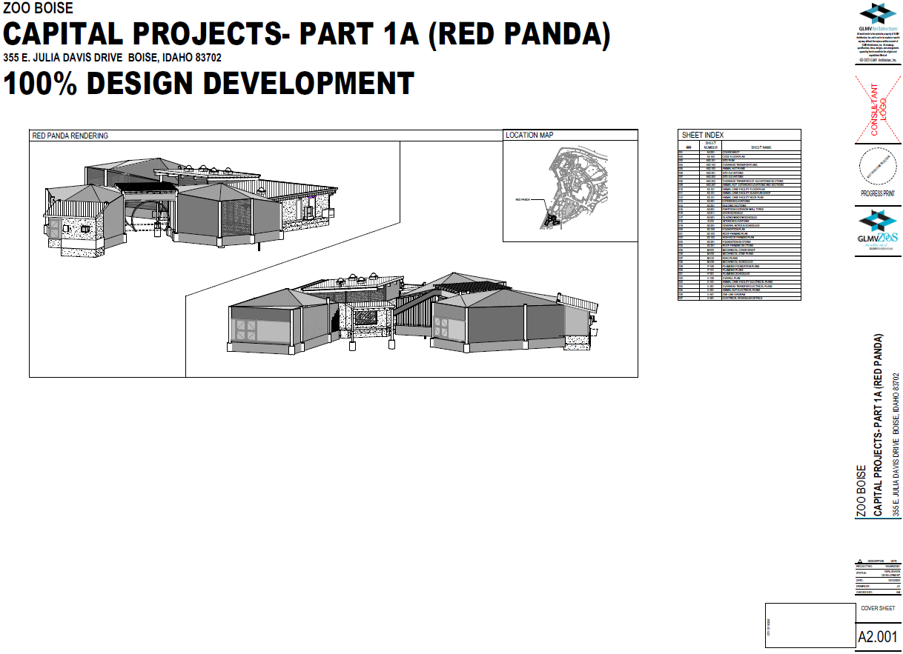
Notes:
• At the same time did a theming plan- the signage and experiences to pull in empathy (part of our 2022 Advancing Empathy Grant Program Tier 2 grant)
• 2022 Advancing Empathy Grant Program Tier 2 grant- Next stage was development drawings and construction documents- May- January 2024 (delayed waiting for available engineers)

Slide 8
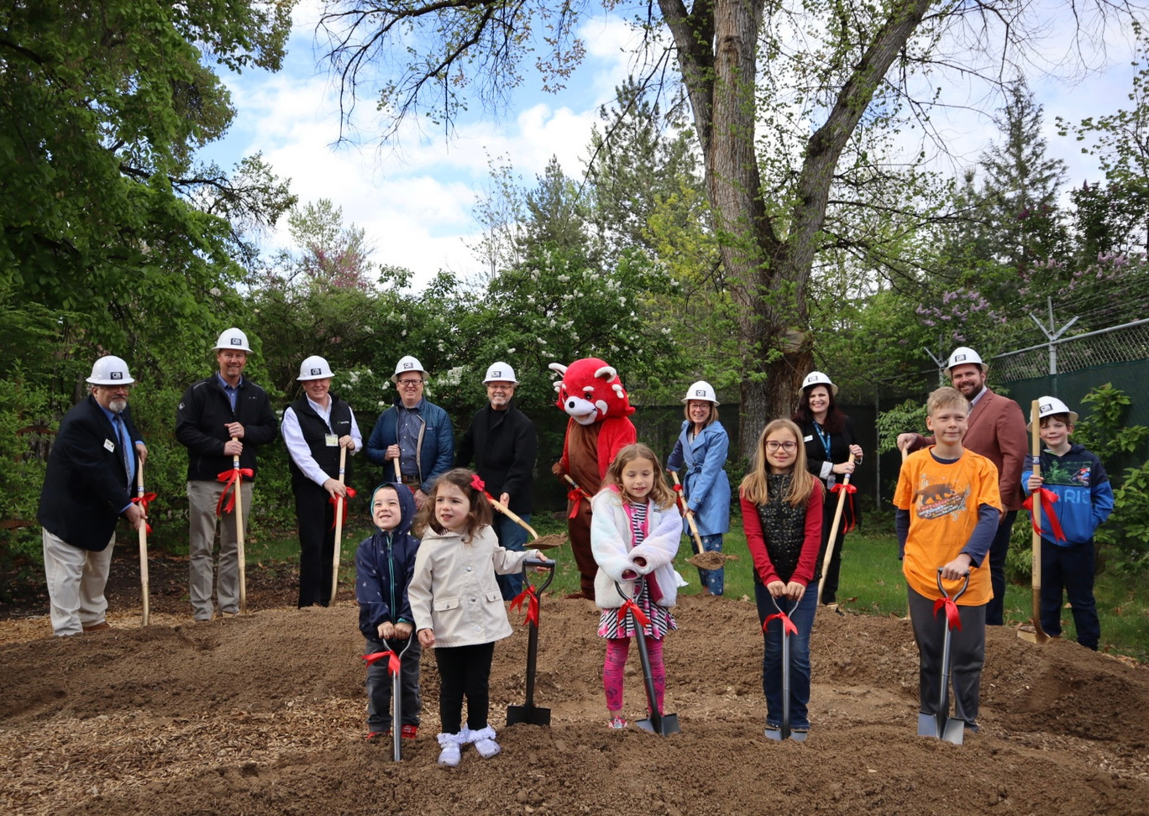
Notes:
• This Advancing Empathy Grant Program grant-Project objectives
o Objective #1:In 2024, construct the new red panda exhibit with features to foster guests’ empathy for wildlife
• Project activities typical for a construction project (don’t need to detail)
o Apply for building permits
o Hold regular meetings with the general contractor, CM Company, Boise-based erstad Architects, GLMV/Tessere, and Zoo Boise leadership to answer questions and ensure meeting deadlines
o Mobilize CM company’s materials and supplies
o Break ground and begin construction in spring 2024
▪ May 2024
o General contractor will construct the new red panda exhibit
o Plan exhibit opening activities
o Hold exhibit opening
o Share process
o Plan for evaluation after opening

Slide 9
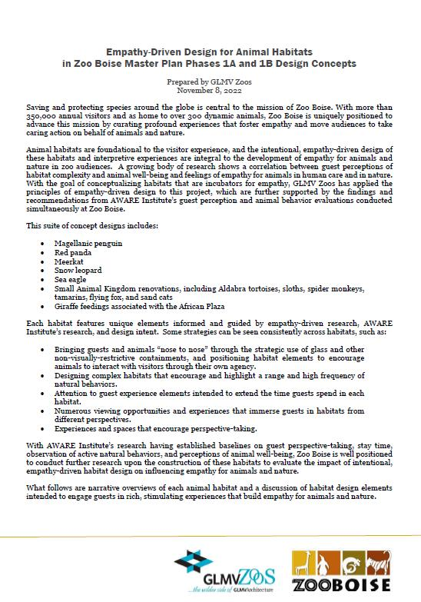
Notes:
• As we built, continually tried to tie back to empathy reports done earlier- yards and keeper practices, based on what we learned from AWARE study. While this grant focuses on red panda, we are applying these concepts to the other exhibits and buildings in this project

Slide 10
Notes:
• One of the key recommendations- “opportunities to increase time spent at the red panda habitat and to increase favorability of visitor perceptions of red panda welfare”
o Slide of site plan- to increase time spent, 3 different yards, loop path, theming and signage
▪ Diverse microclimates in each of the 3 yards due to sun exposure and shade opportunities
▪ Diversity of yards and indoor dayroom will allow for many options for shifting/enrichment
▪ Yards are 1,000, 1,100, and 1,300 square feet. One yard has 100 square feet of indoor holding.

Slide 11
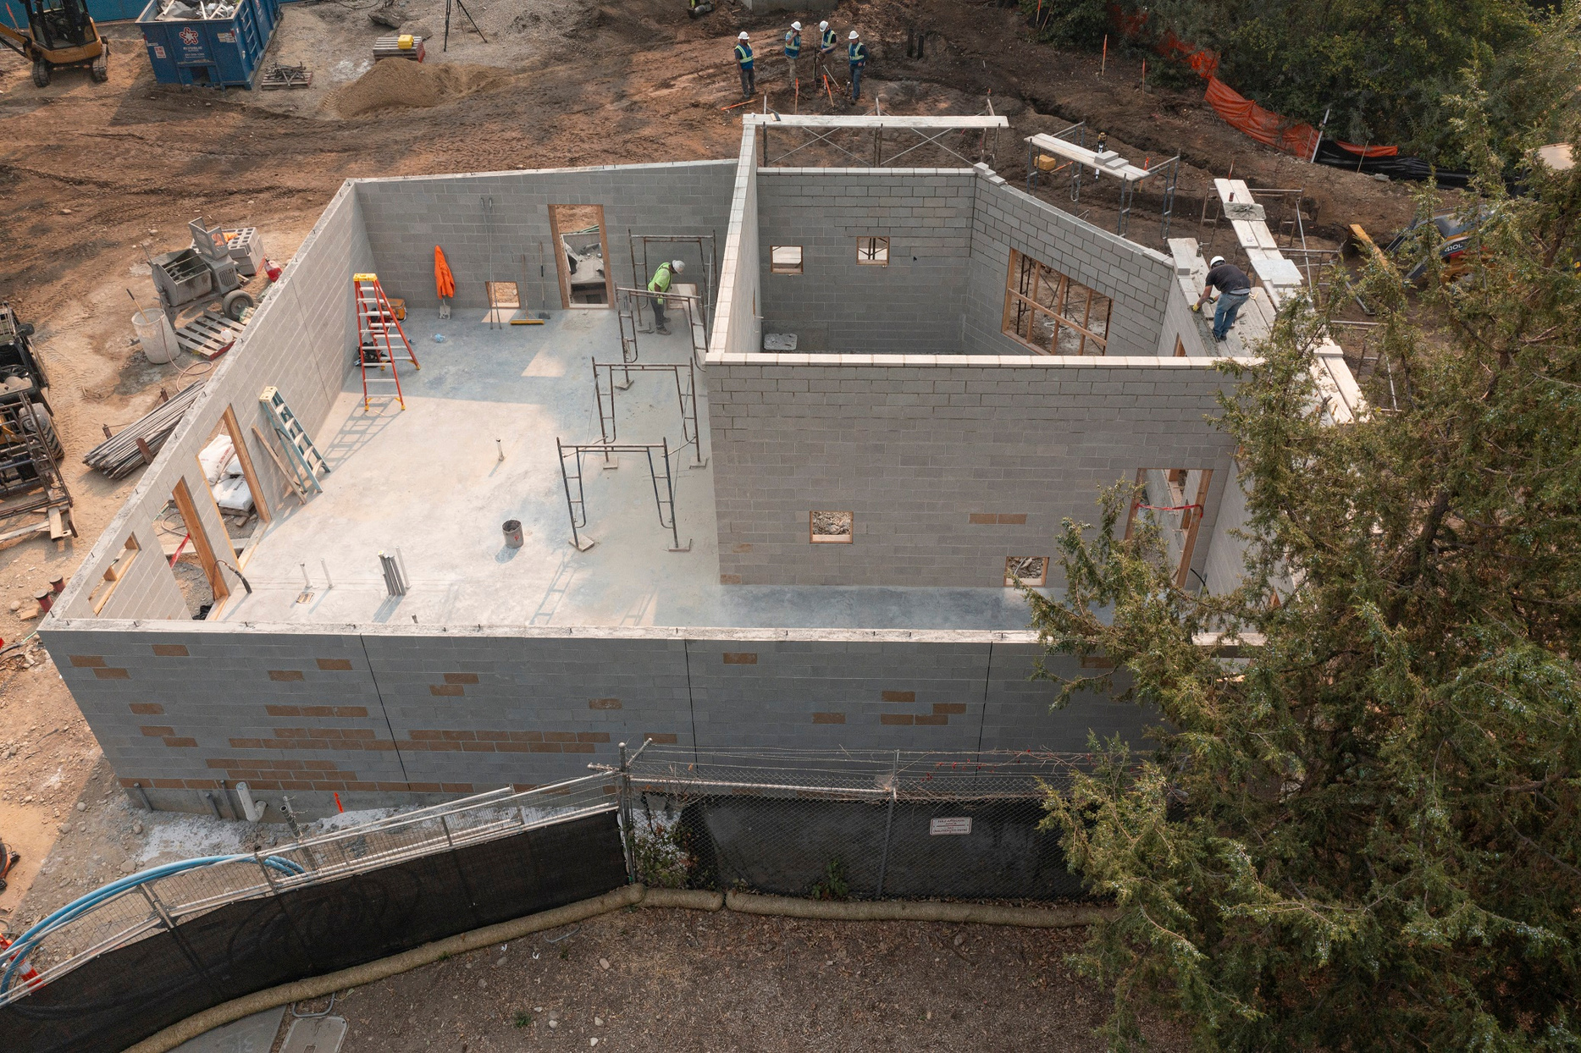
Notes:
• Construction slides- world class red panda facility, been hosting visits and calls from many other zoos (as recently as April 25)
o Slide- red panda building with walls-very large space for red pandas, we build above AZA standards so we can be ahead of the curve and provide flexibility- 1,750 feet

Slide 12
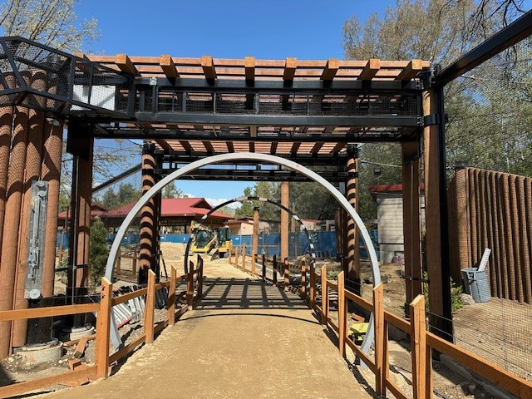
Notes:
moon gates, overhead passages
▪ Immersive experience- feel surrounded by pandas
▪ Climbing opportunity- for the pandas and nature play opportunities for guests

Slide 13
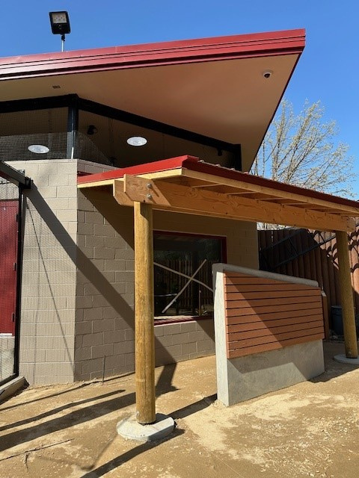
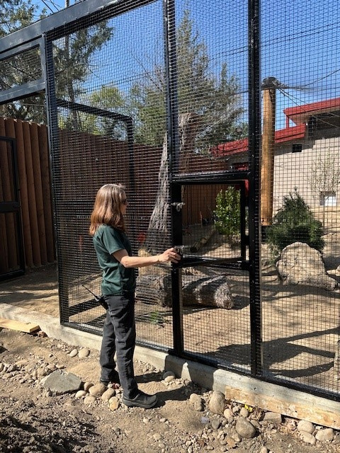
Notes:
open air indoor dayroom, encounter space

Slide 14
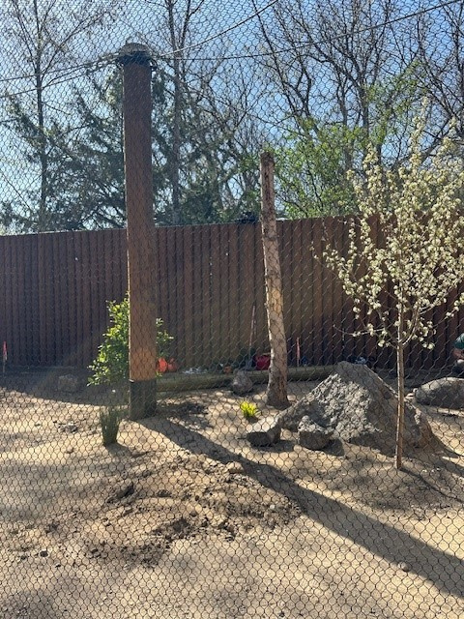
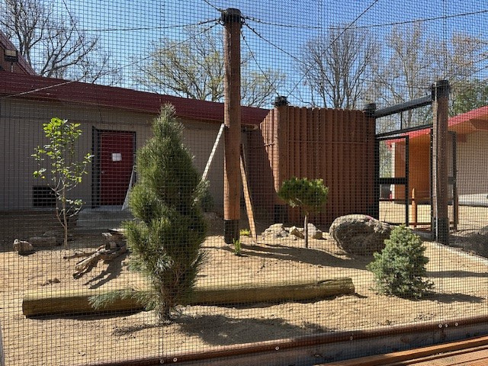
Notes:
Natural trees in exhibit, trees to climb, more climbing to be installed

Slide 15
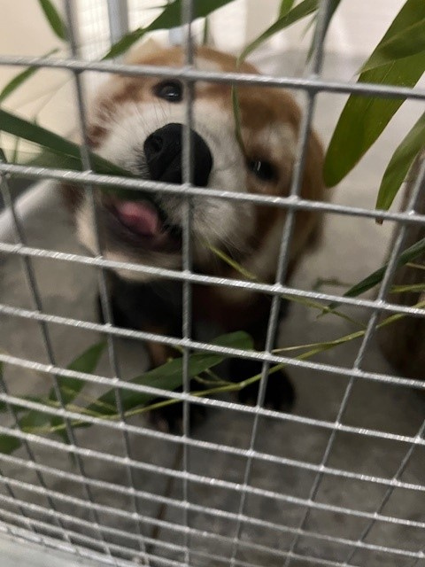
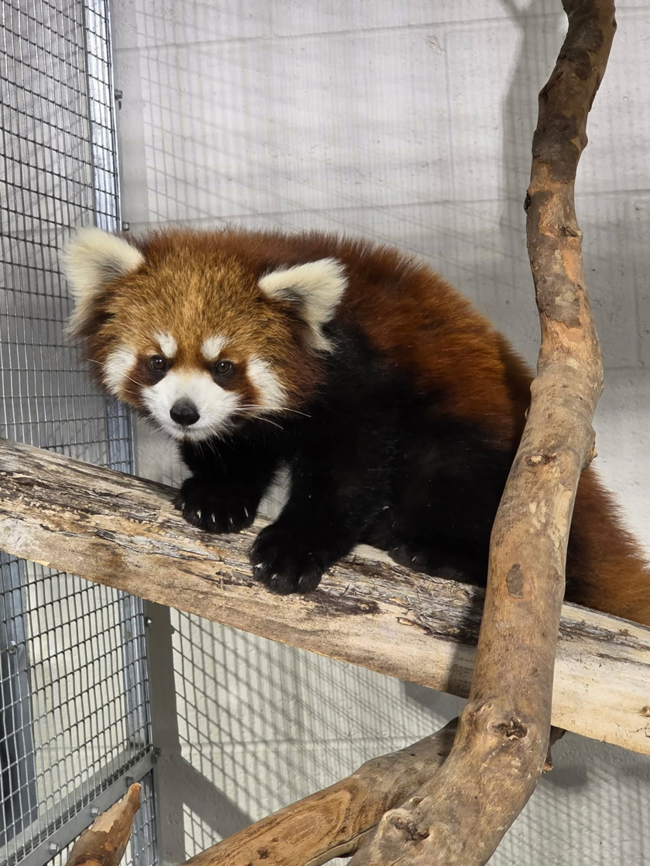
Notes:
- in quarantine, still opportunities for climbing, more installed after quarantine
▪ Lots of flexibility inside
▪ We will house both species of red pandas (Styans and Fulgens), currently housing porcupine and soon sloth as well during construction
▪ Will be able to house cubs and serve as home for pandas with special needs potentially
What's next?
o Finishing construction and installation
o Keepers will add in empathy components
o Opening May 14
o Summer- evaluating (follow up survey to initial baseline survey completed at original exhibit in 2022)
Advice?
o Have an empathy point person to provide input periodically throughout- provides good continuity and they can keep a bigger picture focus- build it in as a touch point in every big meeting/major milestone.
o Have a range of empathy projects you can do- if you had unlimited funding, and then a menu of priorities (taking into account AZA exhibit requirements and recommendations).
o Good to have both interpretative and construction empathy related work in tandem.
o We are still in the world of construction delays- contractor staffing/availability, pricing, unexpected infrastructure needs, tariffs, etc.
o Using the same contractor familiar with empathy work (GLMV) was very helpful- but they brought in a lot of new staff on this part and not all were as familiar.

Slide 16
Empathy-Based Interpretation
Notes:
Hello!
We are going to transition to our second project: Empathy based interpretation

Slide 17
Project Overview
Signage and Interpretive Production
Red Panda
Conservation Plaza
Giraffe Public Feeding Platform and Watering Hole
Interpretive plan creation
Education Building
Small Animal Kingdom
Notes:
As part of the work from a grant through the Advancing Empathy Grant Program, this project fosters guests’ empathy for wildlife through the production of signs and perspective-taking opportunities at the new red panda exhibit, giraffe encounter, and conservation plaza. This project also developed the interpretative and theming plan for the new education campus and renovated Small Animal Kingdom.
These were both part of our bigger work on our most recent master plan, with specific focus on our heart of the zoo campaign. These projects are surrounding animal habitats, experiences, and opportunities that are key to our mission and popular within our community. It is important to us to move them forward and we are grateful for the support to do so.

Slide 18
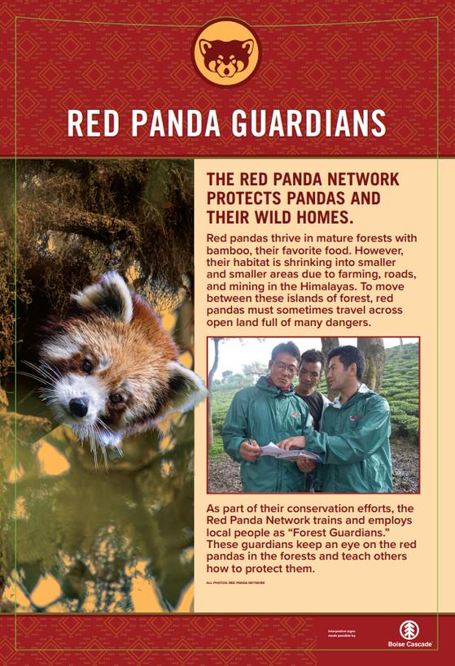
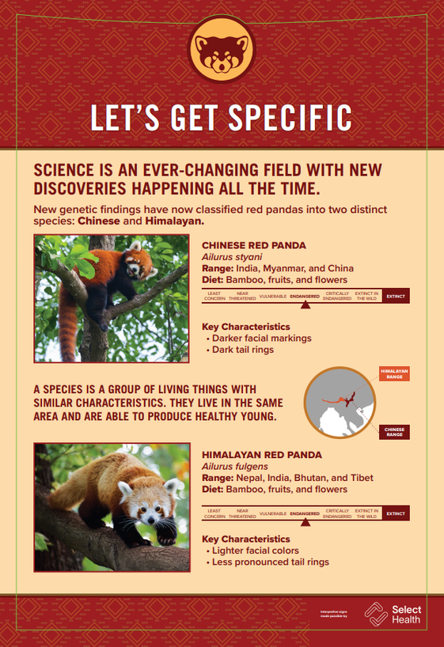
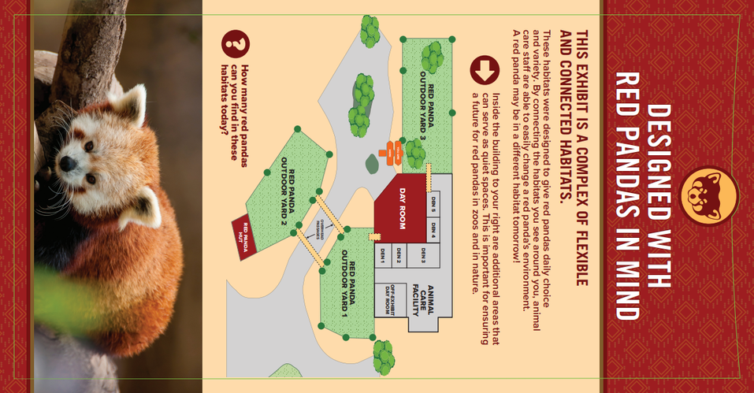
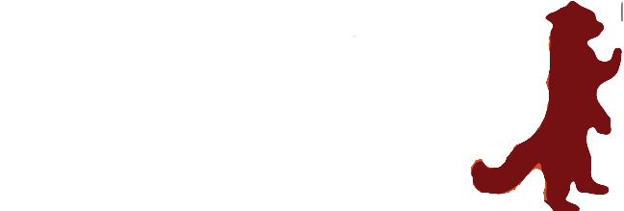
Red Panda
Notes:
Important for us to highlight various aspects of empathy within the exhibits. As you saw with Rachel's presentation, these are very intentionally designed spaces. Some of these features might be obviously noticeable to all, but we also wanted to highlight some of the more unique ones guests might not notice. This also allowed us to highlight the high level of care we provide for our animals.
Great opportunity to showcase a conservation partner
Changing how we do species info signs. Also added biography signs for some of the pandas- will be adding more when more pandas join and we find out more about their personalities and names.

Slide 19

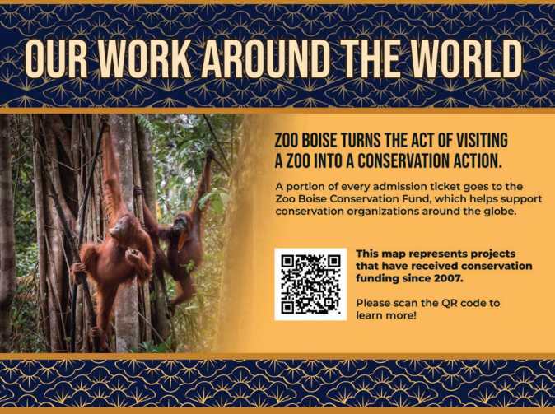
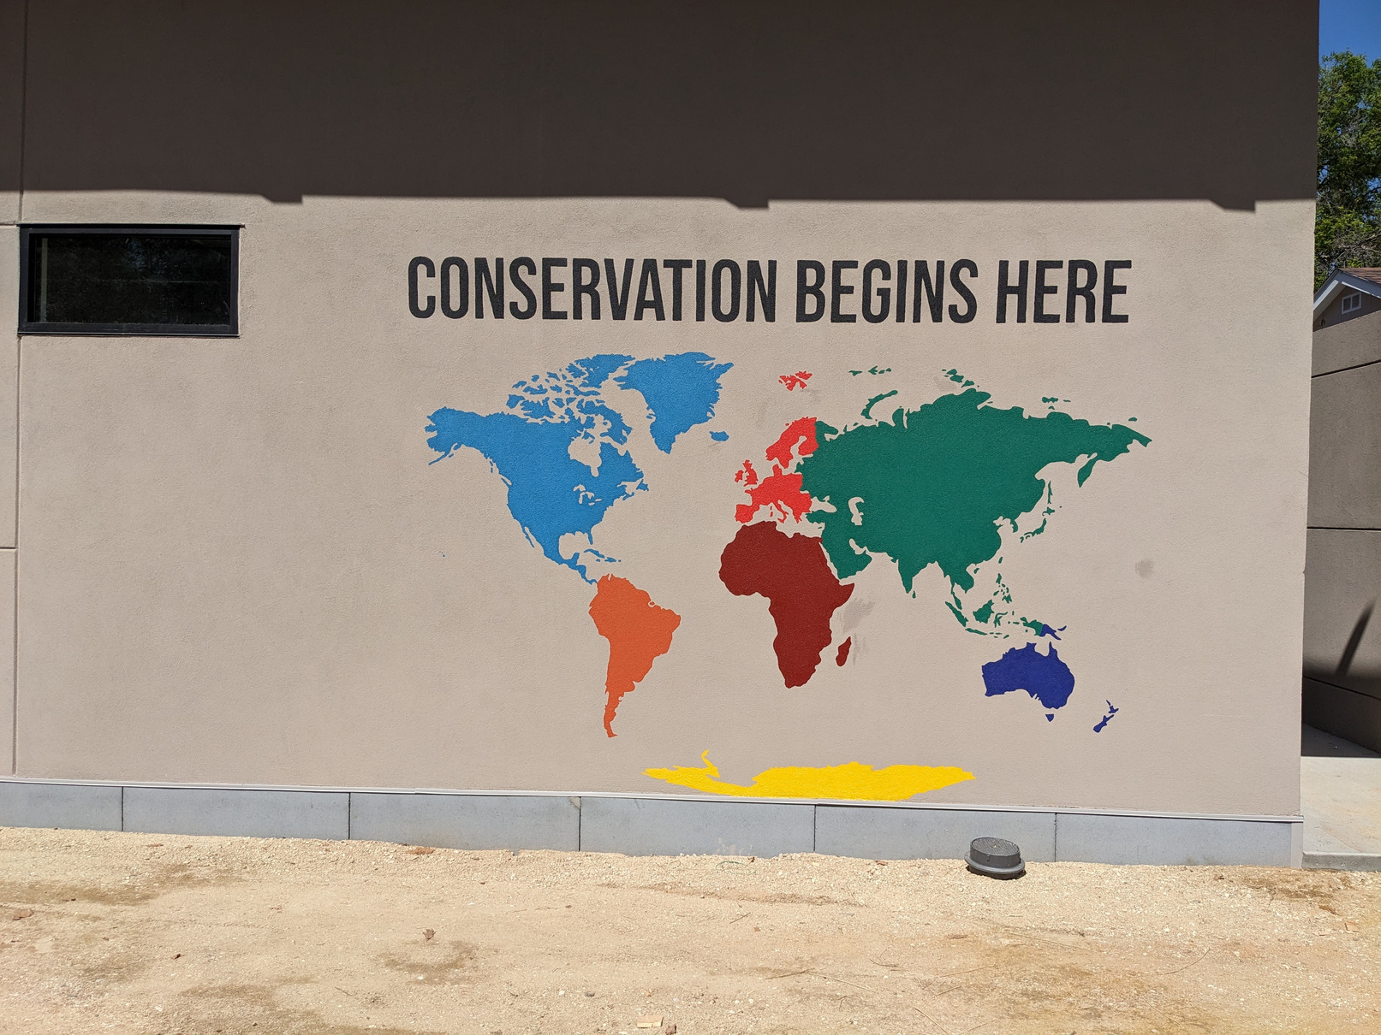
Conservation Plaza

Slide 20
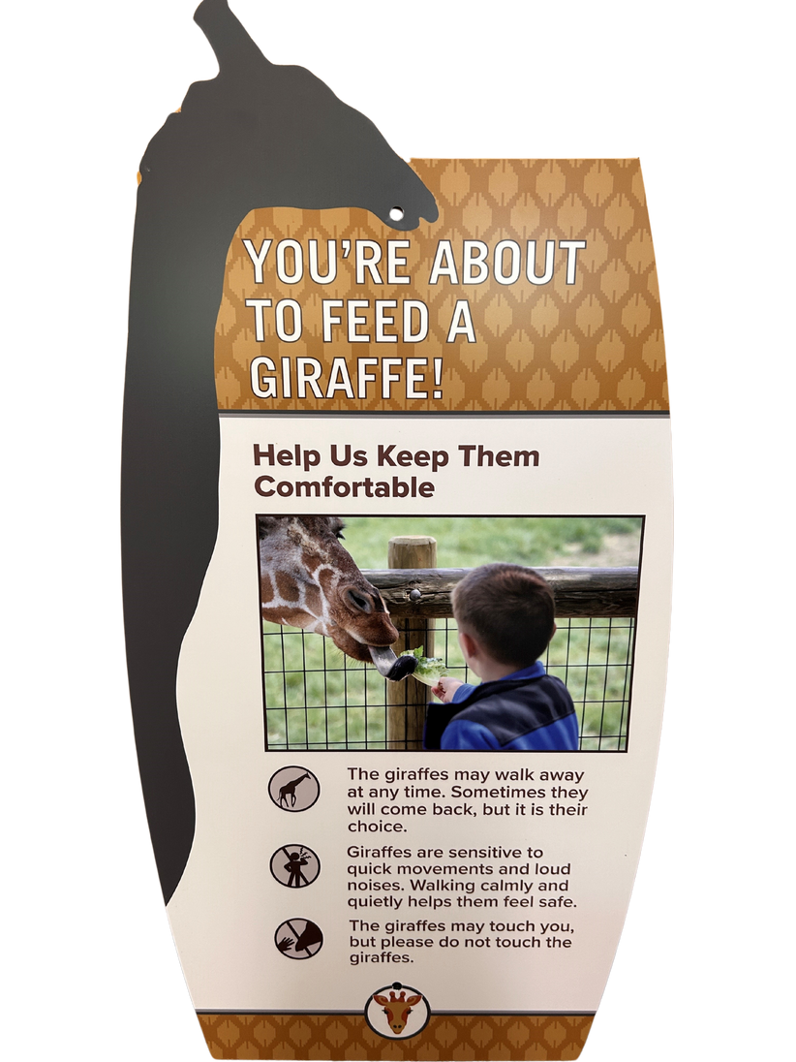
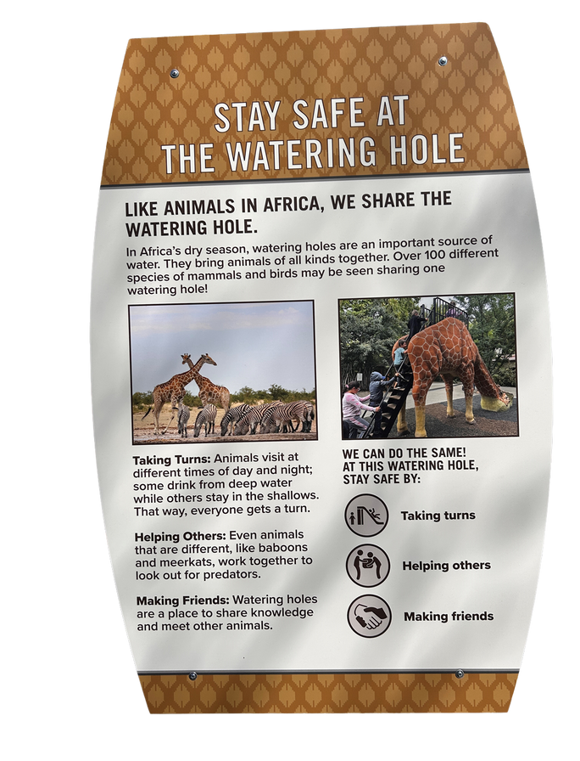
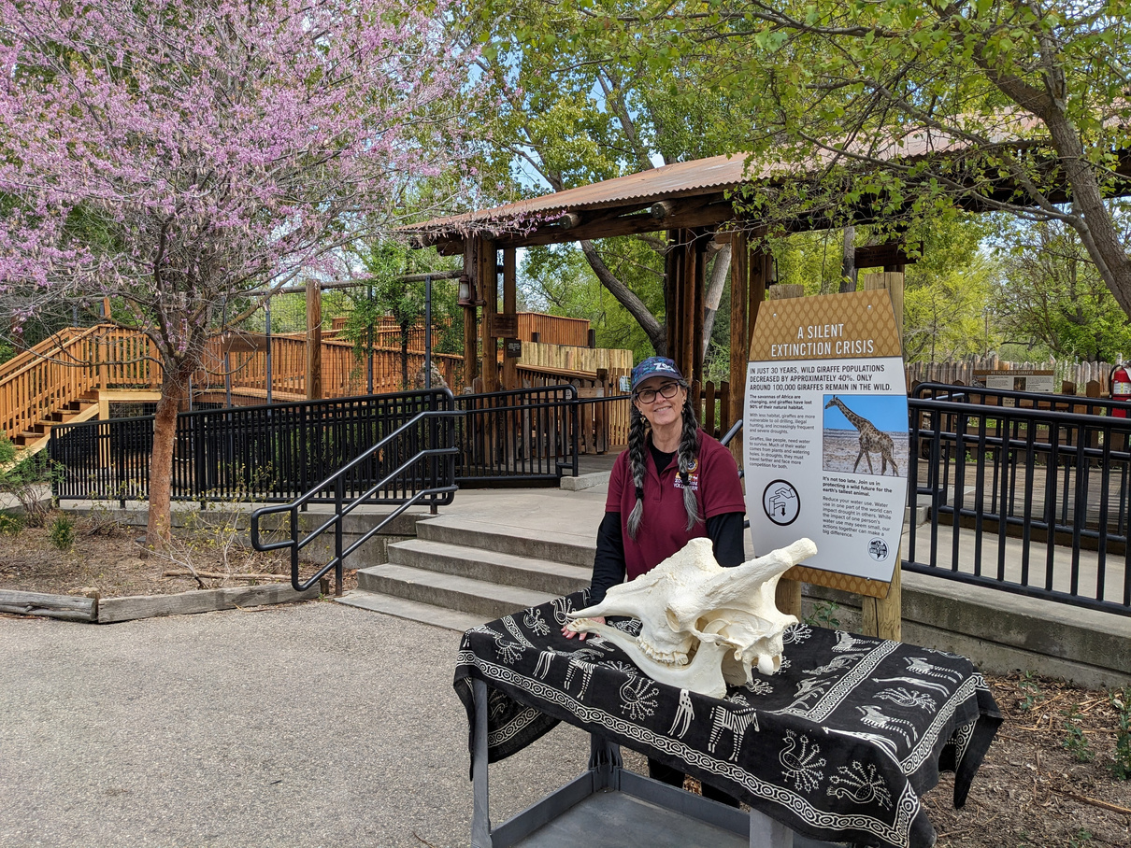
Giraffe Feeding Platform and watering Hole
Notes:
Have been doing the giraffe encounter for over a decade but as a space that was not guest or giraffe friendly.
Creating a much more immersive experience for all
New signage and biofact for the station
Moved our popular giraffe slide over to the giraffe area- this allowed us to really lean into the theming, especially with the renovation of the cafe.

Slide 21
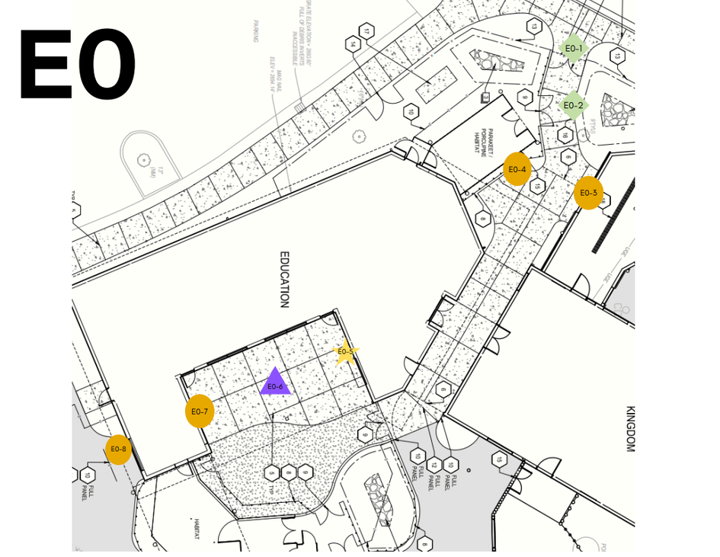
Interpretive Planning
Audience
Infusing emapthy
Purpose
Building themes
Notes:
Quickly recognized audiences would differ quite a bit between the spaces as one was more private than the other
Still wanted to have a cohesive feel between the spaces, as well as the whole zoo
Approached wanting to incorporate emapthy- utilized the many tools we have shared, with the basics being the emapthy bridge- how do we introduce animals to our guests
Purpose:
- Education: Equip students to see themselves in the role of a conservationist. Build pride in the role of education in conservation. Facilitate connection and empathy for animals.
- Establishing strategies to hit empathy goals across new projects such as using personal stories, drawing connections between individuals and their species, highlight animal wellbeing preferences.

Slide 22
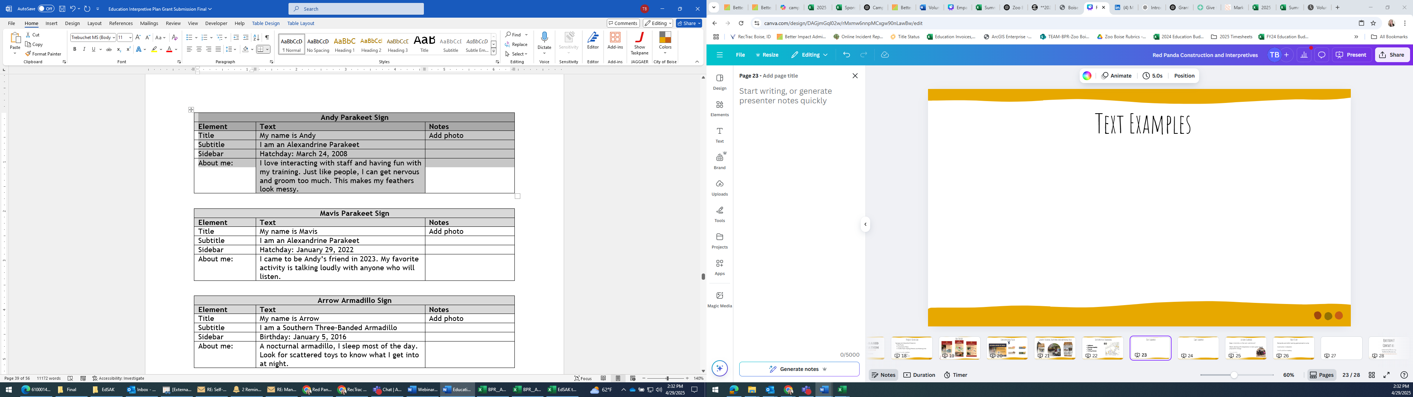
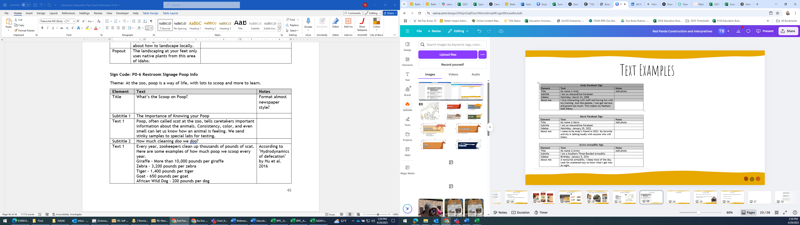
Text Examples
Notes:
One note about the poop sign. It was specifically written because keepers had shared during guest engagement training last year that people looked down on "scooping poop" and that their jobs have been described as "glorified poop scooping" So this was meant to help a bit with empathy for staff, so that guests might have a bit more appreciation for this specific act.

Slide 23
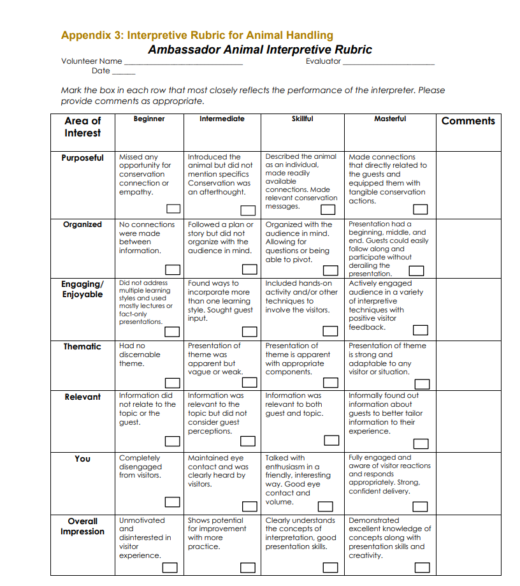
Interpretive Materials Evaluation
Notes:
Not sure if you want to mention bringing in Cheryl for evaluation of Red Panda?

Slide 24
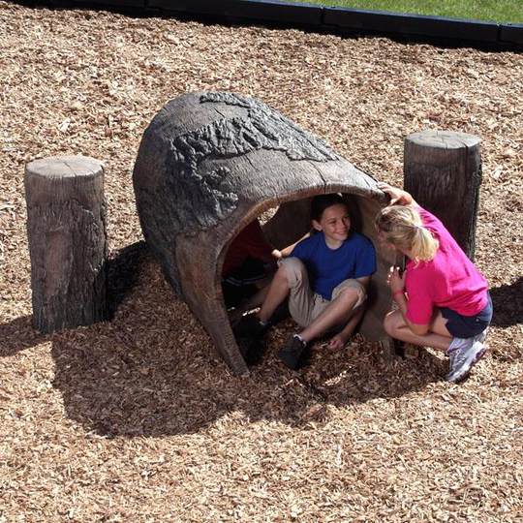
Lessons Learned
Keep in mind who is in the room- and who isn’t
Master planning with interpretation in mind is great- but be prepared for change
Trial and error
Notes:
Task force! Utilizing lessons learned from the production of the red panda signage and how important it was to get feedback from various departments, we created a task force to assist in reviewing the interpretive plan for the Small Animal Kingdom and education building. This allowed multiple staff voices to be heard and created productive conversations about the messaging we will use going forward, ensuring consistency and intentionality behind every sign. We intend to use the task force model for every plan moving forward.
We had several changes and updates along the way. Starting earlier in the process meant more opportunities for brainstorming, but also greater likelihood of going from plan A to plan F
Consistency of language is important, but be prepared for it to take some time to figure out what works best

Slide 25
Next Steps
Red panda post exhibit opening guest perception survey
Construction in education
Giraffe platform tracking
Class evaluation

Slide 26
Questions?
Contact us:
tball@cityofboise.org

