Slide 1




ADVANCING CONSERVATION THROUGH EMPATHY FOR WILDLIFE
February 24, 2021
CC
Notes:
closed captions (computer generated 80% accurate)
invite you to rename yourself with your organization name

Slide 2
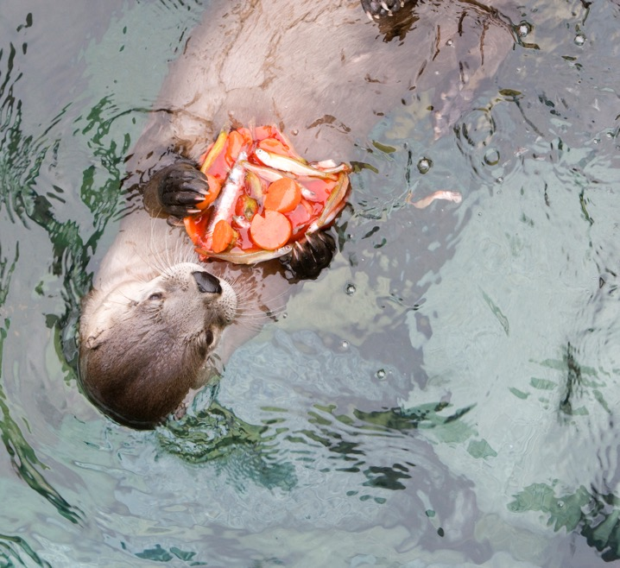
Highlight Reel
Notes:
RESOURCE ID
20583

Slide 4
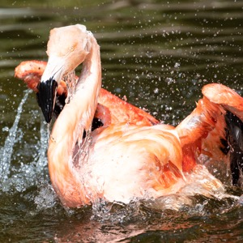
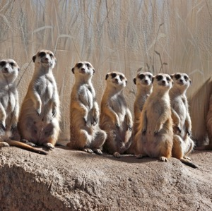
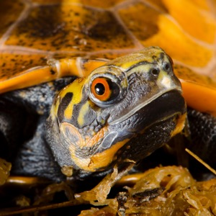
Agenda
Share Updates
Work Together
Look Ahead
Notes:
RESOURCE ID
38944
RESOURCE ID
18596
RESOURCE ID
25408

Slide 5
Agenda
Share Updates
Look Ahead
Work Together
Notes:
RESOURCE ID
38944
RESOURCE ID
18596
RESOURCE ID
25408

Slide 6

ACE Poetry
 |  |  |  | A
 |  |  |  | A
 |  |  |  | B
 |  |  |  | B
Photo Courtesy: Alaska SeaLife Center
Notes:
Rhyming Couplet
Introduced yourslef
Haven't introduced yourslef to everyone else yet, so change yourname

Slide 7
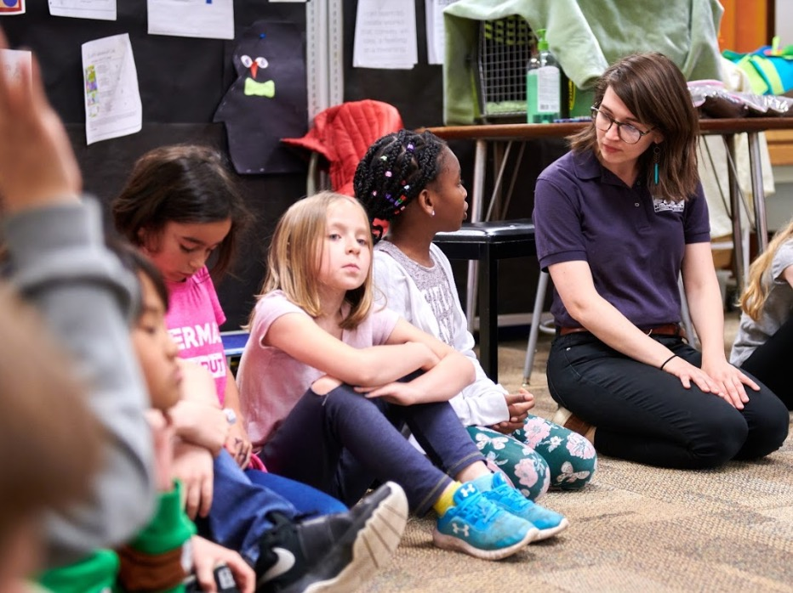
Institutional Updates
Photo Courtesy: Zoological Society of Milwaukee
Notes:
RESOURCE ID
38944
RESOURCE ID
18596
RESOURCE ID
25408

Slide 8
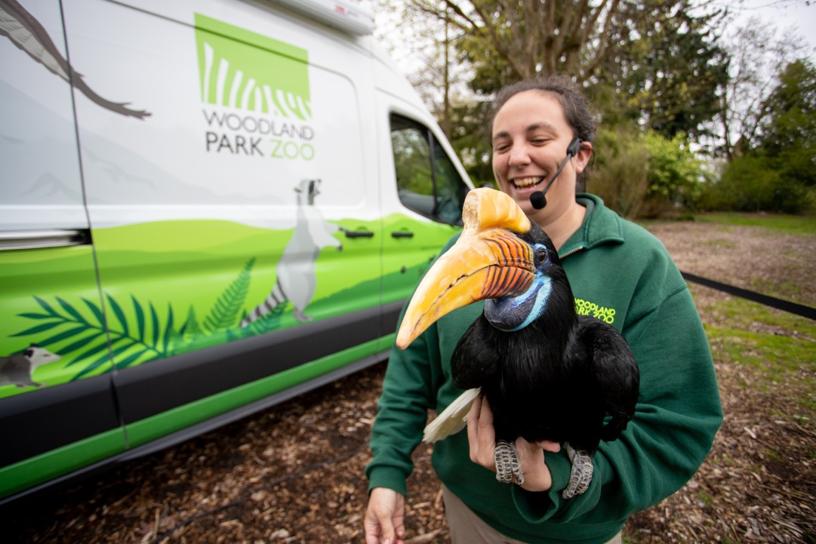

Woodland Park Zoo Updates
Notes:
RESOURCE ID
36131

Slide 9
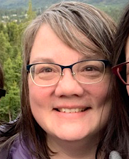
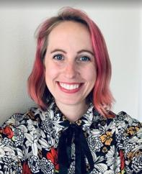

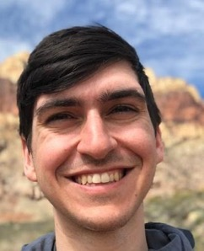

Staff Updates
Laurie Stuart Director of Impact Laurie.Stuart@zoo.org | Laurel Abbotts Project Manager Laurel.Abbotts@zoo.org | Mary Jackson Audience Research Supervisor Mary.Jackson@zoo.org | Daniel Rother Empathy Network Specialist Daniel.Rother@zoo.org

Slide 10
Institutional Updates
Photo Courtesy: Zoological Society of Milwaukee
Notes:
RESOURCE ID
38944
RESOURCE ID
18596
RESOURCE ID
25408

Slide 11
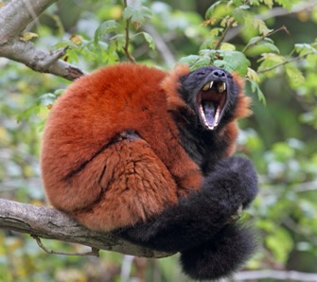
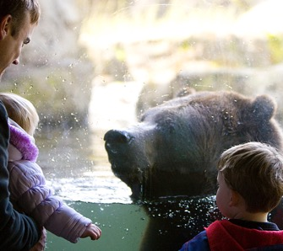
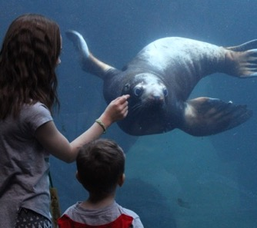
Working Group Updates
Communications Working Group
Strategic Learning Working Group
Operations Working Group
Notes:
RESOURCE ID
17929
RESOURCE ID
20877
Alternate between the two

Slide 12
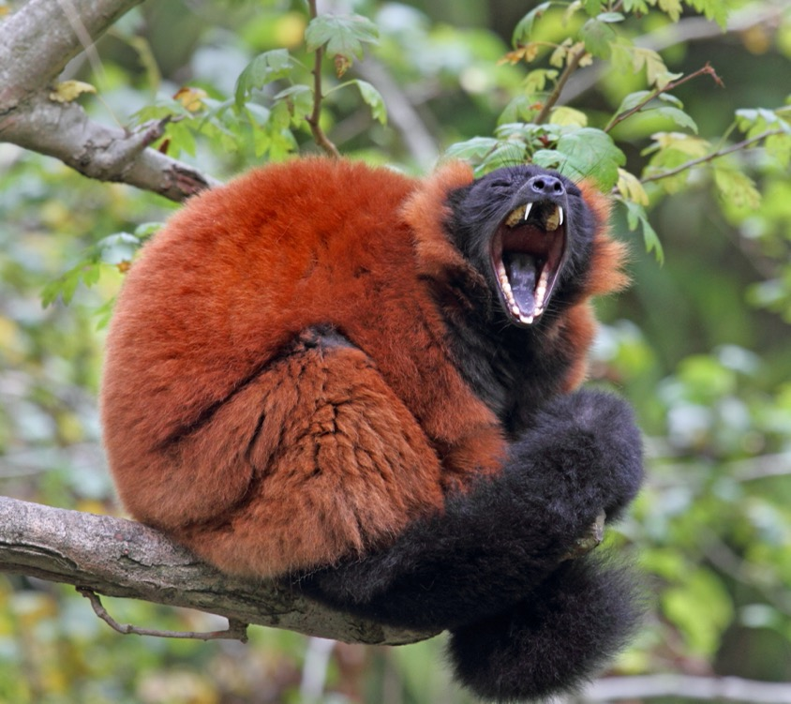
Communications Working Group
Logo
Committee Goals
Website
Notes:
This is a transition slide for Daniel to share the sections and hand off to Marta.
RESOURCE ID
17929

Slide 13

Logo
Notes:
The communications working group has been working on a logo.
Design ideas to talk about
Looks good
Captures the idea of empathy
Represents multiple dimensions of network partners. Since we have aquariums, zoos, and folks focused on birds, we wanted it to speak to everyone and so we centered in nature.
Without further ago
**Drumroll please**

Slide 14

Notes:
- Pause for audience reaction ☺

Slide 15






Option 1
Option 2
Notes:
While the black and white logo is set. We wanted to solicit your feedback for a colored logo. We will present two options. *show options*

Slide 16
Notes:
While the black and white logo is set. We wanted to solicit your feedback for a colored logo. We will present two options. Open up sli.do to vote on which option you like. (We will have used Sli.do earlier in the meeting, so people should be familiar. Daniel will drop link in chat) https://wall.sli.do/event/efnqx2rc?section=444f112a-6c98-4494-b24a-b6ee9cb23e24
*show options*

Slide 17
Yellow Title
ADVANCING CONSERVATION THROUGH EMPATHY FOR WILDLIFE
February 24, 2021
Notes:
Based on voting we will share this option
- Now that we have a logo, let’s restart, hi and welcome to the ACE for Wildlife Network’s Feb 24 meeting

Slide 18
Blue title
ADVANCING CONSERVATION THROUGH EMPATHY FOR WILDLIFE
February 24, 2021
Notes:
Based on voting we will share this option
- Now that we have a logo, let’s restart, hi and welcome to the ACE for Wildlife Network’s Feb 24 meeting

Slide 19

Communications Working Group
Logo
Committee Goals
Website
Notes:
Transition back to Daniel
Now that we have a logo **animation**
We more updates to share from the working groups, but before we do, let me pass this meeting over to Emily at ZooMontana to get our creative brain juices flowing
RESOURCE ID
17929

Slide 20
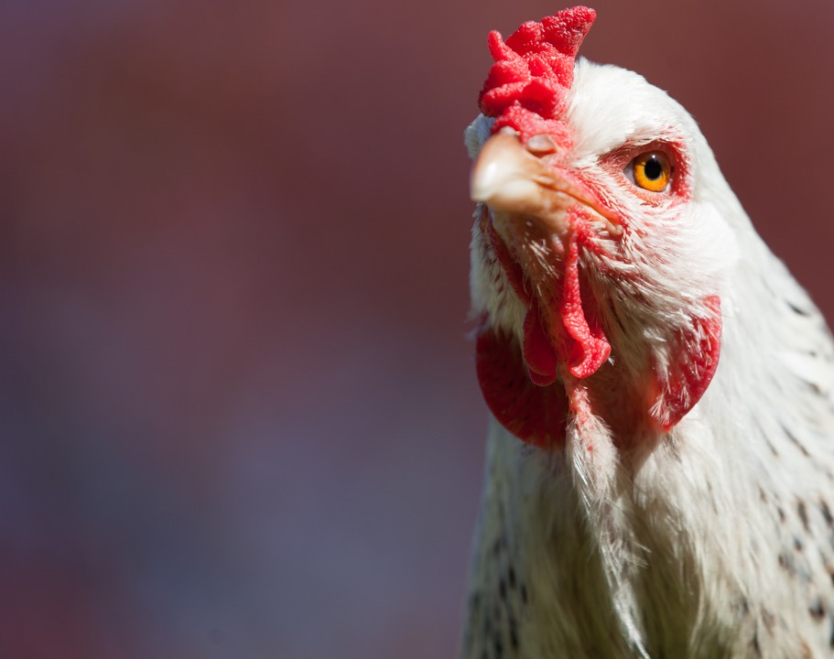
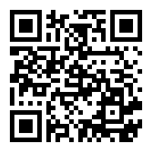
Padlet:
Go to Padlet (link in chat or QR Code)
How to use Padlet:
Find the Column for your Breakout Group Number
+ to add a card
Give your card a title and/ or text
At your institution, if there were no barriers, ideally
HOW WOULD YOU SEE EMPATHY BEING INTEGRATED?
Notes:
Emily to Lead (Daniel to make breakout rooms and drop link in chat)
We are going to spend some time doing a collective brainstorming activity. In a moment we are going to put you in breakout rooms. In those breakout rooms we want you to discuss:
**Text Appears** If you were working at your ideal zoo. Whatever that means to you. How would empathy be integrated for you?
Provide example (i.e. empathy would be integrated into our guest service policies and show up throughout our website and welcoming process)
While we get those breakout rooms ready, spend a minute thinking about your answer to the question.
You will have 15 minutes in your breakout room. As you talk. We want you to capture your ideas.
**Padlet How to Appears** We will use Padlet to capture your ideas. To get to padlet, go to the link in the chat or scan the QR code
https://padlet.com/danielrother/ACESpring2021
In padlet you will see a column for your group #. Add your thoughts each as individual cards in the column. You can designate a note take to put your ideas down on this padlet or you can each write ideas as you have them
Questions? Ready? We’ll Now send you to breakout rooms. Watch which number room you go to.
BREAKOUT ROOMS
Welcome back, we will continue to build off of these answers and will revisit all of these answers shortly. For now, let me hand things back to Daniel
RESOURCE ID
17929

Slide 21
R
B
EAK
Notes:
Daniel to Lead
As you can see, this chicken has a beak, and we will take a 5 minute break. You are welcome to use this time to explore the padlet and see what other people wrote, or get up and stretch your
RESOURCE ID
17929

Slide 22
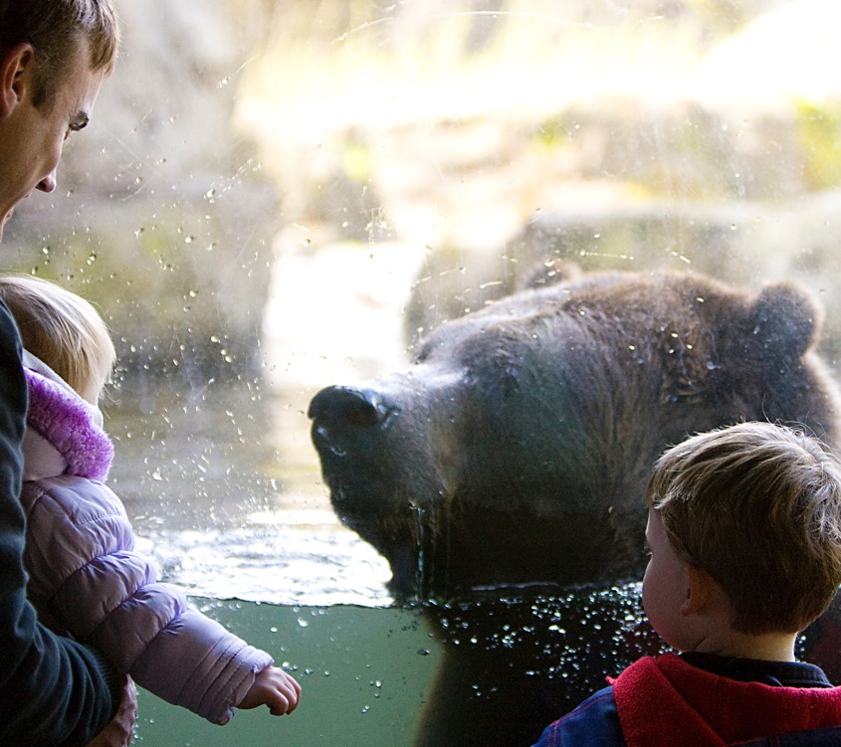

Strategic Learning Working Group
Strategic Learning Framework
Committee Goals
Notes:
This is a transition slide for Daniel to hand-off to Samantha
RESOURCE ID
20877

Slide 23
Strategic Learning Framework
Notes:
The strategic learning committee has been developing a framework for network learning so we can collectively forward our empathy knowledge and achieve our mission as a network.

Slide 24
Strategic Learning Framework
ACE for Wildlife Learning Questions
ACE for Wildlife Learning Questions
Notes:
- Goal to identify ACE for Wildlife Learning Questions annually that we want to spend time diving into, better understanding, and building knowledge around.

Slide 25
Strategic Learning Framework
ACE for Wildlife Interests
ACE for Wildlife Interests
Base what we want to learn on our interests.
ACE for Wildlife Learning Questions
Notes:
Driven by the Strategic Learning Committee, our Learning Questions are chosen by the network based on what we are interested in and want to learn more about.

Slide 26
Strategic Learning Framework
ACE for Wildlife Interests
Our Learning Questions are
Rooted in our empathy work and relate to the Zoo and Aquarium field and AZA's Social Science Research Agenda
Collaborative
Realistic and Achievable
Measurable
Relevant and Scalable
Inclusive
Focused
Filtered
ACE for Wildlife Learning Questions
Notes:
The strategic learning committee will distill and filter our interests so that our learning questions
are rooted in our empathy work and relate to the Zoo and Aquarium field and AZA's Social Science Research Agenda
And are:
Collaborative – Enable equitable collaboration across the network.
Realistic and Achievable – Be within the bounds of what the network is capable of within the next year.
Measurable - Be something we can learn and understand through data, existing content, and conversations
Relevant and Scalable– Account for the diversity of network members represented (size, locality, animal type).
Inclusive – Center diversity, equity, and inclusion work through the questions asked, the way we develop and use evaluation tools, the way we share and learn, and who is included in the conversation.
Focused - clear and defined idea of what we are asking and trying to learn.

Slide 27
Strategic Learning Framework
ACE for Wildlife Interests
Learning About Our Collective Impact
Refine and Build
Ask and Gather
Analyze and Make Meaning
Filtered
ACE for Wildlife Learning Questions
Learning About our Collective Impact
Notes:
There are three avenues we’ll use to explore our learning question.
First:
Learning About Our Collective Impact
There are multiple ways we learn about our collective impact, interested people and institutions can pick and choose their participation based on their capacity and interest
Refine and Build - Refine a strategic learning priority into a question our institutions can answer. Build evaluation tools and suggested interventions to answer the question. Streamline selection and right-sizing of tools for easy use.
Ask and Gather - Gather data from your audience.
Analyze and Make Meaning - Amalgamate and analyze data gathered across organizations and make meaning of combined experiences

Slide 28
Strategic Learning Framework
ACE for Wildlife Interests
Learning Through Existing Knowledge
Lunch and Share
"Book" club
Make Meaning
Filtered
ACE for Wildlife Learning Questions
Learning About our Collective Impact
Learning Through Existing Knowledge
Notes:
We will also be:
Learning Through Existing Knowledge
There are multiple ways we learn through existing knowledge interested people and instititons can pick and choose their participation based on their capacity and interest
Lunch and Share - Establish existing knowledge and understanding. Identify "book" list and prioritize
"Book" club - Informal conversation to consume content (i.e. videos, books, articles, talks) and discuss)
Make Meaning - Revisit what we have discussed through "Book Blucs and make meaning of what we have learned

Slide 29
Strategic Learning Framework
ACE for Wildlife Interests
Learning Through Practice
Create Space
Resource Sharing
Filtered
ACE for Wildlife Learning Questions
Learning About our Collective Impact
Learning Through Existing Knowledge
Learning Through Practice
Notes:
Lastly:
How we learn through practice
We create a forum for partners who are learning through projects or partnerships to share their knowledge and resources with the network.
Create Space - We create space for organizations to share about the relevant partnerships and projects they are involved in.
Resource Sharing - We create Vehicles for people to share resources and lessons learned through their projects.

Slide 30
Strategic Learning Framework
ACE for Wildlife Interests
Sharing
In summarizing what we have learned through these vehicles, we build our knowledge, understanding and toolkit to foster empathy
Filtered
ACE for Wildlife Learning Questions
Learning About our Collective Impact
Learning Through Existing Knowledge
Learning Through Practice
Sharing
Notes:
As we near the end of the year, we’ll discuss sharing our learning
Sharing
In summarizing what we have learned through these vehicles, we build our knowledge, understanding and toolkit to foster empathy

Slide 31
Strategic Learning Framework
ACE for Wildlife Interests
Reflection
Through reflecting on the process and our learnings, we refine this learning framework.
Implementation
We continue to learn through the content we have shared.
We the use the tools and content in our institutions.
We continue to strengthen and modify the tools for member and non-member use.
Filtered
ACE for Wildlife Learning Questions
Reflection
Implementation
Learning About our Collective Impact
Learning Through Existing Knowledge
Learning Through Practice
Sharing
Notes:
This framework also includes network and institutional Reflection and Implementation
Reflection
Through reflecting on the process and our learnings, we refine this learning framework.
Implementation
We continue to learn through the content we have shared.
We the use the tools and content in our institutions.
We continue to strengthen and modify the tools for member and non-member use.
- This reflection will re-inform our interests for future questions. Maybe we want to ask a similar question or a completely different one.

Slide 32
Strategic Learning Framework
ACE for Wildlife Interests
So That
We can strengthen our collective ability to create, use and evaluate practices to foster empathy
Filtered
ACE for Wildlife Learning Questions
Reflection
Implementation
Learning About our Collective Impact
Learning Through Existing Knowledge
Learning Through Practice
Sharing
So That
Notes:
This whole process is designed so that can achieve our mission:
To strengthen our collective ability to create, use and evaluate practices to foster empathy

Slide 33
Strategic Learning Framework
ACE for Wildlife Interests
Next Steps
Better Understand Our Collective Interests
Strategic Learning Committee to filter and distill to arrive at Learning Questions
Filtered
ACE for Wildlife Learning Questions
Reflection
Implementation
Learning About our Collective Impact
Learning Through Existing Knowledge
Learning Through Practice
Sharing
So That
Notes:
To implement this framework our next steps are:
To spend time today identifying our collective interests
After today, the Strategic learning committee will meet to distill those interests into learning questions.

Slide 34
Strategic Learning Working Group
Strategic Learning Framework
Committee Goals
Notes:
This is a transition slide. Daniel will take over from Samantha and pass off to Emily.
RESOURCE ID
20877

Slide 35
Strategic Learning Working Group
The mission of the strategic learning group is to drive the learning priorities of the ACE for Wildlife Network so the network can collaboratively learn, build skills, and share expertise.
We accomplish this through
Creating a learning environment which advocates for and values diversity of members in the network
Leading the implementation of the ACE for Wildlife strategic learning framework
Empowering reflection on the collective learning of the network.
Notes:
RESOURCE ID
20877

Slide 36
Communications Working Group
Logo
Committee Goals
Website
Notes:
RESOURCE ID
17929

Slide 37
Communications Working Group
The mission of the communication working group is to nurture connection and collaboration to further empathy practices with the goal of sharing more accessible and effective voices for conservation action.
We accomplish this through:
Building relationships through network-wide collaboration.
Ensuring inclusive language and ease of accessing information.
Sharing our knowledge, resources, and experiences with other AZA institutions.
Notes:
RESOURCE ID
17929

Slide 38

Padlet:
Go to Padlet (link in chat or QR Code)
How to use Padlet:
Find the Column for your Breakout Group Number
+ to add a card
Give your card a title and/ or text
Give your Card Color
At your institution, if there were no barriers, ideally, how would you see empathy being integrated?
To make those earlier visions tangible, what actions would you want to see in the:
short term (0-3 years)
long term (3+ years)
Notes:
Emily to Lead (Daniel to make breakout rooms and drop link in chat)
As Samantha shared the learning framework earlier, we want to understand our interests as a network. Let’s revisit our earlier brainstorm and turn it into a future mapping activity. We want to turn that earlier brainstorm into some ideas of tangible actions that we would want to see to get to that vision of truly integrated empathy. We are going to put y’all back in breakout rooms, and we want you to answer:
**Text Appears** To make those earlier visions tangible, what actions would you want to see in: the short term (0-1 year), medium term (1-3 years), and long term (3+ years)
Provide example (i.e. for my earlier example empathy would be integrated into our guest service policies and show up throughout our website and welcoming process, I’d want to develop trainings in the next year for guest services staff, co-develop an integration plan, and then maintain a culture of empathy in guest services through refresher training)
While we get those breakout rooms ready, spend a minute thinking about your answer to the question.
You will have 15 minutes in your breakout room.
As you talk we want you to capture your ideas in the padlet.
This will be the same as before
**Padlet How-to Appears** We will use Padlet to capture your ideas. To get to padlet, go to the link in the chat or scan the QR code
https://padlet.com/danielrother/ACESpring2021
In padlet you will see a column for your group #. Add your thoughts each as individual cards in the column. You can designate a note take to put your ideas down on this padlet or you can each write ideas as you have them
With one addition, color coding
After you make a card, click on the three dots in the top right corner. Click on a color to indicate a short term, medium term or long term.
Use Green for Short Term
Use Purple for Medium Term
Use Yellow for Long Term
As we are making actions that reference earlier visions, you can drag the cards around so that the actions fall underneath the vision
Questions? Ready? We’ll Now send you to breakout rooms. Watch which number room you go to.
BREAKOUT ROOMS
Welcome back, we will continue to build off of these answers and will revisit all of these answers shortly. For now, let me hand things back to Daniel
RESOURCE ID
17929

Slide 39
Communications Working Group
Logo
Committee Goals
Website
Notes:
We have heard from you that you want a hub to be able to find projects, find our about each other, and act as a hub for the network.
RESOURCE ID
17929

Slide 40
Communications Working Group
Logo
Committee Goals
Website
www.ACEforWildlife.org
Notes:
DANIEL TALKING ABOUT WEBSITE
Explore
There are two sites. When you go to ACEforWildlife.org that is a public site available to everyone to share our work. “Member Website” is a site that will be closed and only available to network members. This is managed through google. I will share access with everyone in the google group. I will lock it down after this meeting. If you no longer have access after this meeting. There are instructions on how to get access next to the “member website” button. You can always email me too if you have any problems.
We will give everyone some time to explore the website, but before we do, we have one more amazing thing to share. I am going to hand it off to Jessica Moore at NW Trek to share this announcement
HAND–OFF to JESSICA

Slide 41
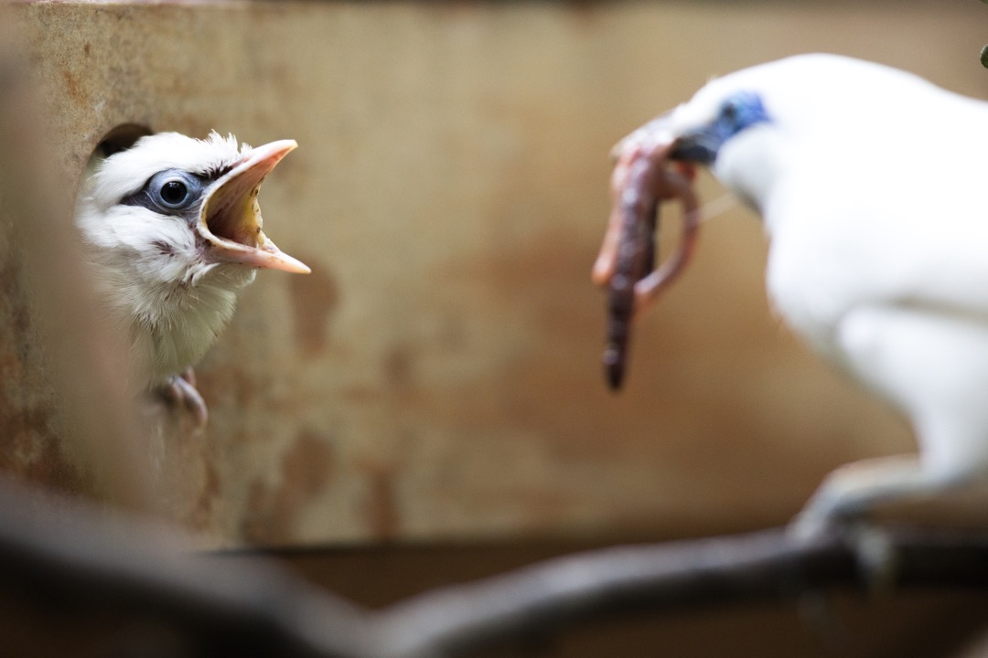
Discussion Platform
We have heard from you.
We are launching a discussion platform
www.ACEforWildlife.org > Member Website > Discussion
Notes:
JESSICA TO PRESENT, DANIEL TO SHARE SLIDE:
We have heard from you.
Through discussions, surveys, and at last year’s symposium we heard. People want a space to connect, share, and build off each other’s works. So
We are launching a discussion platform to keep people connected make conservation easier.
The site is now live. You can get there by going to ACEforWildlife.org, clicking Member Website, and clicking Discussion
RESOURCE ID
29497

Slide 42
Discussion Platform
DEMO
Notes:
JESSICA TO PRESENT:
Let me take a moment to briefly show you the discussion platform so it is something everyone is familiar with.
After this Demo, we are going to have a (10 minute) break. During that break you will, are welcome to stretch your legs, walk away from your computer or spend some time exploring the website and discussion platform
DANIEL END SCREEN SHARING, JESSICA START SCREEN SHARING:
JESSICA DEMO
- When you first go to the site there is a login and a signup button at the top right.
When you are signed in you will see multiple categories. We might organically shift these categories over time based on the discussion. You can see topics next to each category
Demonstrate: Announcements: Introduce yourself
JESSICA END SCREEN SHARE. Daniel to Say:
- Demonstrate we are now going to take a 10 minute break. Explore the website, sign up for the discussion platform. Send a message. We will see you back her are
RESOURCE ID
29497

Slide 43
R
ANOTHER B
EAK
Explore Website and discussion platform (www.ACEforWildlife.org)
Notes:
JESSICA TO PRESENT:
Let me take a moment to briefly show you the discussion platform so it is something everyone is familiar with.
After this Demo, we are going to have a (10 minute) break. During that break you will, are welcome to stretch your legs, walk away from your computer or spend some time exploring the website and discussion platform
DANIEL END SCREEN SHARING, JESSICA START SCREEN SHARING:
JESSICA DEMO
- When you first go to the site there is a login and a signup button at the top right.
When you are signed in you will see multiple categories. We might organically shift these categories over time based on the discussion. You can see topics next to each category
Demonstrate: Announcements: Introduce yourself
JESSICA END SCREEN SHARE. Daniel to Say:
- Demonstrate we are now going to take a 10 minute break. Explore the website, sign up for the discussion platform. Send a message. We will see you back her are
RESOURCE ID
29497

Slide 44

Website
www.ACEforWildlife.org
Discussion Forum
discussion.AceforWildlife.org
Introduce yourself by replying to the announcement
Tech Support
Times for Zoom calls on the calendar on the member webpage home (Scroll Down). Email Daniel if you need more.
Notes:
DANIEL SCREEN SHARING. Daniel to Say:
Welcome back!
That was a lot of updates and new tools we just shared. I wanted to take a moment and see if anyone has immediate pressing questions on the tools. I do want to point out a couple key things highlighted on this slide.
Questions!
To the last point on this slide, if you go to the members website home page (members.aceforwildlife.org or aceforwildlife.org and click on members page) and scroll down to the bottom, you will see a calendar. I put a couple of events for tech support. I will sit on Zoom during this these times and anyone is welcome to drop-by to say hi and ask any questions they have.
RESOURCE ID
31803

Slide 45
Padlet:
Go to Padlet (link in chat or QR Code)
At your institution, if there were no barriers, ideally how would you see empathy being integrated?
What actions would you want to see to make that vision tangible?
To those earlier actions, comment :
“Interest” on 2 that interest you personally
“Together” on 2 you feel your organization could participate in, but could not do alone
“Forward” on 2 you feel like would push your organizations empathy work forward
Notes:
Emily to Lead (Daniel to make breakout rooms and drop link in chat)
With the interest of distilling our future map, let’s revisit our earlier brainstorm. We want to gauge interest in the network tackling this list of brainstormed actions as potential learning goals. Ultimately, the strategic learning committee will use this input as a way to distill our way down to learning priorities for 2021. We aren’t going to just take the one with the most votes, but want to think about what we want to learn as a network that values equitable participation by all network partners. So to gauge interest:
**Text Appears** (describe comment options)
We are going to send you back to your breakout rooms to have this discussion. While we get those breakout rooms ready, spend a minute thinking about your answer to the question.
You will have 10 minutes in your breakout room.
As you talk we want you to capture your ideas in the padlet. Each of these prompts should be per person, as in 2 interests per person, 2 togethers per person, and 2 forwards per person. Feel free to add additional details in your comments.
This will be the same as before
**Padlet How-to Appears** We will use Padlet to capture your ideas. To get to padlet, go to the link in the chat or scan the QR code
https://padlet.com/danielrother/ACESpring2021
Feel free to read and make comments on cards other than your own groups.
Questions? Ready? We’ll Now send you to breakout rooms. Watch which number room you go to.
BREAKOUT ROOMS
As we said, we are going to use this activity to distill our way to learning priorities. The strategic learning committee will be discussing this at our next meeting. Iff you realize you have an additional thought not captured in the padlet, feel free to jump in this week to add your thought.
Back to Daniel.
RESOURCE ID
17929

Slide 46
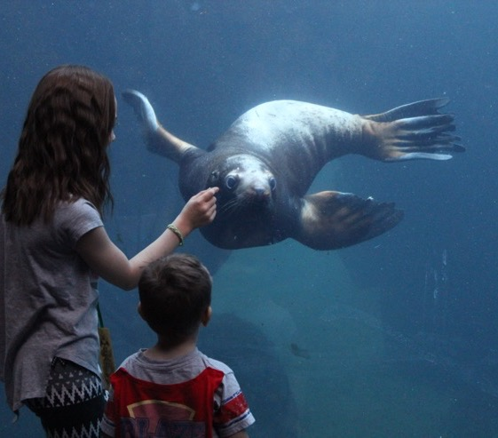


Learning Groups
NEW
Gauge Interest
Choose a pilot group
Photo Courtesy: Alaska SeaLife Center
Notes:
ASZYA TO PRESENT
We want to try adding a new dimension to our learning network. We want to launch Learning groups, topic specific spaces where people can learn from their peers about the overlap of empathy and the topic. This might be zoom meetings or it might be a space in the discussion platform. We want to gauge interest so that we can spend time in 2021 piloting this and seeing if we can make it work.
Learning groups differ from committees in that
Learning Groups create space to learn from your peers, Committees are groups that help push the work of the network forward.
Learning groups are also an opportunity to include our colleagues in network conversations, ones who aren’t network delegates, but who could learn about how empathy informs their work.
We want to choose a pilot topic that we can start this with
RESOURCE ID
17802

Slide 47
Learning Groups
 | I would want to come to a conversation about… | I feel I could talk about….
Animal Welfare
School Education
Marketing
Volunteering
Development
Distance Learning
Notes:
ASZYA TO LEAD
Annotate the screen:
Put your name by a topic you want to come to,
Put your name by a topic you feel you could talk about
Put your institution by a topic that you feel your institution has people that might want to come to.
Put your institution by a topic that you feel your institution has people that might want to talk about it.

Slide 48
Learning Groups
 | My institution has people that may want to come to a conversation about… | My institution has people that might want to talk about….
Animal Welfare
School Education
Marketing
Volunteering
Development
Distance Learning
Notes:
ASZYA TO LEAD
Annotate the screen
Put your name by a topic you want to come to,
Put your name by a topic you feel you could talk about
Put your institution by a topic that you feel your institution has people that might want to come to.
Put your institution by a topic that you feel your institution has people that might want to talk about it.

Slide 49



Working Groups
Strategic Learning
Working Group
Communications
Working Group
Operations
Working Group
Notes:
As we add in a new working group, the operations working group has talked about a proposed model for committee membership. I want to propose this model and then, based on signups, we will put it into action.
Our ideal is that the strategic leaning and communications committee will each have 5-7 people.
As operations and diversity and inclusion inform the way they do their work, our ideal is that there are 3-4 people on each committee. AND that one member from strategic learning and communications is on operations and one member from each is on diversity and inclusion.
This will help keep work not-siloed and let the work of the committees inform each other more moving forward.
Each committee will meet once every 4-6 weeks for an hour.

Slide 50

Working Groups
Strategic Learning
Committee
Communications
Committee
Operations
Working Group
Notes:
As we add in a new working group, the operations working group has talked about a proposed model for committee membership. I want to propose this model and then, based on signups, we will put it into action.
Our ideal is that the strategic leaning and communications committee will each have 5-7 people.
As operations and diversity and inclusion inform the way they do their work, our ideal is that there are 3-4 people on each committee. AND that one member from strategic learning and communications is on operations and one member from each is on diversity and inclusion.
This will help keep work not-siloed and let the work of the committees inform each other more moving forward.
Each committee will meet once every 4-6 weeks for an hour.

Slide 51



Working Groups
Strategic Learning
Committee
Communications
Committee
Operations
Working Group
Notes:
As we add in a new working group, the operations working group has talked about a proposed model for committee membership. I want to propose this model and then, based on signups, we will put it into action.
Our ideal is that the strategic leaning and communications committee will each have 5-7 people.
As operations and diversity and inclusion inform the way they do their work, our ideal is that there are 3-4 people on each committee. AND that one member from strategic learning and communications is on operations and one member from each is on diversity and inclusion.
This will help keep work not-siloed and let the work of the committees inform each other more moving forward.
Each committee will meet once every 4-6 weeks for an hour.

Slide 52
Working Groups
 | Sign Up | Interested
Strategic Learning
Committee
Communications
Committee
Operations
Working Group
Notes:
Daniel to lead
ANNOTATE THE SCREEN

Slide 53
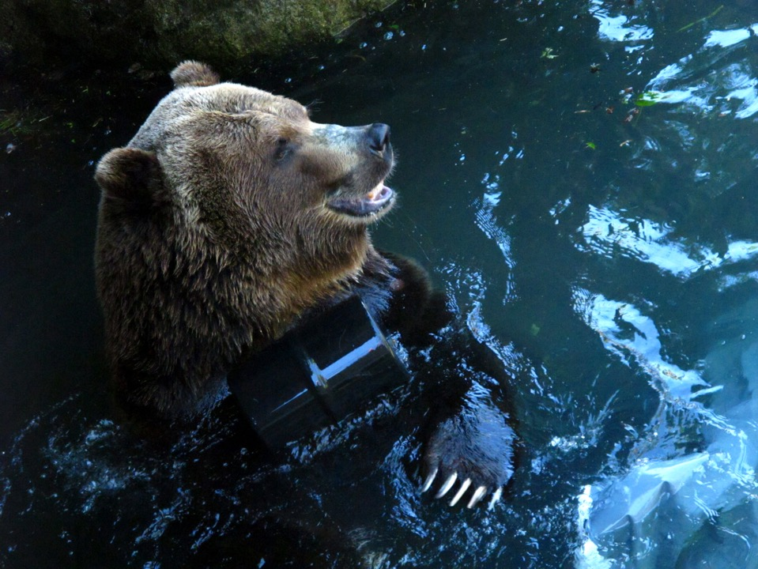
Thank You
Notes:
Scavenger Hunt!
Email follow-up
Tech Support hours

