Slide 1




Learning from Summer
Jumping into Fall
ACE for Wildlife Network Fall Meeting 9/22
Default Zoom Status:
Recording

Slide 2
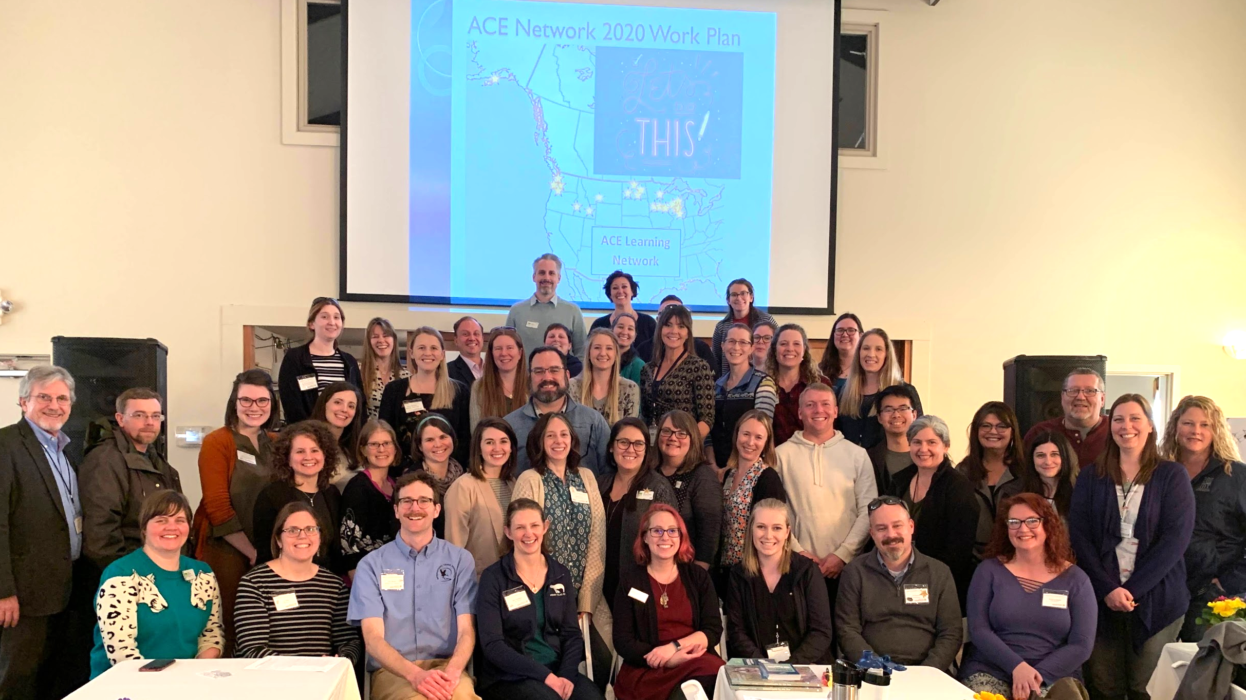

Slide 3

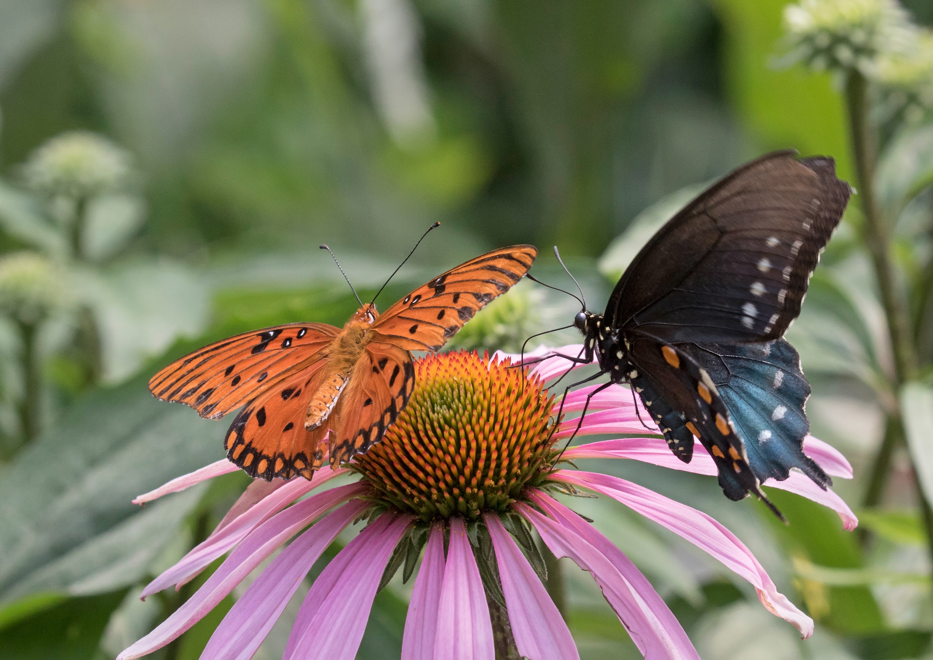
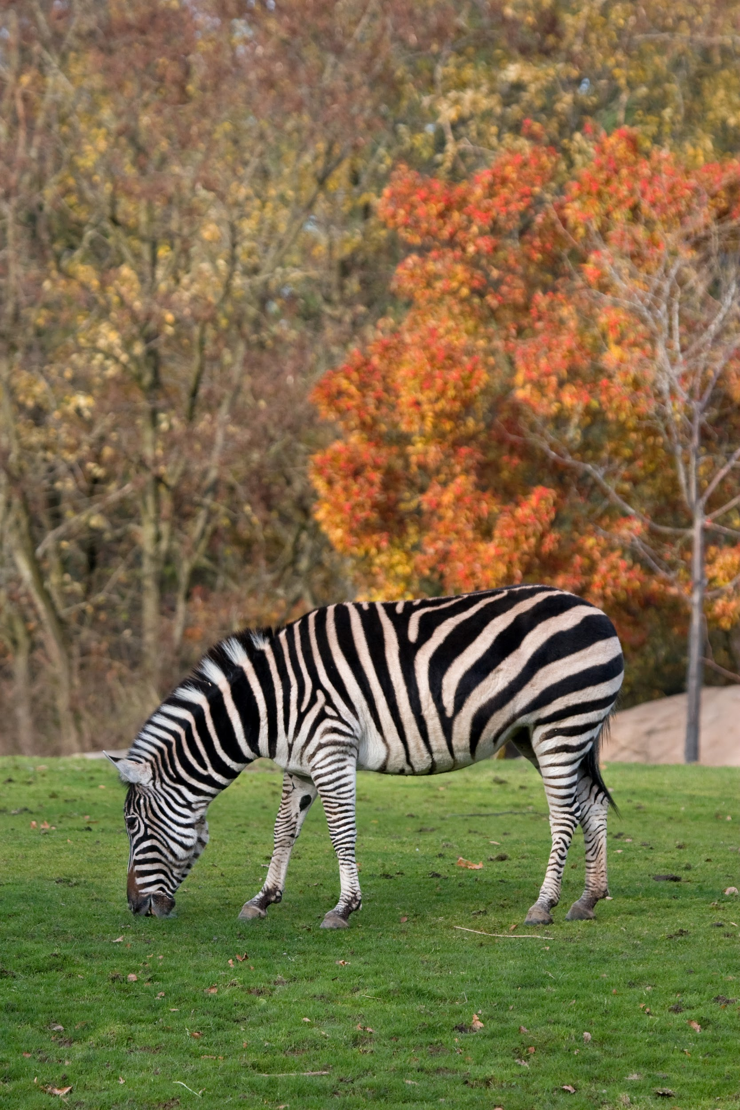
Agenda
Have some fun
Announcements
Check-in on the summer
ACE for Wildlife Network updates from the summer
Looking forward to fall
ACE for Wildlife Network activities for the Fall
Next Steps and announcements

Slide 4
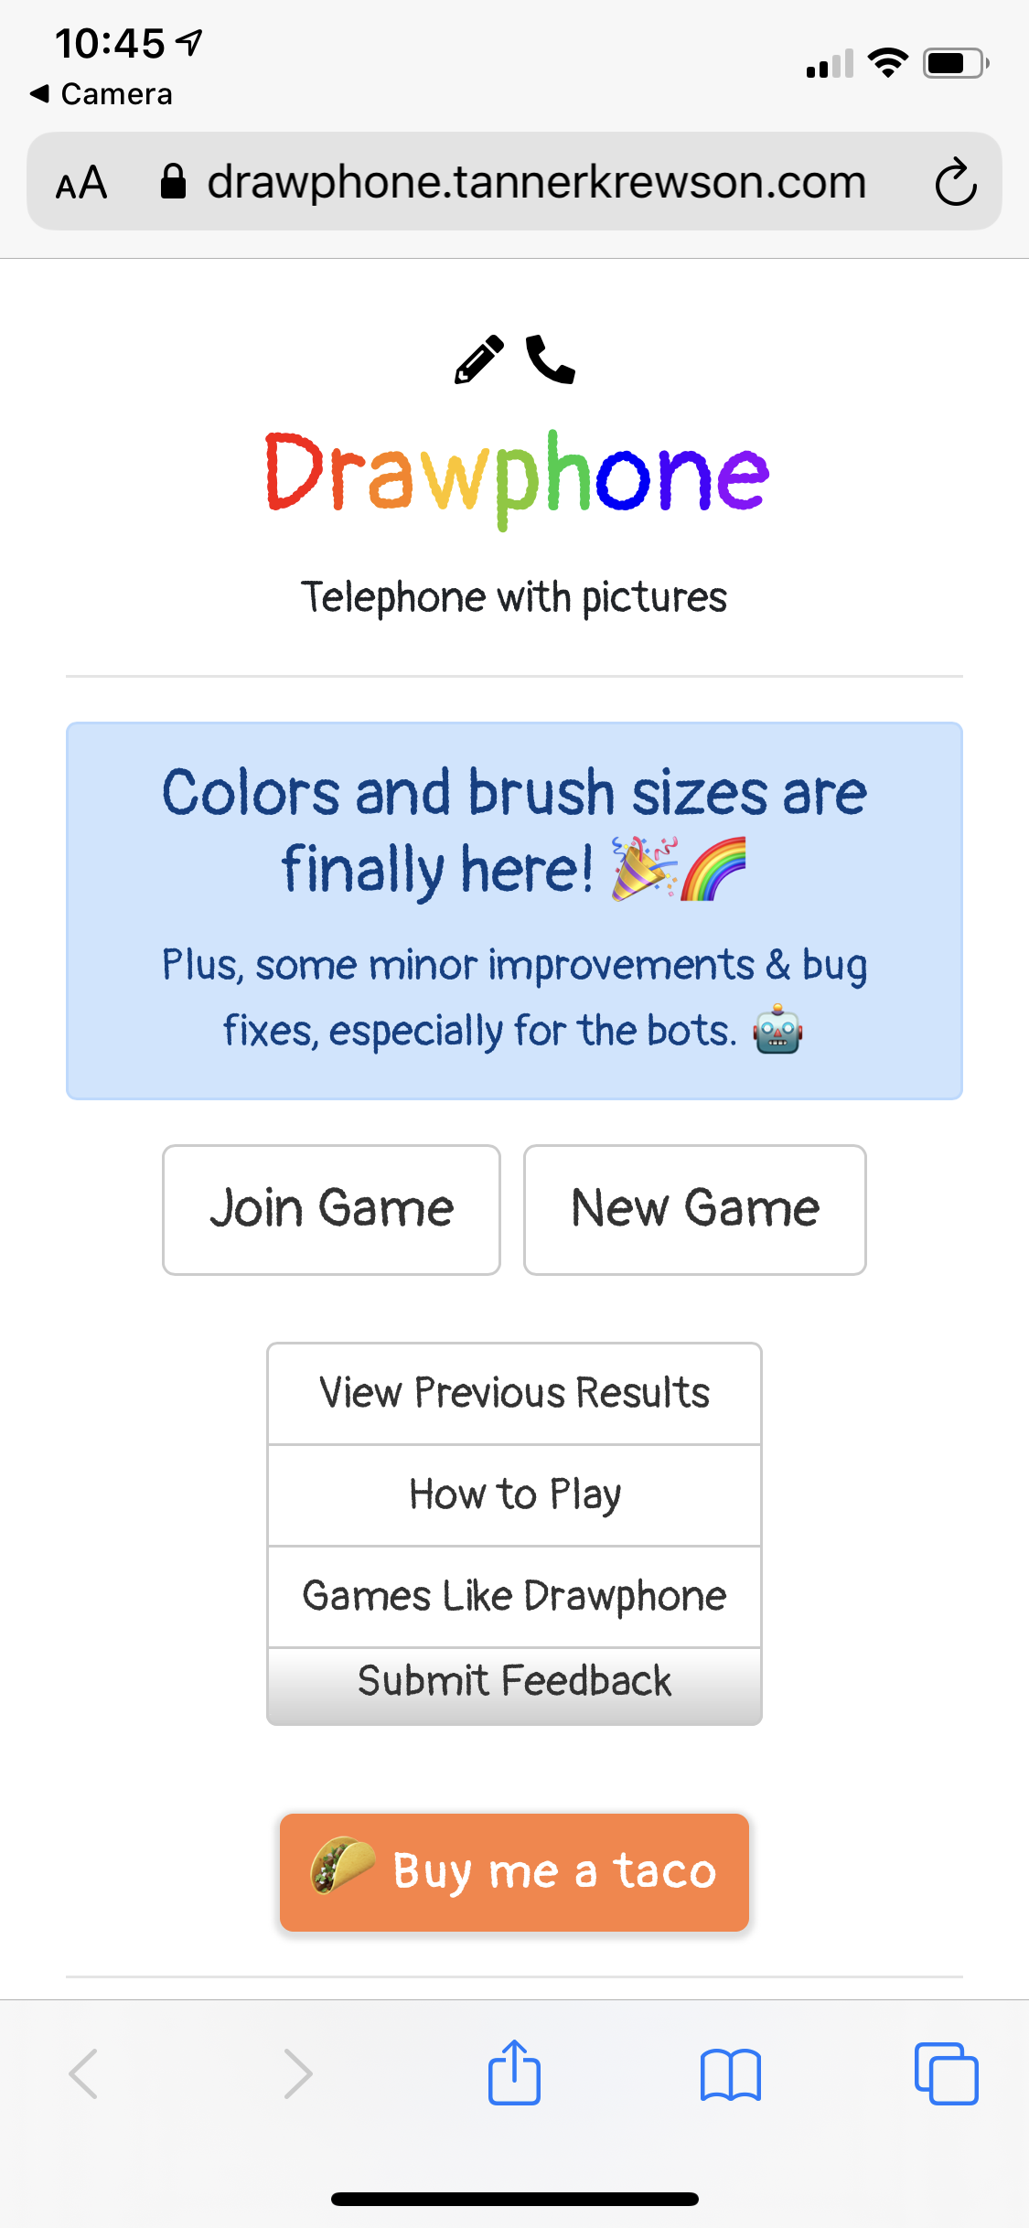
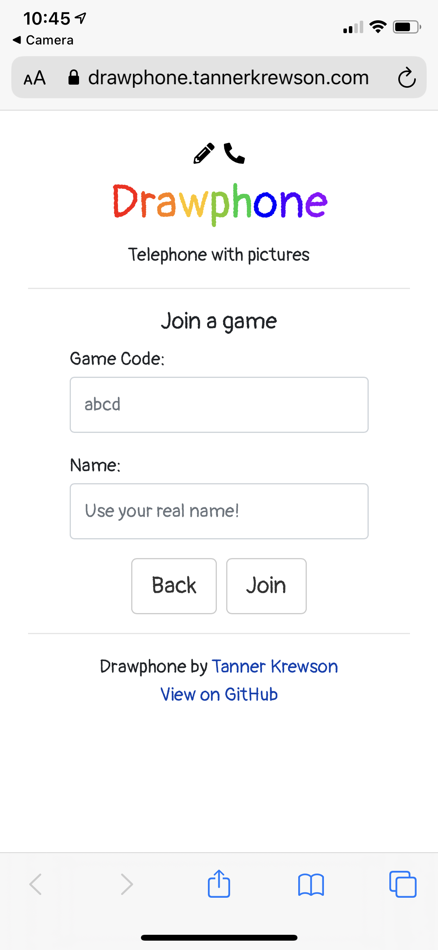
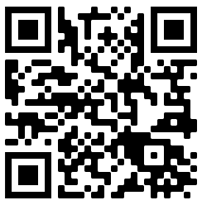
Something Fun
Drawphone
How to us Drawphone:
Go to drawphone.tannerkrewson.com
Click “Join Game”
We will put you in breakout rooms
Type code from breakout room into the “Game Code” field
Type in your name
We will start the game

Slide 5
Agenda
Have some fun
Announcements
Check-in on the summer
ACE for Wildlife Network updates from the summer
Looking forward to fall
ACE for Wildlife Network activities for the Fall
Next steps

Slide 6
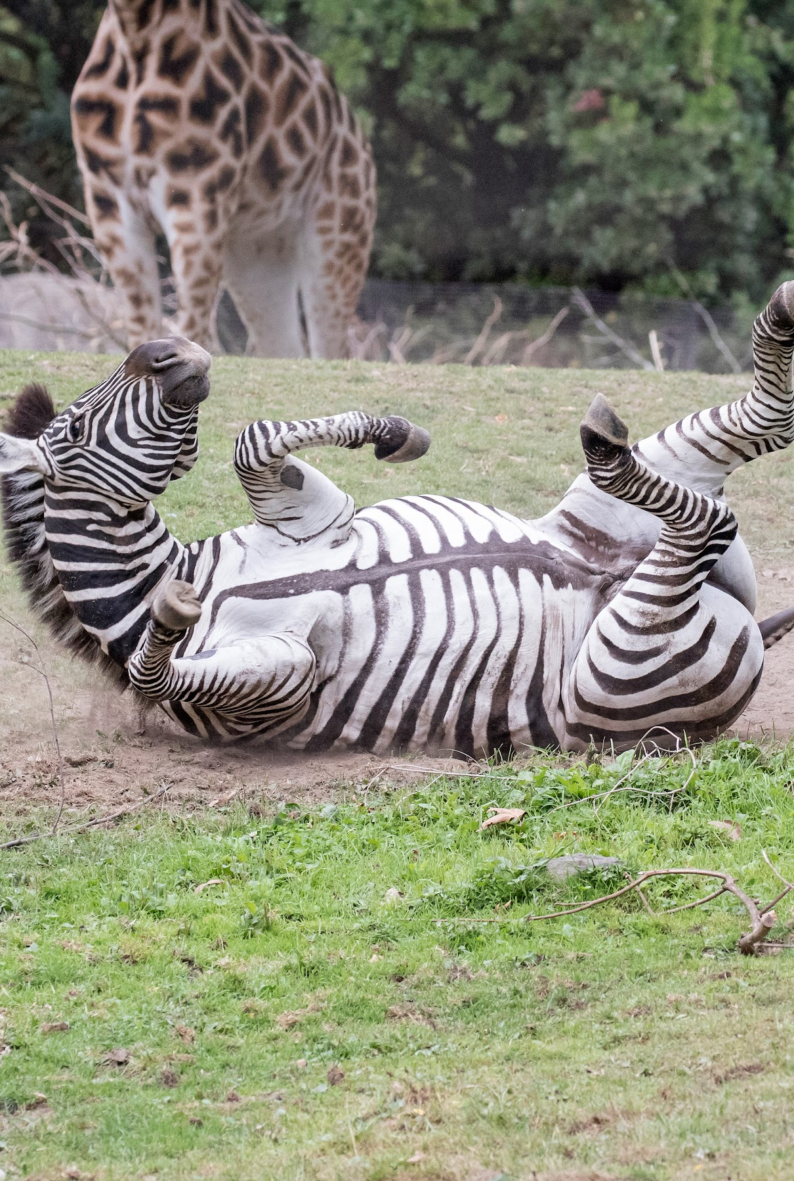
Agenda
Announcements
Have some fun
Check-in on the summer
ACE for Wildlife Network updates from the summer
Looking forward to fall
ACE for Wildlife Network activities for the Fall (+Feedback and input!)
Next steps

Slide 7

Check-in on the Summer
Who found the summer:
Energizing
Uncertain
Scary
Provided clarity of focus
Who was challenged by:
Closures
Funding/Staffing concerns
Guest concerns
Who had to:
Change plans
Double down on their plans

Slide 8
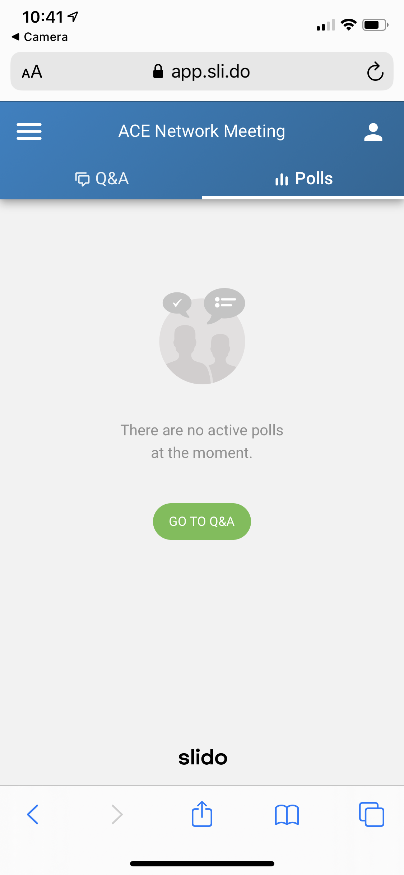

Check-in on the Summer
Small Group Discussions
As you discuss, share answers and keywords to the group using Slido
How to use Slido:
Go to Sli.do
Type in Code “ACEfall”

Slide 9
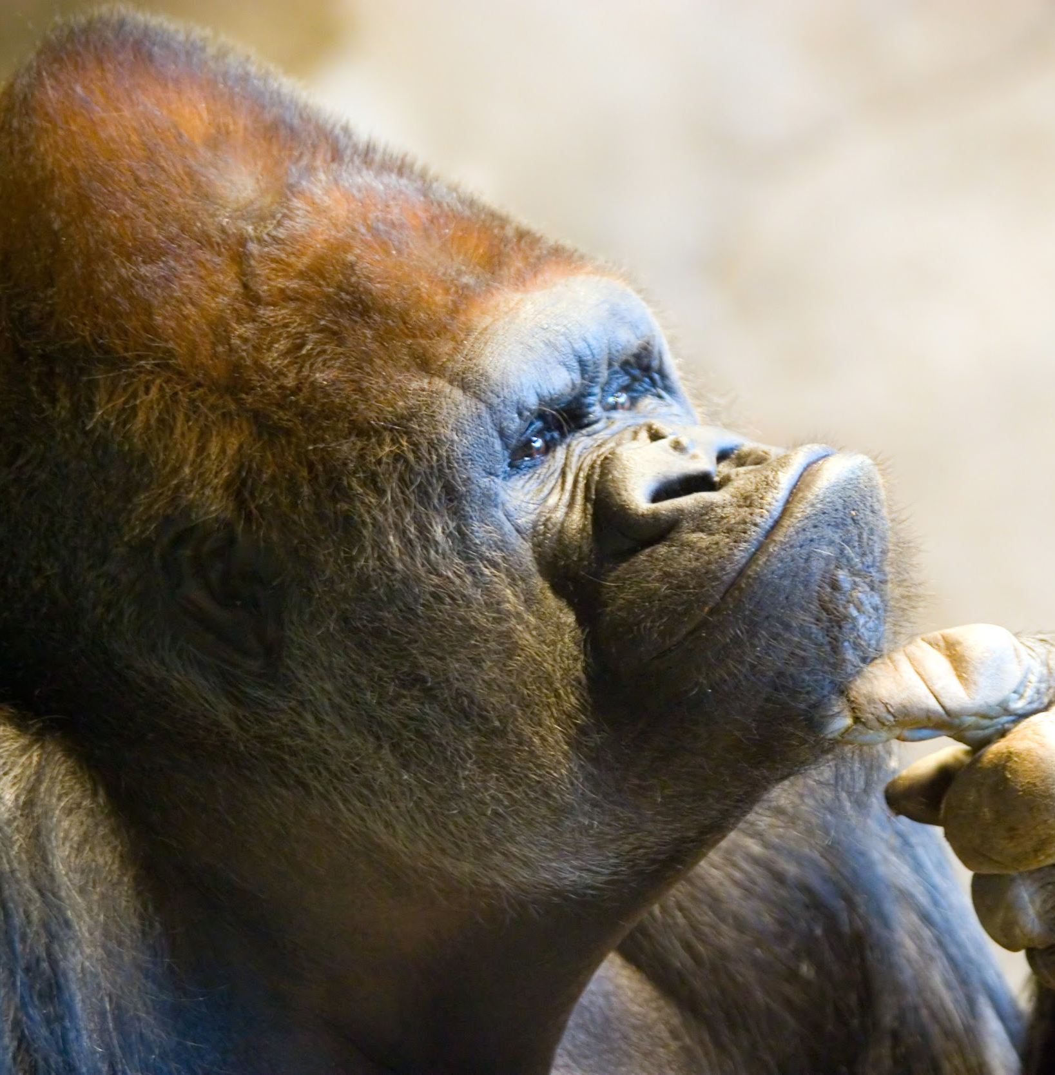
Lessons learned from the summer
Think:
What about this summer was fun?
What about this summer did you find challenging?
You = you, team, organization
Think and Share:
What did you learn?
How to use Slido:
Go to Sli.do
Type in Code “ACEfall”

Slide 10

What did you learn this summer?
ⓘ Start presenting to display the poll results on this slide.

Slide 11
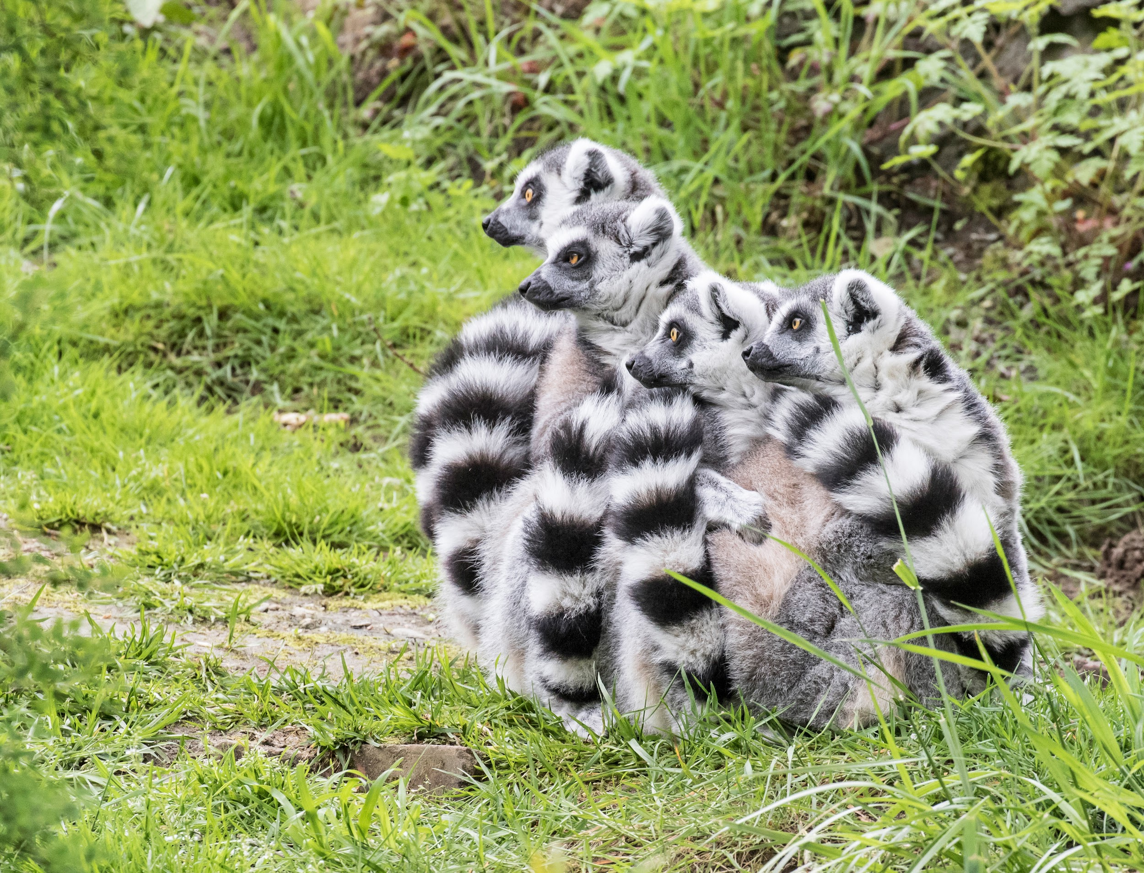
See anything that resonates?
See anything that prompts further questions?
See anything you want to learn more about?

Slide 12
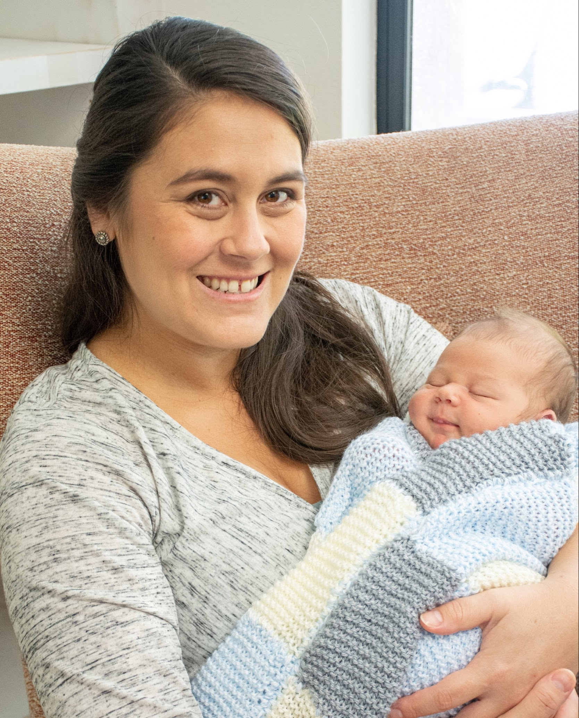
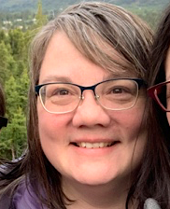
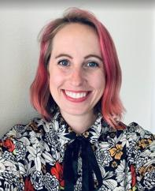
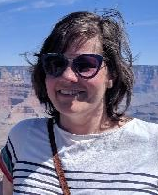
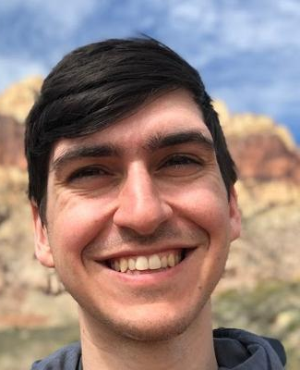

ACE for Wildlife Network’s summer updates
Laurie Stuart Director of Impact Laurie.Stuart@zoo.org | Laurel Abbotts Project Manager Laurel.Abbotts@zoo.org | Mary Jackson Audience Research Supervisor Mary.Jackson@zoo.org | Daniel Rother Empathy Network Specialist Daniel.Rother@zoo.org

Slide 13
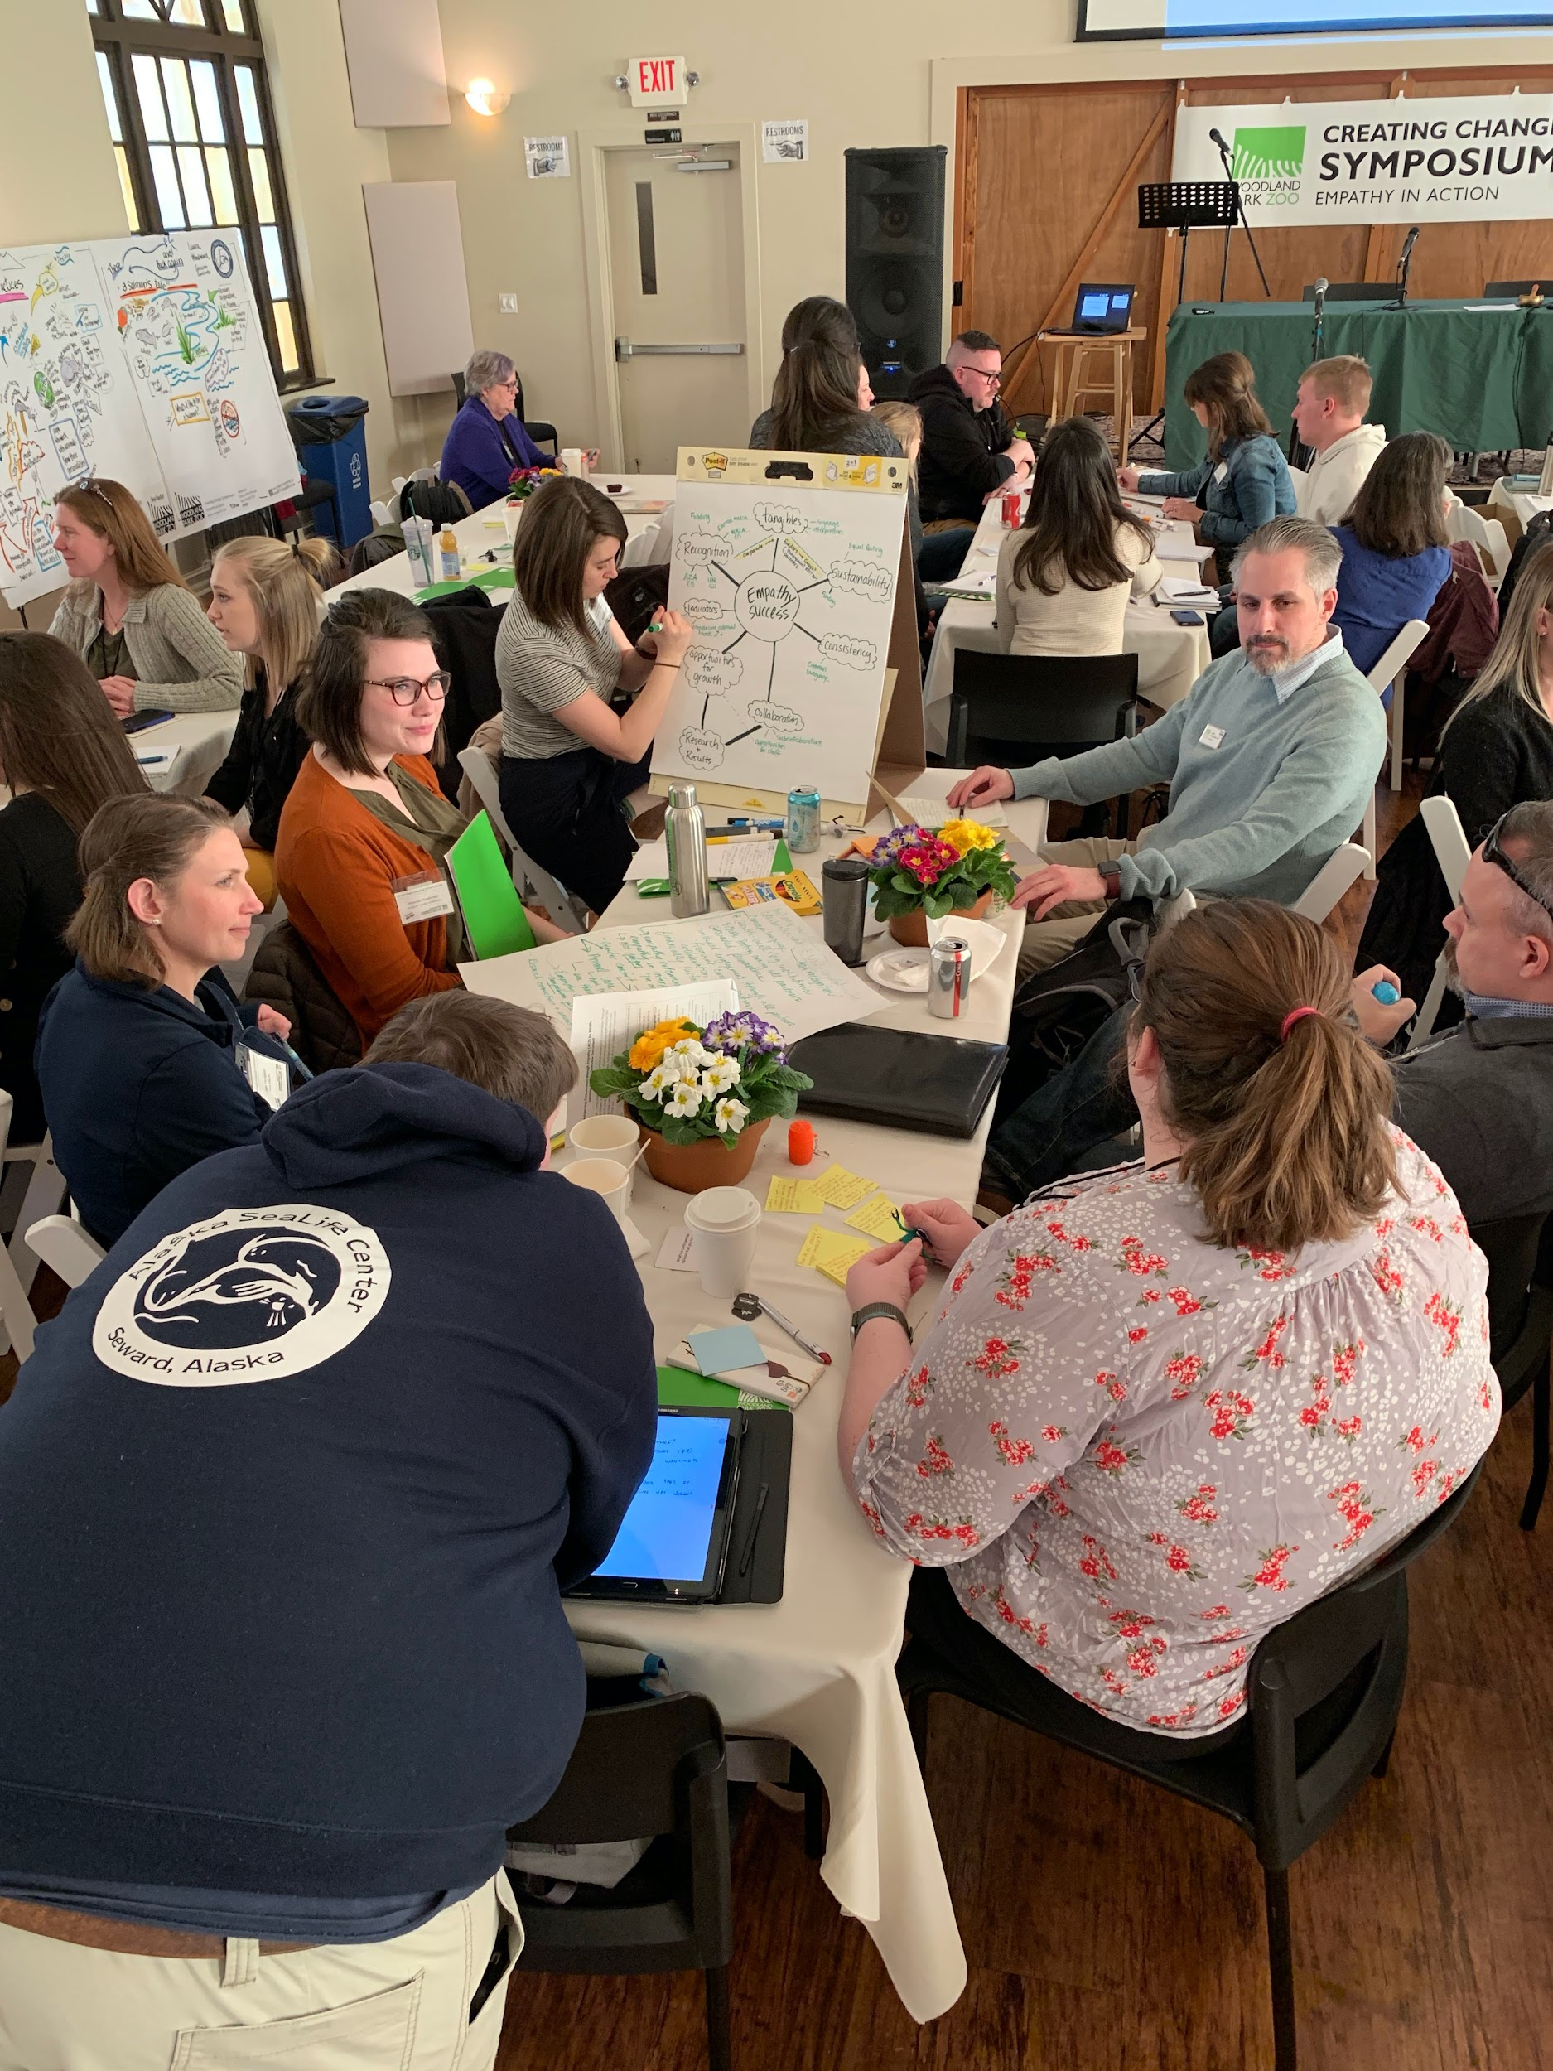
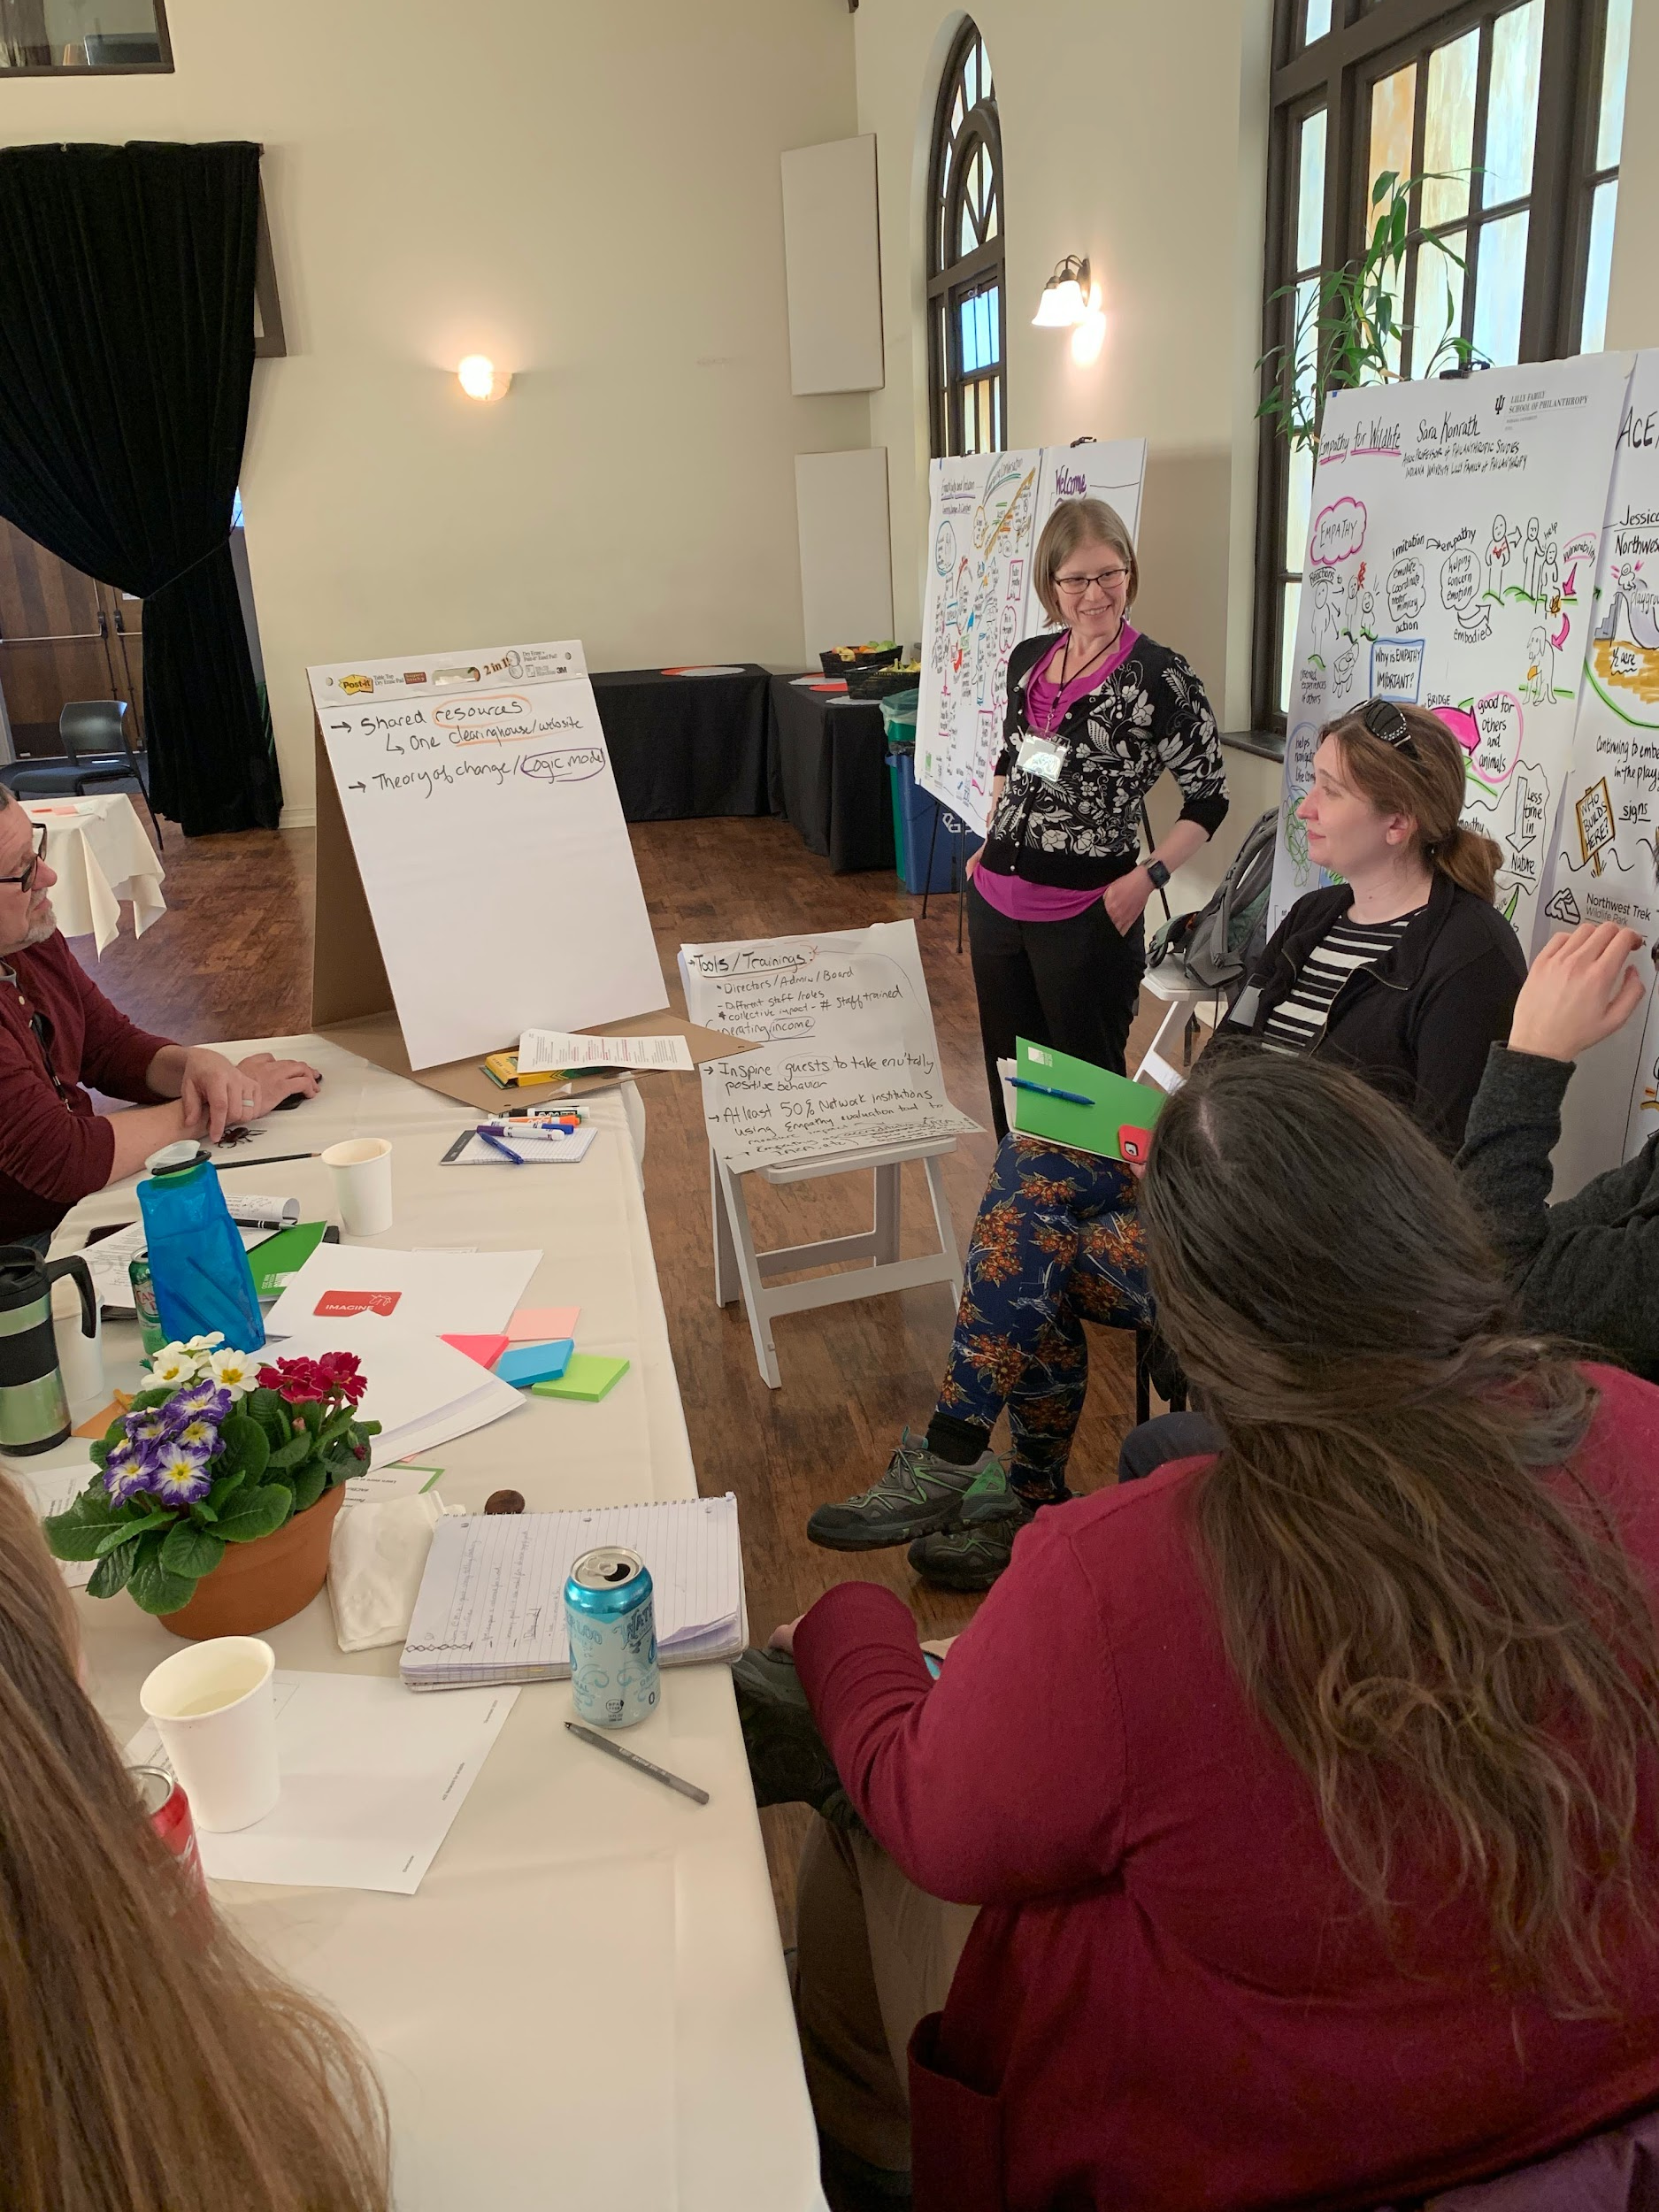
ACE for Wildlife Network

Slide 14
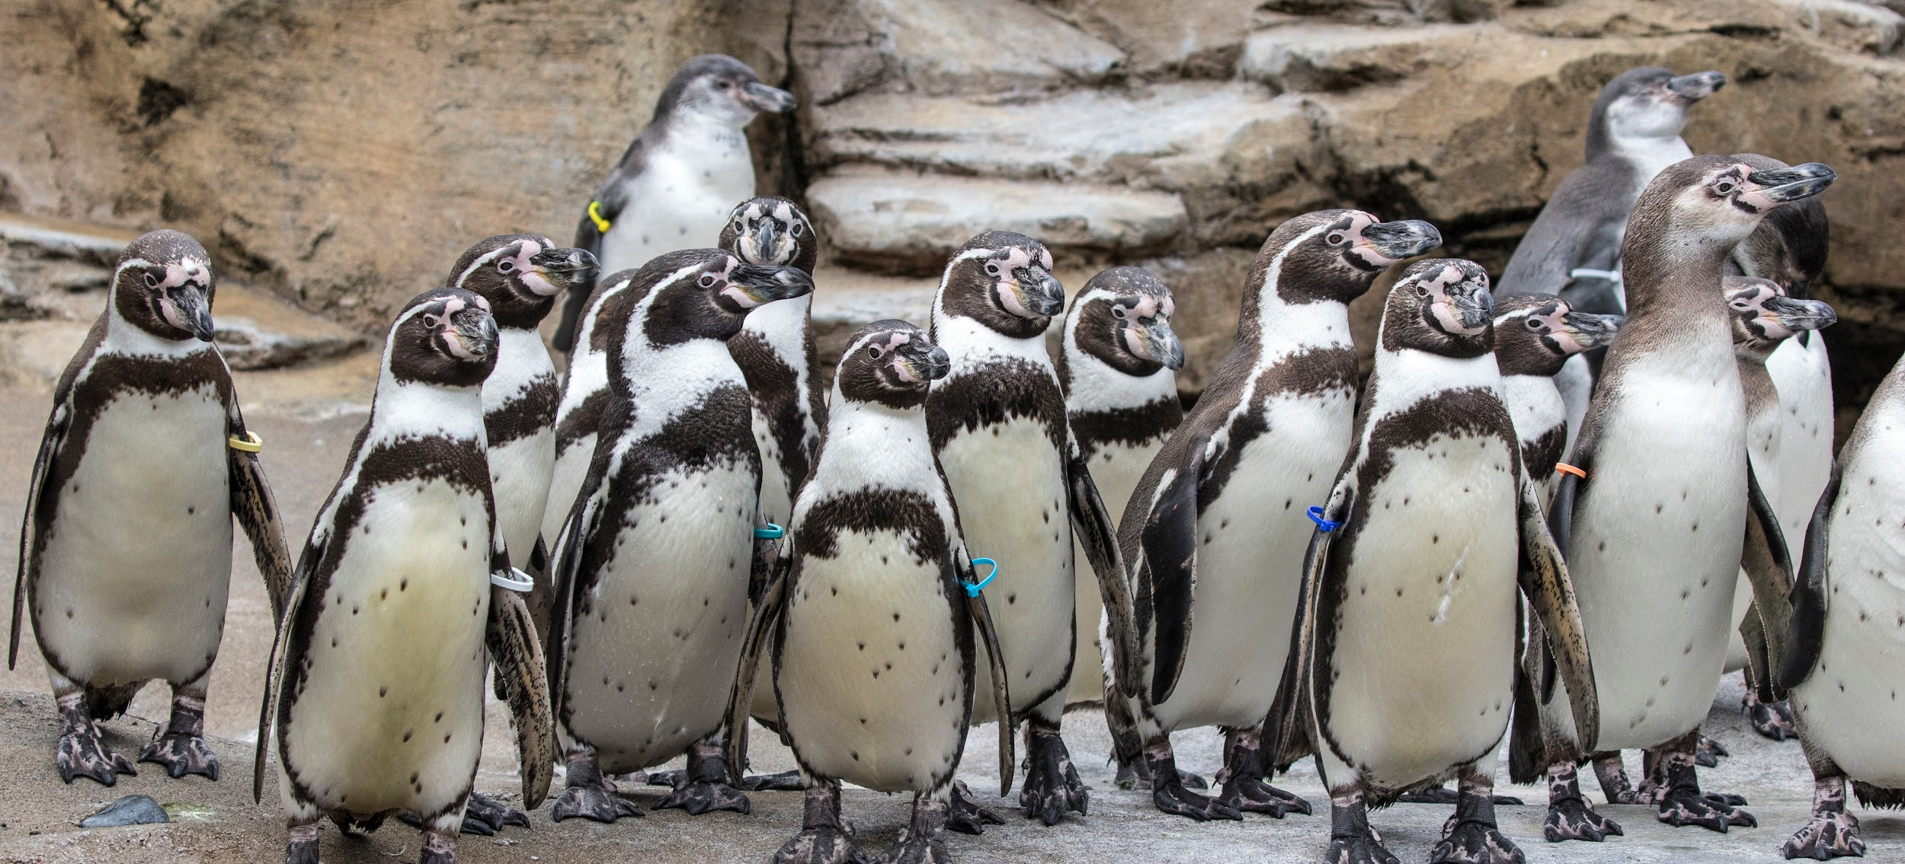
ACE for Wildlife Network
Our Vision | A conservation-minded society motivated by empathy towards all life.

Slide 15
ACE for Wildlife Network
Our Vision | A conservation-minded society motivated by empathy towards all life.
Our Mission | The Advancing Conservation through Empathy (ACE) for Wildlife learning network creates and shares effective practices to foster empathy for animals and people.

Slide 16
ACE for Wildlife Network
Our Vision | A conservation-minded society motivated by empathy towards all life.
Our Mission | The Advancing Conservation through Empathy (ACE) for Wildlife learning network creates and shares effective practices to foster empathy for animals and people.
Our Purpose | We bring together like-minded professionals to strengthen how accredited institutions create, use and evaluate practices to foster empathy for wildlife leading to conservation actions.

Slide 17
Agenda
Have some fun
Announcements
Check-in on the summer
ACE for Wildlife Network updates from the summer
Looking forward to fall
ACE for Wildlife Network activities for the Fall
Next steps and announcements

Slide 18
Looking towards the fall
Think:
What are you hoping to learn this fall?
What are your aspirations for the fall?
You = you, team, organization
Think and Share:
What are your big goals for this fall?
How to use Slido:
Go to Sli.do
Type in Code “ACEfall”

Slide 19
What are your big goals for the fall? (Personal, team, Org)
ⓘ Start presenting to display the poll results on this slide.

Slide 20
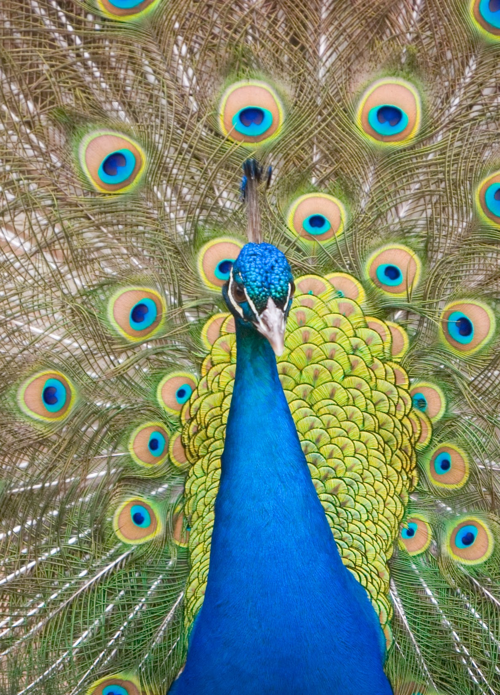
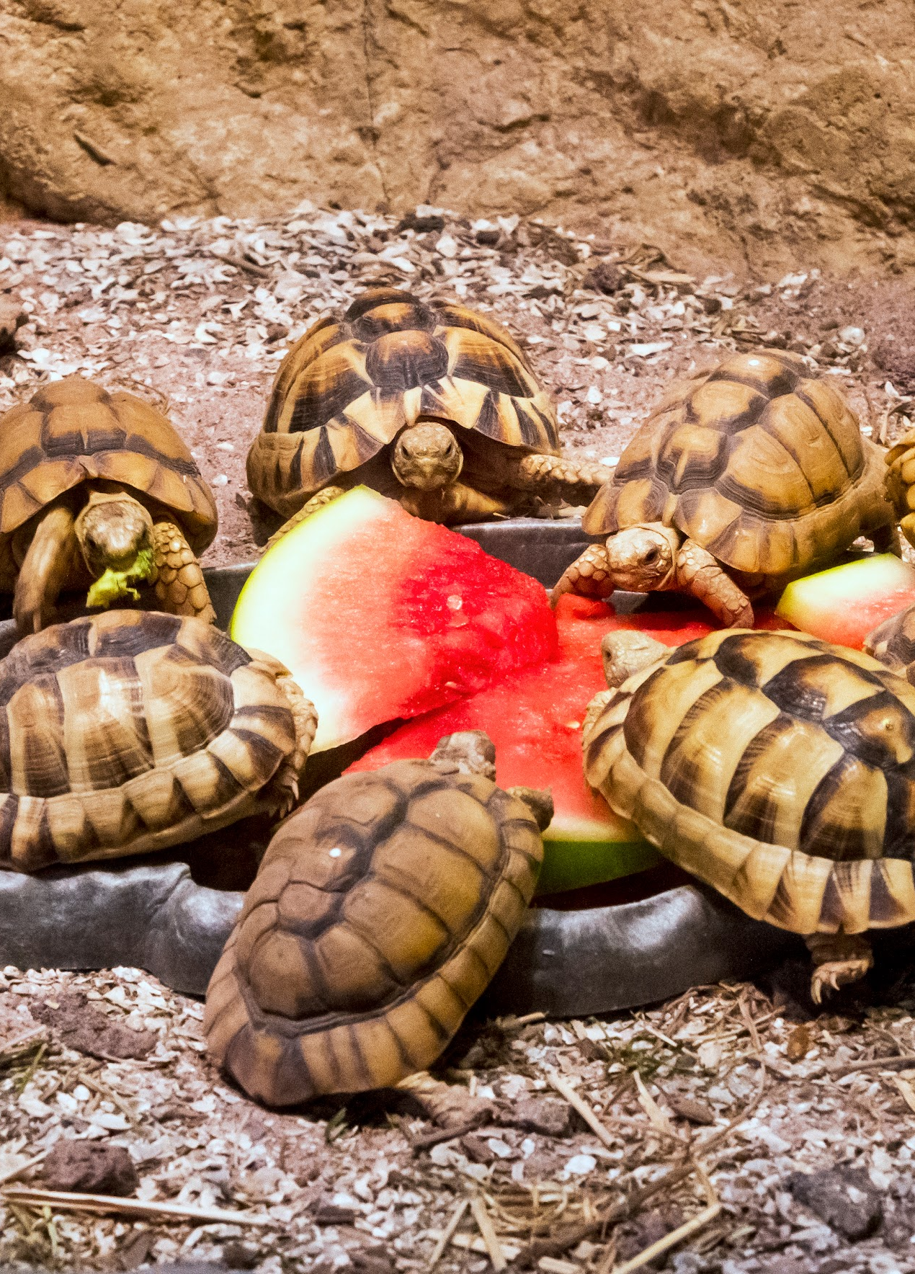
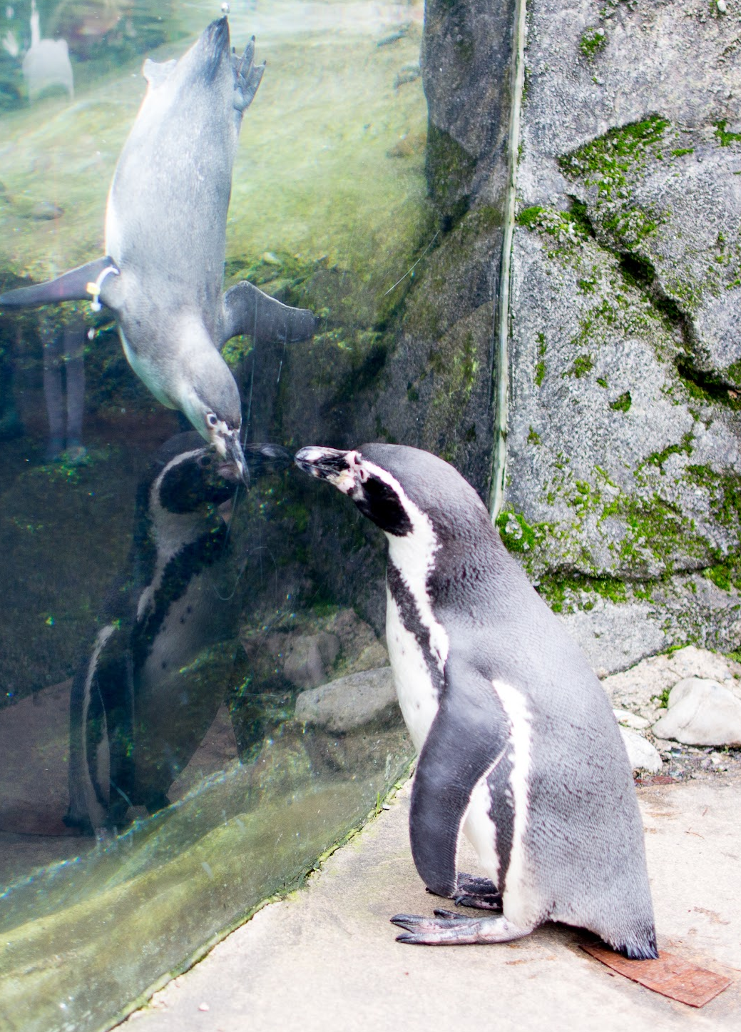
Our Fall
Branding
2. Working Groups
3. Webinars

Slide 21
Our Fall
Branding
2. Working Groups
3. Webinars

Slide 22
What visuals come to mind
when you think of
empathy?

Slide 23
Our Fall
Branding
2. Working Groups
3. Webinars

Slide 24






Feedback on Working Groups
Reflection and Evaluation
Resources and Content
Grant Writing/
Funding
Regions
Diversity Equity
Inclusion
Governance

Slide 25
Working Groups
Strategic Learning
Operations
Communications

Slide 26
Working Groups
Strategic Learning
Operations
Working Groups
Communications
Active Committees

Slide 27
Working Groups
Strategic Learning
Now Working Group
Feb 2021 Committee
Questions to Address
How should ACE share resources and content?
How would we like to learn from each other?
How do we identify common research questions?
Commitment (Now Until Feb 2021)
3 sixty-minute meetings
Review of documents and ideas sent via email
Actions
Refine committee scope
Define committee charter and structure
Questions to Address
What are the common research questions?
How to we enable sharing of evaluation capacity?
How do we continue to grow and share our knowledge?
Actions
Open committee up to more members
Do the work
This group is for people who are excited about:
Evaluation
Training
Peer Learning

Slide 28
Working Groups
Communications
Now Working Group
Feb 2021 Committee
Questions to Address
What brand and identity should ACE have?
What’s the most useful formats for ongoing communication?
Commitment (Now Until Feb 2021)
3 sixty-minute meetings
Review of documents and ideas sent via email
Actions
Refine committee scope
Define committee charter and structure
Review and feedback on logo design
Questions to Address
How do we best facilitate network conversations?
How do we leverage institutions clustered in regions or other subgroups?
Actions
Open committee up to more members
Do the work
This group is for people who are excited about:
Storytelling
Technology Platforms
Bridging out to AZA at large
How the network stays in touch

Slide 29
Working Groups
Operations
Now Working Group
TBD 2021/2022 Committee
Questions to Address
What does a governance committee look like long-term?
Commitment (Now Until Feb 2021)
3 sixty-minute meetings
Review of documents and ideas sent via email
TBD Feb 2021+
Actions
Refine committee scope
Define committee charter
Plan what a governance committee looks like
Questions to Address
What foundation needs to be in place to move to financial sustainability?
How is membership defined for an institution or an individual?
How do regions factor into participation?
Actions
Open committee up to more members
Do the work
This group is for people who are excited about:
Leadership
Sustainable Growth
Direction and membership

Slide 30
Questions?
?
Strategic Learning
Operations
Communications

Slide 31
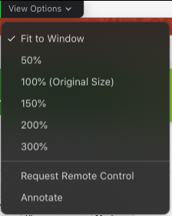

Working Groups Sign Up
READY TO COMMIT
How To:
1. Select “view options” and select “annotate”
2. Select “Text”
3. Click in the appropriate box
4. Type your name
Strategic Learning
INTERESTED
Communications
READY TO COMMIT
INTERESTED
Operations
READY TO COMMIT
INTERESTED

Slide 32
Our Fall
Branding
2. Working Groups
3. Webinars

Slide 33
Webinars and network activities
October
November
December

Slide 34

Webinars and network activities
October
 |  |  | 21
Virtual Workshop by the Seattle Aquarium
Best Practices in Developing Empathy Towards Wildlife
9:30a-12:00p Alaska | 10:30a -1:00p Pacific | 11:30a - 2:00p Mountain | 12:30p - 3:00p Central
October 21, 2020

Slide 35
Webinars and network activities
October
November
December
Grantee Webinars
Dates TBD Times: 12:00-2:00 Pacific

Slide 36


Grantee Webinars and network activities
8 Grantees presenting their work
Webinars will be open to all.
Please forward invite along to team members.
Topics shared ahead of time.
Option 1:
4 Total Webinars (35 minutes each)
Topics narrowed. More conversation time.
Option 2:
2 Total Webinars (Max 60 minutes each)
Hear from more groups at once. Easier scheduling and attendance
Share Your Preference (Consider what would allow other people from your institution to be able to attend)
How to use Slido:
Go to Sli.do
Type in Code “ACEfall”

Slide 37
Which option do you prefer?
ⓘ Start presenting to display the poll results on this slide.

Slide 38
Agenda
Have some fun
Announcements
Check-in on the summer
ACE for Wildlife Network updates from the summer
Looking forward to fall
ACE for Wildlife Network activities for the Fall (+Feedback and input!)
Next Steps and announcements

Slide 39

Thank You
Thank You for your time and participation.
Keep an eye out for emails!
I would love your feedback.

