Slide 1


Slide 2
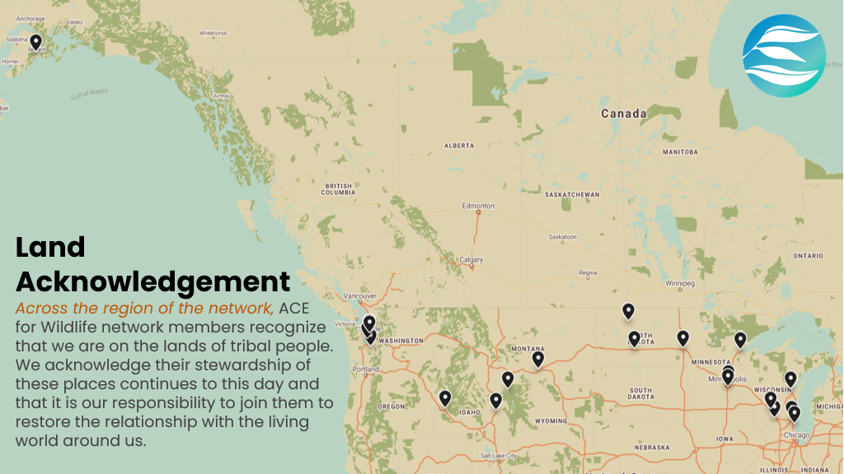
Notes:
https://native-land.ca/​
​
Stop sharing after this slide for Ivel and Erica's portion

Slide 3
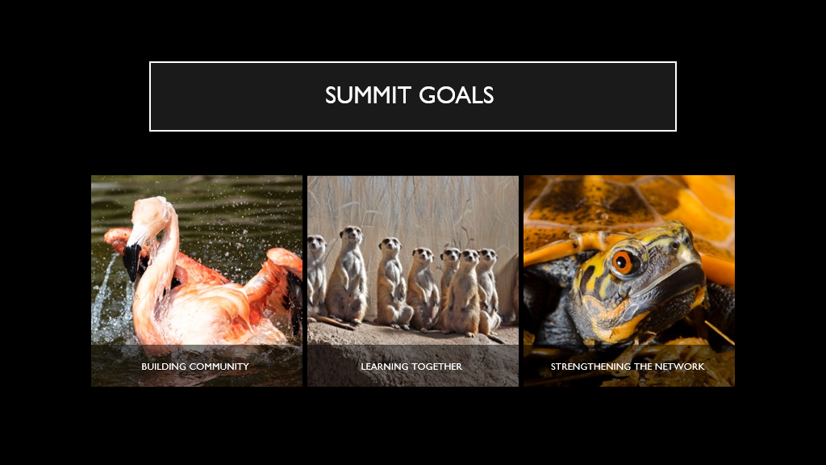

Slide 4
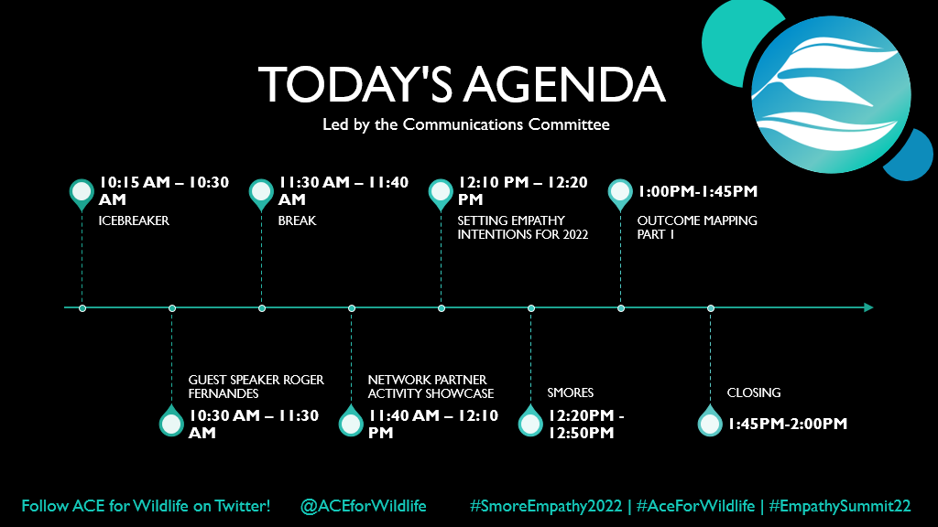
Notes:
Include hashtags and information about Twitter account ​
​
Kirinne to drop agenda in the chat

Slide 5
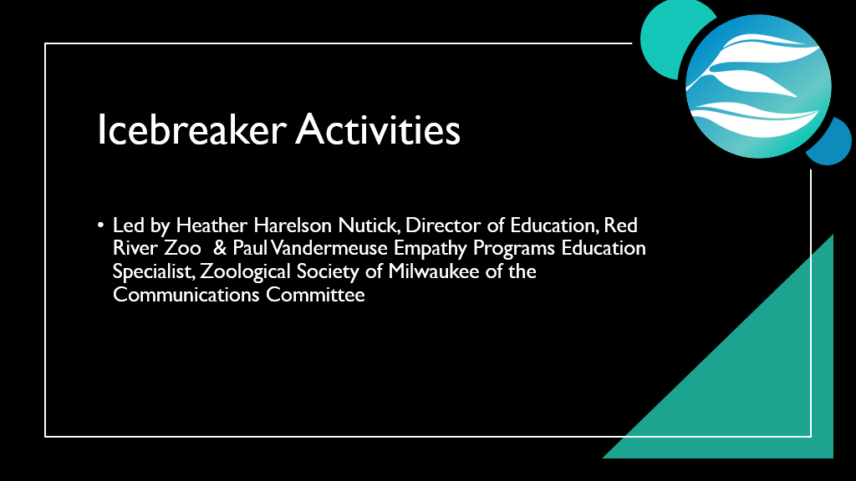
Notes:
Ivel pass off to Heather & Paul ​
​
Heather & Paul ​
"Hi everyone, [introduces selves]. We are part of the ACE for Wildlife Communications Committee, which is a committee that aims to nurture and enable collaboration and connection within the Network to move empathy work forward. Today, we are going to begin with a couple of icebreakers – the themes of which will make more sense later on today."

Slide 6
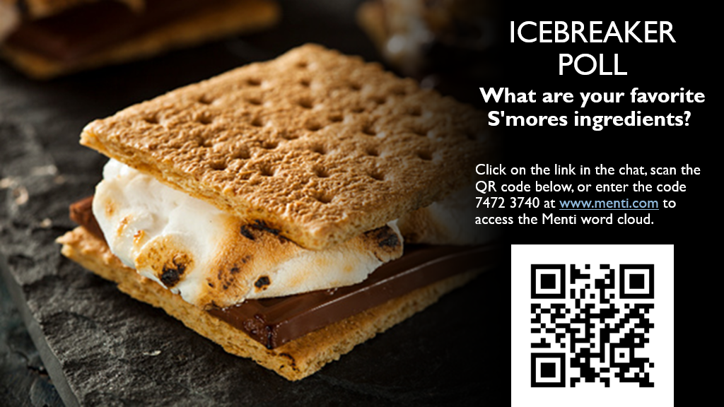
Notes:
Heather ​
​
Mentimeter word cloud link: https://www.menti.com/ku9aikibe4​
​
"If you're wondering why we sent campfire mugs and hot chocolate with marshmallows to each one of your organizations, it has to do with our theme for the Summit: SMORES! We all love a good SMORE – they're associated with the outdoors, everyone has their own unique take on them, and we're all experts in how to make *the* perfect one. So, for our first icebreaker activity, let's learn what each other's favorite SMORE's ingredients are? Maybe it's a Reeses cup instead of chocolate, or whip cream. If you click on the link in the chat or scan the QR code on the slide you will be brought to our word cloud where you can enter up to 5 answers." ​
​
Screensharing of the slides will stop so that people can see the word cloud as it populates with answers ​
​
"Share some of the toppings that we see populating the word cloud" ​
​
"Awesome – so, now that we all know what our colleagues think make up the perfect smore, I'm going to pass it over to Paul for the next part of our icebeaker."

Slide 7
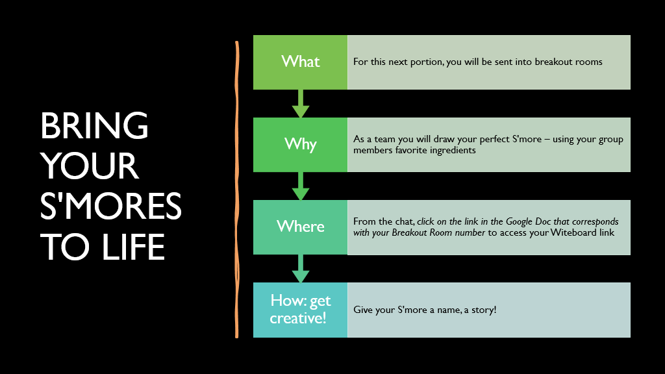
Notes:
Paul ​
​
Google doc link: https://docs.google.com/document/d/1HOtB0_qkB0lI8E73G-phmWxQSE4WRCb_hbDC2NEFlsQ/edit?usp=sharing​
​
"Thanks, Heather. For this portion of the icebreaker, you will be placed in breakout rooms with ~4-5 other people. You'll be in these rooms for ___ minutes with a 2 minute warning before they close. As a team, you are going to draw your perfect S'more – using your group member's favorite ingredients if you'd like. The link in the chat is the Google Doc launchpad, once you're placed in your breakout room – click on the link that corresponds with the number of your breakout room. There you will find your Witeboard link. Everyone should be able to use that link to collaboratively create your Smore mascot! Get creative, give them a name – a backstory even."​
​
Double check to make sure breakout rooms are good to go​
​
"Alright, it looks like your rooms are good to go – have fun"​
​
Once everyone is back in the main area "I hope you all enjoyed creating your Smore's – that won't be the last time you see them! I'm now going to pass it back over to Ivel"

Slide 8


Slide 9
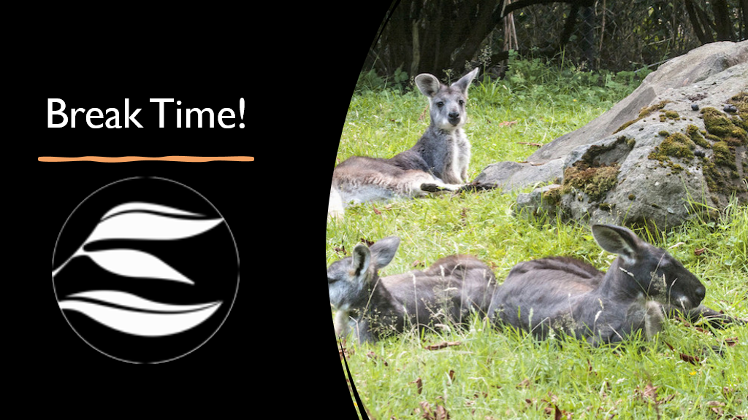
Notes:
2-3 minutes before the break finishes, message Jennifer Kleen to make sure that she's ready to go

Slide 10


Slide 12
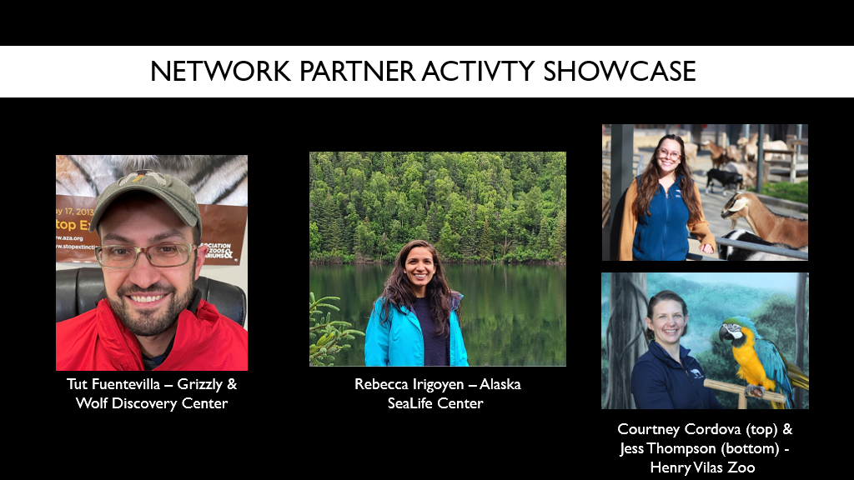
Notes:
Jennifer: "For the next segment, we are going to hear from 3 network partners about some empathy projects or activities they have been undertaking. Like with the AZA buzz, presenters will be limited to 5-minute presentations and then we will move to the next speaker. After all three presentations, we will have some time for Q&A. Introduce each speaker."

Slide 13
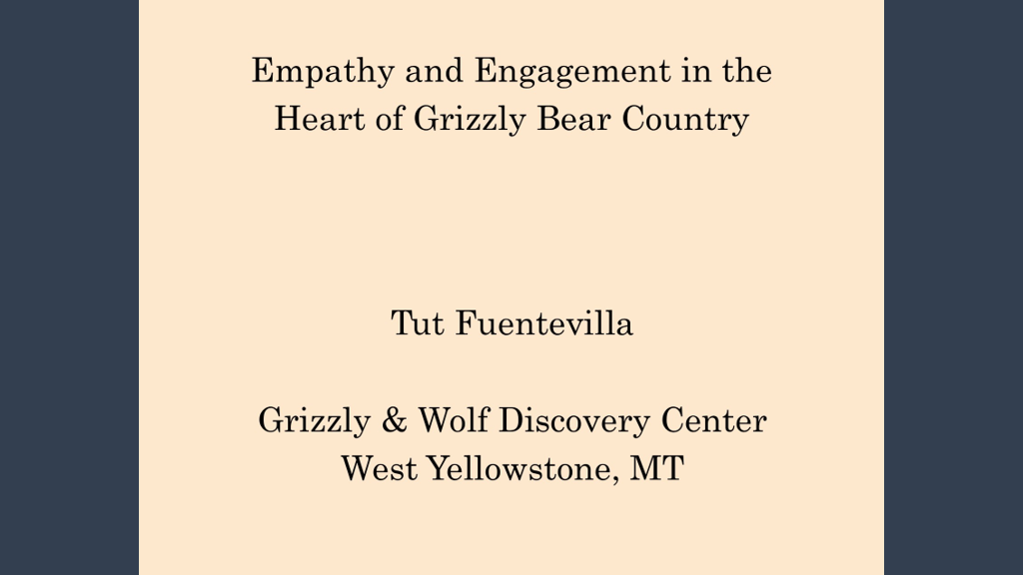

Slide 14
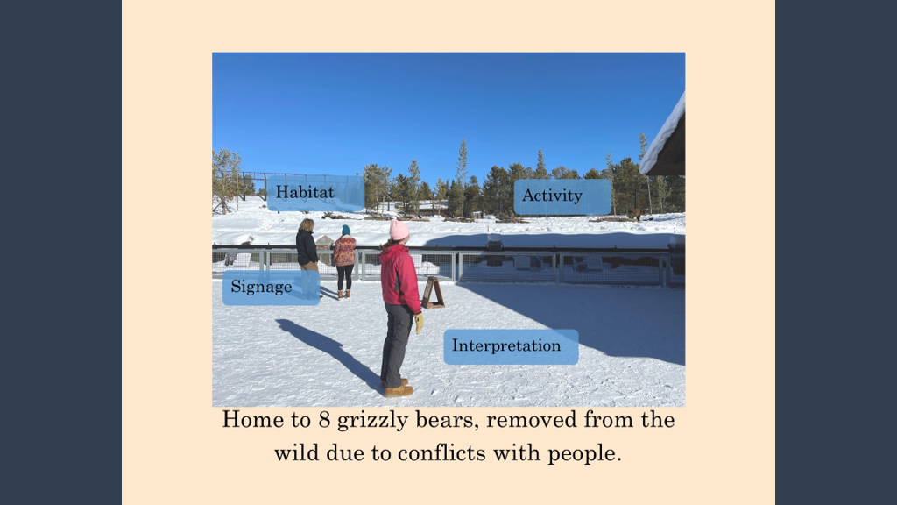

Slide 15
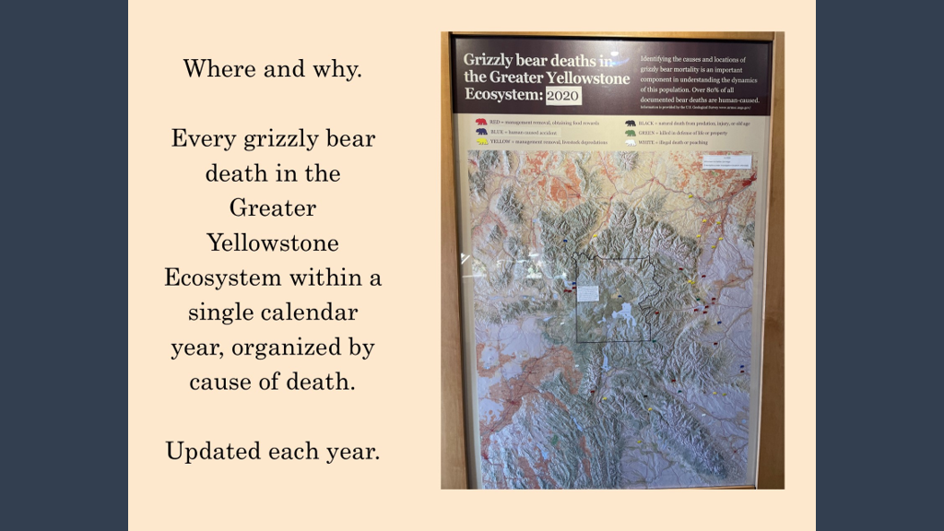

Slide 16
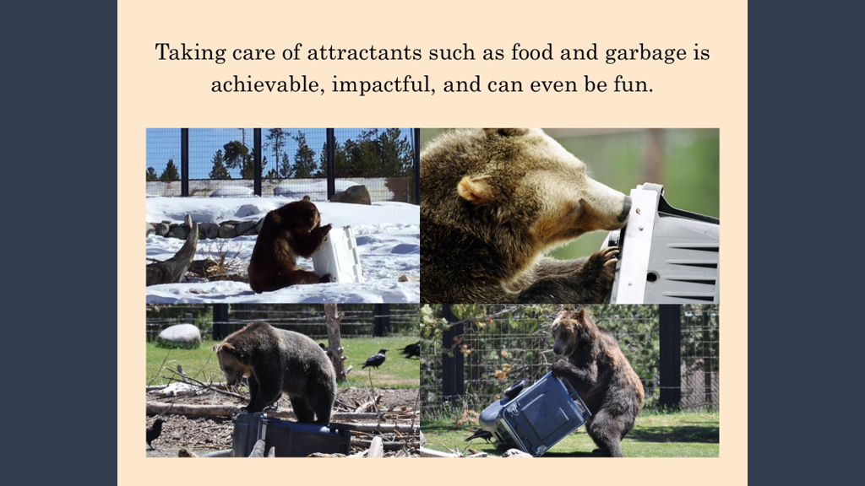

Slide 17


Slide 18
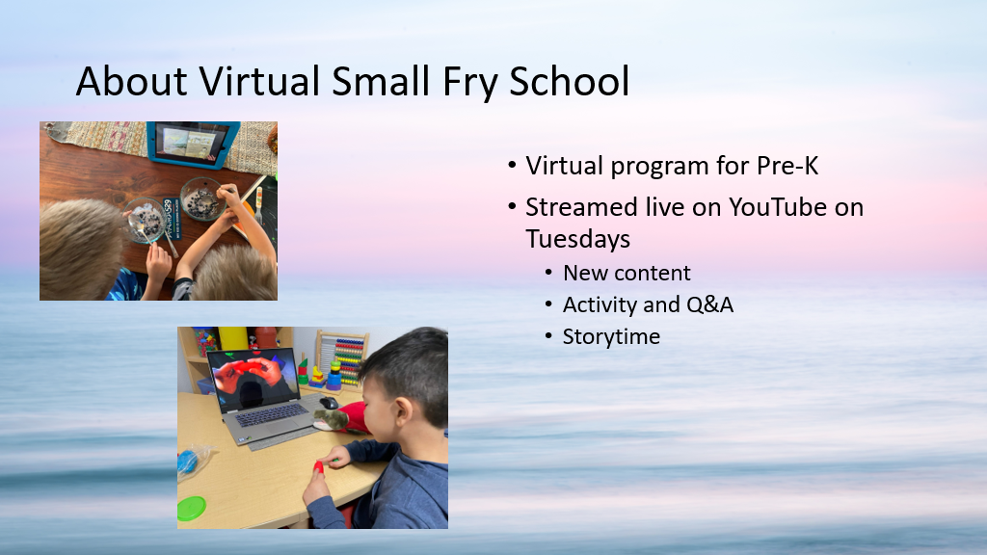

Slide 19
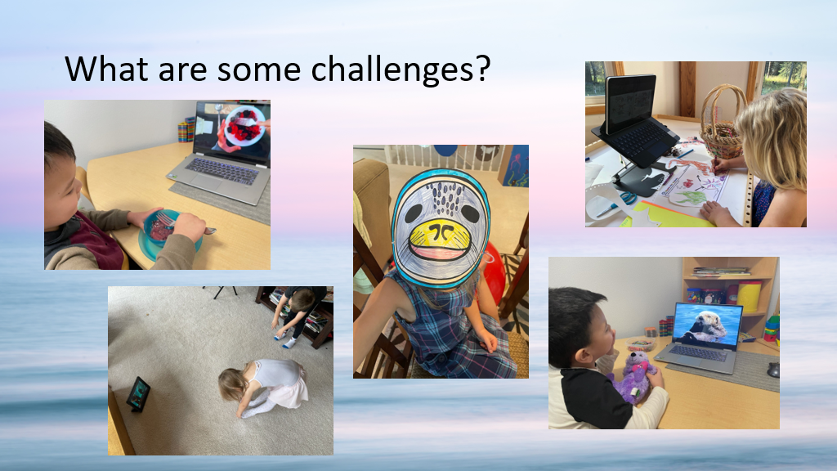

Slide 20
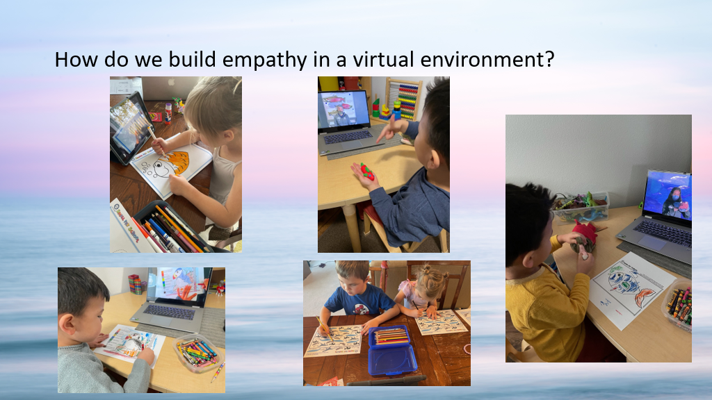

Slide 21


Slide 22


Slide 23
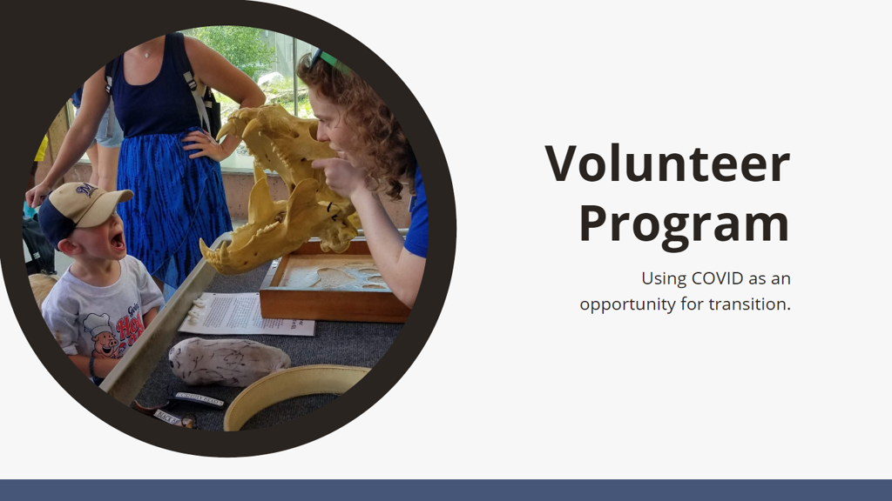

Slide 24
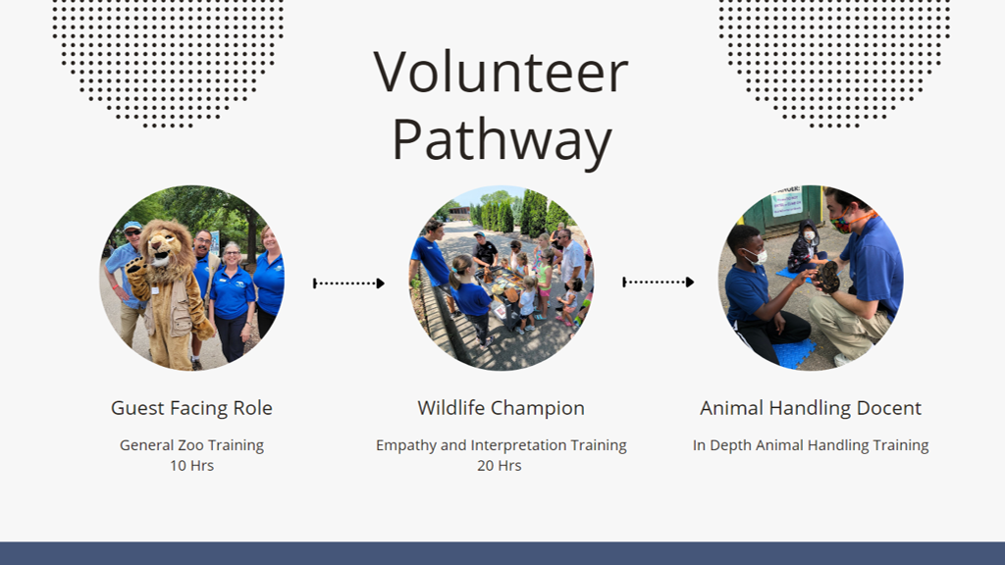

Slide 25
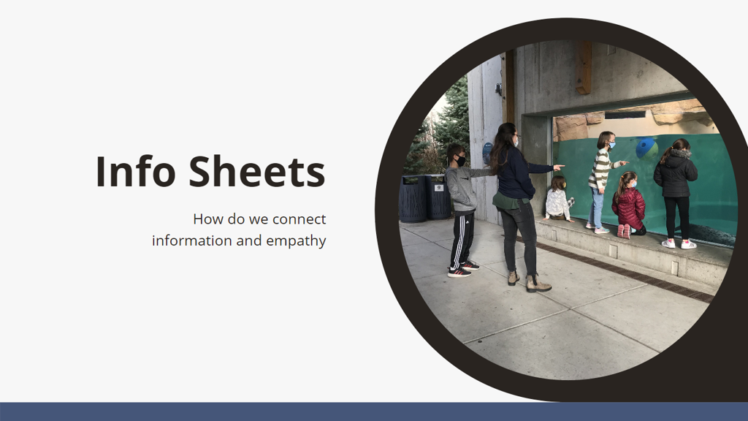

Slide 26
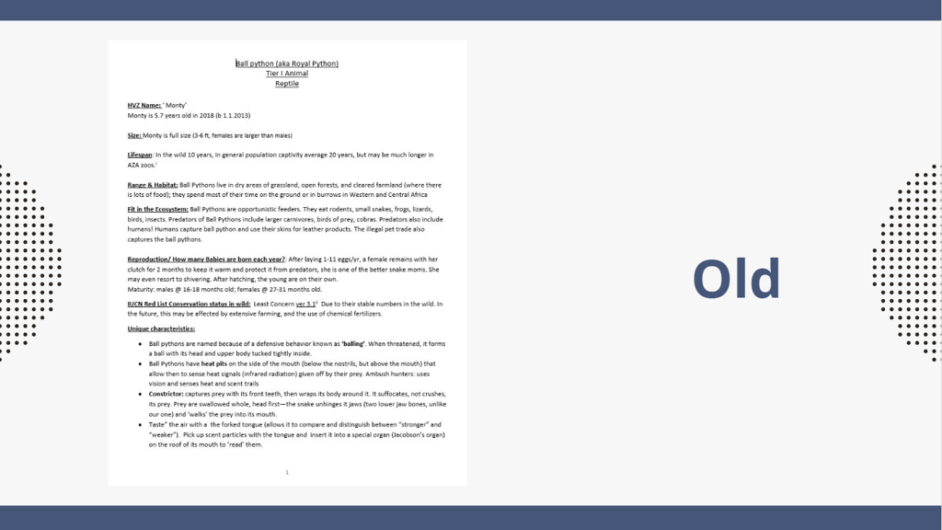

Slide 27
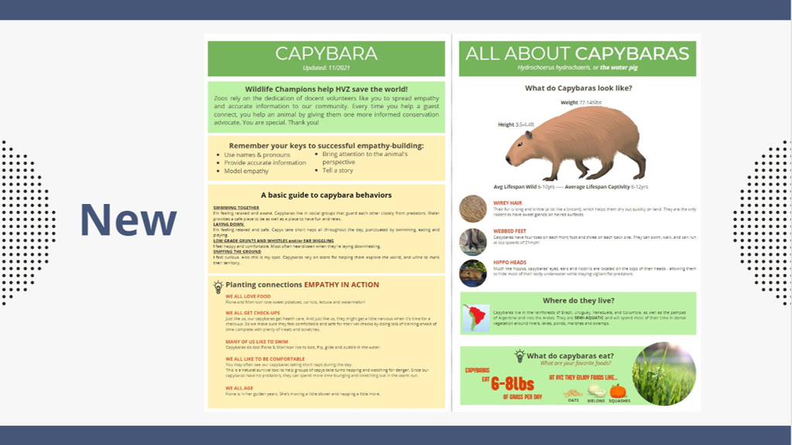

Slide 28
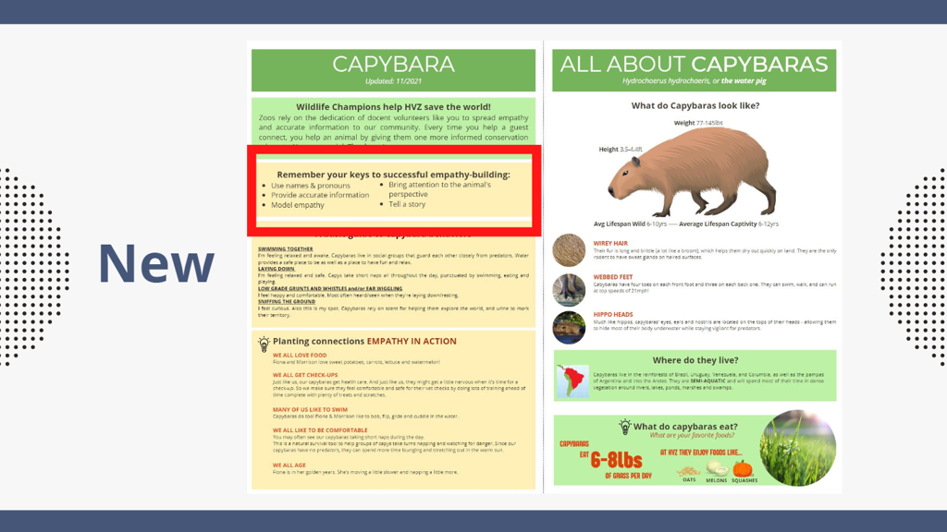

Slide 29
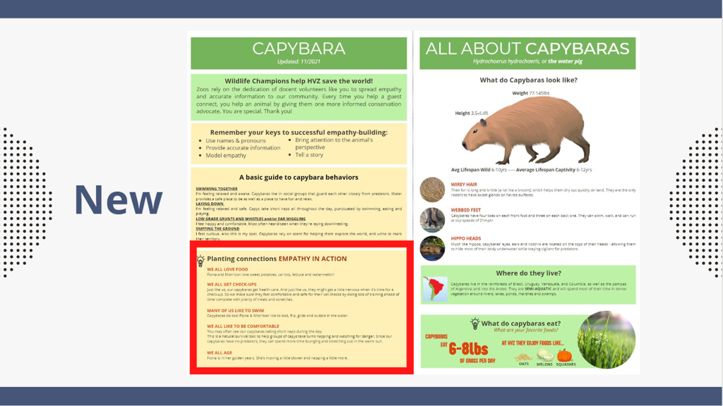

Slide 30


Slide 31
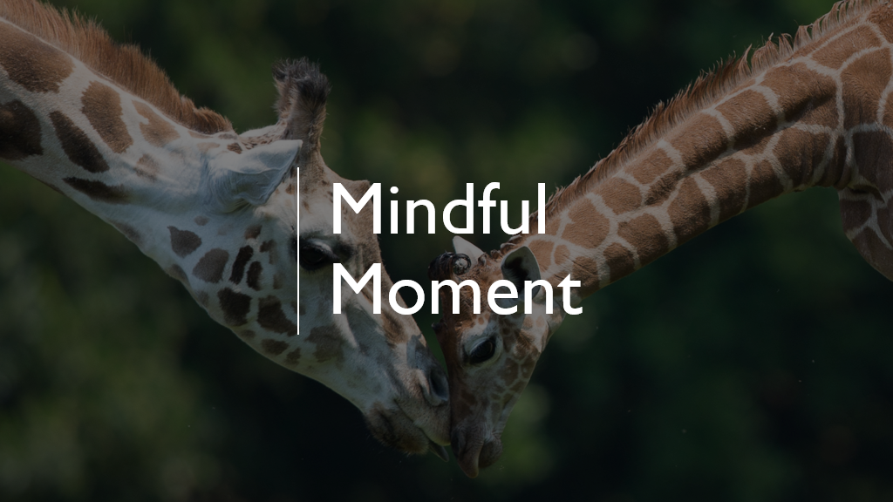
Notes:
We now will take 10 minutes for some mindful time…Turn off screens, stretch or move around for 5 min, refresh your beverage, then think about intentions for 2022/learnings from Buzz sessions – we will be discussing these in the next session. Try not to check email if you can.

Slide 32

Notes:
https://www.youtube.com/watch?v=aXItOY0sLRY - mute audio when playing video
Audio: Heart Chakra (4:40), Root Chakra (4:41), and The Opening (1:19) by Beautiful Chorus
After the video wraps up, call everyone back and transition to Heather and Paul

Slide 33
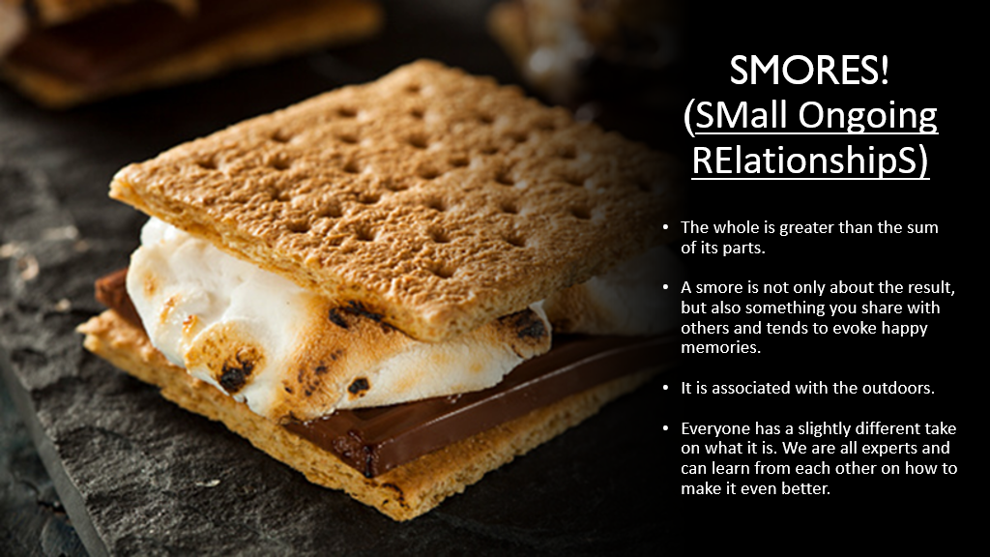
Notes:
Paul ​
​
"Like we said – the smores are coming back! So, why SMORES? Today, we will be starting SMall, Ongoing RElationships, or SMORES, of 4-5 individuals to help support each other’s learning, problem-solving and collaborating on moving this empathy work forward. Those groups that you made your mascot in earlier, those are your SMORE group members! As a group, your whole is greater than the sum of its part, our work is inherently tied to the outdoors, and we all have the tools we need to help each other make our work even better!"​
​
Community Building + Shared Learning = SMORES Perfection! ​
​

Slide 34
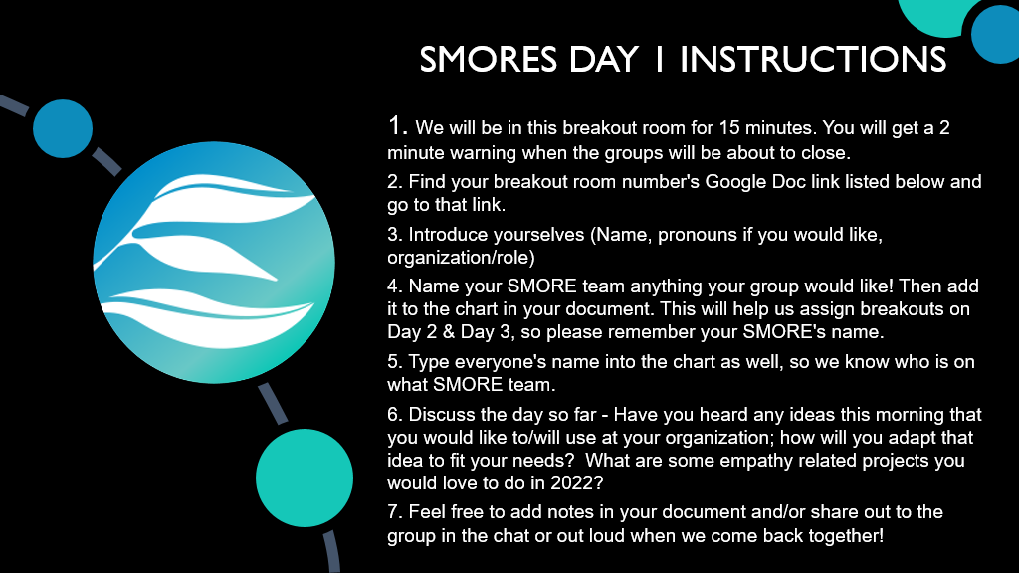
Notes:
Heather ​
​
"For our first official SMOREs group activity, you will be placed in the groups you were in this morning for 15 minutes. If you didn't already, introduce yourselves with your name, pronouns if you'd like, and the role you have at your organization. Next, give your group a name! Once you've done that, discuss the first day of the Summit so far and record your notes in your SMOREs Google Doc, that you'll access from the launch pad being dropped in the chat right now. As earlier, click on the link that corresponds with your breakout room number. Before your breakout rooms close, if you would like to share what you discussed with the larger group as a whole, please delegate someone to share."​
​
Check to make sure the breakout rooms are good to go.

Slide 35
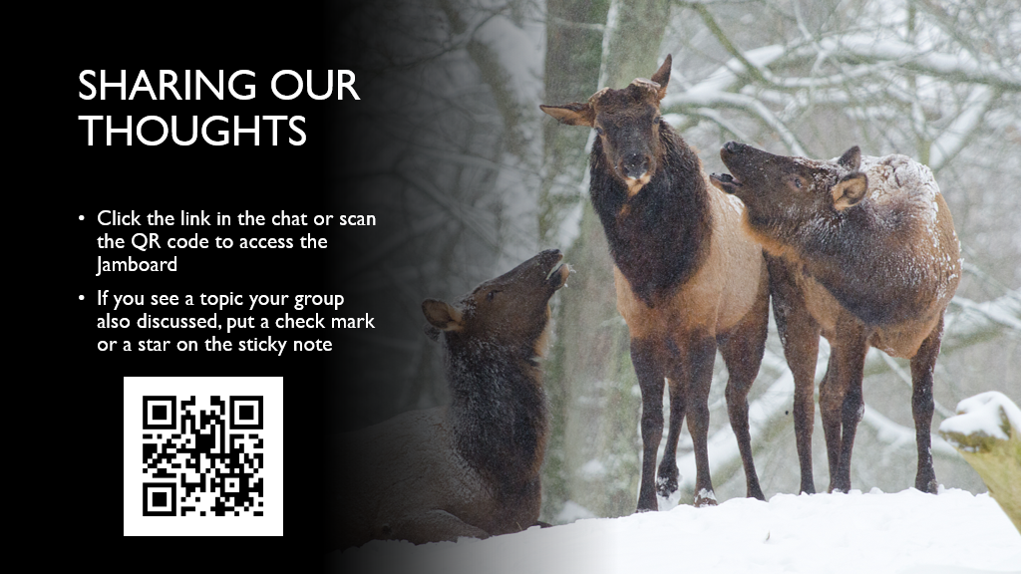
Notes:
Heather ​
​
Jamboard link: https://jamboard.google.com/d/1NVGnUqmxZ5SZwk-a5lgFnhmRwgwYdx5V4MYNNkUOdK8/edit?usp=sharing​
​
Stop screen sharing the slides and instead share screen so that everyone can see the Jamboard. ​
​
"Welcome back, everyone. If you click on the link in the chat or scan the QR code on your screen you will be brought to our Jamboard. Before we verbally share out anything, let's take a few minutes to place the big thoughts from your groups here on this Jamboard. If you see a topic on the Jamboard that your group also discussed, put a check or star on the topic's sticky note. If you've never used Jamboard before, to add to the board, click the sticky note icon from the menu bar on the left hand side, choose your color, type, save, and place!" ​
​
Wait until the sticky note additions slow down to ask if anyone would like to share about what they wrote until time ends ​
​
"Thank you for sharing, everyone! It's time for a well deserved 10 minute break. We will be back at (10 minutes from current time / x time)​

Slide 36
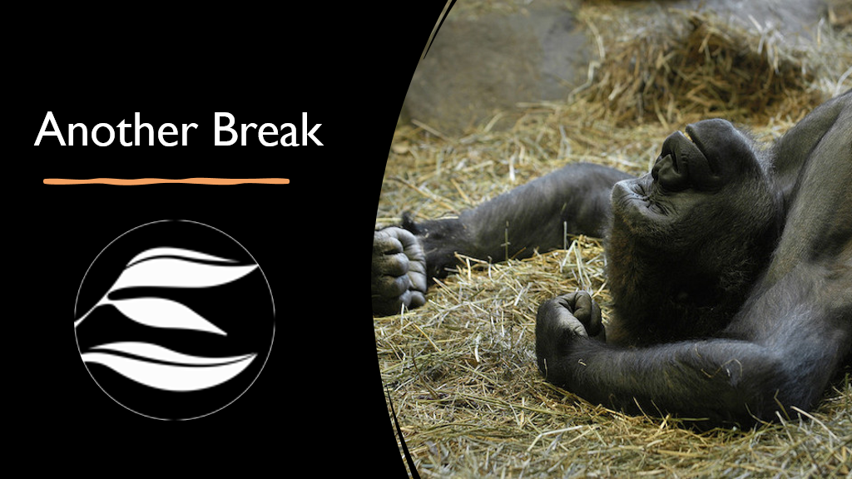

Slide 38
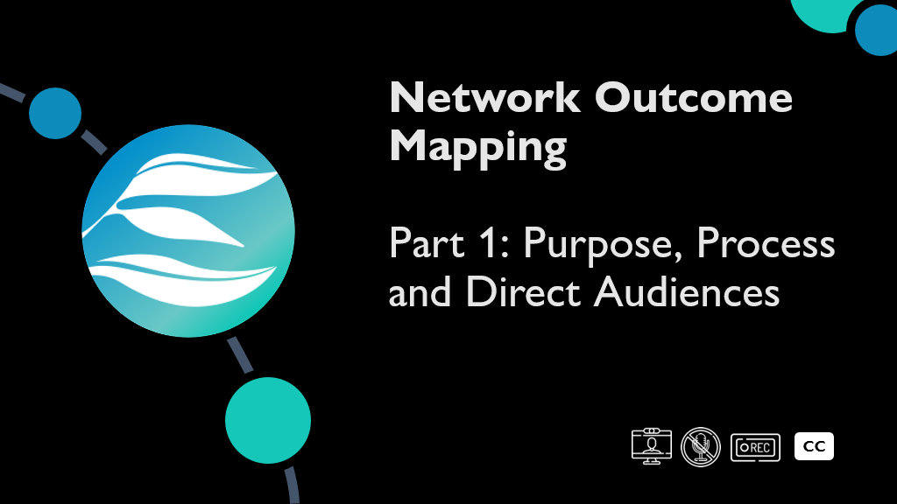

Slide 39
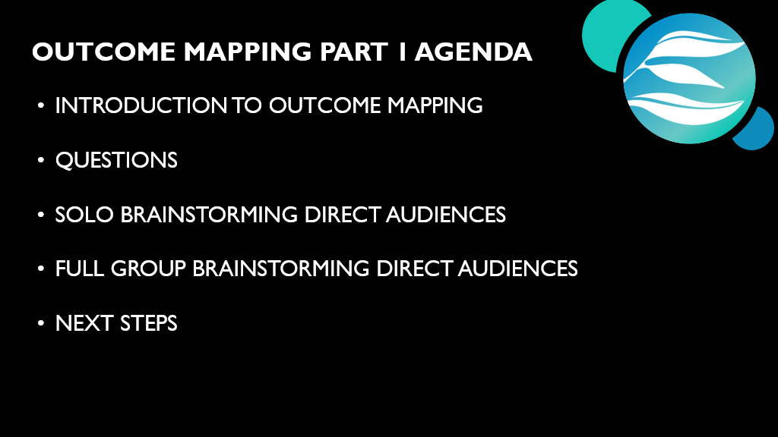

Slide 40
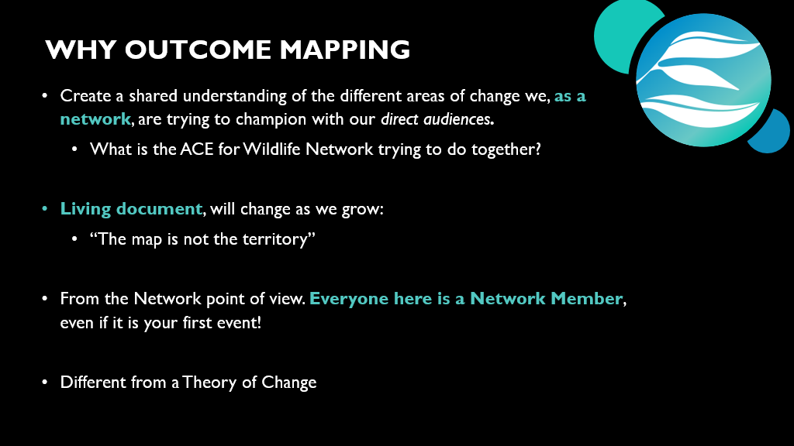
Notes:
Hiking adage: We will keep our eyes open for unexpected changes in the terrain. But without a map we can get so lost in the territory that it’s hard to even figure out where you started much less find your way to an outcome. ​
​
(that shows how outcomes lead to other outcomes)​
​
not what your organizations wants to see—

Slide 41
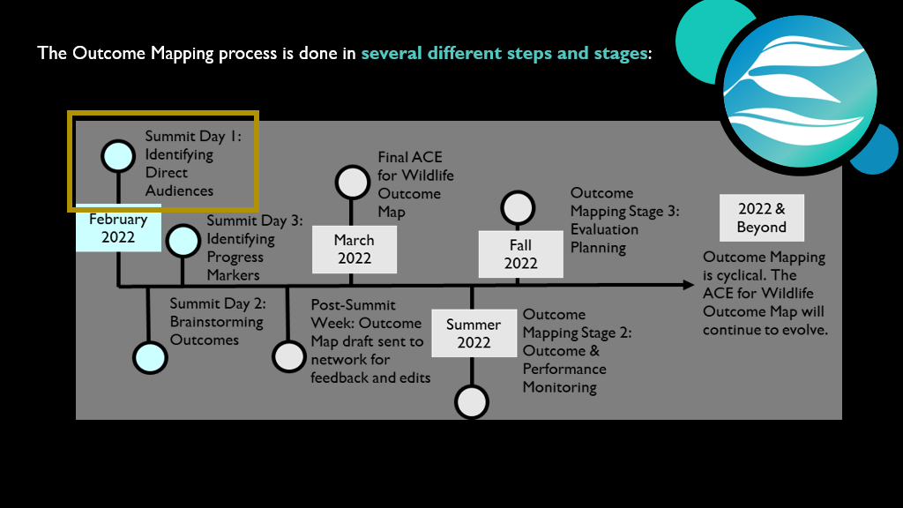
Notes:
and the figure below highlights what to expect for the summit and beyond:

Slide 42
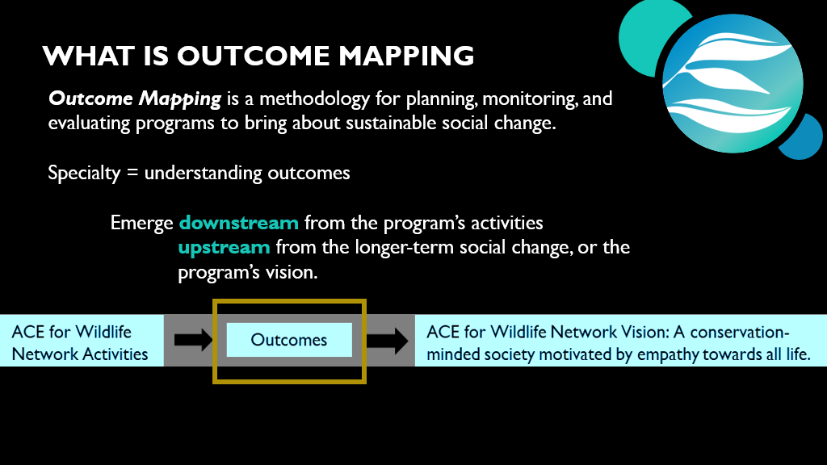

Slide 43
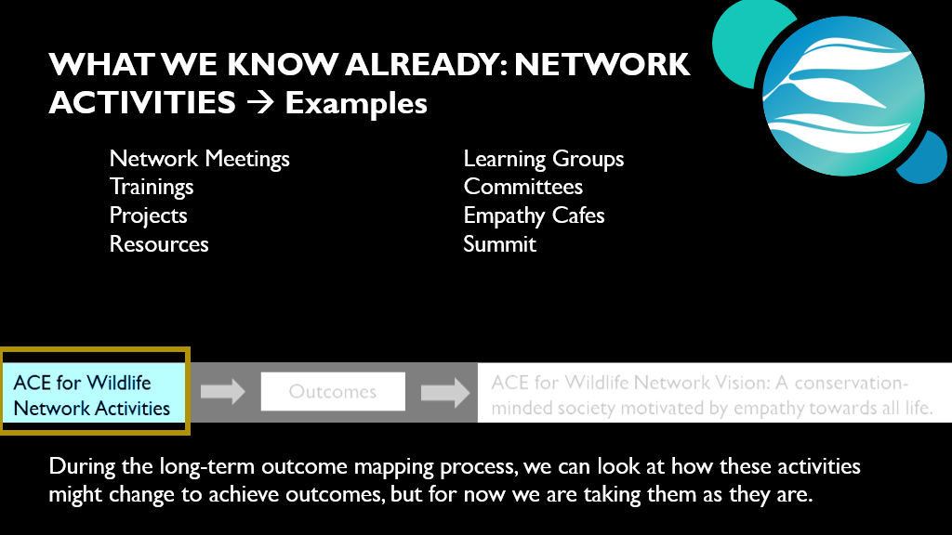
Notes:
Taking for granted the network activities as they are: Network –Stage 2 looks at that but now we are looking per audience. Change is per audience not per activity.

Slide 44
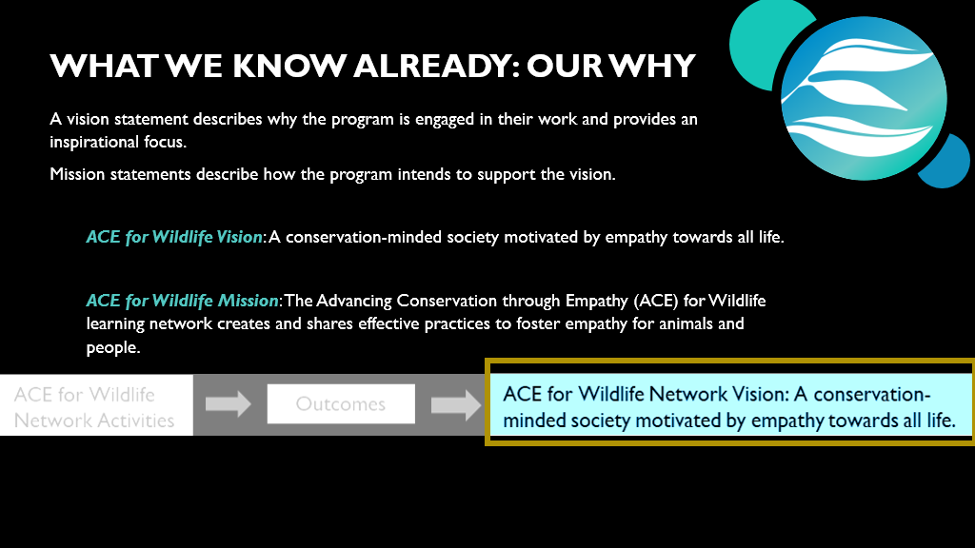
Notes:
Solidifying a mission and vision statement for our work is the first step of an Outcome Mapping process. Because we did this work together at the Empathy Symposium in 2020, we will use those vision and mission statements as the guiding pillars for the rest of our process.

Slide 45
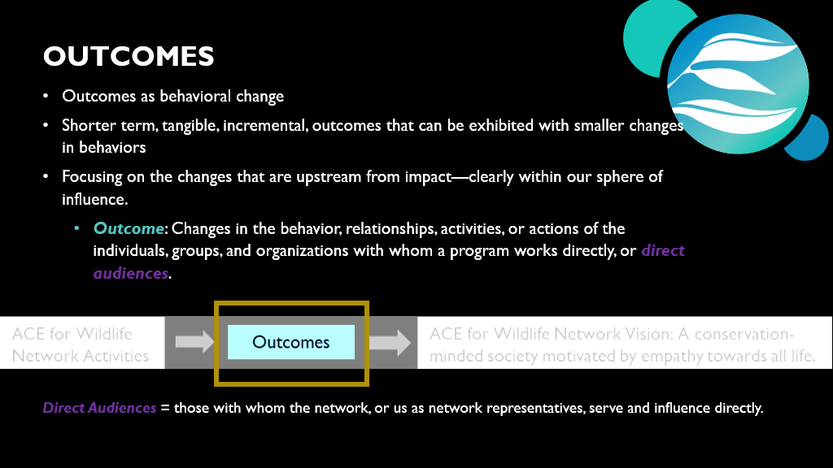
Notes:
one specific type of result: ​
​
Outcome Mapping focuses on outcomes instead of impact, while recognizing the importance of impact as the ultimate goal toward which programs work. For us, if we were showing impact of our network, we would need to show we accomplished our vision: a conservation-minded society that shows empathy towards all life.​
​
ACE for Wildlife Network point of view​
​
​
Who do we directly influence, engage with, or serve as a community of practice?

Slide 46
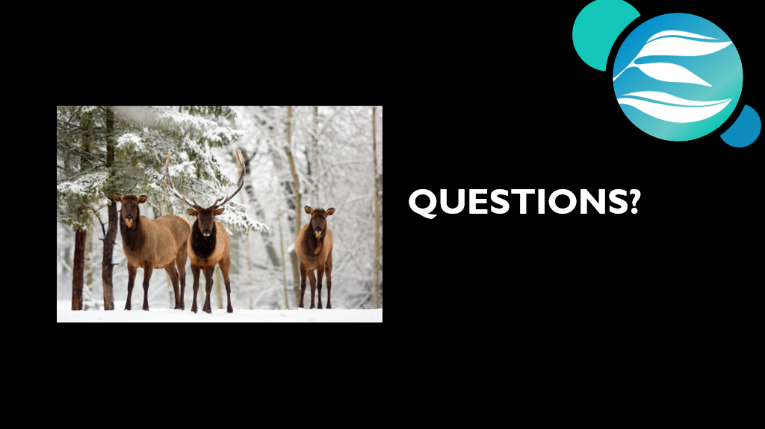

Slide 47
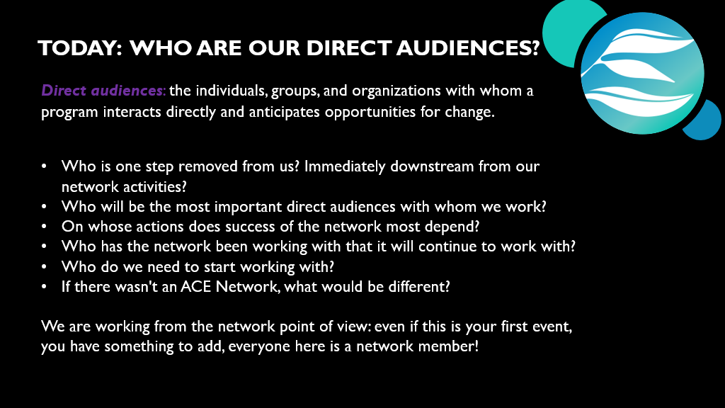
Notes:
Other partners that the program needs to work with but does not necessarily want to change, can be listed separately as strategic partners. An example of a strategic partner for the ACE for Wildlife network could be other potential funders or donors.

Slide 48
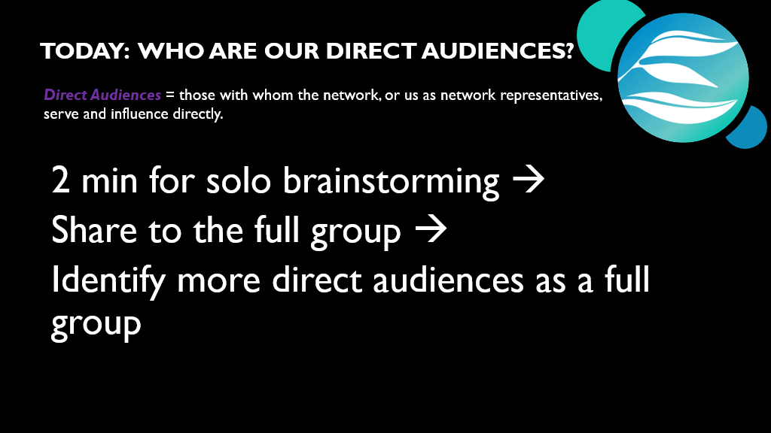
Notes:
Other partners that the program needs to work with but does not necessarily want to change, can be listed separately as strategic partners. An example of a strategic partner for the ACE for Wildlife network could be other potential funders or donors.

Slide 49
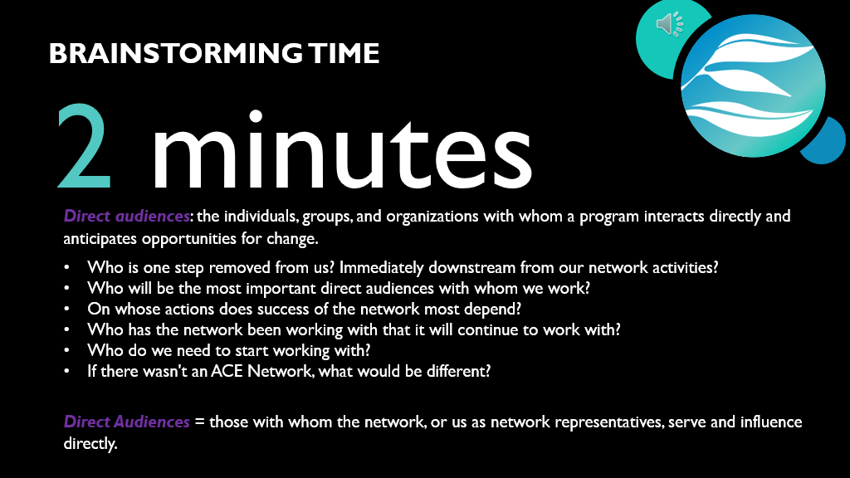

Slide 50
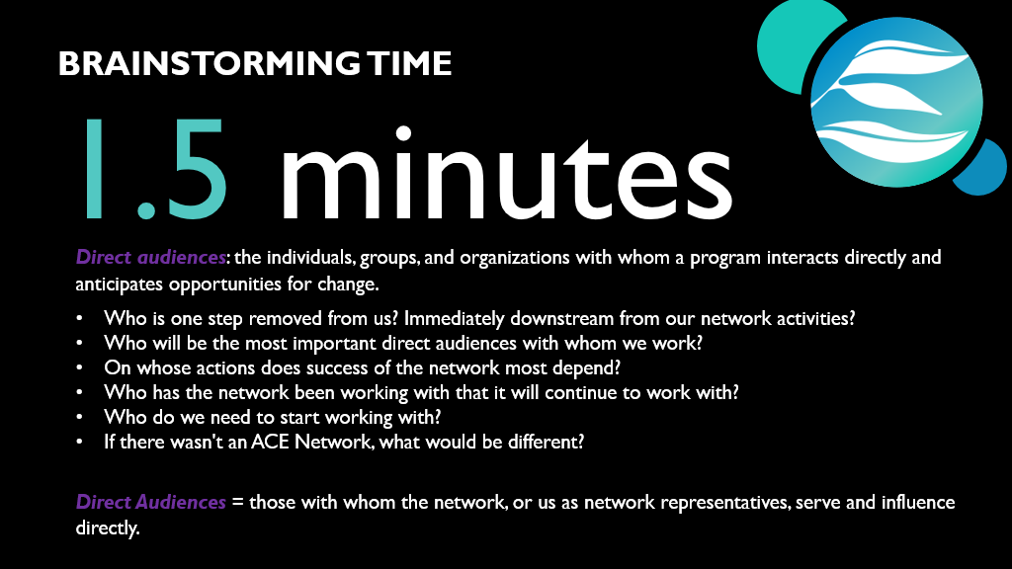

Slide 51
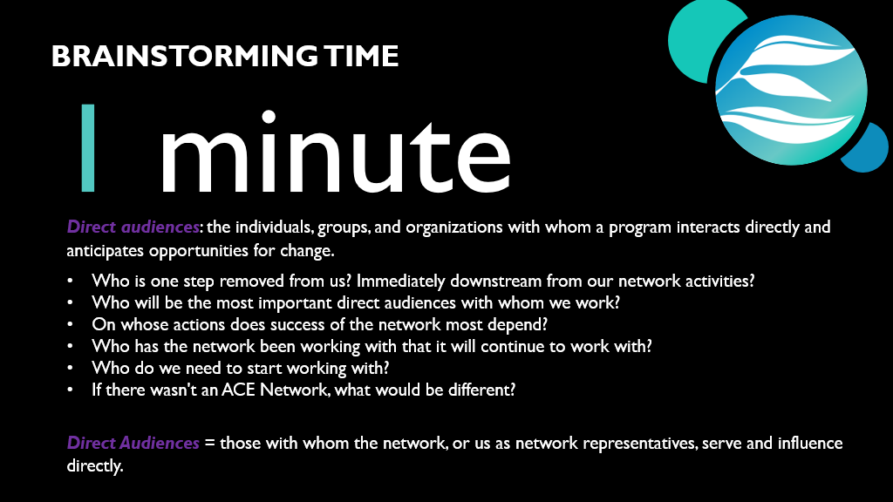

Slide 52
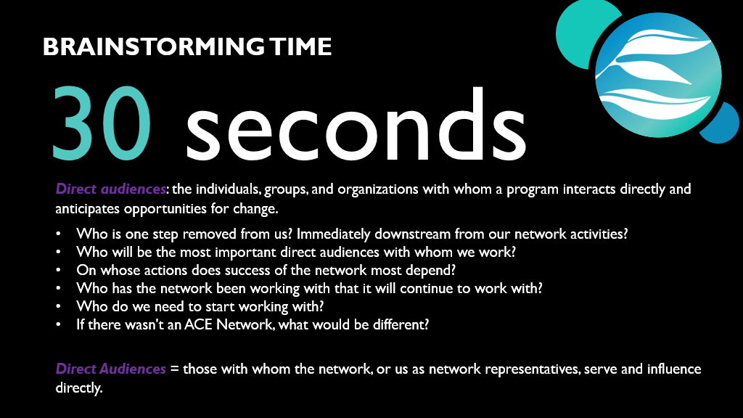

Slide 53

Notes:
End screen share and bring up white board!

Slide 55
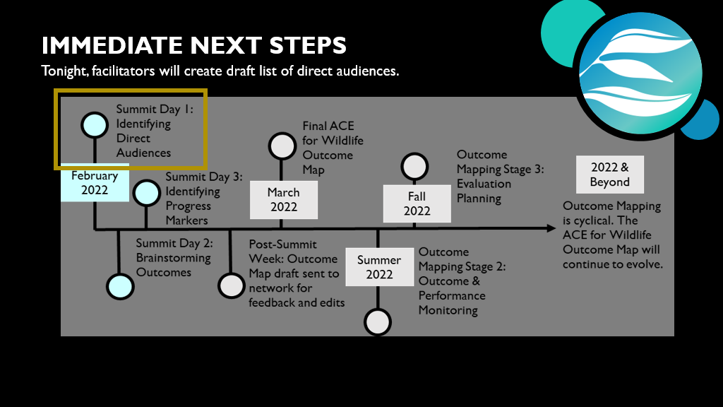
Notes:
At the end of the activity, the product is quickly reviewed and the reasons for the activity are reiterated and placed with the larger context of the workshop (described below).

Slide 56
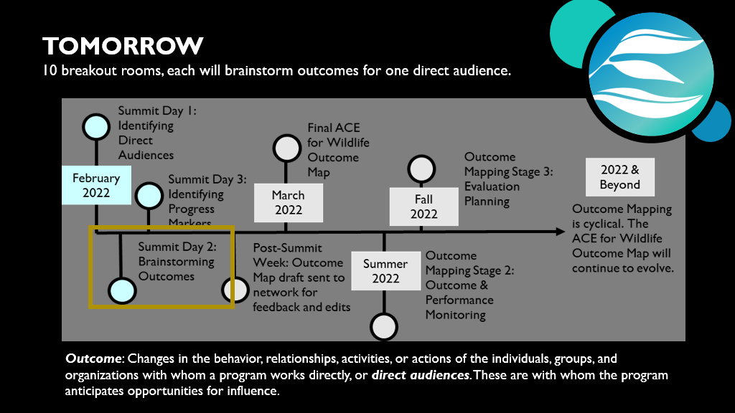

Slide 57
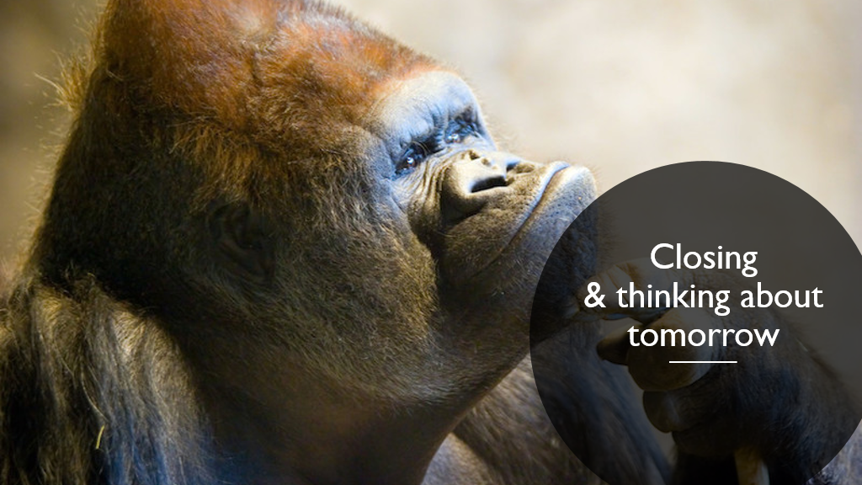

Slide 58
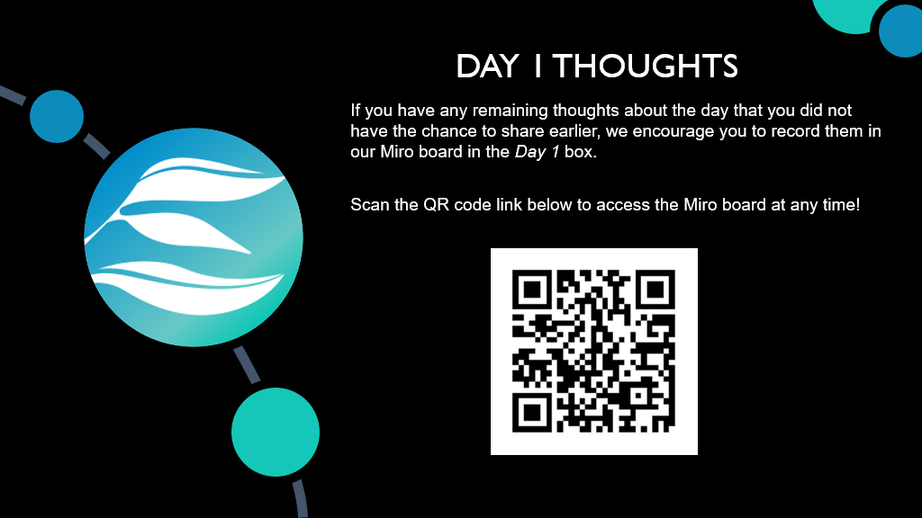
Notes:
We will be doing this tomorrow morning as well, but if you have any remaining thoughts about what we discussed and learned today or if something comes up later today and you would like to record it, you can drop it in this Miro board in the Day 1 box by clicking the link in the chat or scanning the QR code.

Slide 59
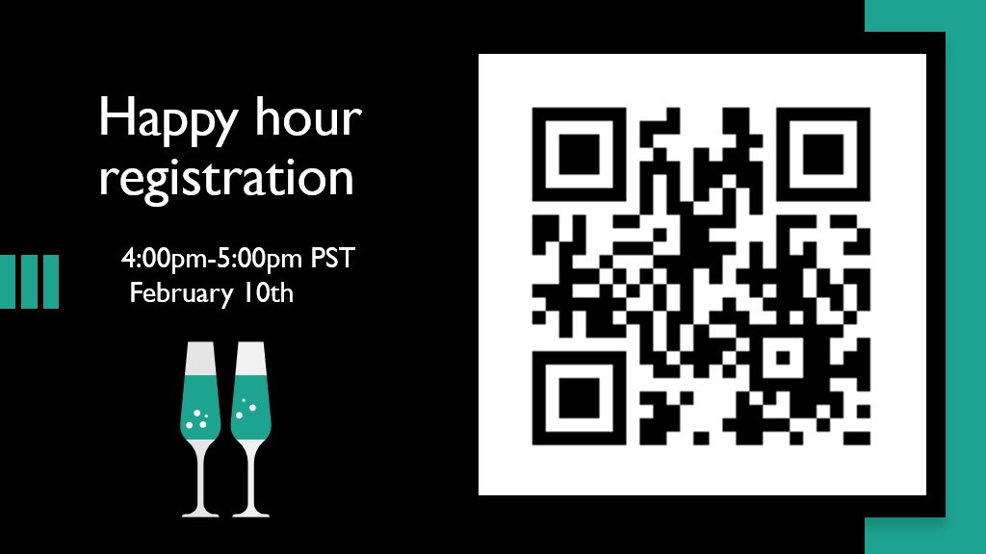
Notes:
Haven't registered for our happy hour on February 10th after the Summit? Click the link in the chat or scan the QR code to do so! It will be a great opportunity to get to meet and get to know your ACE for Wildlife colleagues.

Slide 60
