Slide 1
Evaluation:
From the Grind to the Grid
Shanna Hillard & Isabelle Bieser
ACE for Wildlife October Member Meeting
Notes:
SH

Slide 2
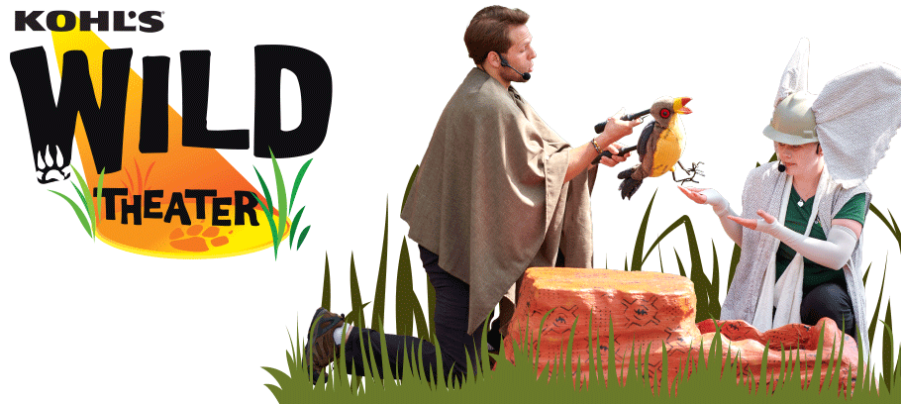
Agenda
What is Kohl’s Wild Theater (KWT)
Key grant outcomes
Evaluation grids
Evaluation methodology
Sneak peak on results
Notes:
IB

Slide 3
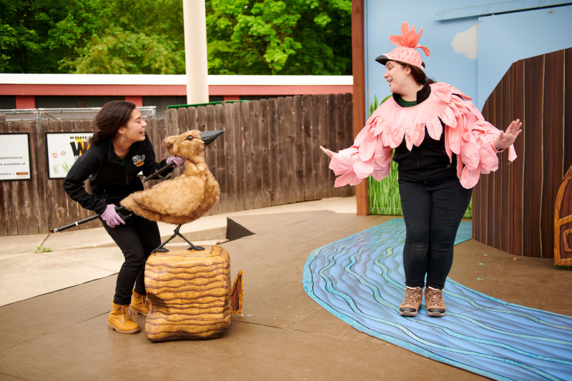
What is Kohl’s Wild Theater
Summer
Stage theater performances
At-Habitat engagement
Theater Summer Camp
School year
Touring theater performances
Notes:
IB
Kohl’s Wild Theater is made possible by a partnership between Kohl’s, the Milwaukee County Zoo, and the Zoological Society of Milwaukee. This educational and fun-filled program offers conservation-themed theater performances using drama, songs and puppetry to engage and delight audiences young and old. Kohl’s Wild Theater performs for children and their families at the Milwaukee County Zoo and also travels to schools, festivals and community events.

Slide 4
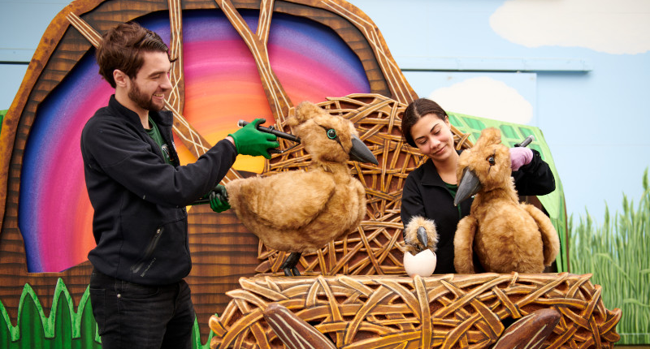
Stage theater performances
Notes:
IB
We have 2 performances every day throughout the summer each play is about 20 mins
Pictured here is Grace and Jimmy two Hammerkops from Rear Hippo

Slide 5
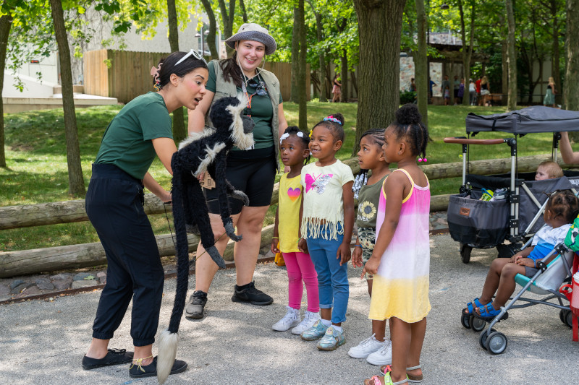
At Habitat Engagement
Notes:
IB
Over the summer our actor-educators engage guests in improv conservation education through their puppets

Slide 6
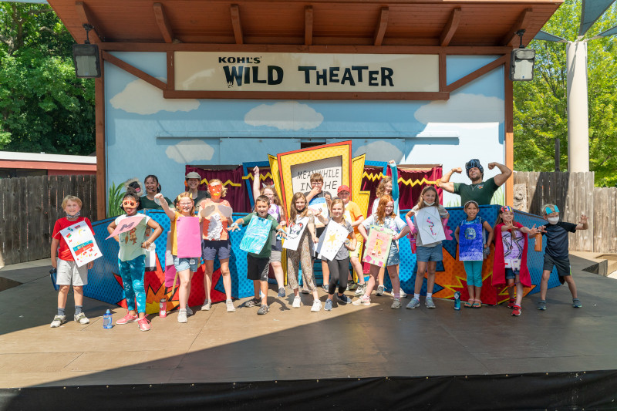
Summer Theater Camp
Notes:
IB
This year we ran our weeklong theater camp twice for 8/9s and twice for 10-13s
Campers spend the week practicing acting skills and learning about our animals.
They are tasked with creating a conservation themed skit by the end

Slide 7
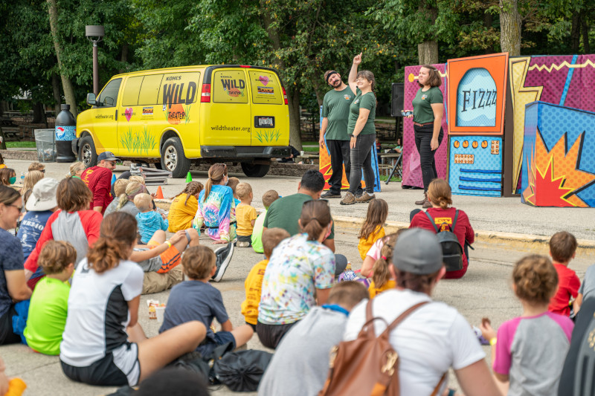
SY Touring Performances
Notes:
IB
- The school year shows are longer 45 minute performances and at community locations like schools, our local state forest and others

Slide 8
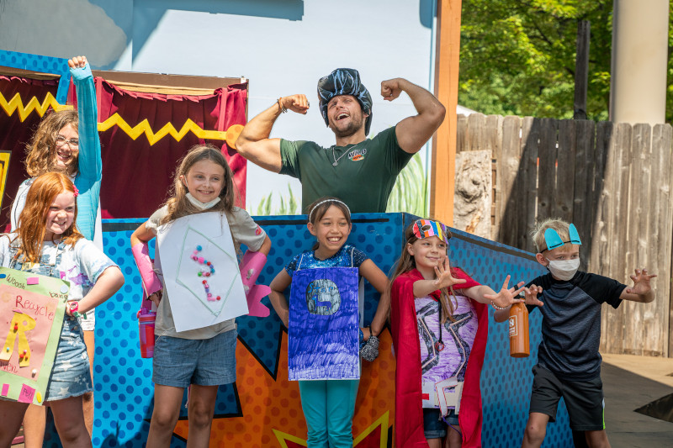
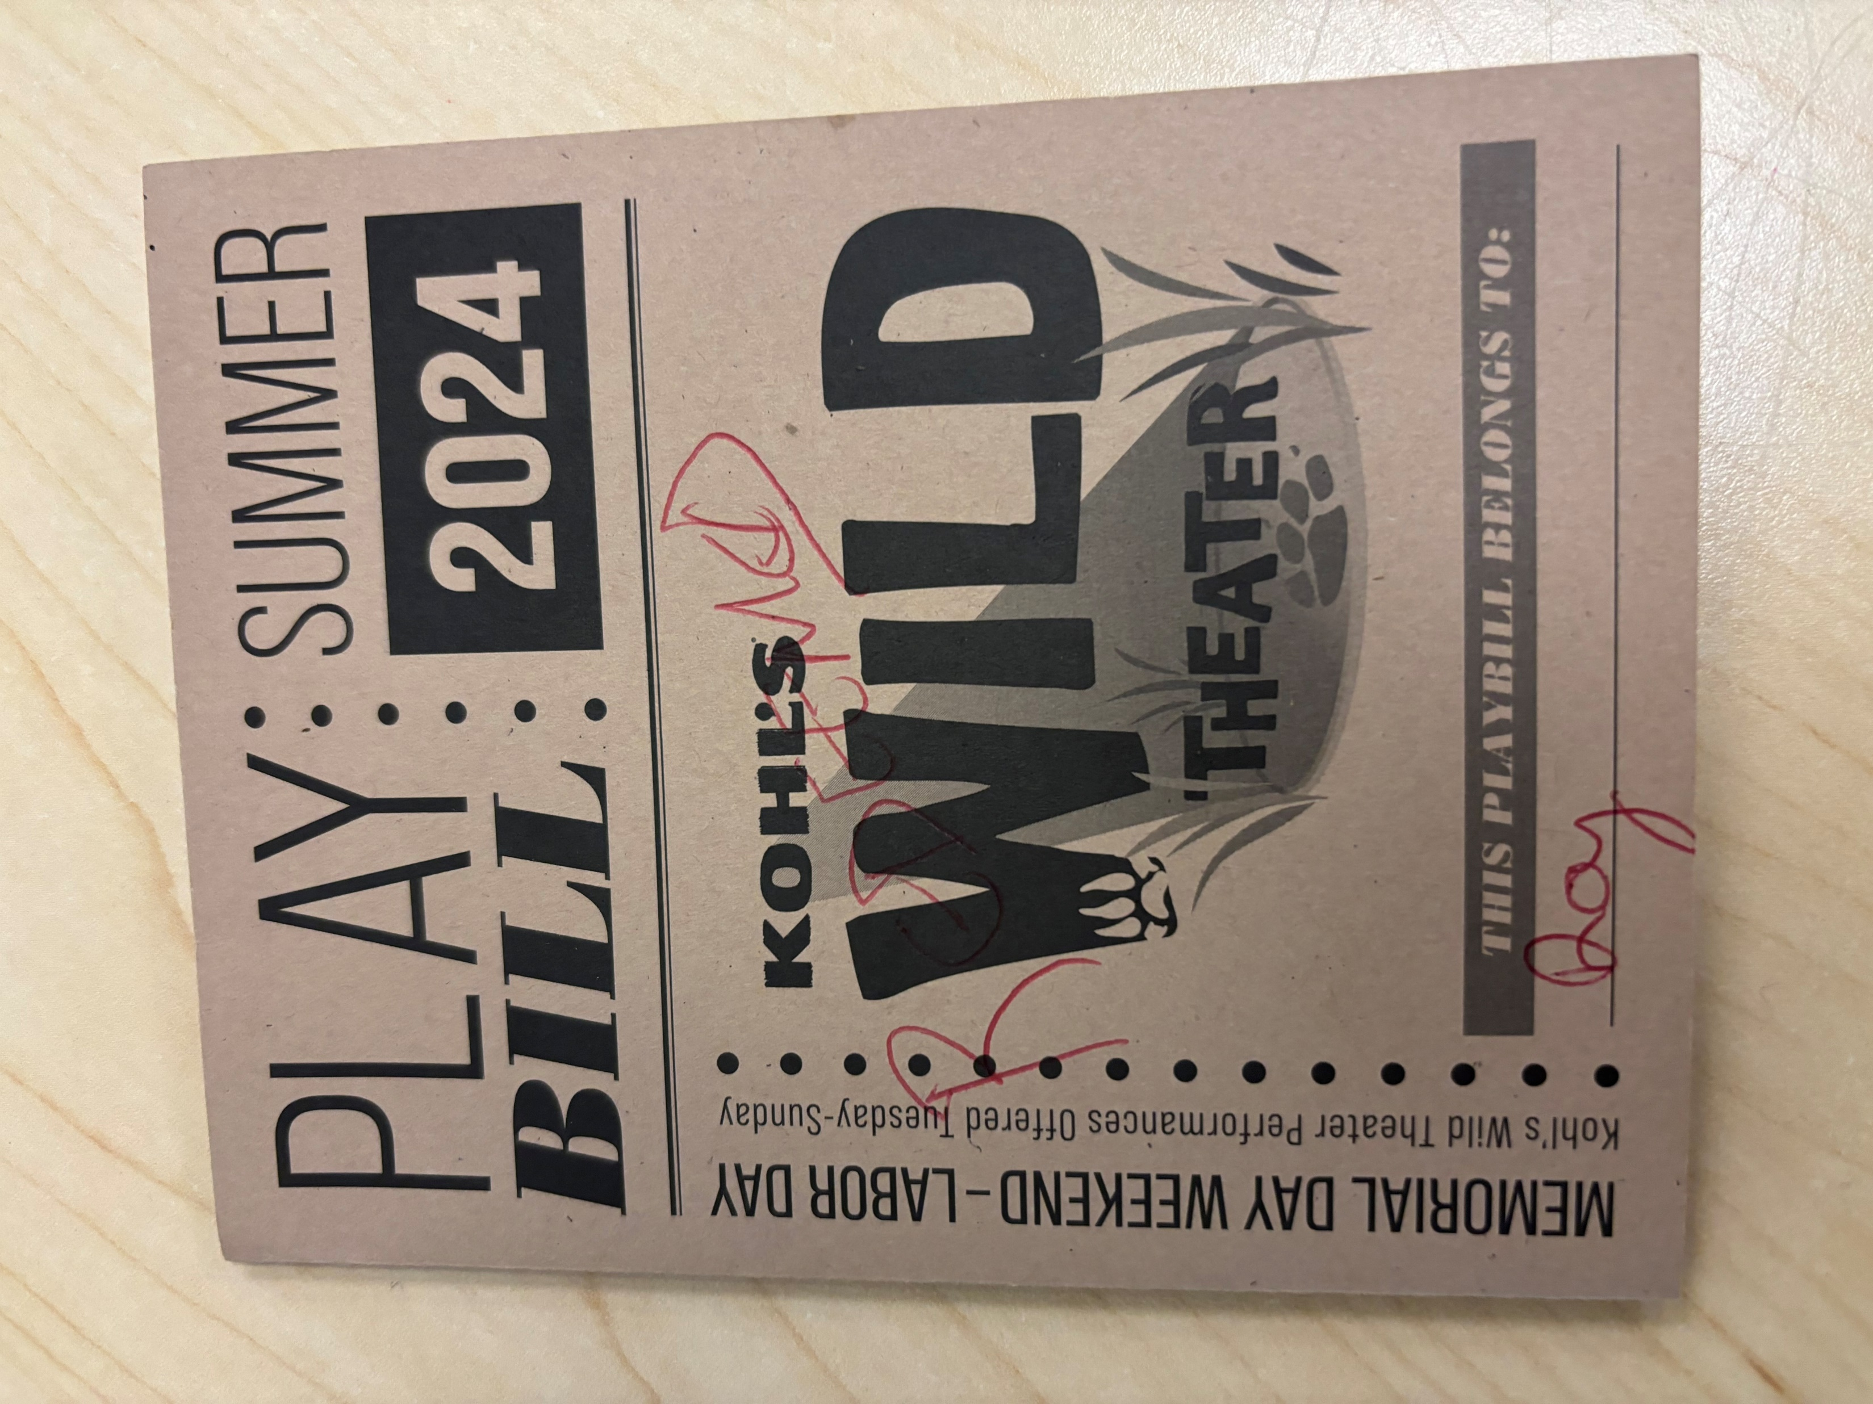
Program Generated Assets
Summer stage playbills
Summer Theater Camp student created plays
Notes:
IB
We wanted to be mindful of assets that were already in use that we could double for our evaluation.
Camper written plays was one
We distribute a playbill for the summer stage performances as well

Slide 9
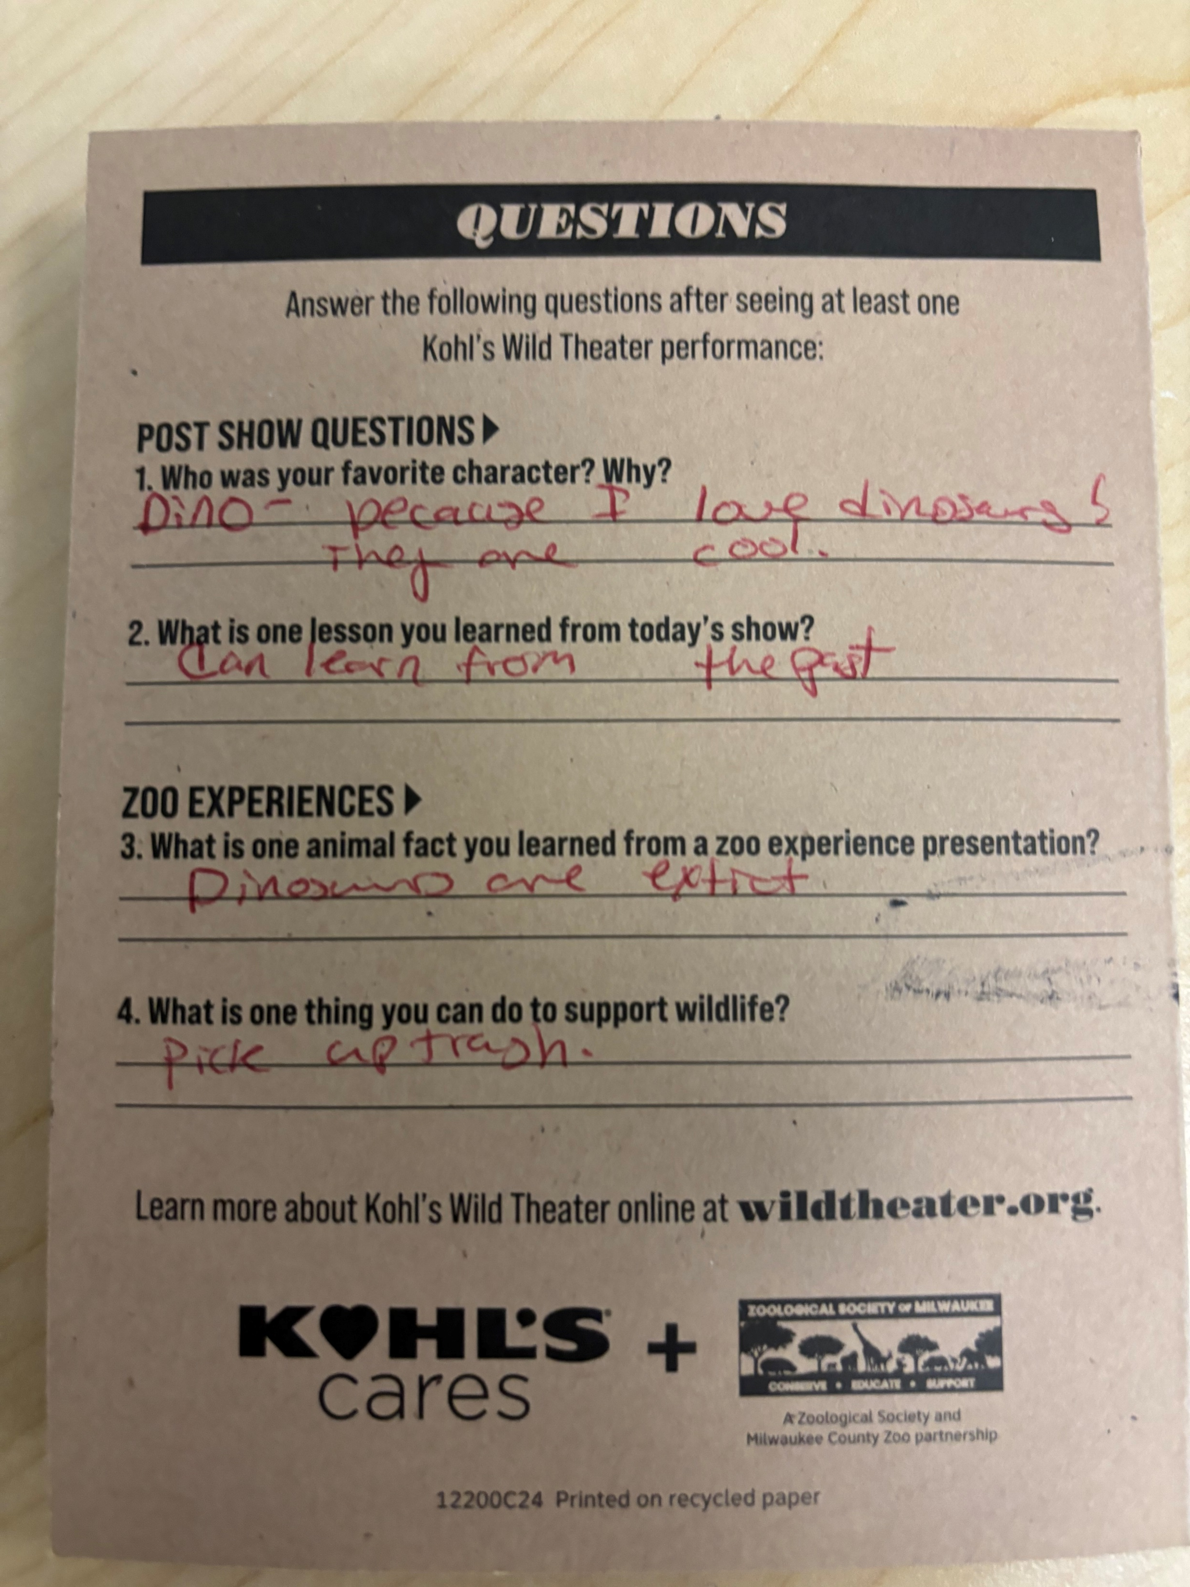
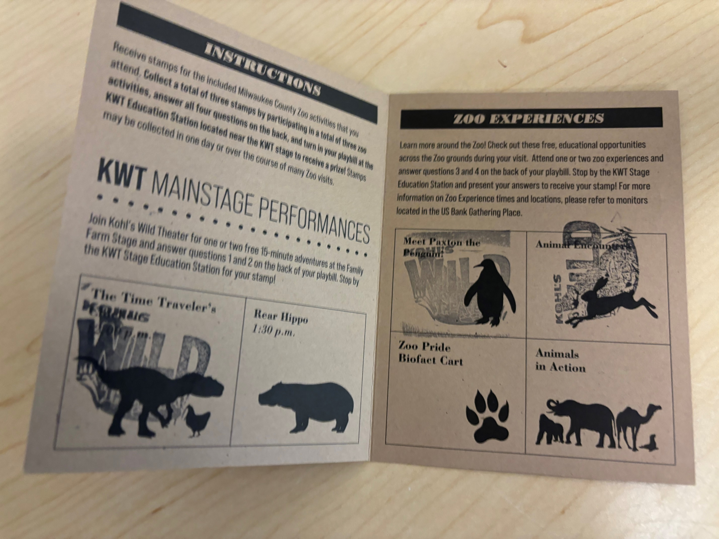
Playbill
Notes:
IB
The playbill highlights other experiences guests can have around the zoo where they collect stamps.
If they visit enough locations and complete the questions on the back then they can receive a train or carousel attraction ticket
Ray answered on the back that his favorite character was dinosaurs because they like dinos, they learned that you can learn from the past, and a zoo fact they learned is that dinosaurs are extinct and one thing they can do to support wildlife is picking up trash.
And your trivia hint today - Playbills are an answer to a question about how we can evaluate one of our indicators later ;)

Slide 10
Key Grant Outcomes
Outcome 1: Refinements will help audience members feel represented and included as they increase their wildlife knowledge
Outcome 2: Incorporating an empathy-based curriculum with various education standards for instruction will increase audiences’ empathic behavior towards wildlife
Outcome 3: Audience members will be inspired to engage in sustainable conservation action
Notes:
SH
Our grant objectives focused on further developing the plays with empathy and conservation messaging as well as building out and age-banding our theater camps. The objectives had these desired outcomes
We outlined the indicators for each outcome in our grant the task once we got the grant was figuring out how to measure those indicators

Slide 11
Outcome 1 Indicators
Outcome 1: Refinements will help audience members feel represented and included as they increase their wildlife knowledge
2 school year performances that are age specific and multicultural
2 zoo stage performances with multicultural components
Summer theater camp is age specific
70% of teachers agree play is age-specific and inclusive
70% Zoo stage participants enjoyed the play
70% of observed at-habitat participants demonstrate at least 1 empathy outcome
Notes:
IB
Here are the indicators for outcome 1 – we will go through outcomes 1 & 2 and maybe you can help us with outcome 3 and if we found a quality way to measure

Slide 12
Outcome 1 Indicators to Measures
Indicator | Measure
2 SY performances multicultural and age specific | Y/N review scripts and note indicators
Summer theater camp is age specific | Y/N review curriculum and note age-banding
70% of teachers say play is age-specific & inclusive | School feedback form; hard copy to teachers after show and stage managers return
70% zoo stage participants enjoyed the play | Feedback form post-show administered by volunteers to random participants
70% of observed at-habitat participants demonstrate at least 1 empathy outcome | MECAP observation protocol noting frequency of empathy outcomes
Notes:
IB

Slide 13
Outcome 2 to Indicators
Outcome 2: Incorporating an empathy-based curriculum with various education standards for instruction will increase audiences’ empathic behavior towards wildlife
70% of teachers state performances provide a basis for discussion
70% of students can identify the emotions of animals in the play and compare to their own lived experiences
70% of observed campers will demonstrate caring behavior or beneficial action towards animals and the environment
70% of at-habitat participants demonstrate at least 1 empathy outcome
Notes:
SH

Slide 14
Outcome 2 Indicators to Measures
Indicator | Measure
70% teachers state performances provide a basis for discussion | School feedback form; hard copy to teachers after show and stage managers return
70% of students can identify the emotions of animals in the play and compare to their own lived experiences | Embedded assessment of camp activity
70% of observed campers will demonstrate caring behavior or beneficial action towards animals and the environment | Camper play conservation message
70% of observed at-habitat participants demonstrate at least 1 empathy outcome | MECAP observation protocol marking frequency
Notes:
SH

Slide 15
Outcome 3 to Indicators
Outcome 3: Audience members will be inspired to engage in sustainable conservation action
70% of observed at-habitat participants will demonstrate at least 1 empathy outcome
70% of students identify 1+ way to help the environment
Notes:
IB

Slide 16
Outcome 3 Indicators to Measures
How would you measure?
Indicator | Measure
70% of observed at-habitat participants demonstrate at least 1 empathy outcome
70% of students identify 1+ way to help the environment
Notes:
IB

Slide 17
Outcome 3 Indicators to Measures
What we ended up doing…
Indicator | Measure
70% of observed at-habitat participants demonstrate at least 1 empathy outcome | MECAP observation protocol marking frequency
70% of students identify 1+ way to help the environment | Observe camper plays & playbill free response
Notes:
IB

Slide 18
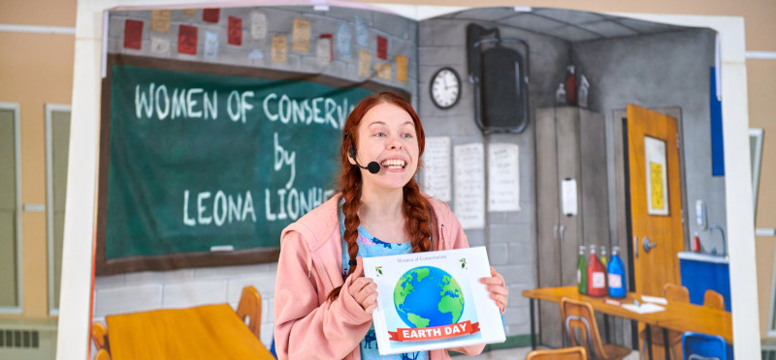
Evaluating Arts Education Programs
Grant Outcomes
Indicators
Measures
Methods
Notes:
H

Slide 19
Methodology
Current Evaluation for Kohls Wild Theater
Summer
At-Habitat MECAPS
Content Embedded Assessment of Let's Get Wild/Wilder (1 per program)
MECAPs for Let's Get Wild/Wilder (2 per program)
Emotion Wheel/Emotional Perspectives Embedded Assessment(two per class: KWT play and student play)
Guest survey of performance (required by Kohls)
Guest Satisfaction Survey (through Milwaukee County Zoo)
Fall/Spring
MECAPs of Fall and Spring performances (2 per play)
Empathy Survey for Student Q&A portion of performance
Notes:
SH

Slide 20
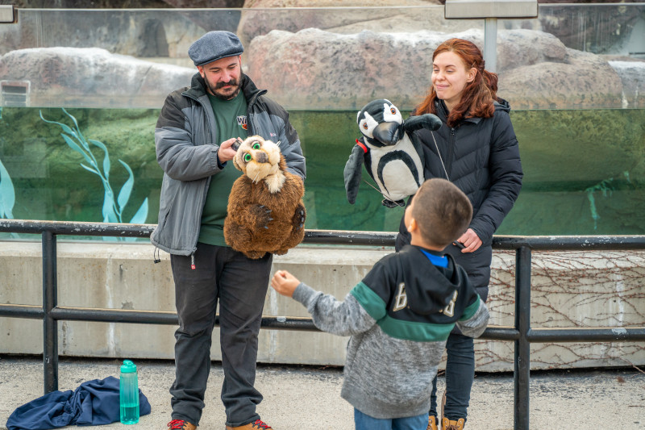
Summer: At-Habitat MECAPs
Focused on Humboldt penguins and penguin behaviors.
Encouraged biomimicry through parallel play (kids would waddle to the water and then dive to catch a fish)
Included meeting "Braxton," a penguin puppet
201 people engaged in observed at-habitats
Notes:
SH

Slide 21
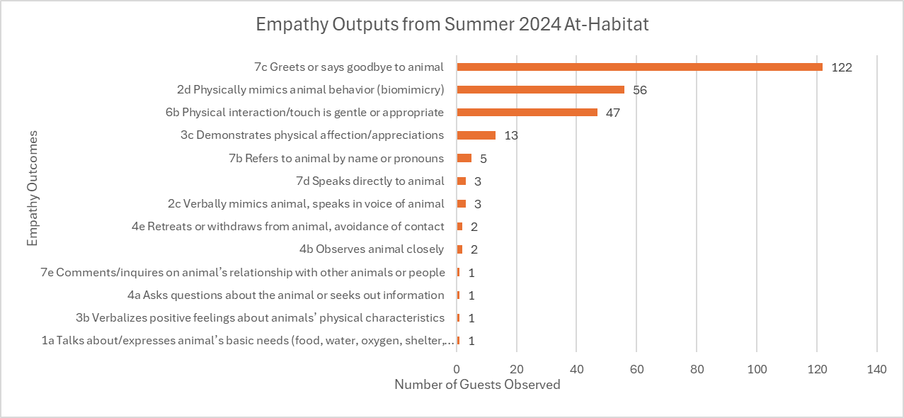
At-Habitat MECAP Results
Notes:
SH
- Observed 201 people and saw more than 200 empathy outcomes meaning we met our indicator measure

Slide 22
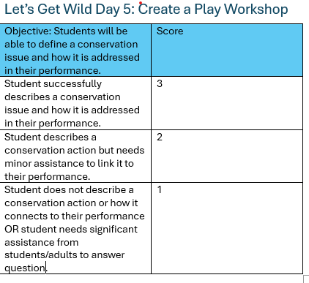
Embedded Assessment
Objectives were determined for each class based on the scope of the final project.
Each assessment used a 3-point rubric scale, with 3 being content mastery, 2 indicating partial understanding, and 1 indicating that the student did not understand the content.
Notes:
SH

Slide 23
Embedded Assessment Results
Let's Get Wild | ProficiencyScore | Average Score
Objective One: Students will be able to define a conservation issue and how it is addressed in their performance. | 83% | 2.8
Objective Two: Students will be able to recall a specific game actors play and how it helps them prepare for performances. | 50% | 2.3
Let's Get Wild-er | ProficiencyScore | Average Score
Objective One: Students will be able to define a conservation issue and how it is addressed in their performance | 100% | 3.0
Objective Two: Students will be able to recall a specific game actors play and how it helps them prepare for performances. | 83% | 2.8
Notes:
SH
Include how many % wise hit our proficiency we were shooting for 70%

Slide 24
MECAPs for Summer Camps
Observed each camp twice on different days/times.
Measured for frequency of empathy outcomes.
Notes:
SH

Slide 25
MECAP Results: Let's Get Wild
MECAP Outcomes | Frequency
2d Physically mimics animal behavior (biomimicry) | 15
4a Asks questions about the animal or seeks out information | 13
2a Predicts or speaks to animal’s state, emotion or wants | 12
2c Verbally mimics animal, speaks in voice of animal | 12
1c Compares self to animal | 10
2b Provides reasons for prediction of animal’s state, emotion or desires | 8
1a Talks about/expresses animal’s basic needs (food, water, oxygen, shelter, space) | 5
5e Shares beneficial actions with others | 5
7b Refers to animal by name or pronouns | 5
1b Talks about/expresses secondary animal needs (e.g. safety, health, comfort, emotional wellbeing) | 4
1d Contrasts self to animal | 1
4c Expresses observations of animal | 1
Notes:
19 students observed across two class periods
- We were looking for 1

Slide 26
MECAP Results: Let's Get Wild-er
MECAP Outcomes | Frequency Count
2a Predicts or speaks to animal’s state, emotion or wants | 23
2d Physically mimics animal behavior (biomimicry) | 20
2c Verbally mimics animal, speaks in voice of animal | 16
4a Asks questions about the animal or seeks out information | 13
1c Compares self to animal | 12
7b Refers to animal by name or pronouns | 8
1a Talks about/expresses animal’s basic needs (food, water, oxygen, shelter, space) | 5
5a Expresses concern for an individual animal’s well-being | 5
2b Provides reasons for prediction of animal’s state, emotion or desires | 3
1b Talks about/expresses secondary animal needs (e.g. safety, health, comfort, emotional wellbeing) | 2
5d Wants to take action/behave in a way act to help animals overall | 2
5b Wants to take action/behave in a way that helps an individual animal | 1
5e Shares beneficial actions with others | 1
Notes:
32 total students observed over two different classes.

Slide 27
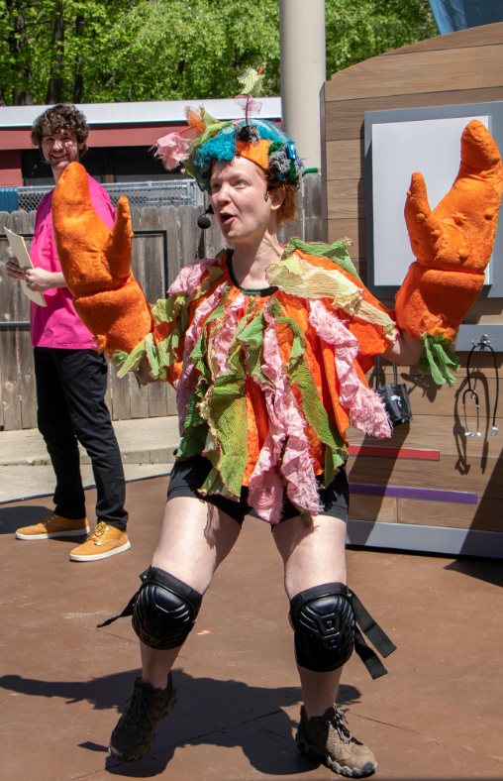
Embedded Assessment Journey
Indicator for Outcome 2:
70% of students can identify the emotions of animals in the play and compare to their own lived experiences
Measure: Embedded Assessment and observation of “Hot-seat” activity
Notes:
SH
Campers embodied a character from the play and performed on a panel.
The instructor facilitated questions
Evaluators observed responses
First run of the camp the instructor did not prompt the kids to speak on their feelings during scenes from the play but rather focused on preferences and character traits.
This meant there were very few student comments
We also observed the students struggling to improv and come up with responses on the spot
Next iteration of the camp we had students brainstorm answers to questions on a quick worksheet that also asked about their emotional response to scenes from the play – this was much more successful in engaging kids in the activity and for helping us fulfill our evaluation and meet our indicators

Slide 28
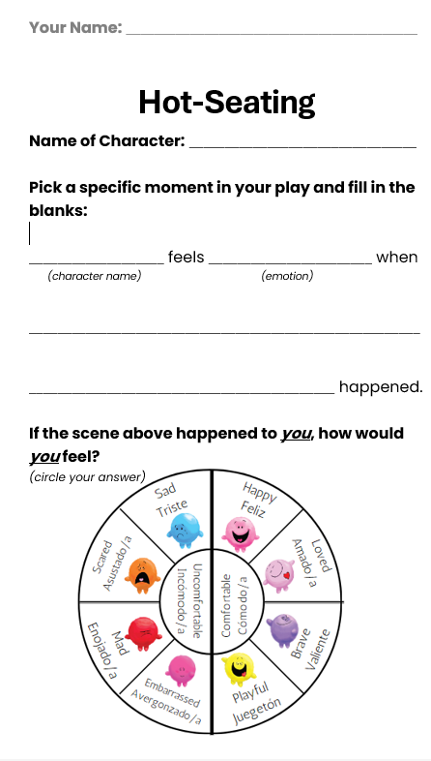
Emotional Perspectives Assessment
Rubric was used for this activity on a 2-point rubric where 2 was full competency, 1 was approaching competency, and 0 was lacking competency.
Activity was run twice per week-long camp.
Post-viewing of KWT show "Rear Hippo"
In Part One, students chose a character, an emotion they felt, and then describe the scenario that led to the emotion.
In Part Two, students circled the emotion they would feel if they were the character in the same situation.
After writing their own group play
Same activity, but students chose a character from their own play.

Slide 29
Emotional Perspectives Assessment: Results
Rear Hippo | Competency | Student-written plays | Competency
Part One | 91% | Part One | 96%
Part Two | 68% | Part Two | 85%
17% Increase!
Notes:
According to the assessment of the Rear Hippo Play, students were already pre-disposed to remember the characters and their emotions in the play. However, some struggled with putting themselves into the "shoes" of the character. This was meant to be a practice round and the student-led plays showed that students improved in their competency in both categories. There was a five percent increase in students identifying characters and emotions in their own plays. There was also a 17% increase in students being able to place themselves into the "shoes" of the character by choosing an emotion that matched the scene.

Slide 30
Thank you!
Shannah Hillard | shannah@zoosociety.org
Isabelle Bieser | isabelleb@zoosociety.org

Slide 31
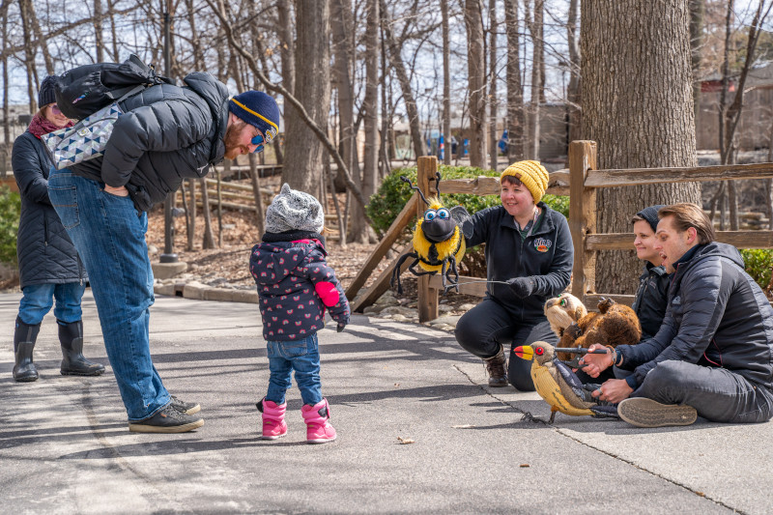
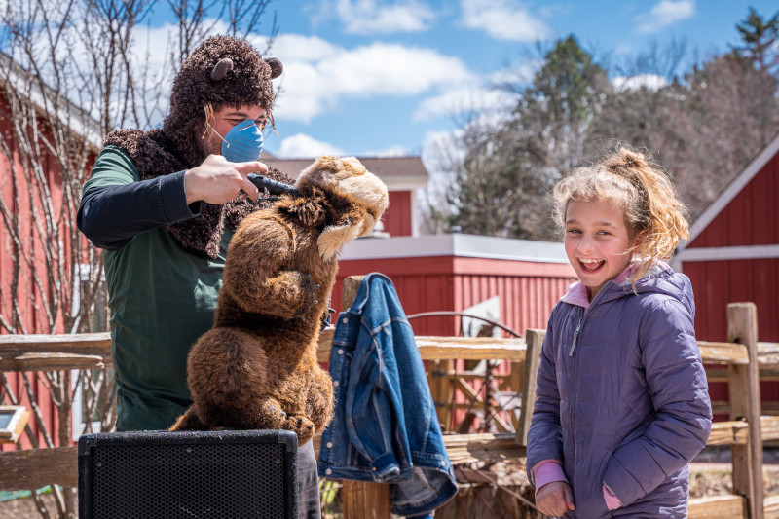

Slide 32
