Slide 1
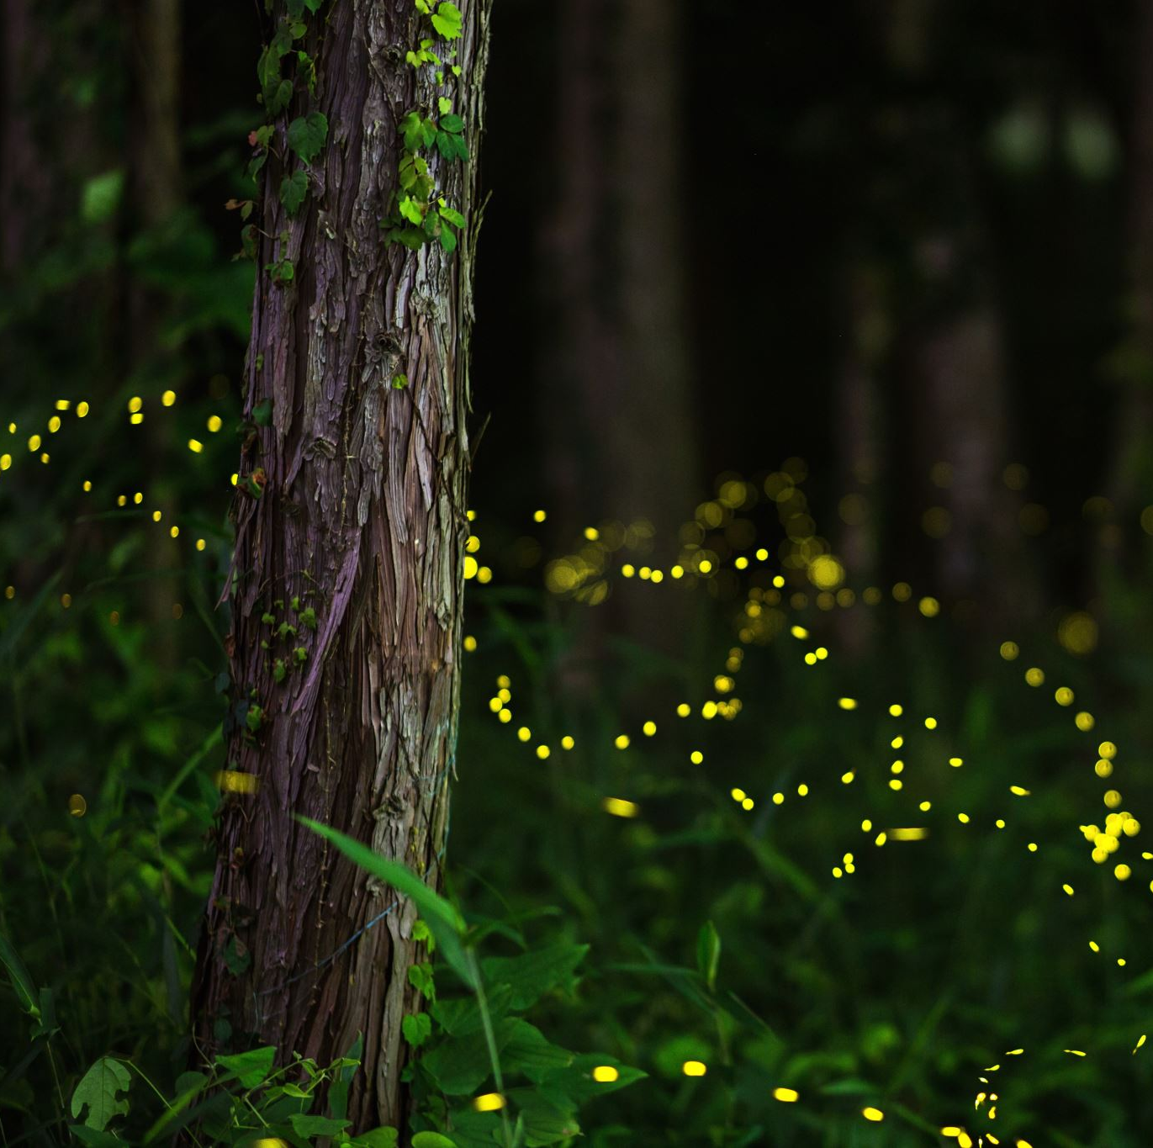
Home Sweet Habitat: Passing the Torch
Travis Heil - Roosevelt Park Zoo
Education, Conservation & Outreach Coordinator
Phone: 701-857-4166
Email: travis@minotparks.com

Slide 2
Overview
Original Home Sweet Habitat Program (1st grade)
New version Home Sweet Habitat (Pre-k to 2nd grade)

Slide 3


Original Home Sweet Habitat Program
Show pictures of Habitats and ask audience to share feelings about pictures

Slide 4
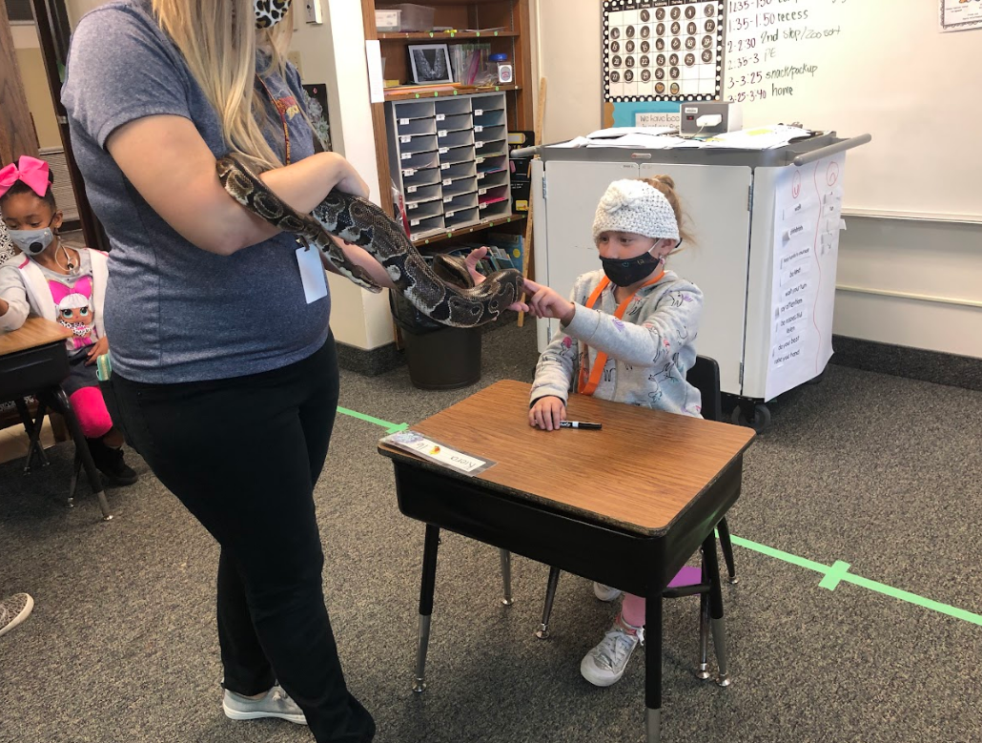
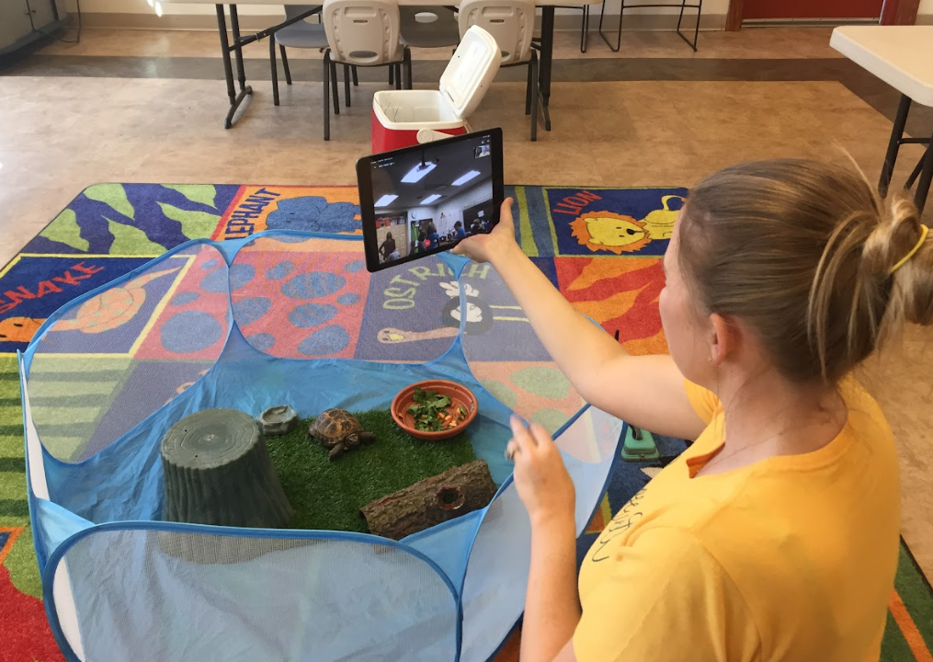
Original Home Sweet Habitat Program
Show pictures of habitats and ask audience to share feelings about pictures
Interact with the animal or biofact related to that animal

Slide 5
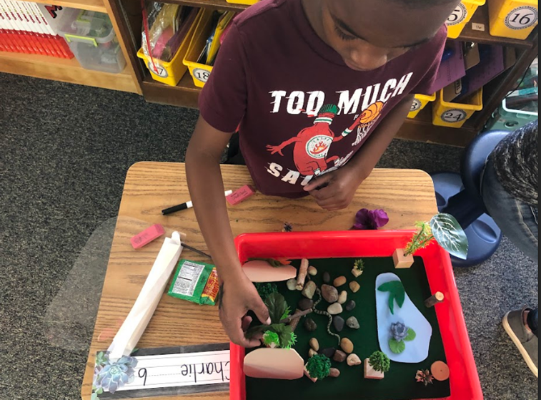
Original Home Sweet Habitat Program
Show pictures of Habitats and ask audience to share feelings about pictures
Interact with the animal or biofact related to that animal
Build habitat for that animal

Slide 6
New Version
Review what is a Habitat
Basic needs for all living things
Meet animal and identify 4 basic needs
(2nd grade) Living vs Non-living
Build Habitats

Slide 7




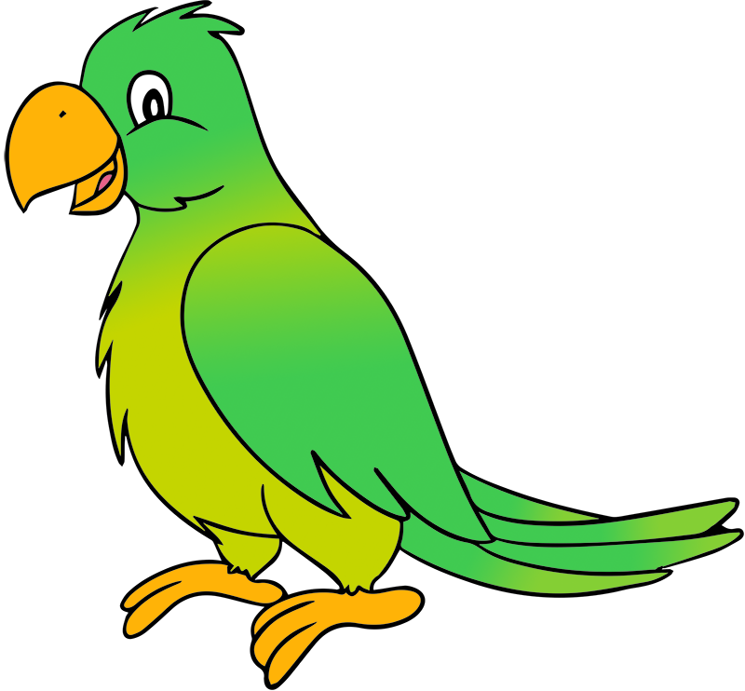



Home Sweet Habitat

Slide 8
What is a Habitat?
Home for living things

Slide 9
4 Basic Needs of Animals
Food
Water
Air
Shelter

Slide 10




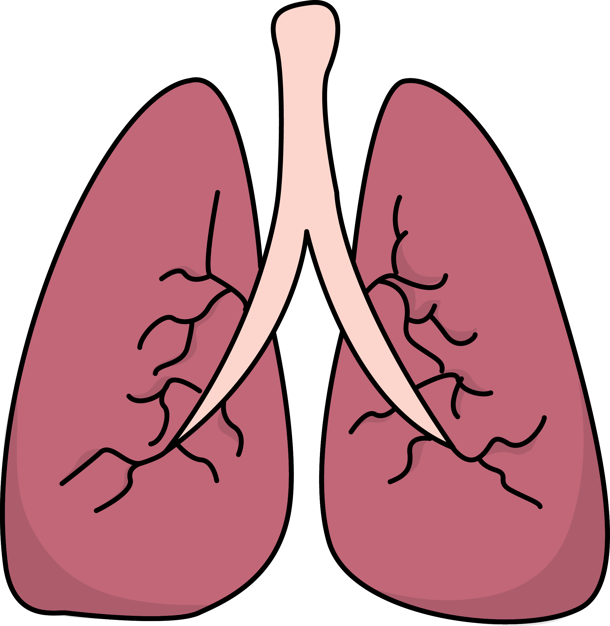
4 Basic Needs
Food
Water
Air
Shelter

Slide 11

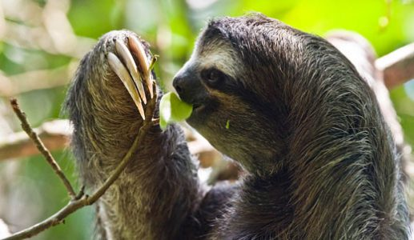


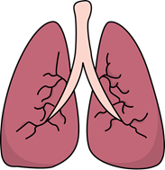
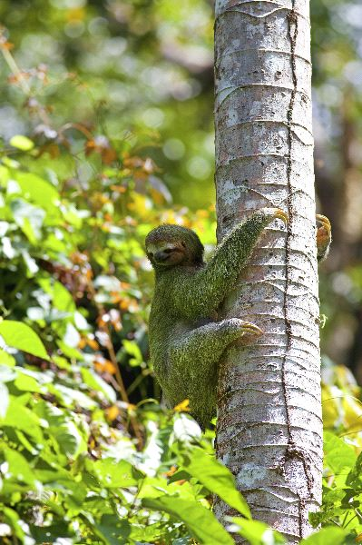
4 Basic Needs
Food
Water
Air
Shelter

Slide 12
Living vs Non-Living
Questions to ask
Does it eat and drink water in order to survive?
Does it grow and develop over time?
Can it make more of themselves?
Can it respond to changes around it?

Slide 13
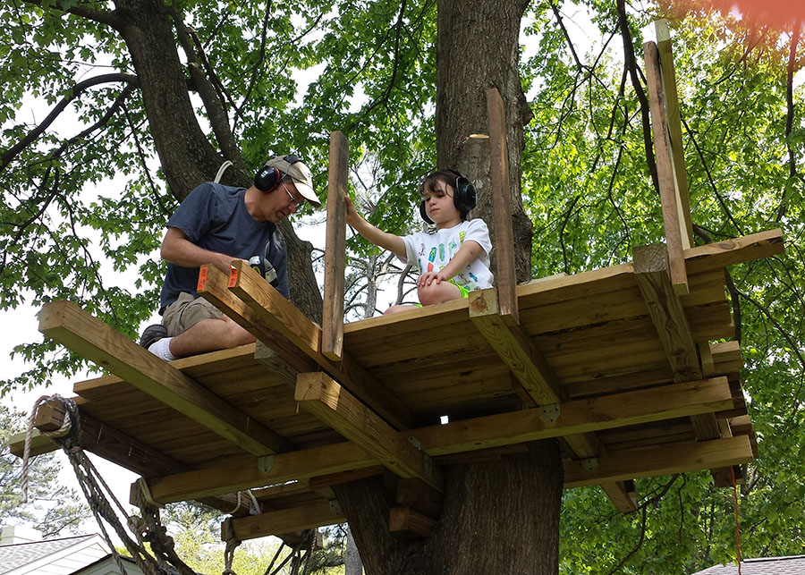
Activity: Build Habitat
Make sure your animal has 4 basic needs in their habitat

Slide 14

Habitat Song
Air, Food, Water and Shelter
Air, Food , Water and Shelter
Air, Food, Water and Shelter
Things I need in my habitat

Slide 15
Home Sweet Habitat: Passing the Torch
Travis Heil - Roosevelt Park Zoo
Education, Conservation & Outreach Coordinator
Phone: 701-857-4166
Email: travis@minotparks.com

