Slide 1

Priming Empathy in Early Childhood Audiences
9/12/2024
ACE for Wildlife Learning Group
Terra Herrmann
Learning Coordinator

Slide 2
Notes:
And in that spirit, a big part of our work is connecting children to wildlife from very early ages so that they see themselves as a part of the living world around us.

Slide 3
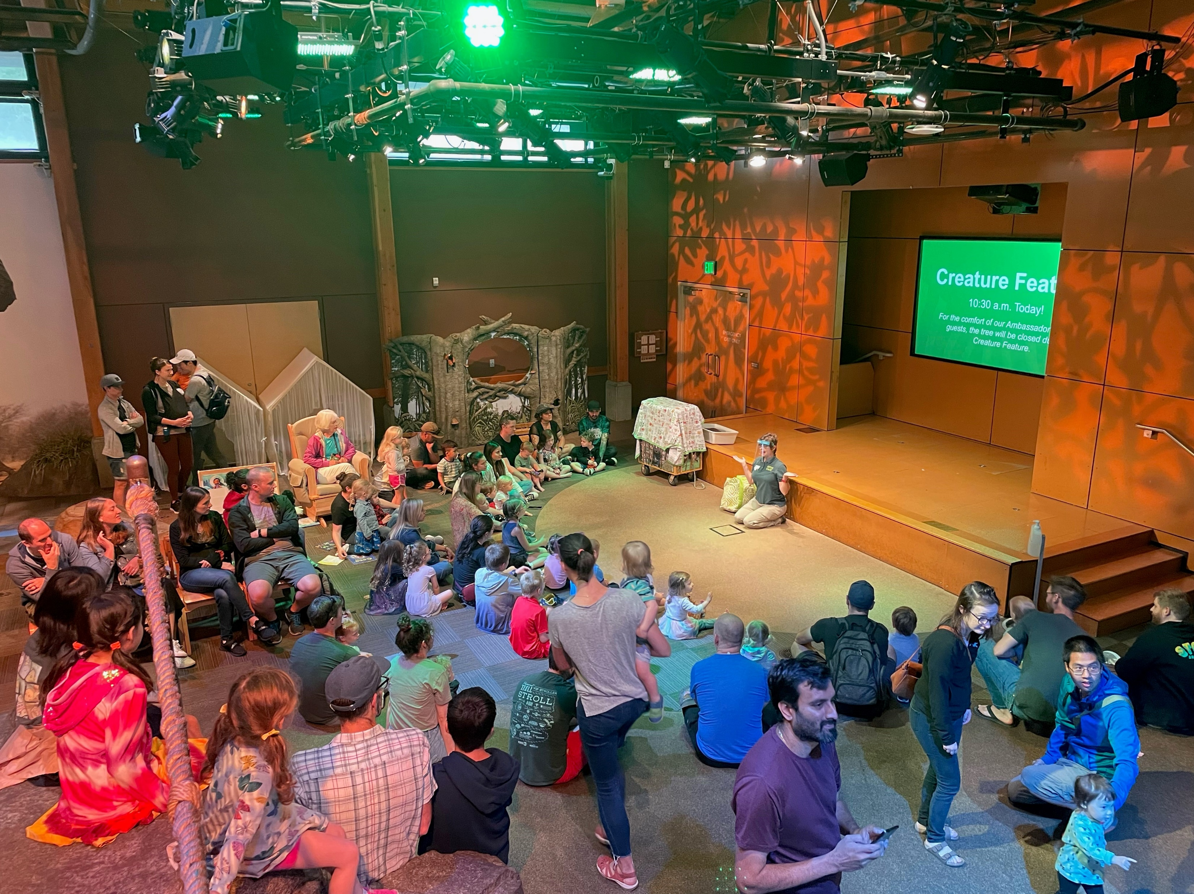
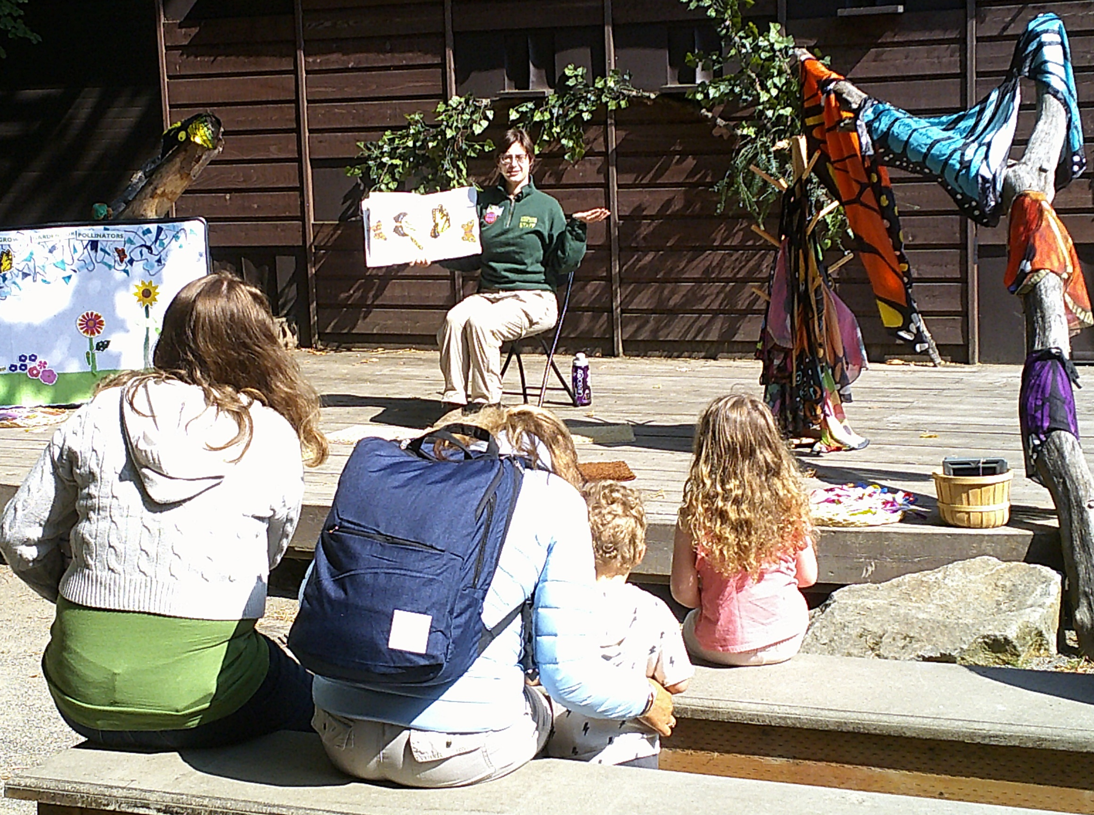
Creature Feature & Look, Listen, and Feel Storytime
Look, Listen, and Feel Storytime
Caption: A family sits on a bench and watches a presenter reading from a book
Creature Feature
Caption: an audience of children and caregivers sits on the floor around a presenter in front of a stage
Notes:
Locations, audience (age 0-5), both lead into an opportunity to share space with live animals.

Slide 4
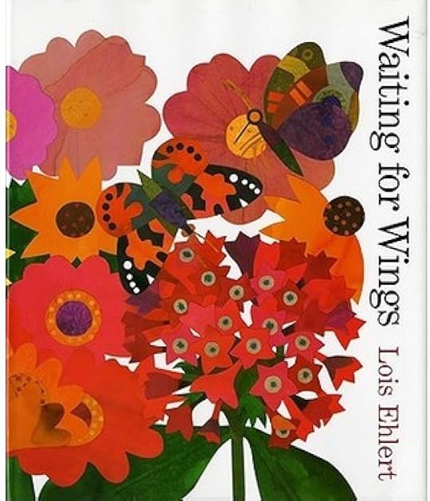
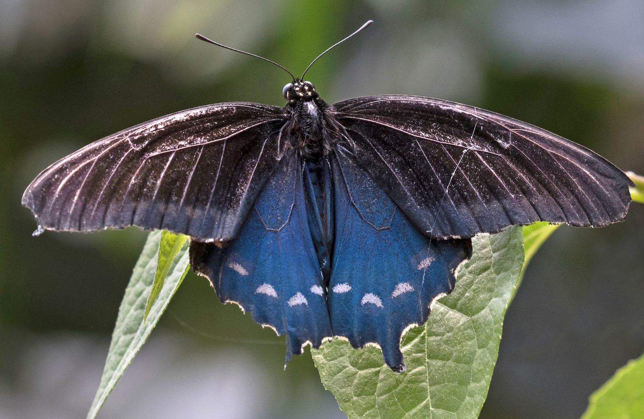
Look, Listen, & Feel Program Overview
Story (~10 min; interactive)
Activities
Re-read story
Repeat activities
Visit butterfly garden
Caption: The cover of the book Waiting for Wings by Lois Ehlert. It is a collage of flowers and butterflies.
Caption: A blue and grey butterfly

Slide 5
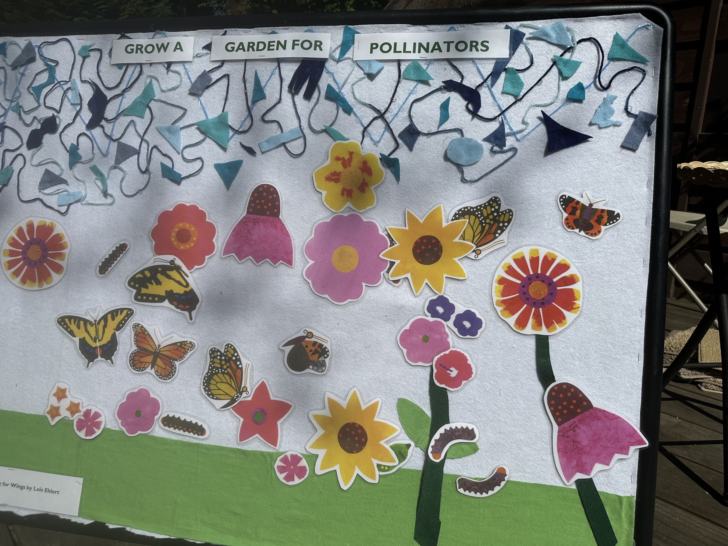
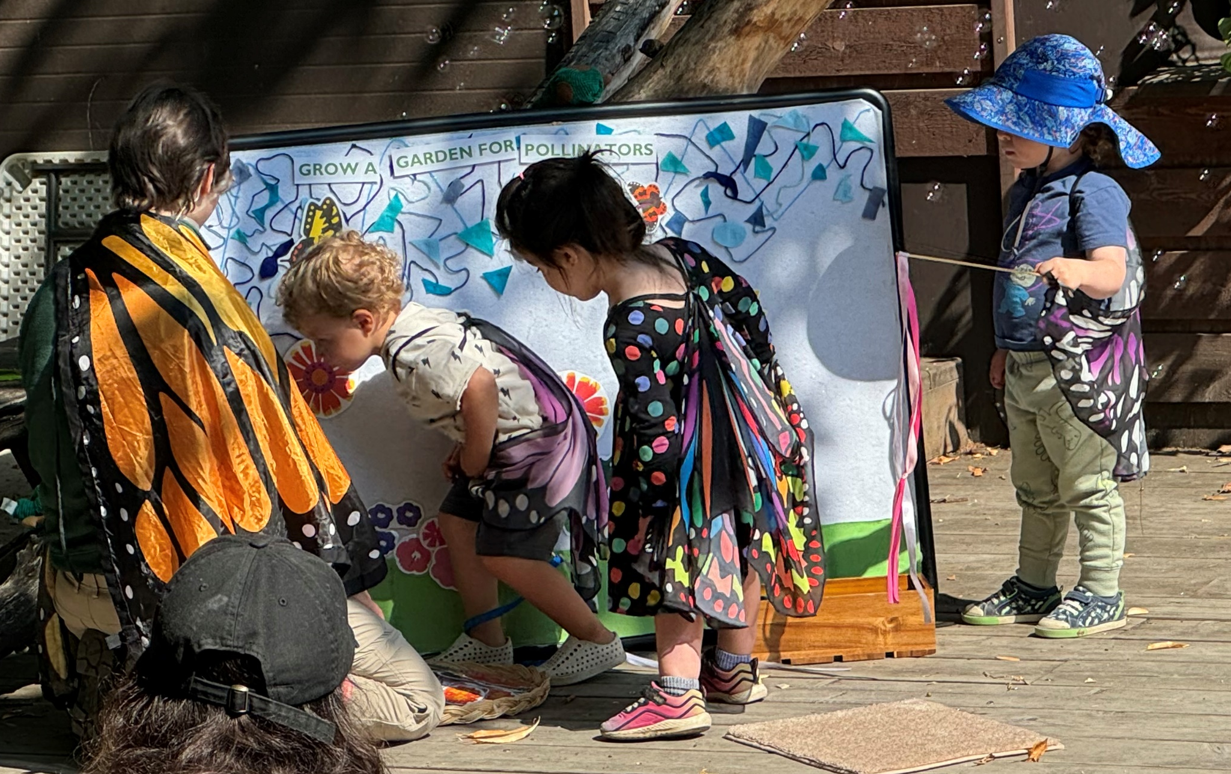
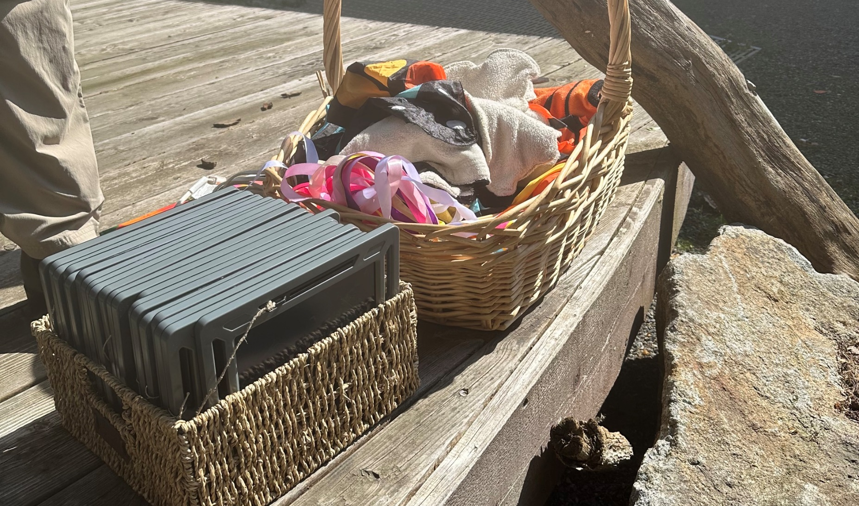
Look, Listen, & Feel Activities
Book: Waiting for Wings by Lois Ehlert
Felt “grow a garden” board
Drawing pads
Wings, music, & bubbles for butterfly dance
Caption top left: A felt board with butterfly and flower cutouts.
Caption top right: Children wearing butterfly wings interacting with the felt board
Caption bottom: a basket filled with drawing tablets and a basket filled with costume butterfly wings

Slide 6
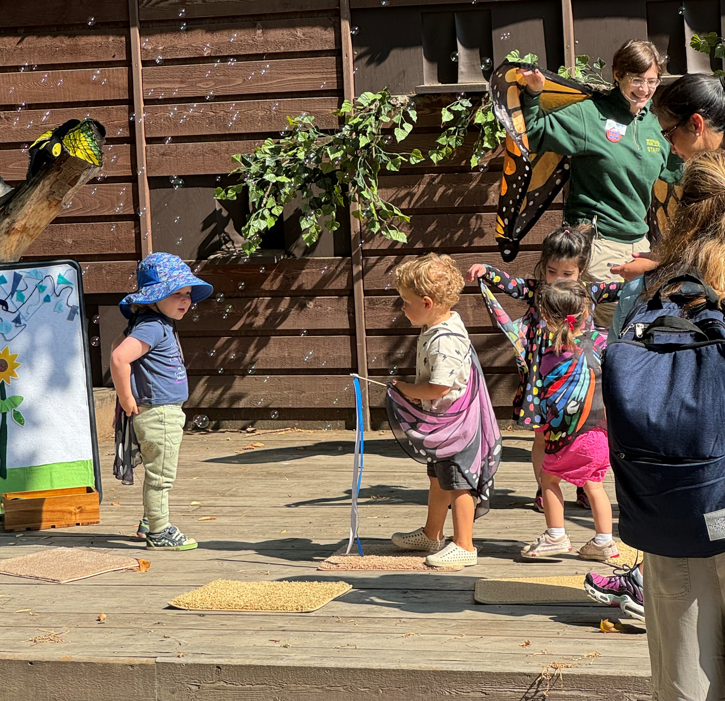
Priming Strategies – Look, Listen, & Feel Storytime
Encourage consideration of animals’ needs
Take on the role of the animals
Tie directly to experience of animals in our care
Caption: Children wearing butterfly wings and holding streamers outdoors surrounded by bubbles.
Notes:
“Where do you butterflies want to fly today?” “I’m going to go drink some nectar from those flowers” “The way you are flying reminds me of a butterfly I saw in the butterfly garden yesterday!”

Slide 7
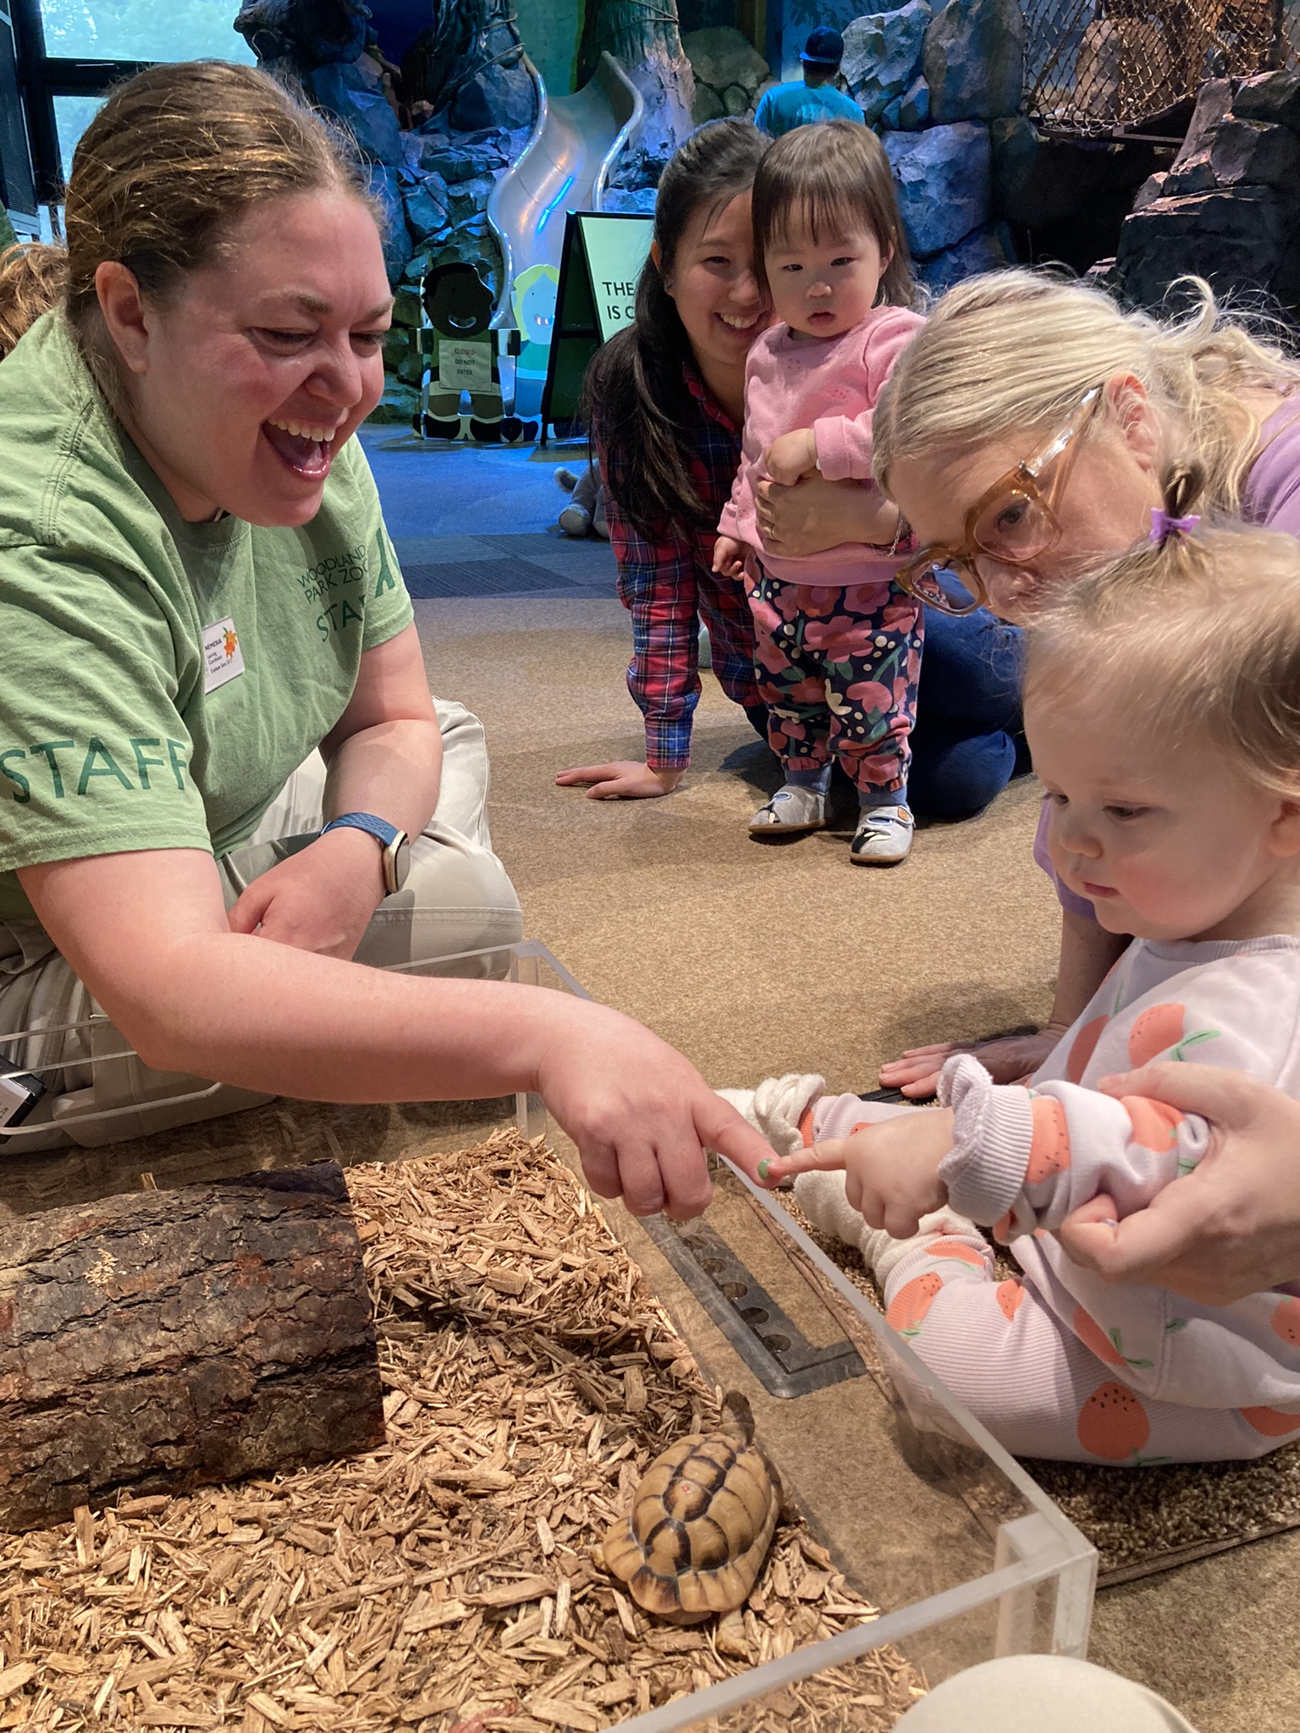
Creature Feature Program Overview
Expectations
Puppet Story
Mindfulness/body awareness
More Expectations
Introduction
Choice and control
Observations
Perspective taking
Give kids choice &
control too!
Before animal is visible
Before animal experience
During animal experience
Caption: A toddler and a presenter touch fingers above an Egyptian tortoise while another family observes.
Notes:
You may already do some or all of this intuitively, but I wanted to call attention to the elements of the structure that leads to successful empathy and behavioral regulation in our programs. When the child is in a positive state of mind and a “yes” environment, there are more opportunities to express empathy, and this structure has been successful in creating that kind of environment.

Slide 8
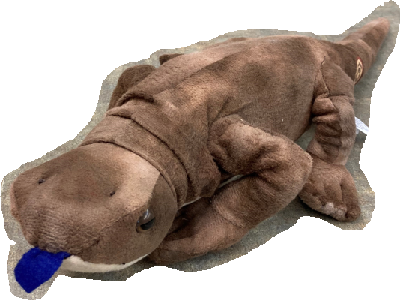
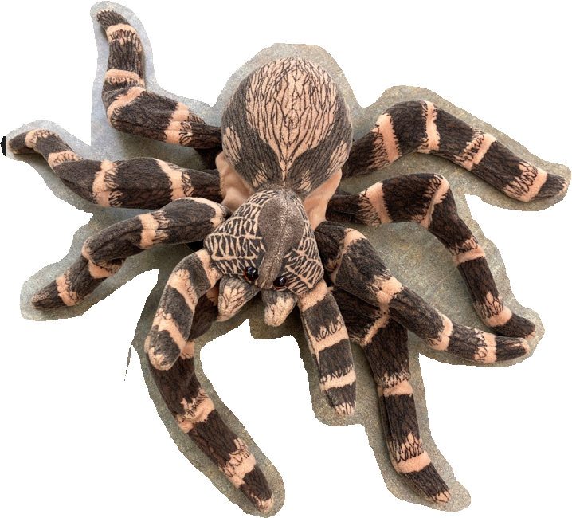
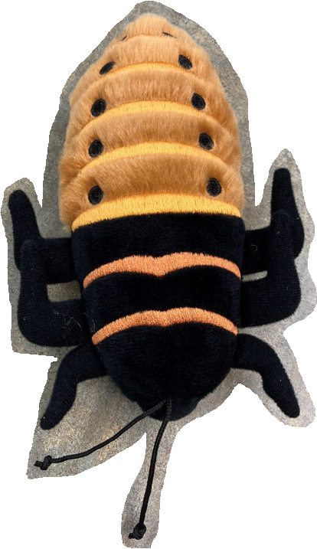
Creature Feature Examples
Henry the blue-tongued skink learns how to catch bugs
Bonita the spider learns how her friends locomote with different numbers of limbs
The zoo animals have a picnic, and Sebastian the cockroach saves the day by eating the leftovers
Caption: Stuffed animals representing blue tongued skink, tarantula, and Madagascar hissing cockroach.
Notes:
Notes: don’t villainize any animals – our stories should never have a “bad guy”.

Slide 9
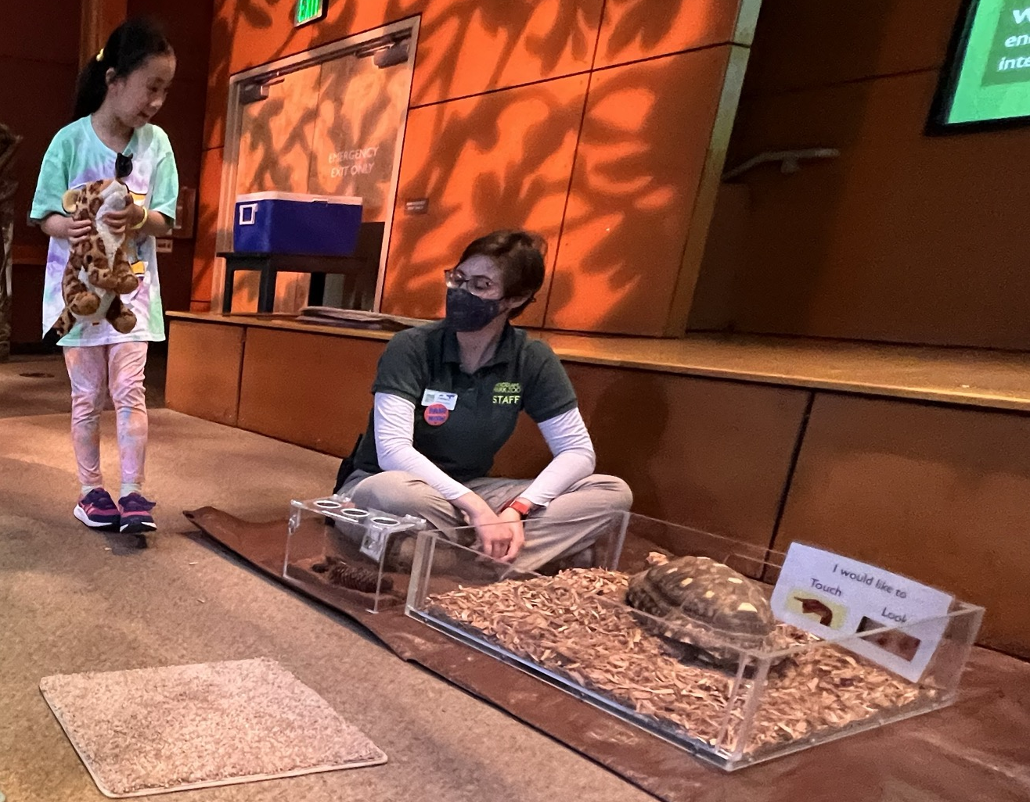
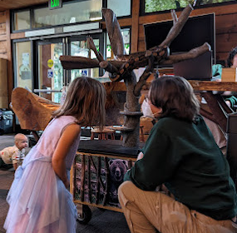
Structural Priming
Caption left: a child smiles at a presenter indoors near a red-footed tortoise in a low open-topped plexi bin on a tarp on the ground.
Caption right: A presenter kneels next to a child indoors as they both look up at a ball python climbing on a branch
Carpet squares (line management)
Lizards/tortoises:
plexiglass corral
Snakes: branch

Slide 10
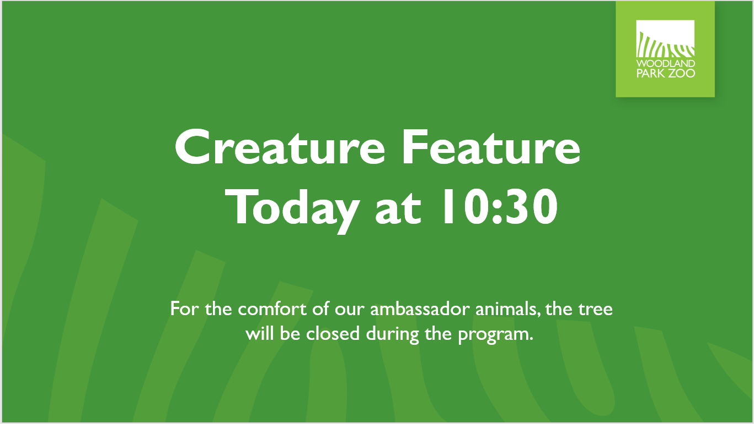
Notes:
This powerpoint slide is displayed on our stage screen before and throughout Creature Feature.

Slide 11

Intentional Language Choices
AVOID control-based language
“I will put them…” “I will let them…”
OKAY to explain when you need to intervene
“I will help them…” with an explanation of
what you are doing and why
BEST to give animals agency
“I will find out if they want to…” “I will ask them…”
(explain how we “ask” and “listen” to animals’ answers)
Your words matter!
Caption: a stop light. This Photo by Unknown Author is licensed under CC BY-NC.

Slide 12
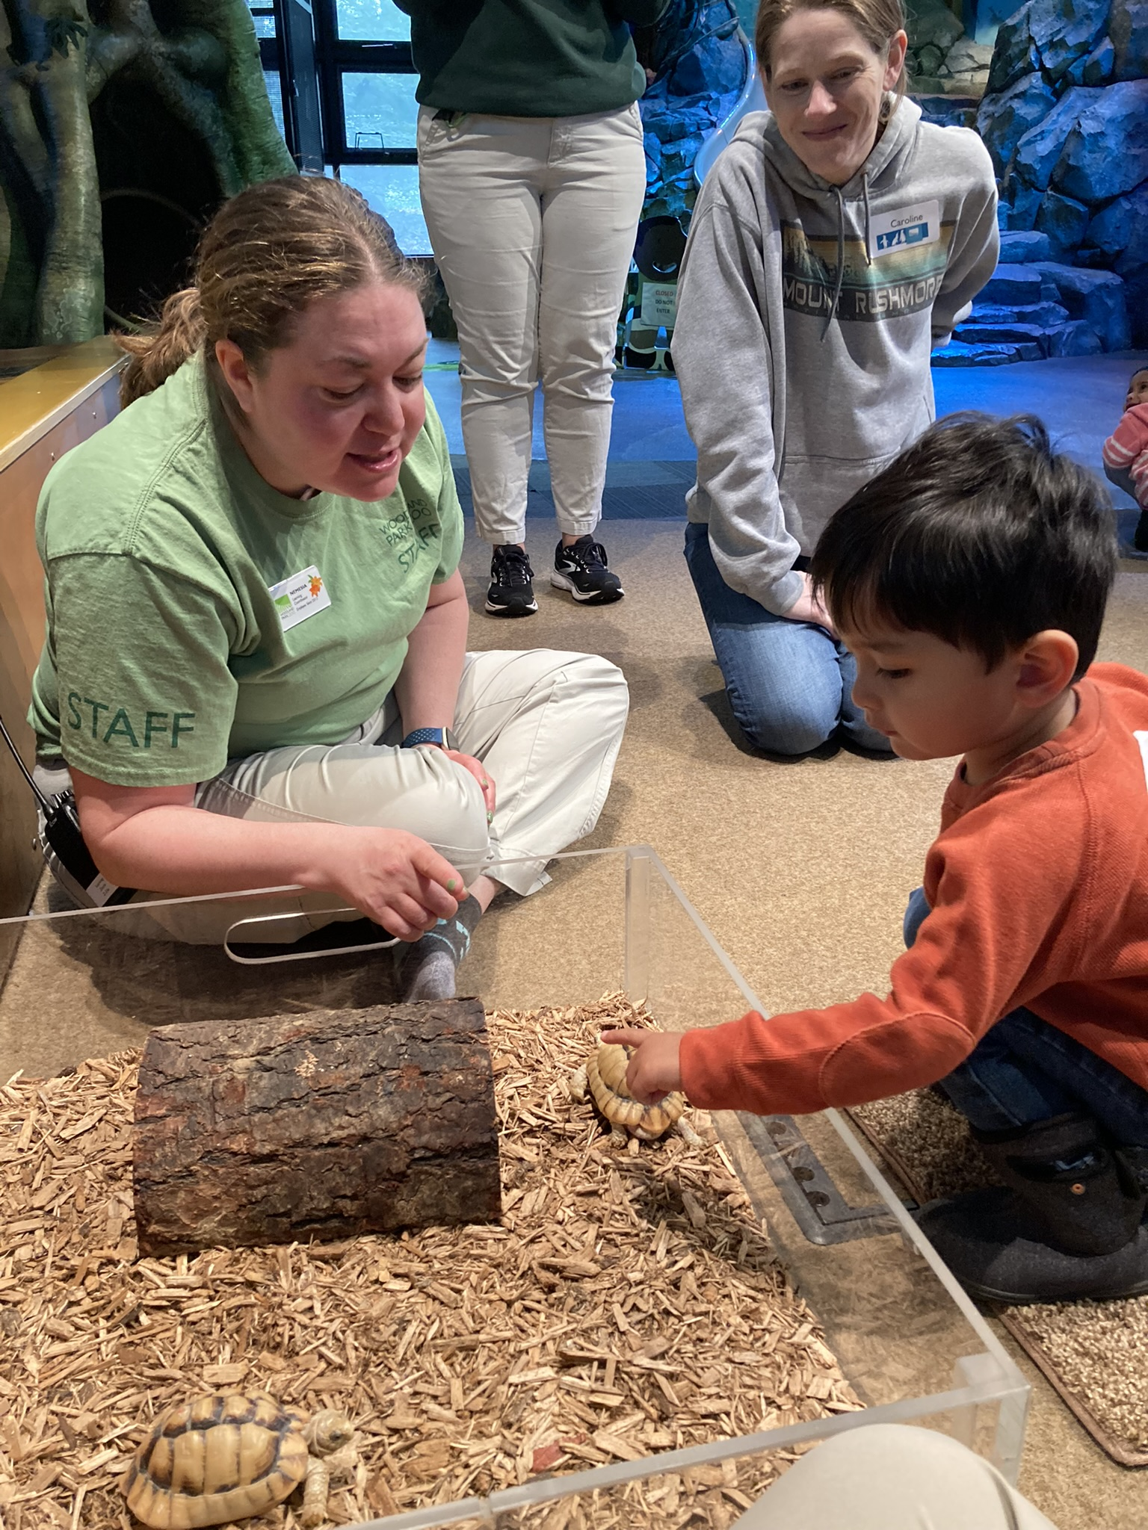
Touch Experience Details
Empathy wheel
Praise kind actions
Emphasize connection to the animal
E.g. “Obi is curious about you so he is sticking his tongue out to smell you – what do you think you smell like today?”
“Blue appreciates how gently you touched. See how he is still calm and relaxed?”
“You made friends with Tut the tortoise today!”
Tie animal actions to familiar motivations – curiosity, shyness, fear, etc.
Caption: a child reaches out towards an Egyptian tortoise with one finger while a presenter and a caregiver observe. The tortoises are in a low, open-topped plexi bin on the ground indoors.
Notes:
Literature on the subject of children’s relationships to animals indicates that children are capable of seeing animals as their “peers” or “acquaintances” more than adults are typically likely to do. Friendship is an important concept at this age.

Slide 13
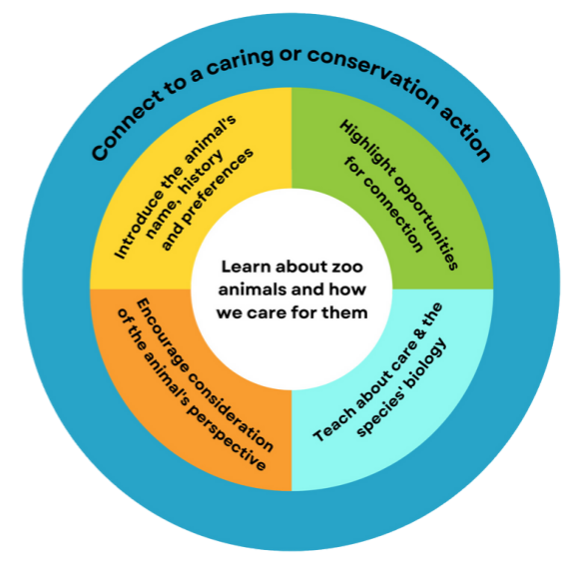
Early Childhood Strategy Review
Physical structure
Agency
Care/welfare
Program structure
Expectations
Introduction scaffolding
Empathy Wheel
Language structure
Agency
Individuality
Caption: The Empathy Wheel. The outer rim reads “connect to a caring or conservation action”. The middle ring has four sections, reading “Introduce the animal’s name, history, and preferences”, “Highlight opportunities for connection”, “Encourage consideration of the animal’s perspective”, and “Teach about care & the species’ biology.” The inner core reads “Learn about zoo animals and how we care for them.”
Notes:
Empathy wheel is infused into all of these practices; today I hope to have highlighted specific strategies that are particularly effective with a young audience of ages 0-5.

Slide 14
Thank you!
terra.herrmann@zoo.org
Notes:
Please email with any questions or if you want to know more about our programs!

