Slide 1
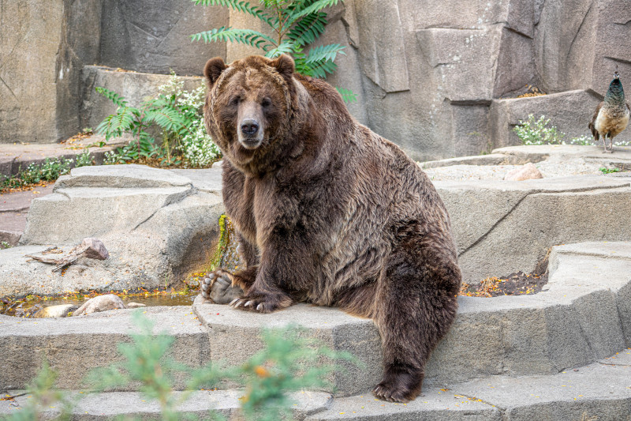
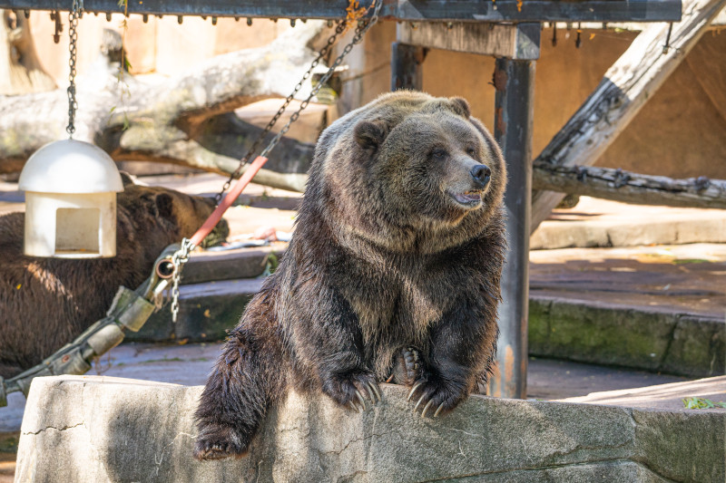
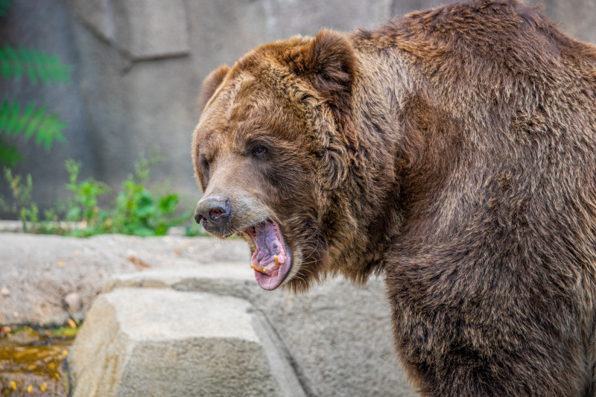
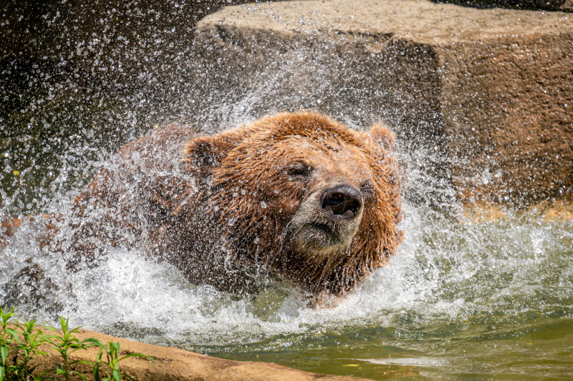
Meet Your Milwaukee County Zoo Bears
Mama Ronnie
And her sons
Born January 27, 2002
1. Brian
2. Chinook
3. Bozeman
Are our 4 grizzly bears
Borealis is an Alaskan Brown Bear. He was orphaned and came to your Zoo in 1999

