Slide 1


Empathy in Action at Zoo Boise
Tierney Ball, Director of Education
Notes:
Thank Zoo Montana for work on signage- collaboration

Slide 2


Staff and Volunteer Training and Resources

Slide 3
Video Trainings

Slide 4
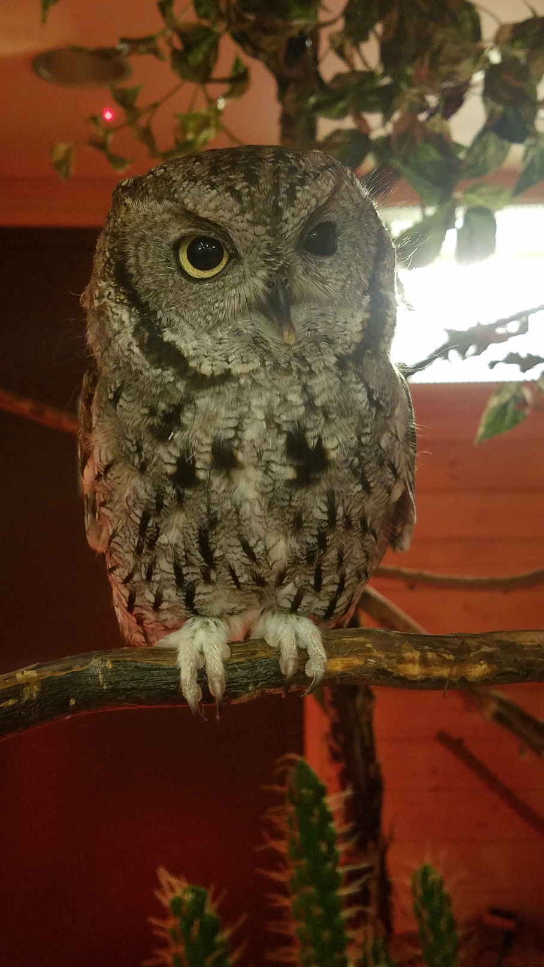
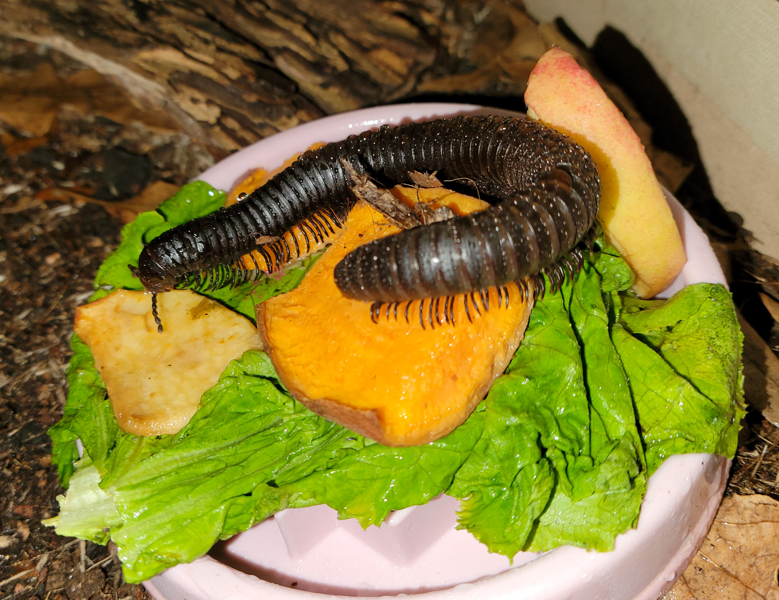

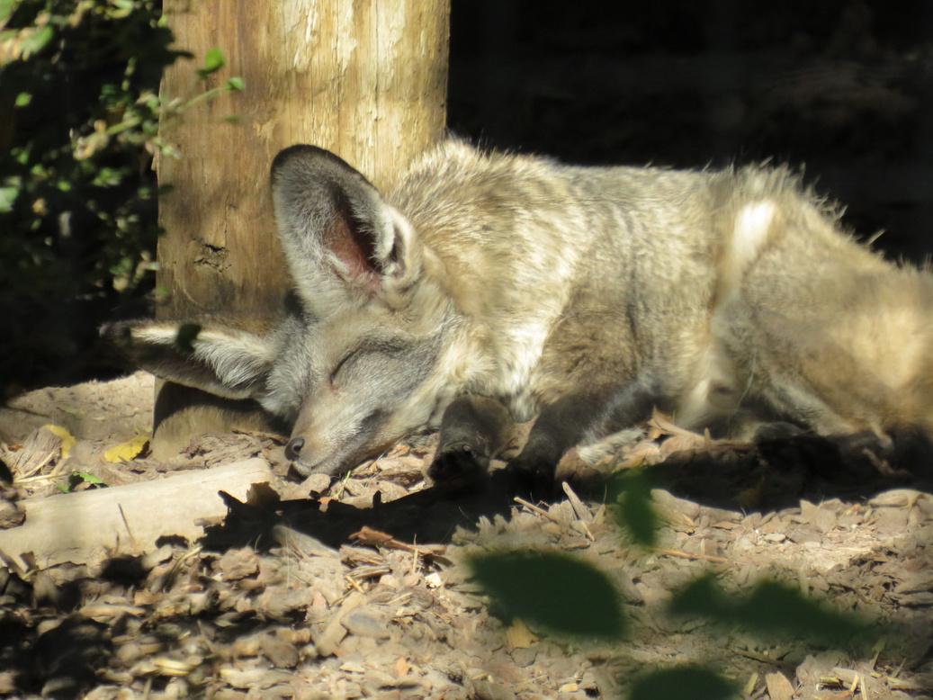
In-person Training Example
  Reframes guests' perception to view a situation as the animal would experience it.
    An animals experience can be both similar and different from our own experiences
    Highlight some of those differences or similarities that would have a big effect on perception.
    "Imagine being able to hear bugs digging underneath the dirt. It makes sense why Fletcher the Bat Eared fox is not a fan of loud noises."
Perspective
Taking

Slide 5
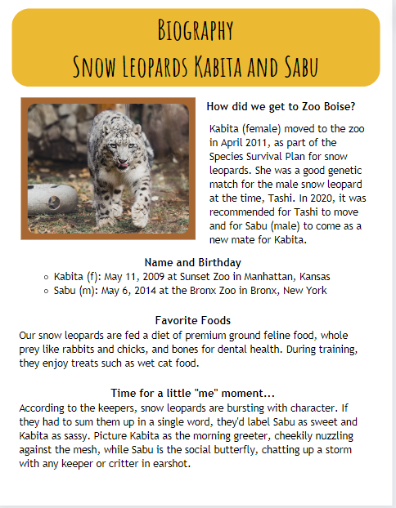


Interpretive Guides
Time for a little “me” moment...
According to the keepers, snow leopards are bursting with character. If they had to sum them up in a single word, they’d label Sabu as sweet and Kabita as sassy. Picture Kabita as the morning greeter, cheekily nuzzling against the mesh, while Sabu is the social butterfly, chatting up a storm with any keeper or critter in earshot.

Slide 6
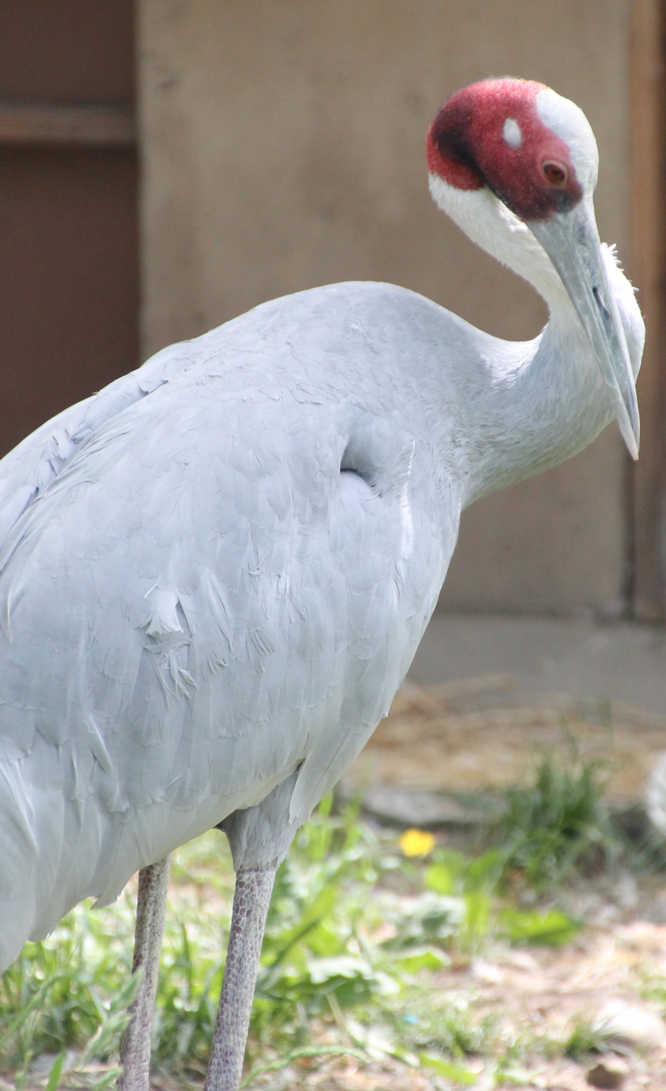
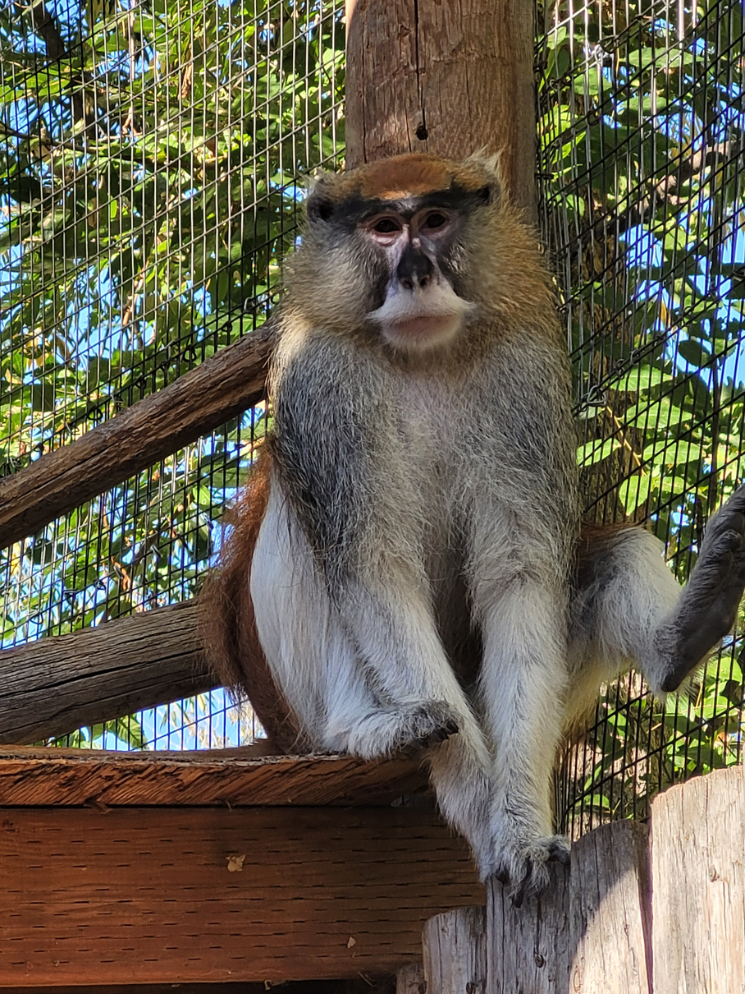
Staff and Volunteer Responses
20% increase in staff and volunteer average of comfort/knowledge
42% of staff self rated a 5/5 in knowledge and comfort with empathetic techniques

Slide 7
Examples and Projects

Slide 8
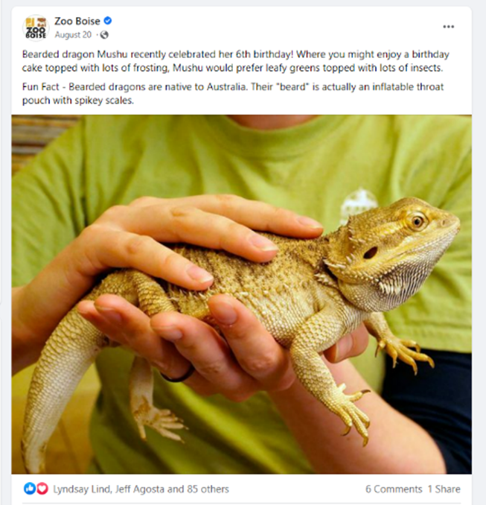
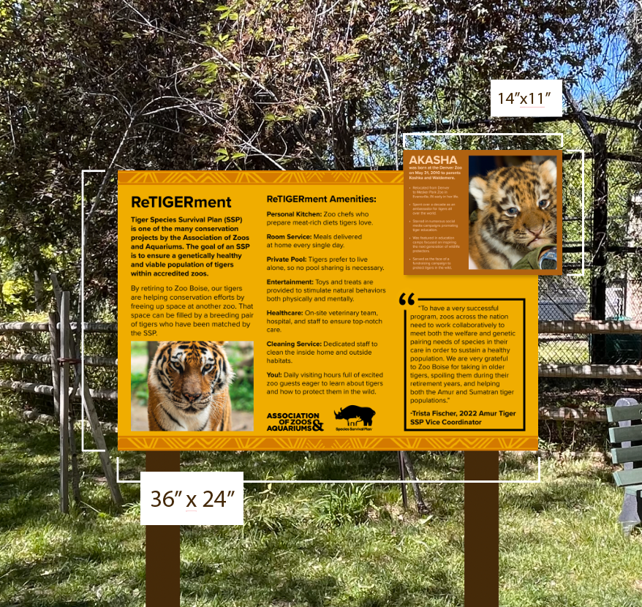
Examples

Slide 9
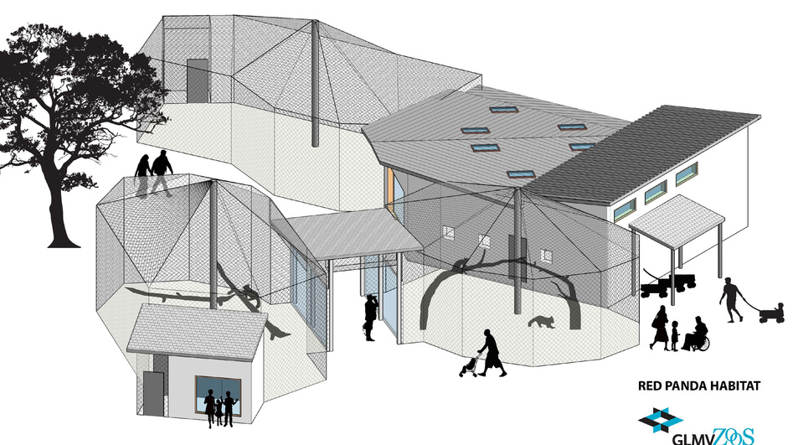



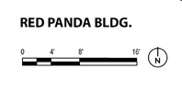
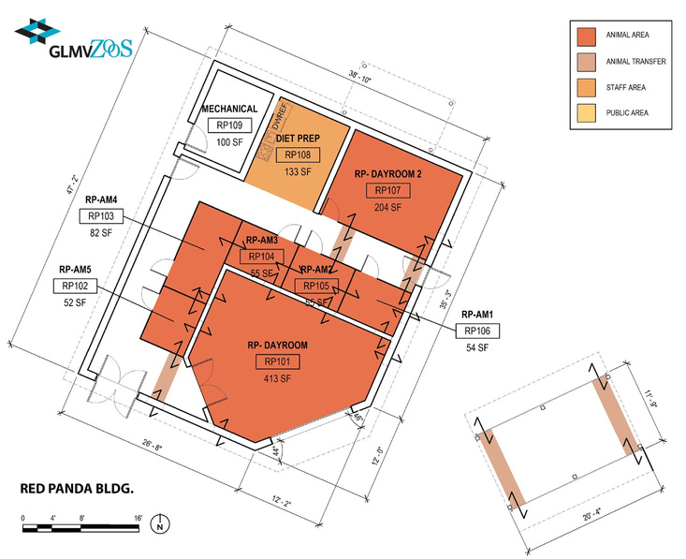
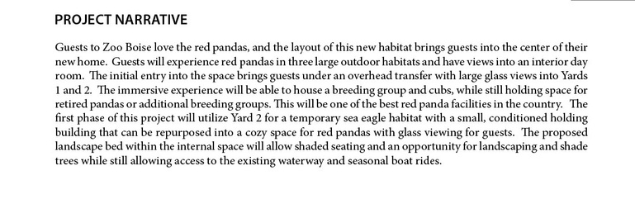
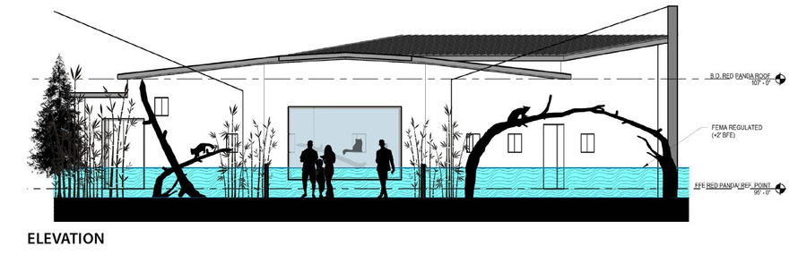


Exhibit Design
Examples

Slide 10
Did it work?

Slide 11
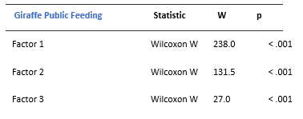
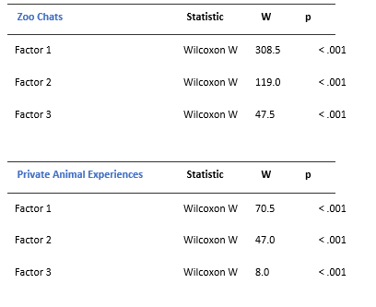
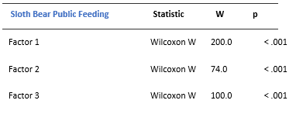
Comparative Analyses

Slide 12
Questions?
tball@cityofboise.org

