Slide 1

Site Visit Data Share-Out
Insights and findings from the 2022-2023 ACE for Wildlife Network visits to Partner Organizations
Presented by: Theo Bamberger

Slide 2


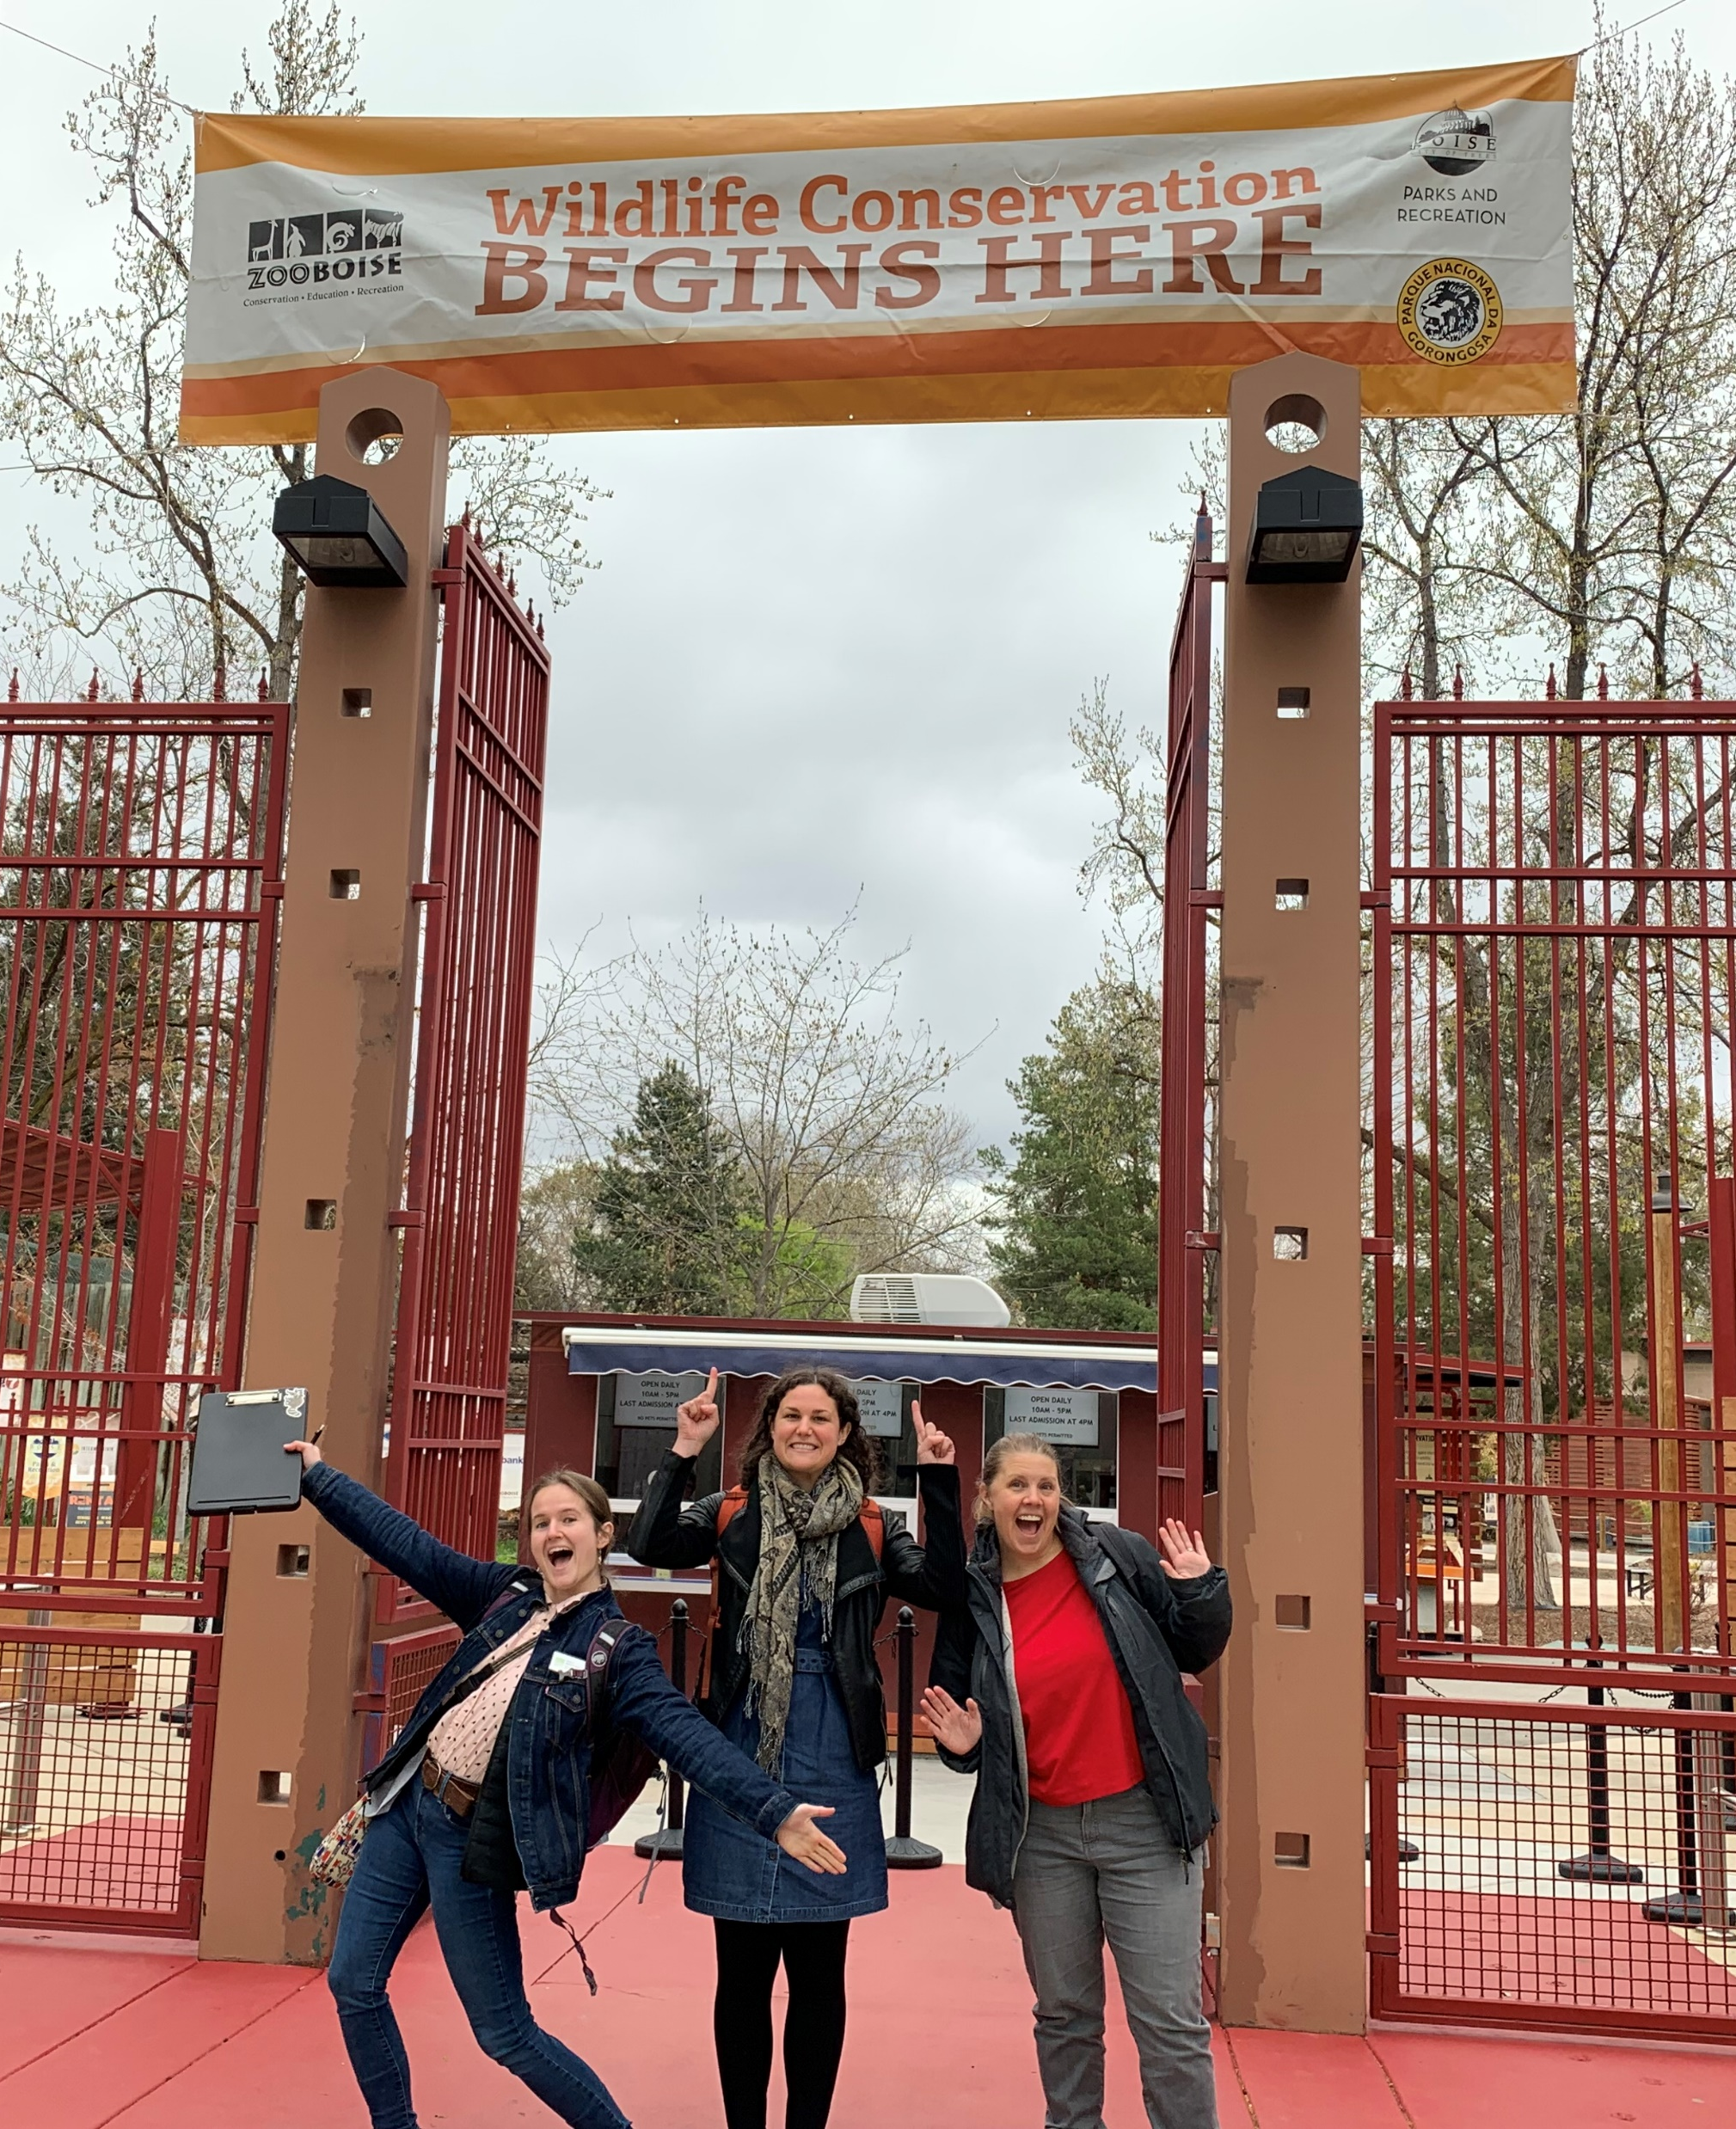
Background
The Advancing Empathy Initiatives (AEI) staff from Woodland Park Zoo visited the 20 original ACE for Wildlife Network Partner Organizations from April 2022-May 2023 in order to:
Strengthen connections between AEI staff and Partner Organization staff
Meet with staff to provide training/answer questions, understand additional resource needs, and gain insight into existing empathy initiatives
Hold Capacity Building Grant check-ins
Conduct observations in support of WPZ’s Advancing Empathy for Wildlife Program Evaluation Plan

Slide 3
Evaluation Purpose
Identify strengths and opportunities for growth in how empathy practices are used
Guide AEI team in providing resources and support
Monitor changes in the use of empathy practices over time
Establish a baseline understanding of the prevalence of “effective empathy practices” at Network Partner Organizations
Expand our knowledge of how visitors demonstrate empathy for animals

Slide 4




Methods
In-person observations at all 20 zoos and aquariums of:
Use of empathy practices in exhibit* signage;
Use of empathy practices by program presenters;
Expressions of empathy by exhibit visitors; and
Expressions of empathy by program audiences
using the MECAP Observation Framework (link in chat)
*exhibits refers specifically to the interpretive elements around an animal’s habitat

Slide 5
Categories of
Empathy-Related Practices
Categories of
Empathy-Related Behaviors
Encourage focused observation of animal
Include appropriate conservation or caring action
Include expectations for audience behavior around animals
Inform about animals’ needs
Invite perspective-taking
Highlight similarities and differences between animals and people
Reinforce that animals are individuals
Reinforce that animals have relationships
Reinforce that animals have agency
Able to take perspective of animals
Caregivers support positive behavior and attitudes
Connection between the animals and own lived experiences
Engages in direct action to help animal
Has appreciation/respect for animal
Has compassionate concern for animals
Has interest or curiosity toward animal
Recognizes animal as individual with own agency
Shows positive behavior toward animals
Understands needs of an animal
Wants to help animals

Slide 6
Methods
Observed at exhibits featuring all types of animals
Intentionally observed at exhibits with animals that are present at many sites (e.g., bears, big cats) for direct comparison
Observed a variety of program audience and visitor types
At each site, we observed (as available):
Signage at 8 exhibits
Visitors at 4 exhibits
At least one program presenter and audience

Slide 7
Data Summary
25
Program Audiences
552
Exhibit Visitors
59
Program Presenters
166
Exhibits

Slide 8
What did we learn?

Slide 9
Key Findings: Use of Empathy Practices
Program presenters utilized more empathy-related practices than exhibit signage

Slide 10
Number of unique practices used in exhibits and programs
Median number of unique practices used per program was 13.
Median number of unique practices used per exhibit was 7.
Notes:
Avg of 7.9 practices in exhibits and 4.8 categories
Avg of 14.4 practices in programs and 7 categories

Slide 11
Key Findings: Use of Empathy Practices
Program presenters utilized more empathy-related practices than exhibit signage
Even brief programs incorporated a wide variety of empathy-related practices
Informing about animals’ needs was the most frequently observed category of practices in both exhibits and programs

Slide 12
Frequency of each empathy-related practice category

Slide 13
Key Findings: Use of Empathy Practices
Program presenters utilized more empathy-related practices than exhibit signage
Even brief programs incorporated a wide variety of empathy-related practices
Informing about animals’ needs was the most frequently observed category of practices in both exhibits and programs
Exhibit signage was more likely to highlight conflict between people and wildlife than to include conservation or caring actions visitors could take
Empathy-related practices are not implemented consistently for all types of animals, especially marine invertebrates
Notes:
vague or specific mentions of human-wildlife conflict in 72% of exhibits compared to 53% which included caring or conservation actions

Slide 14
Frequency of each empathy-related practice category by animal type
n=4 n=49 n=10 n=140 n=8 n=22 n=10 n=225

Slide 15
Key Findings: Use of Empathy Practices
Program presenters utilized more empathy-related practices than exhibit signage
Even brief programs incorporated a wide variety of empathy-related practices
Informing about animals’ needs was the most frequently observed category of practices in both exhibits and programs
Exhibit signage was more likely to highlight conflict between people and wildlife than to include conservation or caring actions visitors could take
Empathy-related practices are not implemented consistently for all types of animals, especially marine invertebrates
Partner Organizations varied in both number and type of empathy practices being implemented
Notes:
vague or specific mentions of human-wildlife conflict in 72% of exhibits compared to 53% which included caring or conservation actions
Across sites, the median (midpoint) number of practices used in exhibits and programs combined ranged from 5.5 to 16, and the mean (average) ranged from 5.5 to 13.6. Among individual exhibits and programs, the maximum number of practices used occurred in NEW Zoo’s penguin encounter program, which included 27 unique practices. Across exhibits alone, Minnesota Zoo’s Russia’s Grizzly Coast exhibit utilized the most empathy practices, with 22.
Partner Organizations varied in the frequency with which they utilized each of the nine categories of practices. Informing about animals’ needs was a strength across all sites. This variation was most pronounced when it came to reinforcing that animals have relationships and reinforcing that animals are individuals. At ZooMontana in particular, 90% of observed exhibits and programs used practices that reinforce that animals have relationships, and 100% reinforced that animals are individuals. At some sites, as few as 18% of exhibits and programs reinforced that animals have relationships and as few as 30% reinforced individuality. Similar patterns in use across sites exist for highlighting similarities and differences between animals and people or other animals and reinforcing that animals have agency.

Slide 16
Key Findings: Expressions of Empathy
Attending zoo or aquarium programs led to more outward expressions of empathy and related emotions than viewing exhibits
Exhibit visitors and program audiences most frequently demonstrated interest or curiosity toward animals and recognized animals as individuals with agency

Slide 17
Frequency of each empathy-related behavior category

Slide 18
Key Findings: Expressions of Empathy
Attending zoo or aquarium programs led to more outward expressions of empathy and related emotions than viewing exhibits
Visitors and audiences most frequently demonstrated interest or curiosity toward animals and recognized animals as individuals with agency
Expressions of empathy increased with both exhibit stay time and program length
Visitors and audiences were more likely to engage in several forms of empathy-related behavior when exhibits and programs invited perspective-taking or included behavioral expectations
Expressions of empathy were not dependent on animal type or group type, but touch opportunities were important
Notes:
Practices were significantly related to: understanding animals’ needs, ability to take animals’ perspectives, interest or curiosity toward animals, and desire to help animals.

Slide 19
Other Findings: Exhibit Stay Time
Median stay time was 2 minutes, 13 seconds.

Slide 20
Limitations
Observation Framework isn’t tailored to capturing nonverbal expressions of empathy
Lower numbers of visitors and program offerings at some sites due to the timing of visits
Spread of observations over a year-long period
Differences in which exhibits and programs were available to observe at each site
Interrater agreement between observers wasn’t reassessed throughout the evaluation period
Potential human error in data entry

Slide 21
Recommendations
Incorporate additional empathy-related practices into exhibits and programs
Prioritize reinforcing that animals are individuals by including their names and other unique information and inviting perspective-taking
focus on quality rather than quantity.
Focus staff and volunteer empathy trainings on practices that are used less frequently, especially those that may be more strongly linked to audience expressions of empathy such as inviting perspective-taking
Increase opportunities for visitors to engage with zoo and aquarium staff and interpretive volunteers through programs or at exhibits themselves
Notes:
reinforcing that animals are individuals by including their names and other unique information is shown to be of interest to visitors
inviting perspective-taking was positively related to multiple forms of empathy-related behavior
number of empathy practices used in signage was not shown to increase visitors’ expressions of empathy
visitors may experience increased empathy for animals when engaging with live interpretation compared to static signage.

Slide 22
Questions for Further Exploration
What feelings of empathy beyond those that are verbalized or indicated through behavior, if any, are elicited by exhibits and programs in zoos and aquariums? To what extent, if at all, are these affected by the intentional use of empathy practices?
To what extent, if at all, does the use of empathy practices affect the efficacy of existing conservation messaging in exhibits and programs?
Is there a significant difference in how exhibits and programs impact expressions or feelings of empathy for animals when potentially confounding variables are controlled? Do individuals who both attend programs and observe exhibits express or experience more empathy than those who do only one or the other?
To what extent, if at all, does the type of animal featured in an exhibit or program impact visitors’ and audiences’ empathetic responses when all other variables are controlled?
What factors influence how zoos and aquariums incorporate empathy practices into exhibits and programs? Do these factors affect which types of empathy practices are incorporated?

Slide 23
Future Evaluation Directions
Digital observation tools to minimize data loss, reduce data entry and cleaning time, and create opportunities for collaboration
Will be made accessible to all Partner Organizations on tablets distributed by the Network as part of ongoing monitoring related to the new Network Outcome Map

Slide 24
Questions?
Unmute, write them in the chat, or email theo.bamberger@zoo.org
Notes:
Now we will have a presentation from one of our grantees in the Building Organizational Capacity to Foster Empathy for Wildlife Granting Program
The purpose of this grant program, supported by a private funder, is to increase the capacity of AZA-accredited zoos and aquariums in seven states to develop and deliver effective programming aimed at advancing empathy for animals and wildlife.
Allison Malkowski and Brent Weston from Dakota Zoo will present on one piece of their Round 3 grant, "Cultivating Empathy for Wildlife through Staff Development and Guest Programming Enhancements." If you have questions, you can type them into the chat or wait until the end and come off mute when we do Q&A.

Slide 25
Observation Data Breakdown
Type of Program Audience | Program Presenter Observations | Program Audience Observations
General zoo visitors | 37 | 12
Grade school groups | 10 | 7
Pre-K | 7 | 5
Private adult groups | 4 | 1
Virtual | 1 | 0
Type of Group | Exhibit Visitor Observations
Adults | 156
Mixed-Age | 368
Solo Visitor | 28
Type of Animal | Exhibit Observations | Program Observations | Visitor Observations | Audience Observations
Amphibian | 3 | 1 | 0 | 0
Bird | 36 | 13 | 74 | 5
Fish | 8 | 2 | 18 | 1
Mammal | 114 | 26 | 424 | 10
Marine Invertebrate | 8 | 0 | 23 | 0
Reptile | 13 | 9 | 45 | 5
Terrestrial Invertebrate | 5 | 5 | 11 | 3

Slide 26
Frequency of each empathy-related behavior category by animal type

Slide 27
Questions for Further Exploration
Do the target audience age and program type influence programs’ efficacy at eliciting feelings and expressions of empathy?
What impacts, if any, does inviting perspective-taking have on empathy-related behaviors and/or feelings of empathy for animals?

