Slide 1

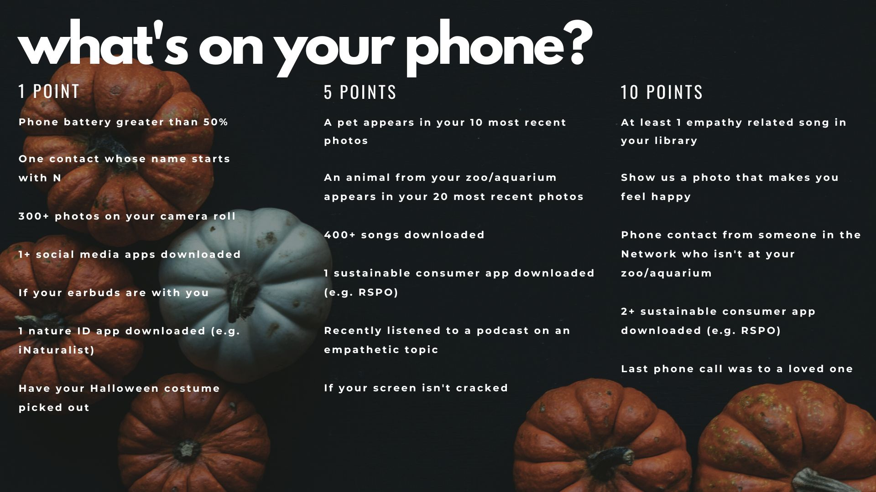

Notes:
RYAN
Instructions
-Every person gets points for everything in each category that applies to what's on their phone
-If people are interested in sharing their points, they can do anonymously in a Mentimeter link that will be dropped in the chat
-For the prompts in the 5 and 10 point categories, people must share the podcast, photo, and/or song in the Padlet link to be dropped in the chat in order to receive the points (based on the honor system)
-There is no incentive for winning, just friendly competition!
TRANSITION TO EMILY

Slide 2


All-Network
Meeting
October 2022
aceforwildlife.org
Notes:
EMILY

Slide 3
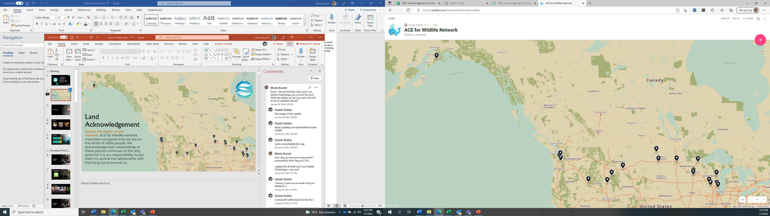
Land Acknowledgement
Across the region of the network, ACE for Wildlife Network Members recognize that we are on the lands of tribal people. We acknowledge their stewardship of these places continues to this day and that it is our responsibility to join them to restore the relationship with the living world around us.
Notes:
EMILY

Slide 4
Agenda
Icebreaker, welcome, and updates
Emily Bernhardt & Communications Committee
Investigating the Impact of Preschool Type on Young Children's Empathy
Dr. Julie Ernst
Updates from the Membership Committee
Tierney Ball
Updates from the Strategic Learning Committee
Liz Gilles
Updates from the Steering Committee
Aszya Summers
Conservation calls to action brainstorming
Marta Burnet
Committee sign ups
February Summit: Save the date!
DEAI Working Group
Fernanda Mora
Emily Bernhardt
Notes:
EMILY

Slide 5
ACE for Wildlife committee and working group members have the chance to share out what they have been working on since February to enhance Network transparency and knowledge sharing.
Attendees have the opportunity to get involved in committees and working groups.
Attendees have the opportunity to learn about an empathy related research project and its findings.
Attendees have the opportunity to brainstorm collaboratively about conservation events in 2023.
Goals for today's meeting
Notes:
EMILY
Transitions to Communications Committee

Slide 6

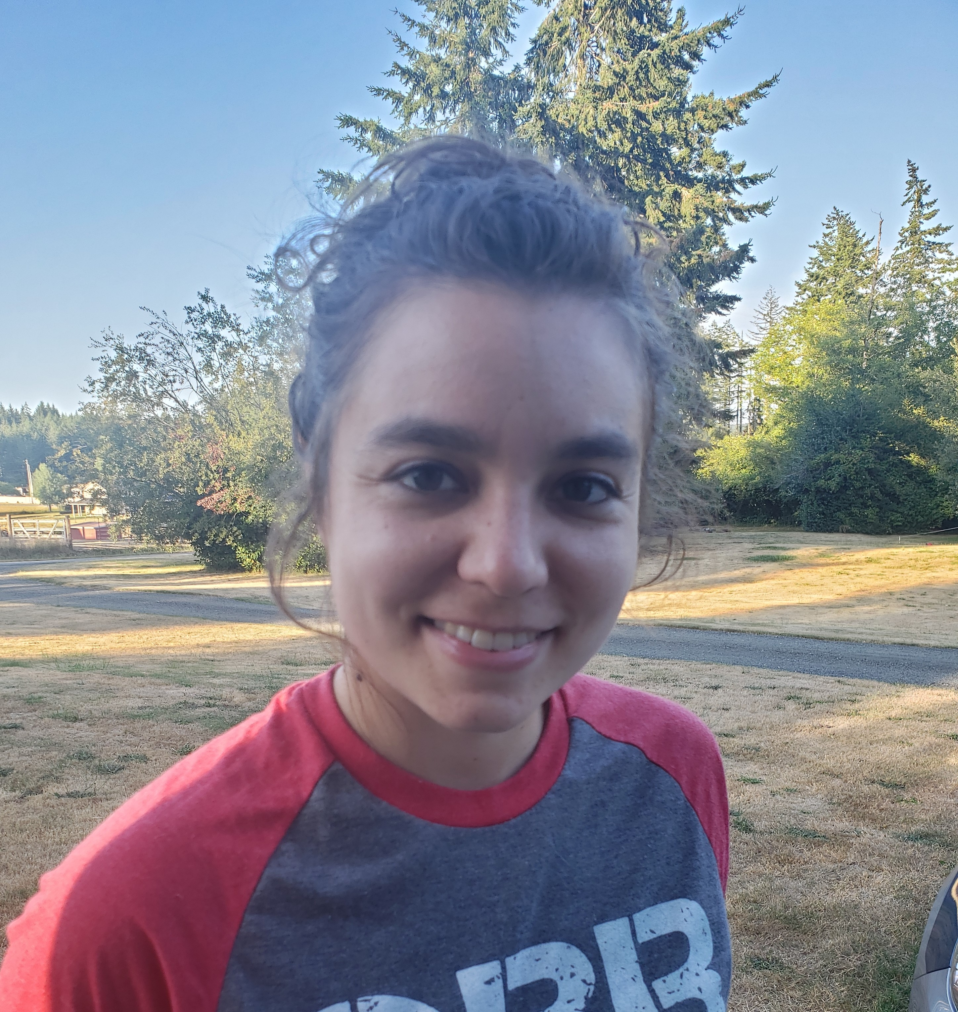
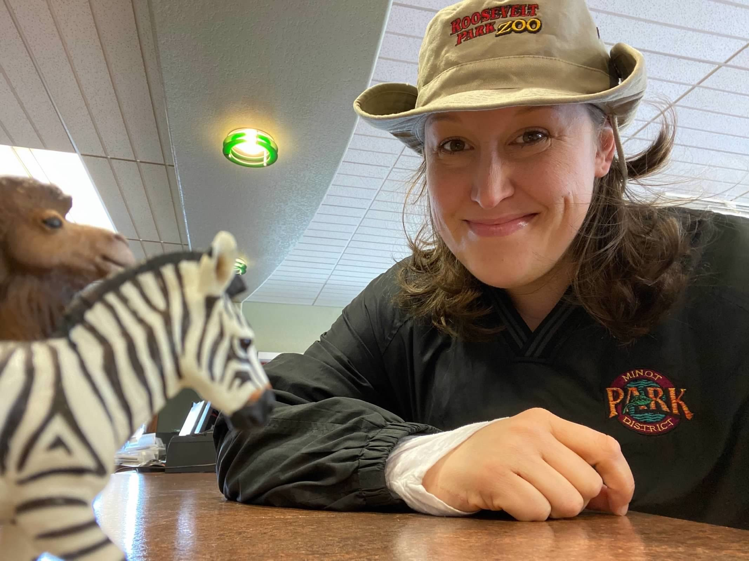
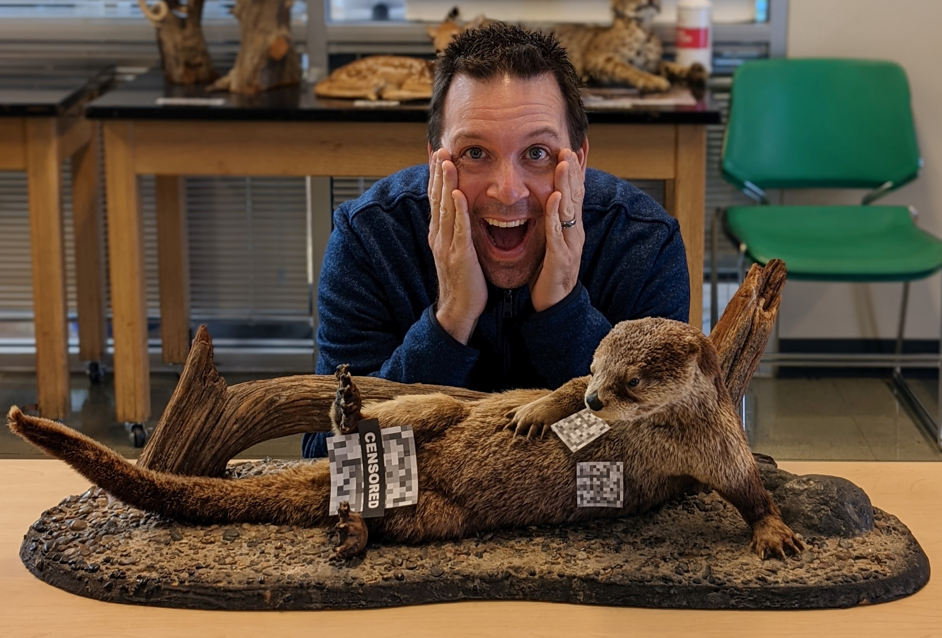
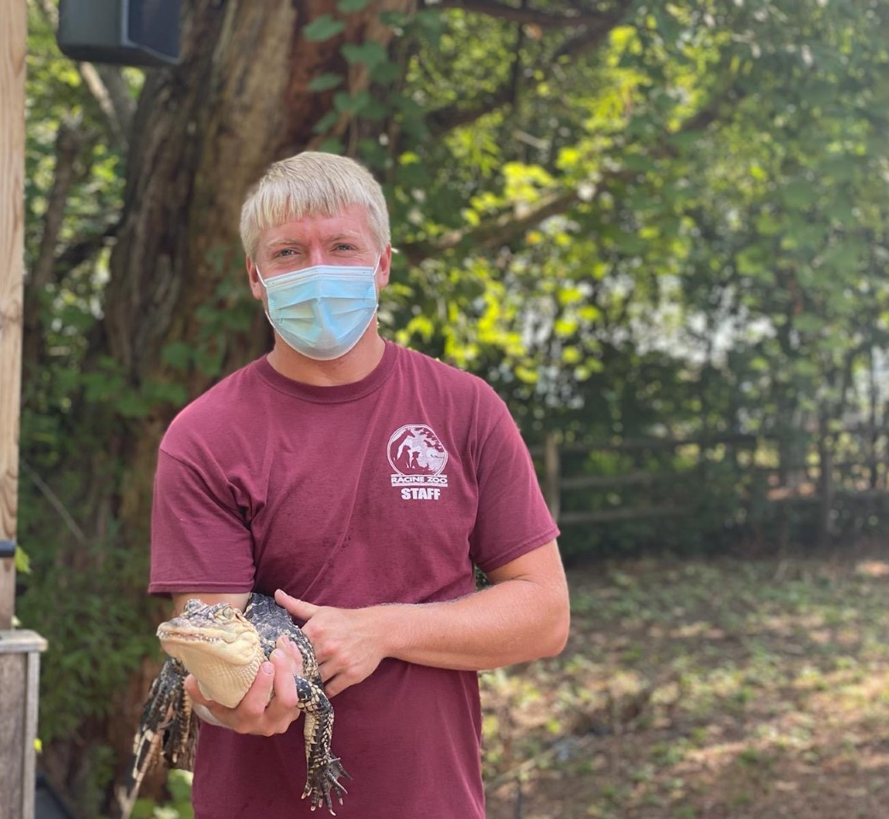
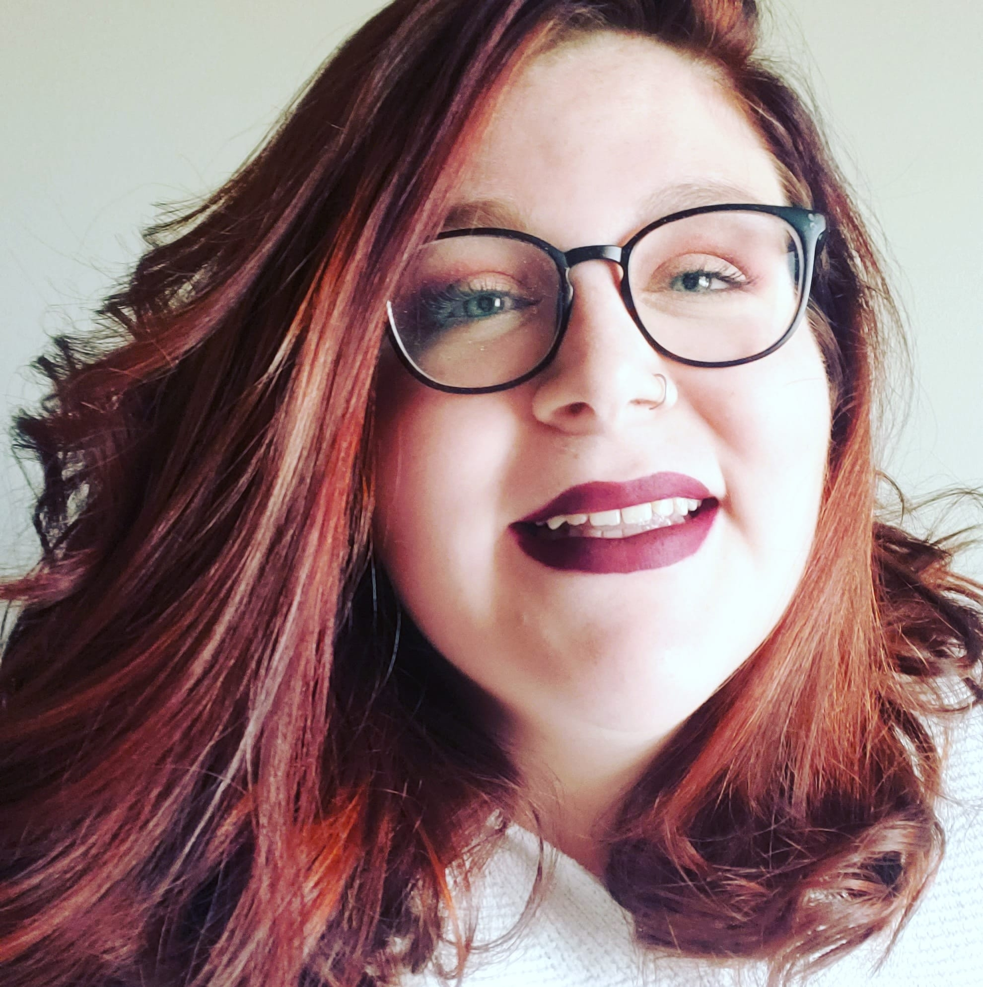
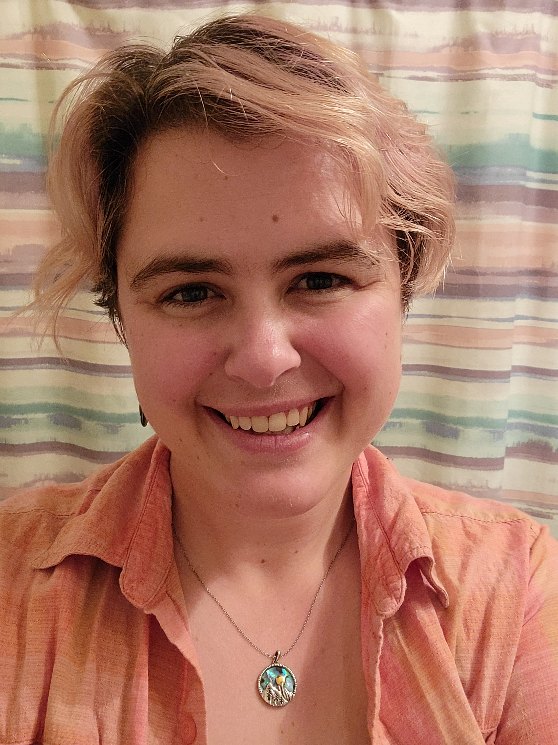
Communications Committee
Chair: Paul Vandermeuse
Meagan Ashton
Seattle Aquarium, WA
Jennifer Kleen
Roosevelt Park Zoo, ND
Paul Vandermeuse
Zoological Society of Milwaukee, WI
Ryan Retzke
Racine Zoo, WI
Heather Harelson Nutick
Red River Zoo, ND
Katie Elam
ZooMontana, MT
The mission of the Communications Committee is to nurture connection and collaboration to further empathy practices with the goal of sharing more accessible and effective voices for conservation action.
Notes:
MEAGAN + Communications Committee
Introduce themselves in the order on the slide.
Advance slide after Katie.

Slide 7
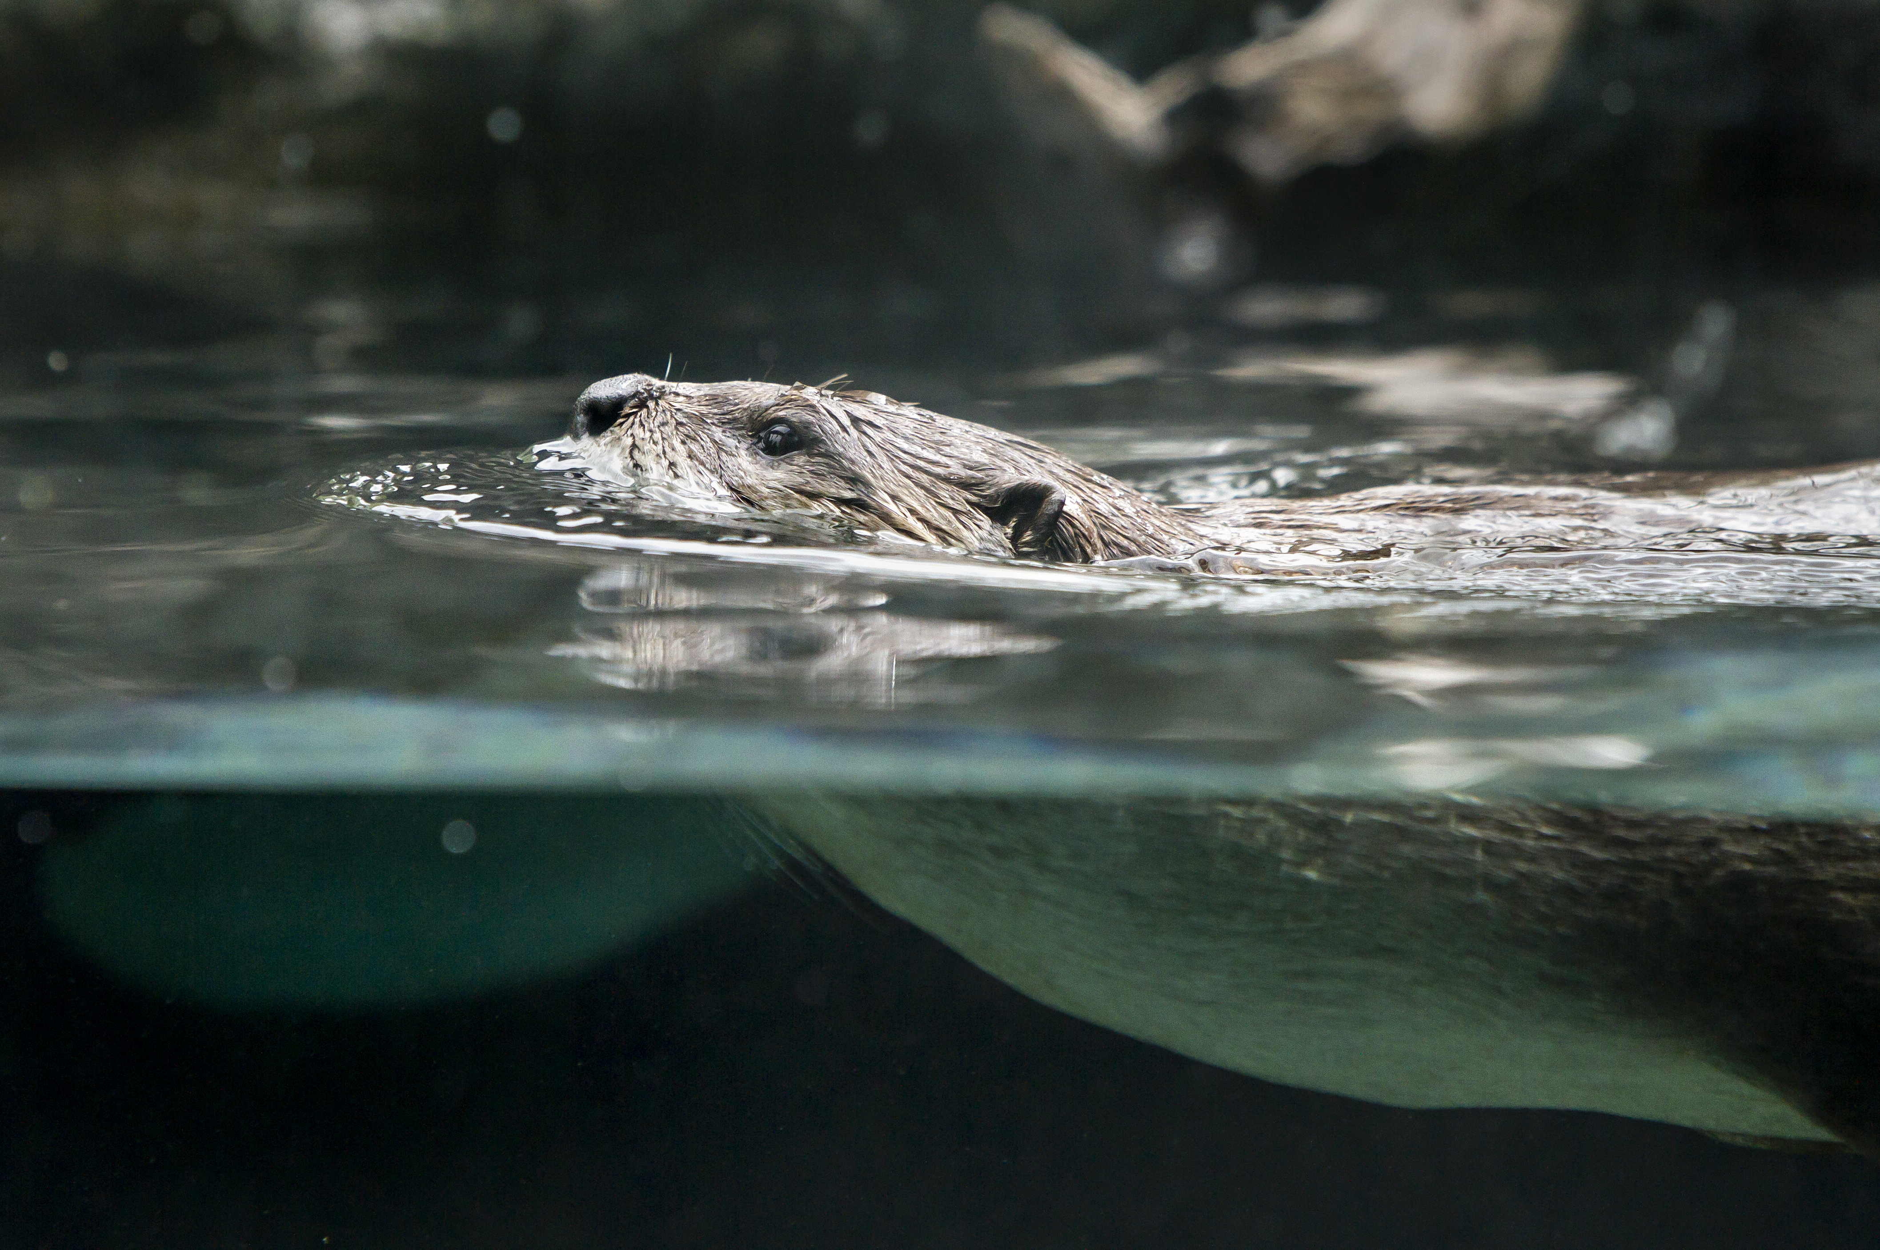
Communications Committee Updates
Streamline Network communication
Re-evaluate website organization
Action informed by data from Rapid Inquiry Cycle #1
Closed the Google Group in July to move intra-Network communication to the discussion board.
Kickstarted the creation of the Empathy Matters Newsletter that is curated by Marta Burnet and goes out monthly.
Created an Empathy Glossary page.
Reorganization of the Empathy Resources page.
Added a "Fun" channel on the discussion board.
Provide opportunities for relationship building
4 social/happy hours this year.
  February 10th
  April 8th
  October 13th at 2pm
  TBD!
Notes:
MEAGAN
Drop Zoom link for the happy hour in the chat

Slide 8
Looking to 2023
Enhance community
Restructure the discussion board to help encourage posting and community building.
Facilitate sharing
Create a Network conservation work and projects database.
Collaborate
Work with the Membership Committee to create a standardized welcoming process for ACE for Wildlife Affiliates and new Partners.
Notes:
MEAGAN
Transition it to Emily

Slide 9
Investigating the Impact of Preschool Type on Young Children's Empathy
Dr. Julie Ernst
University of Minnesota, Duluth
Notes:
EMILY INTRODUCES CLAIRE/JULIE
EMILY Introduces Tierney/Membership Committee

Slide 10
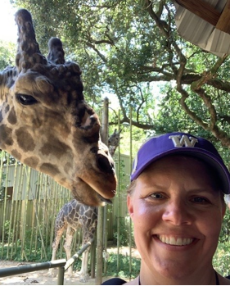
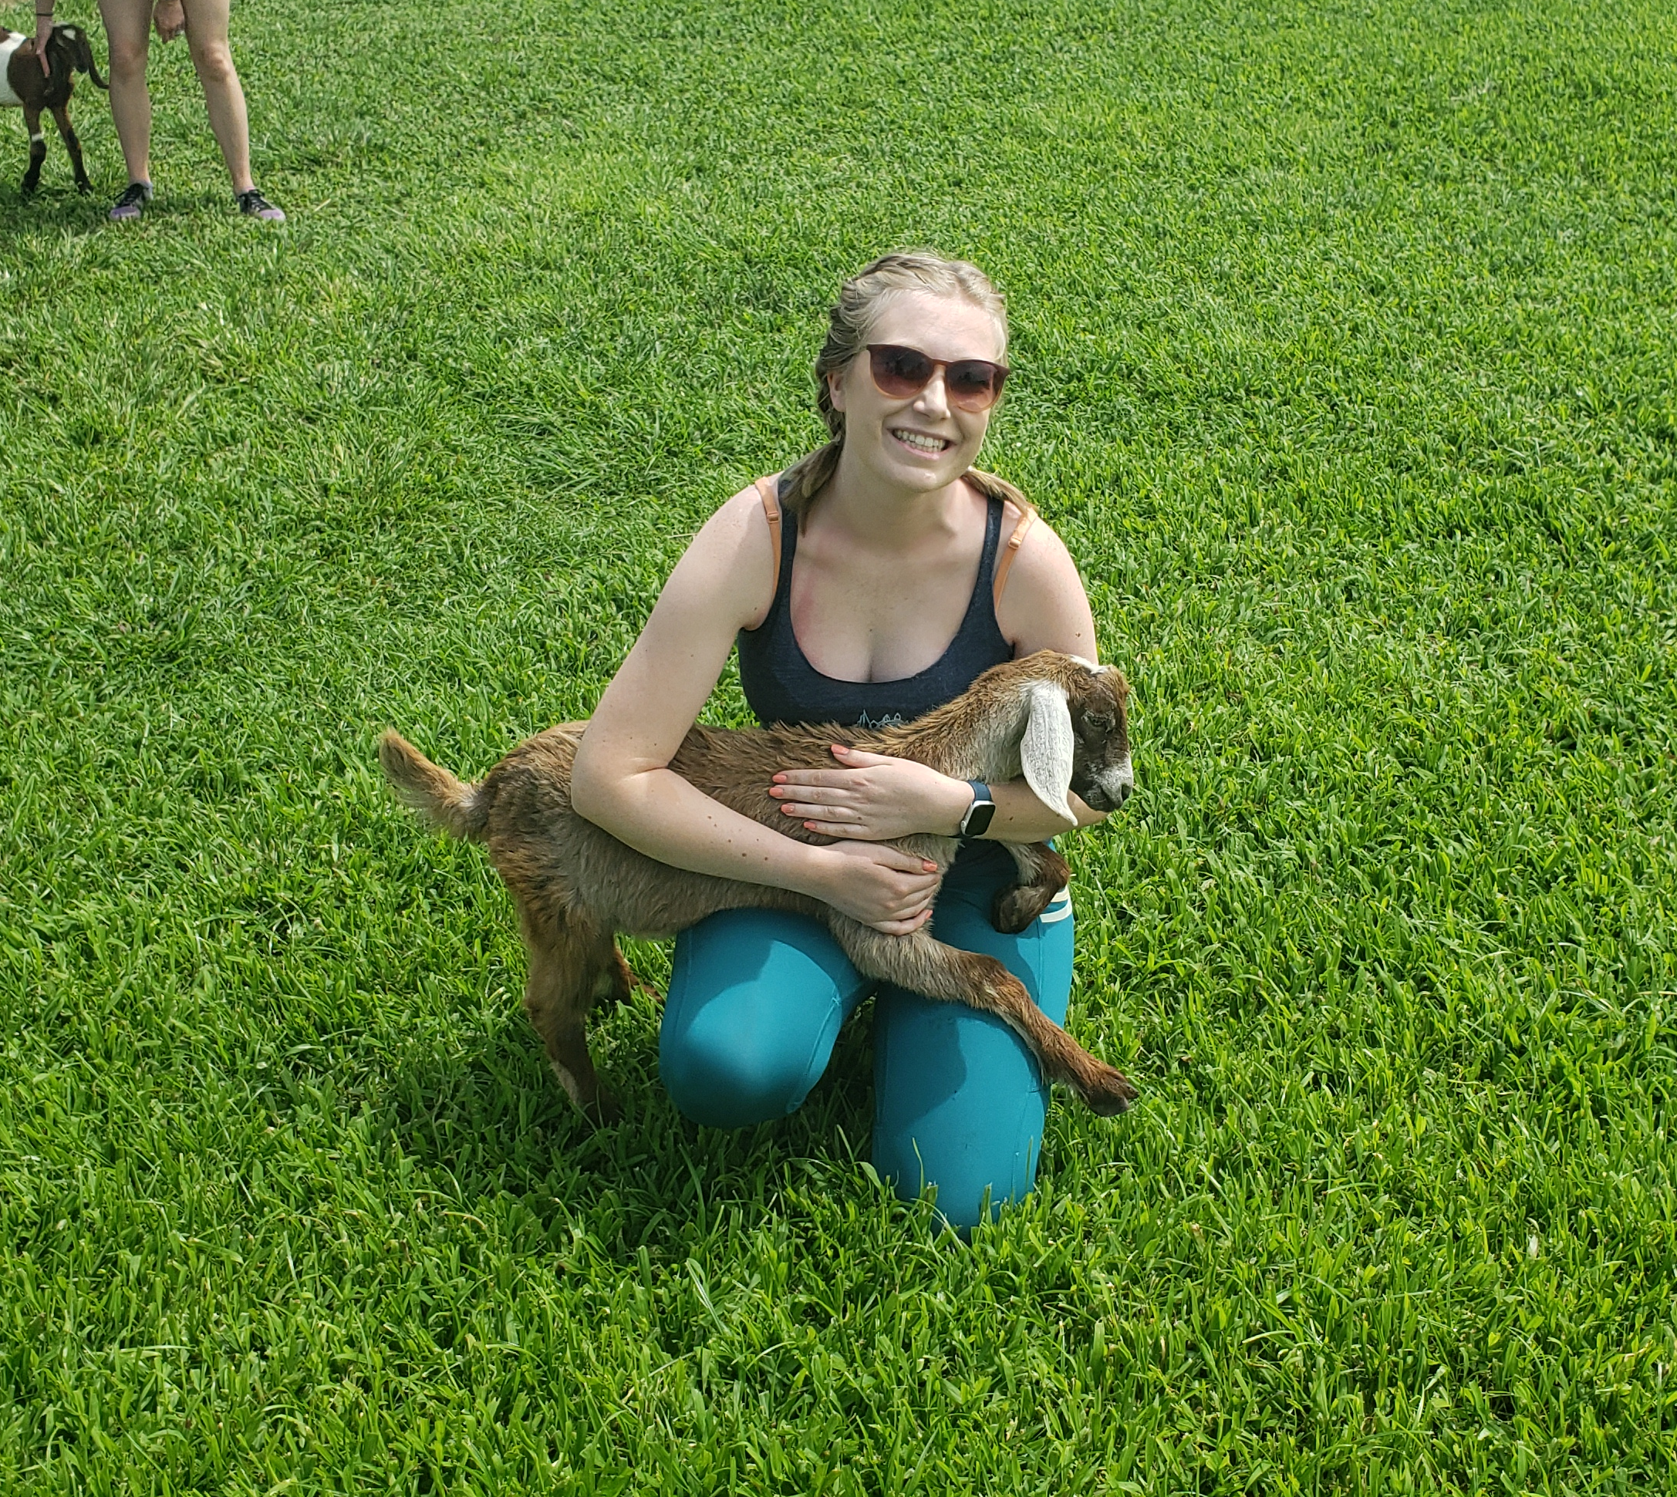
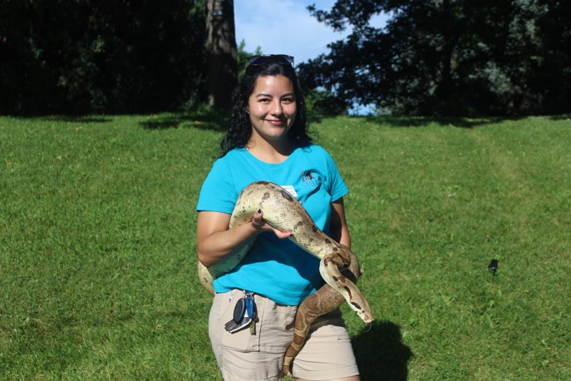
Membership Committee
Tierney Ball
Zoo Boise, ID
Fernanda Mora
ZooMontana, MT
Heather Harelson Nutick
Red River Zoo, ND
Marta Burnet
Woodland Park Zoo, WA
The Membership Committee is responsible for developing the guidelines and practices of ACE for Wildlife membership levels and collaborating with the other committees to nurture connection between and within membership levels as the Network grows.
Notes:
Emily will hand over to y'all to introduce yourselves in the order of the pictures.

Slide 11


THANKS, EVERYONE!
Welcome ACE for Wildlife Network Affiliates!
Congratulations on passing the first ACE for Wildlife Network bylaws!
Notes:
TIERNEY
We are so excited to be joined today by many of our new affiliates, a new status of level of involvement for the Network. Welcome to your first Network event!
Take this time to welcome Affiliates to their first large Network event.

Slide 12
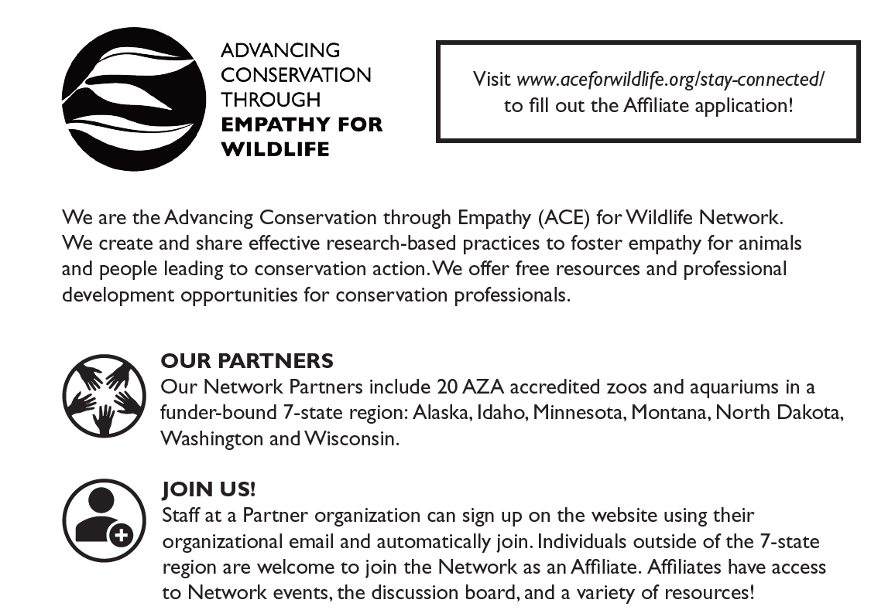
Welcome ACE for Wildlife Affiliates!
Network Affiliate
Introductory level of participation in the ACE for Wildlife Network.
Open to individuals not employed by our Institutional Partners.
Do not have voting rights.
Unable to serve on committees.
Network Member
Individuals employed by our Institutional Partners.
Have voting rights.
Able to serve on committees.
Notes:
TIERNEY
Affiliates are able to apply through the ACE for Wildlife website and are asked to provide information regarding their interest in the Network, as well as any relevant experience. Regardless of previous work, all who are interested are encouraged to apply, as we value the input the range of organizations and individuals have to offer. Applications are reviewed monthly and accepted affiliates are welcomed with an orientation letter, including links to videos that walk through the ACE website and discussion board.
Talk main difference between two levels: While affiliates can’t join committees or vote, they do still have access to some great resources and conversations, like these!
Review main goals of Network: sharing resources on fostering empathy based practices to lead to further conservation action
Talk about how the Affiliate application process works, success from AZA conference. Talk about video orientation links for Members and Affiliates.

Slide 13

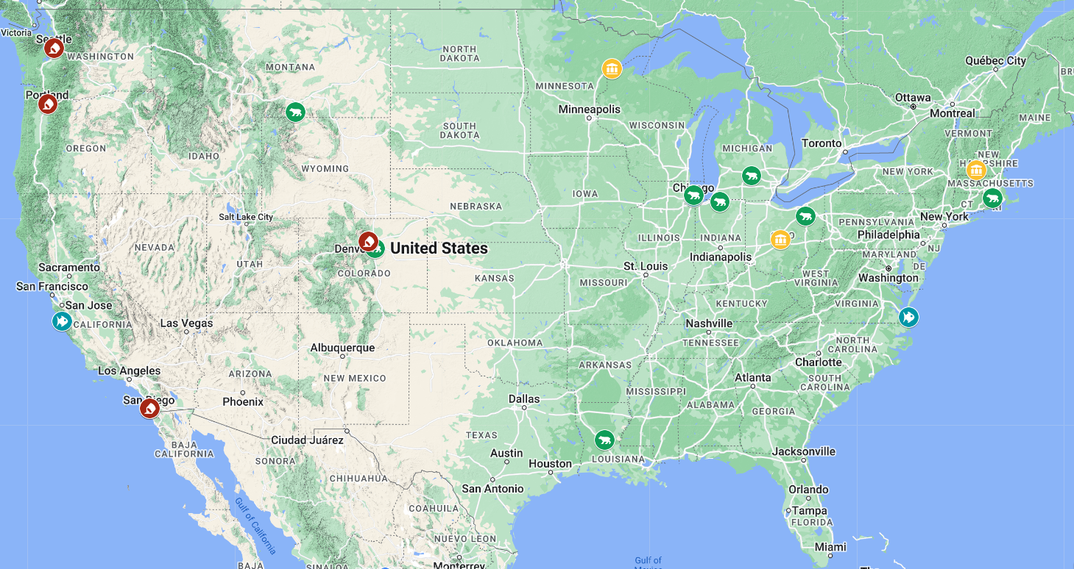
27 Individual Affiliates at
7 zoos
  San Diego Zoo Wildlife Alliance
  Yellowstone Wildlife Sanctuary
  Potawatomi Zoo
  Lincoln Park Zoo
  Denver Zoo
  Alexandria Zoological Park
  Potter Park Zoo
  Akron Zoo
  Roger Williams Park Zoo
4 consultants
  AWARE Institute
  Beez Kneez Creative
  ECOS Communications
  Kathryn Owen Consulting
3 aquariums
  Shedd Aquarium
  Monterey Bay Aquarium
  Virginia Aquarium and Marine Science Center
3 universities
  University of Minnesota Duluth
  Otterbein University
  Antioch University New England
Notes:
TIERNEY
As of 9/29 this is our map of the various organizations that we have Network Affiliates at. This would be a good place to mention that AZA attributed to a lot of the Affiliate spread we see across the country (we didn't have a lot of eastern coast places prior).
Red pencil: consultant
Blue fish: aquarium
Green bear: zoo
Yellow building: university

Slide 14
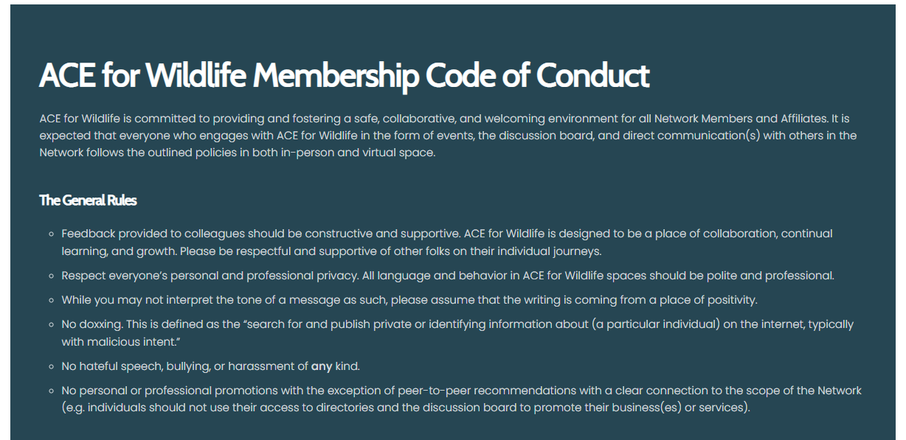
ACE for Wildlife Code of Conduct
In response to events both in and out of the Network this year that impacted many of our Members, we decided it was important to have an intentional document stating engagement rules and support for Network Members.
This document can be found on the "Our Membership" page on the ACE for Wildlife website.
Voting on the content of this document will occur during the bylaw amendments section of the Steering Committee's share-out.
Notes:
TIERNEY
Code was shared prior to meeting, but ultimately focuses on specifics that allow the Network to remain a positive and professional environment for everyone involved.
We don't need to specify what they events were – keep it vague.

Slide 15
Looking to 2023
Recruitment
ACE for Wildlife recruitment video.
Focusing on what active recruitment of Members and Affiliates will look like moving forward.
Ensuring an equitable process
Regular collaboration and communication with the Diversity & Inclusion working group.
Active collaboration
Working in coordination with the Steering Committee as a 3–5 year plan for the Network is created.
ACE for Willdife booth at AZA 2023.
Notes:
TIERNEY
Can use this slide as a recruitment slide as well.
Tierney passes it to Liz and the Strategic Learning Committee.

Slide 16
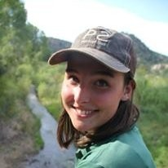
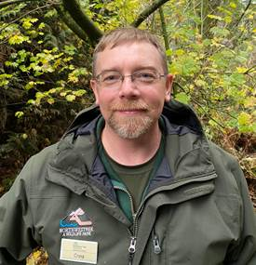
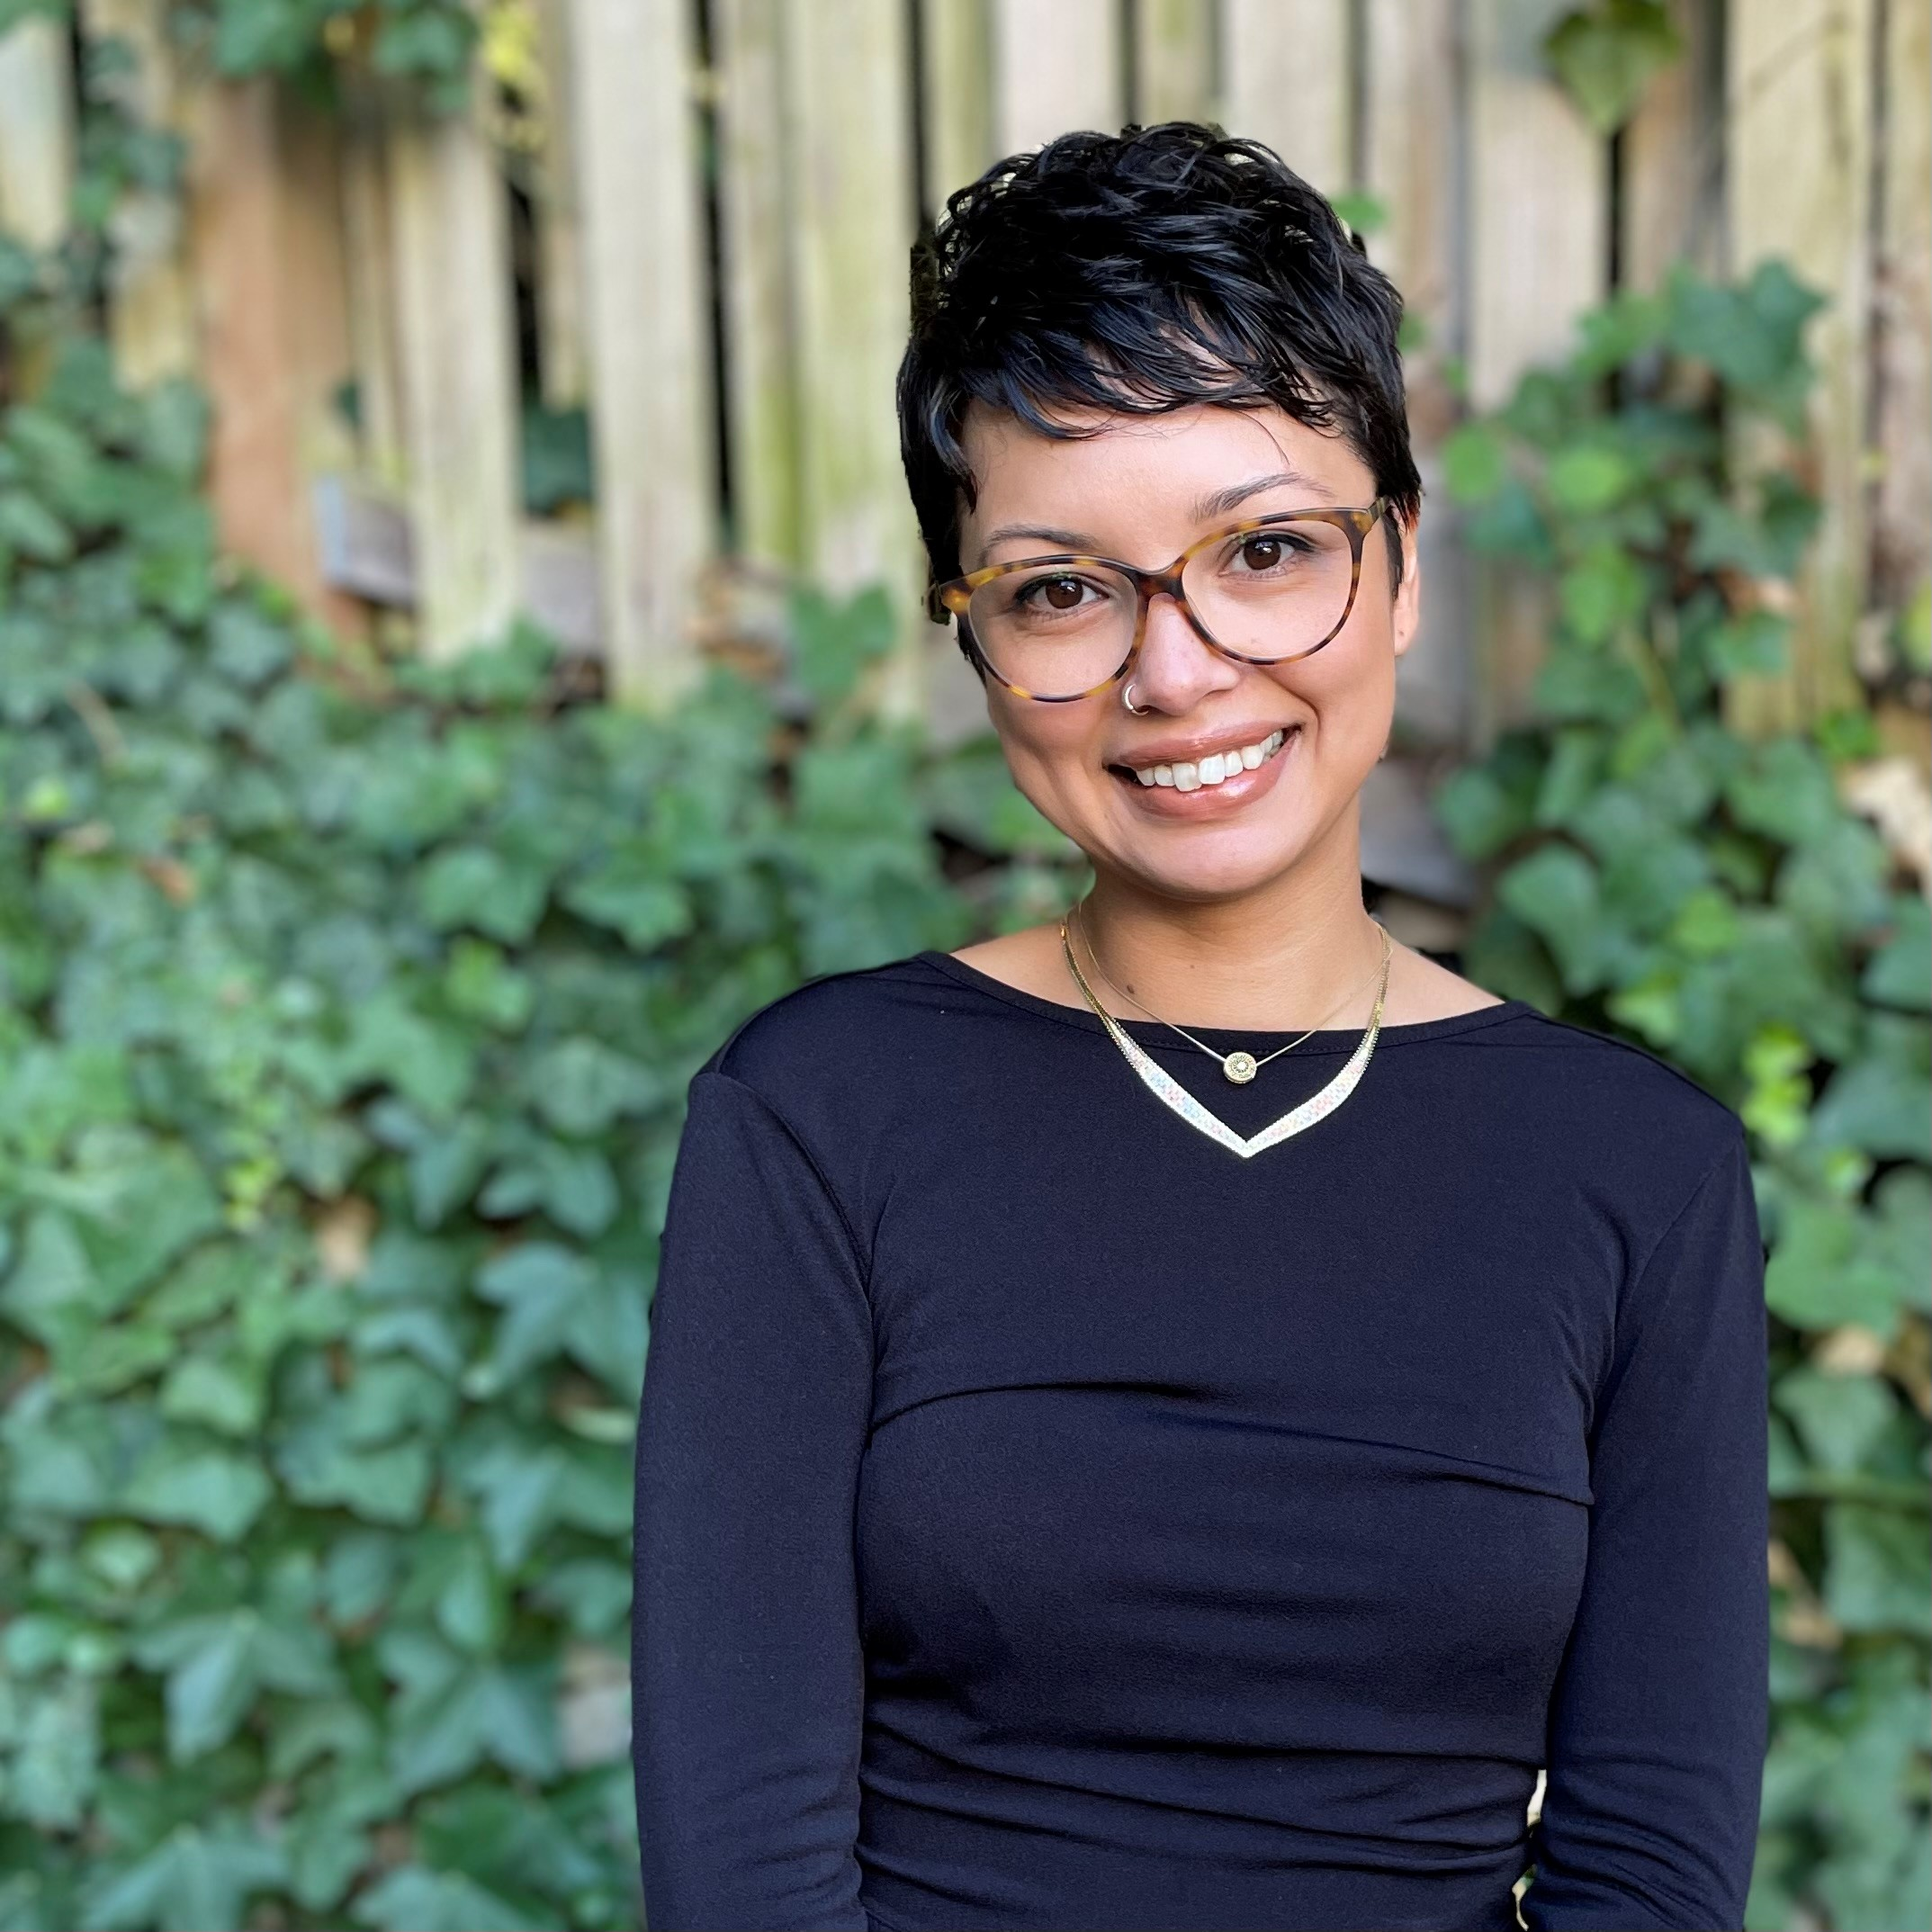
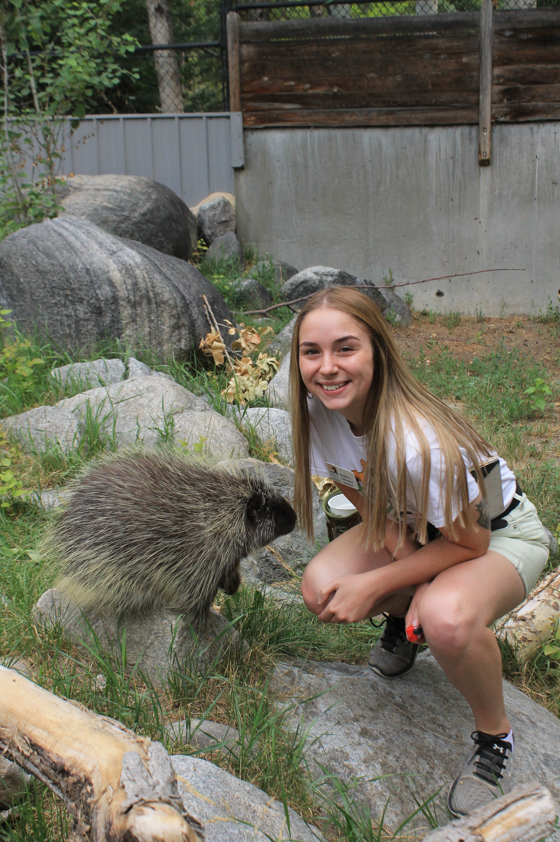
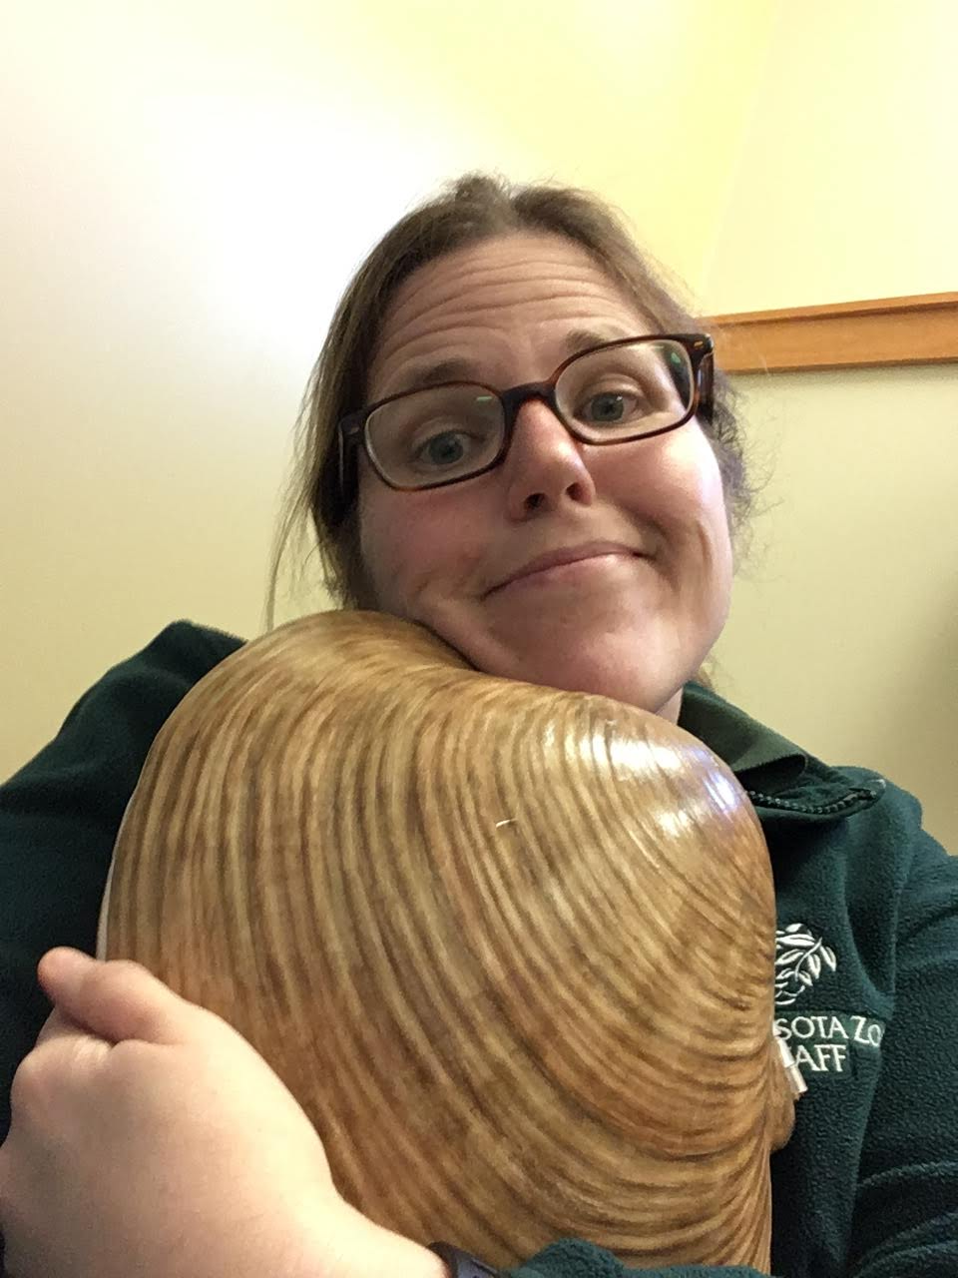
Strategic Learning Committee
Chairs: Isabelle Herde & Liz Gilles
Liz Gilles
Minnesota Zoo, MN
Isabelle Herde Bieser
Zoological Society of Milwaukee, WI
Craig Standridge
Northwest Trek Wildlife Park, WA
Melia Paguirigan
Woodland Park Zoo, WA
Brooke Tucker
ZooMontana, MT
The mission of the Strategic Learning Committee is to drive the learning priorities of the ACE for Wildlife Network so the network can collaboratively learn, build skills, and share expertise.
Notes:
LIZ
Tierney will be passing it off to this committee – folks will introduce themselves in the order of the images on the screen.

Slide 17
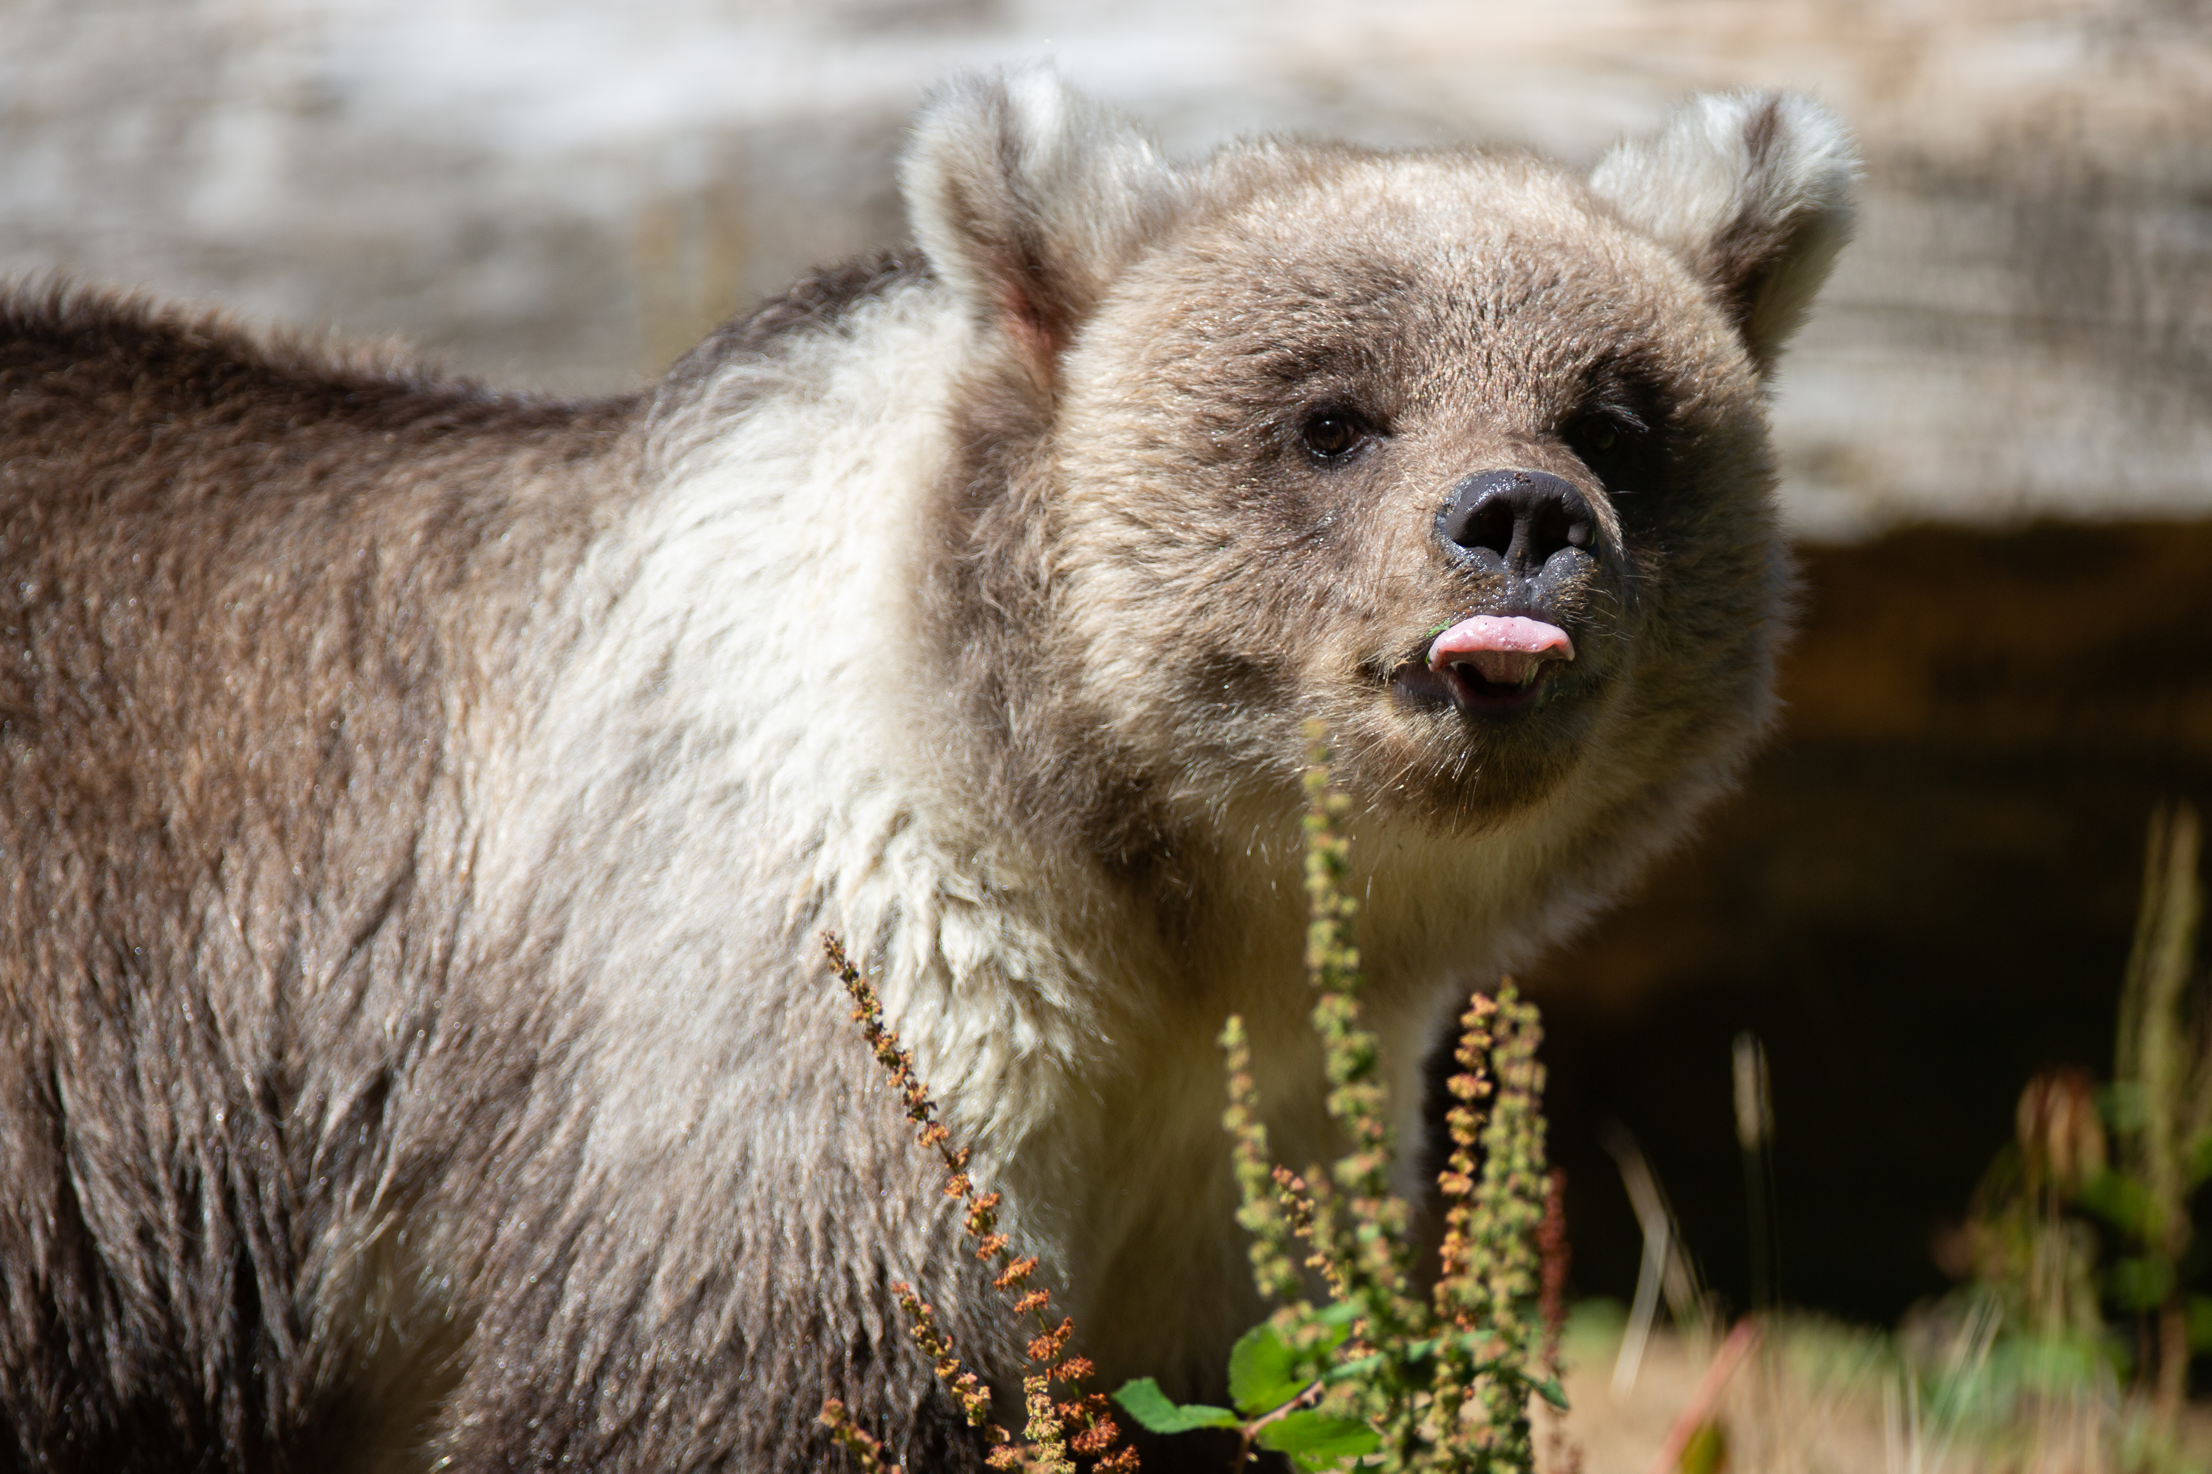
Strategic Learning Question #1
How are we sustainably promoting empathy for animals and people within and across our organizations?
ACE for Wildlife Empathy Training Toolkit
Resources gathered from 9 Institutional Partners
Five videos with accompanying scripts and audio
  Introduction to empathy and the ACE for Wildlife Network
  Types of empathy
  Effective empathy practices
  The empathy bridge
  Anthropomorphism
Resources on DEAI practices and their intersections with empathy
Empathy evaluation how-to
Notes:
LIZ
Deliverables around SLQ #1
Bullet points are examples of what will exist in the toolkit (data from sight visits are on the next slide that informed this)
Data and insights from site visits: https://drive.google.com/file/d/18vfr_Ajlz3sBwemAB_tDVqNl2Ue1eEde/view?usp=sharing

Slide 18

WHAT RESOURCES DO YOU WISH EXISTED WITHIN THE NETWORK?
The resources that folks are interested in correlate with the empathy struggles that Institutional Partners identified.
Notes:
LIZ
Information gathered from our Apr-June 2022 site visits.
*PT/TTE = part time

Slide 19
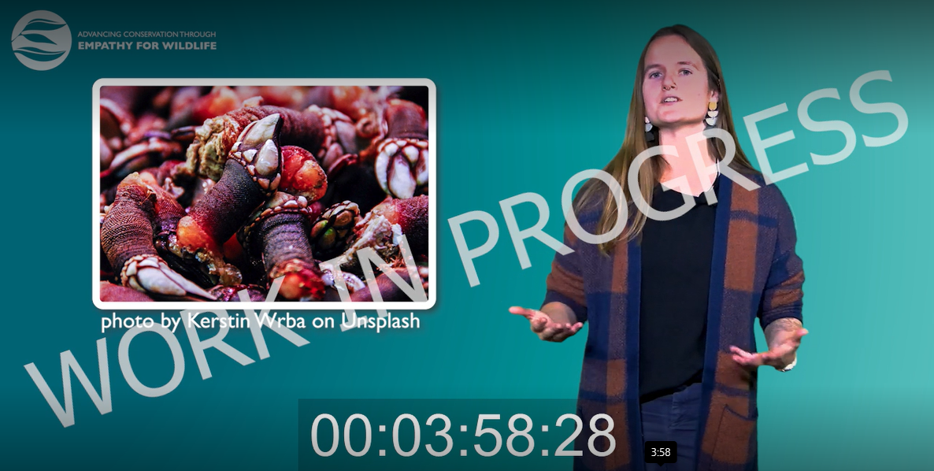
INTRO TO EMPATHY + ACE FOR WILDLIFE VIDEO
The first video of the empathy training toolkit is close to being finished!
The completed version will be posted on the discussion board soon for Members to review.
Notes:
LIZ

Slide 20
Strategic Learning Question #2
What are the intersections of empathy (and empathy for animals) and diversity, equity, inclusion, and justice (DEIJ) oriented futures in zoos and aquariums?
DEAI Learning Group Series
DEAI Working Group
Series goals
  Create a space for folks to collectively unpack the processing that comes along with their DEAI journey.
  Highlight the different ways that zoos and aquariums within our Network are tackling DEAI work as well as discuss and digest the challenges that people encounter.
  Create a space to reflect on the intersection between DEAI and empathy.
First event held September 13th facilitated by Ivel Gontan.
Future events informed by Rapid Inquiry Cycle #3.
Aim to hold the next event in December.
Created in coordination with the Steering Committee to have a group of people dedicated to giving this SLQ the full attention it needs.
Held first meeting in July – actively recruiting working group members!
Notes:
LIZ
DEAI learning group series + the working group are the two main deliverables around this question.

Slide 21
Looking to 2023
ACE for Wildlife & AZA
Investigating the link between ACE for Wildlife's mission and learning questions and the AZA Social Science Research Agenda.
Collaboration
Working with the Diversity & Inclusion Working Group to further our work with the second strategic learning question.
Increasing capacity
Editing the empathy training toolkit as it gets piloted throughout 2023.
Notes:
LIZ
You can also use this slide to recruit potential future members (mention that there is a chance to sign up at the end of the meeting).
Pass off to Aszya and the Steering Committee.

Slide 22
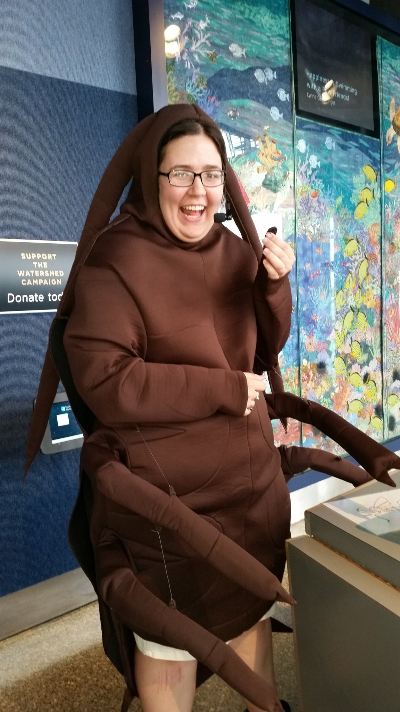
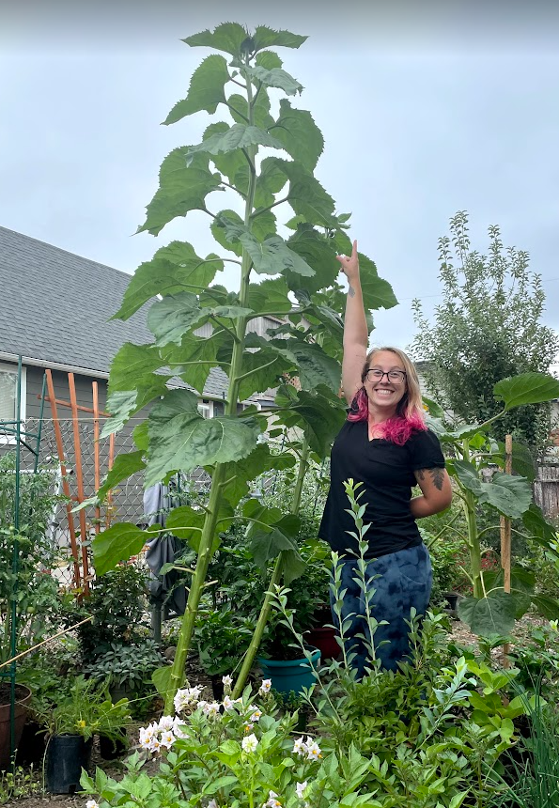
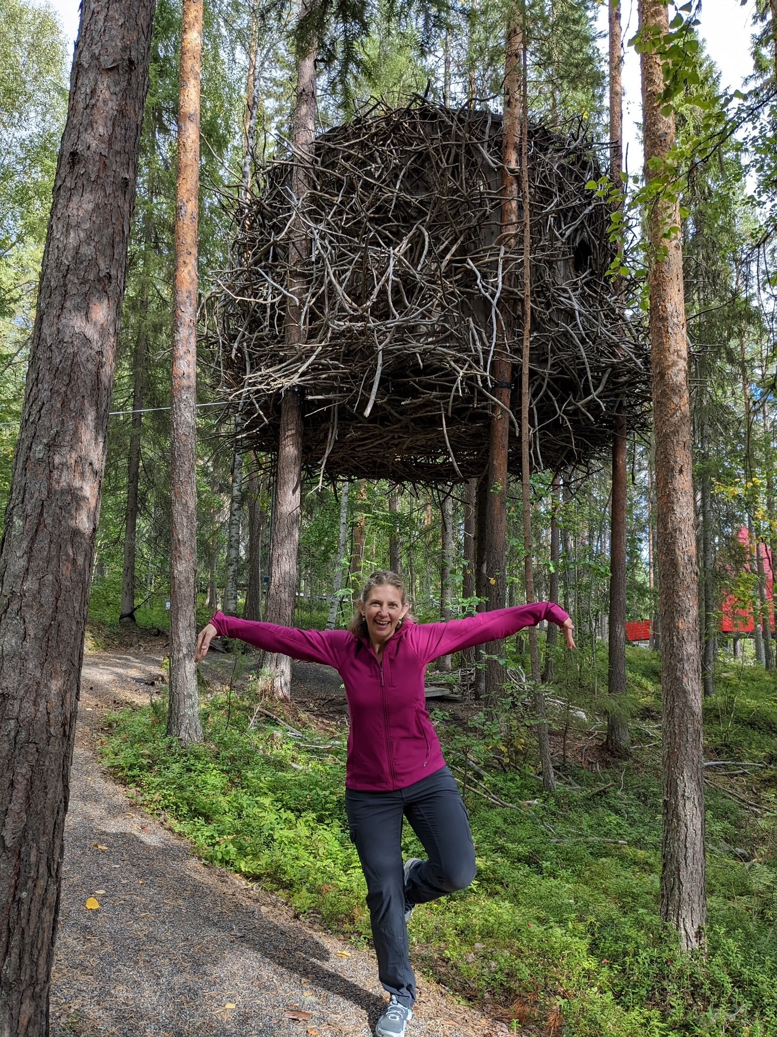
Steering Committee
Chair: Aszya Summers
Aszya Summers
Racine Zoo, WI
Laurel Abbotts
Woodland Park Zoo, WA
Jess Thompson
Henry Vilas Zoo, WI
The Steering Committee’s goal is to decide priorities, goals, structure, and direction of the Network.
Notes:
Introduce themselves in the order of the photos

Slide 23
ACE for Wildlife Network Expansion Refresher
Demand Based
Admit any interested AZA accredited institution regardless of empathy experience/knowledge.
Experience Based
Admit AZA organizations who have already begun to incorporate empathy into their operations.
Two-tiered Approach
Admit AZA organizations with experience to full membership, those with little/no experience to an affiliate status while we help them build their capacity.
Regional Expansion
Add neighboring states and grow geographically in phases.
Presented 4 different expansion options at the February Summit.
SMOREs groups discussed likes/ dislikes for each option.
Steering Committee took the notes from the SMOREs groups and large group discussion to determine which approach best suits our Network going forward.
Notes:
ASZYA

Slide 24
Transitioning from...
Demand Based
Admit any interested AZA accredited institution regardless of empathy experience/knowledge.
Demand Based with flexibility
Expansion will be on a flexible, demand-based basis that allows interested applicants to choose their level of participation through either individual Affiliate status or an organization as an Institutional Partner.
Notes:
ASZYA

Slide 25
What does that mean?
Be accredited by AZA
Be organizationally committed
Organizational leadership has signed the ACE for Wildlife letter of commitment
Have attended or watched an introductory empathy training
Items within the Empathy Training Toolkit
Best Practices in Developing Empathy Towards Wildlife Executive Session recording
Seattle Aquarium empathy workshop
Organizations attend at least 4 Network events (including recordings) yearly.
ACE for Wildlife Institutional Partner
This is noted in the supplemental bylaw document.
Notes:
ASZYA

Slide 26
Terminology Refresher
Network Affiliate
Introductory level of participation in the ACE for Wildlife Network.
Open to individuals not employed by our Institutional Partners.
Do not have voting rights.
Unable to serve on committees.
Network Member
Individuals employed by our Institutional Partners.
Able to serve on committees.
Network Parter (Institutional Partner)
Only open to organizations, not individuals (e.g., Woodland Park Zoo is an Institutional Partner, not Emily Bernhardt).
Requires buy-in from organizational leadership.
Votes are represented by organizational representatives.
Participate in Capacity Building Grant projects.
Notes:
ASZYA

Slide 27
Proposed Bylaw Amendments
Remove
Insert
Guidelines for expansion of ACE for Wildlife will be proposed by the Steering Committee with input from the network for consideration at a later date.
Code of Conduct
  ACE for Wildlife is committed to providing and fostering a safe, collaborative, and welcoming environment for all Network Members and Affiliates. It is expected that everyone who engages with ACE for Wildlife in the form of events, the discussion board, and direct communication(s) with others in the Network follows the outlined policies and rules in our Code of Conduct in both in-person and virtual spaces.
  The full Code of Conduct can be read here, or on the “Our Membership” page on www.aceforwildlife.org.
  The Membership Committee is responsible for drafting and updating the Code of Conduct.
Insert
Expansion Plan
  The ACE for Wildlife will expand beyond the current 7-state region on a flexible, demand-based basis that allows interested applicants to choose their level of participation through either an individual Affiliate status or as a full Institutional Partner.
  In addition to institutional membership requirements outlined under Membership Structure, new Institutional Partners must:
    Have at least one staff member attend or watch an introductory empathy training to ensure that they have a base level understanding of empathy practices and ACE for Wildlife.
    Have at least one Member attend at least 4 Network events (including recordings) per year.
The full expansion plan can be read here.
The Steering Committee is responsible for drafting and overseeing implementation of the expansion plan.
Notes:
ASZYA – make sure you message her about the poll before her speaking portion

Slide 28
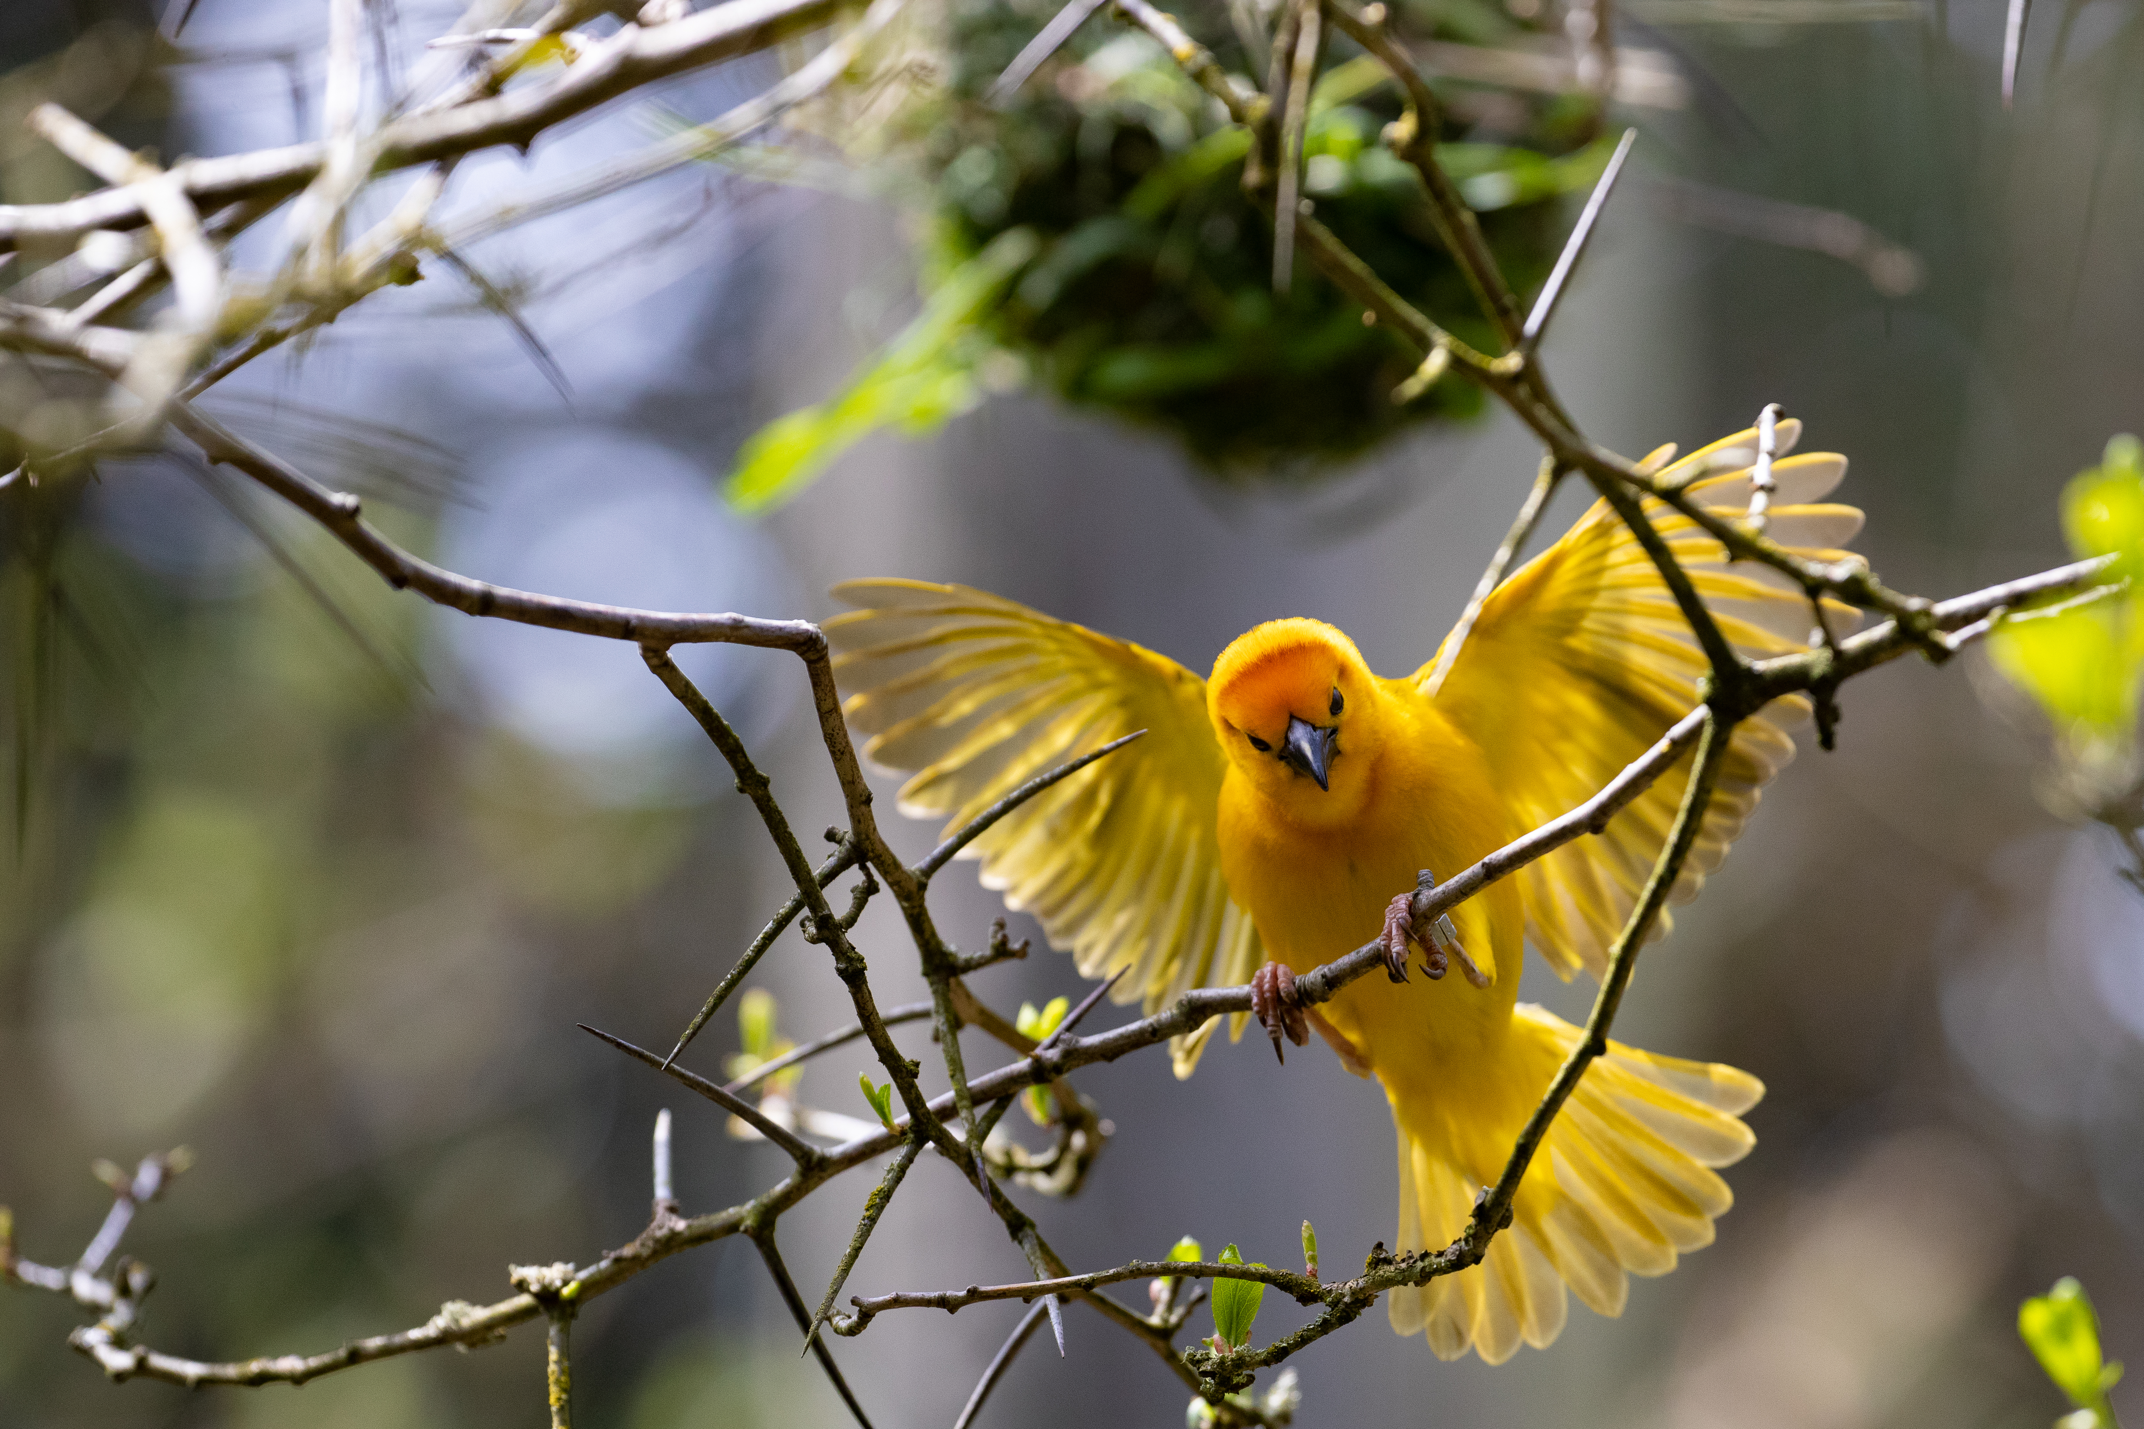
Looking to 2023
Collaborate
Continue working with the Membership Committee to ensure that the Affiliate and general expansion process is equitable and continues to align with the scope and direction of the Network.
Create Empathy Adoption Rubric.
Develop a 3-5 year plan for the ACE for Wildlife Network.
Recruit new Members.
Build up the Network
Notes:
ASZYA
Pass off to Marta

Slide 29
Conservation Calls to Action Brainstorming
Marta Burnet
Notes:
MARTA

Slide 30
Looking to 2023
Support messaging
Make it easier for Partners to consistently encourage guests to take caring and conservation action(s)
Collaborate
Foster collaboration and shared learning about calls to action
Increase capacity
Identify ways to evaluate calls to action to assess impact and incorporate reflection/improvement cycles
Notes:
MARTA
Good morning everyone! Work continues on the conservation action project. Based on the conversations we have had and the survey results, the things we are going to be focusing on as we finish out the year and move into 2023 will be to:
Support messaging – we want to make it easier for make it easier for Network Partners to consistently encourage guests to take caring and conservation action(s). We will do that by continuing to gather examples and resources of various calls so folks “don’t have to reinvent the wheel” – something we heard a lot and identifying and sharing ways to be more intentional about fostering empathy as part of calls to action. So if you have Conservation event templates and completed event samples with programs, activities, calls to action, social media clips for others to adapt please email me at Marta.Burnet@zoo.org!
And then next we have a reoccurring theme here, collaborating. We want to Foster collaboration and shared learning about C2As (both as an end goal and way to make it easier to do C2As). We have a learning group coming up later this month and I am hoping to recruit a working group to help with this work moving forward.
And then finally, one thing that came out in the surveys and conversations, folks are so busy moving from one thing to the next, we aren’t spending a lot of time identify ways to evaluate C2As for assessing impact and incorporating reflection time, so that we can make improvements. This also will help with building evaluation capacity!)

Slide 31
Let’s Brainstorm!
Name | Date | Possible Links to Conservation Topics | List any Existing Resources | Done Before? (Name of Zoo/Aquarium) | Interested in Doing? Your Name, email
New Year's Day | 1/1 | Conservation resolution? 12 conservation resolutions | 12 New Year's Resolutions for Conservation | NRCS Pacific Islands Area (usda.gov)
National Bird Day | 1/5 | Bird-Safe Coffee, Keep Cats Indoors, Anti-strike tape | Live Bird Friendly® | Smithsonian's National Zoo (si.edu)
National Penguin Day | 1/20 | Seafood watch, reduce carbon footprint, plant a tree, less plastics, eat less meat | Join the movement | Recommendations | Seafood Watch, | Monterey Bay Aquarium | Marta Burnet marta.burnet@zoo.org
Steering Committee
Membership
Committee
Strategic Learning Committee
Communications Committee
D&I Working Group
Notes:
MARTA
So let’s get started! Several Members talked about wanting to develop seasonal campaigns with longer lead time, so folks can build into their planning.
Today we are going to break into small groups for about 10 minutes and look at https://docs.google.com/spreadsheets/d/1rNlQ-gHQ8e4zCMHcR51EGUqiqT4MIIRh/edit?usp=sharing&ouid=117337792874373147357&rtpof=true&sd=true a conservation calendar we have put together. I am putting the link in the chat. Sorry Emily that it wasn’t in your wonderful pre-meeting materials. Feel free to download this for your own purposes if you would like. That’s what it is here for!
So your group is going to pick a month. January has been started as an example. I want you all to brainstorm a list of :
Possible conservation links to the various significant dates listed. If you leave something blank, no big deal. If you see a significant date missing, feel free to add it. I encourage you to put in multiple items in each box if you have them.
And if you know of an existing resource like Seafood Watch or something, you can add it to column D.
The next column is for you to write out your zoo or aquarium if you have done it before, or if you know a zoo that has. This will help us to identify folks to reach out to to learn from them
And finally, I want you to take the last 2-3 minutes (I will send a reminder) to see if there are any that you individually are interested in doing in your month or other months. If so, write in your name and email (or if there is a colleague who would be the one to loop in, you can volunteer them). And this is partially to gauge interest, so you can sign up for as many as you want and this isn’t committing you to hours of work or anything, it is just a starting point. And if someone else’s name is already there, try not to replace it, but just list your name and email after theirs.
Hand it over to Fernanda and the D&I working group.

Slide 32
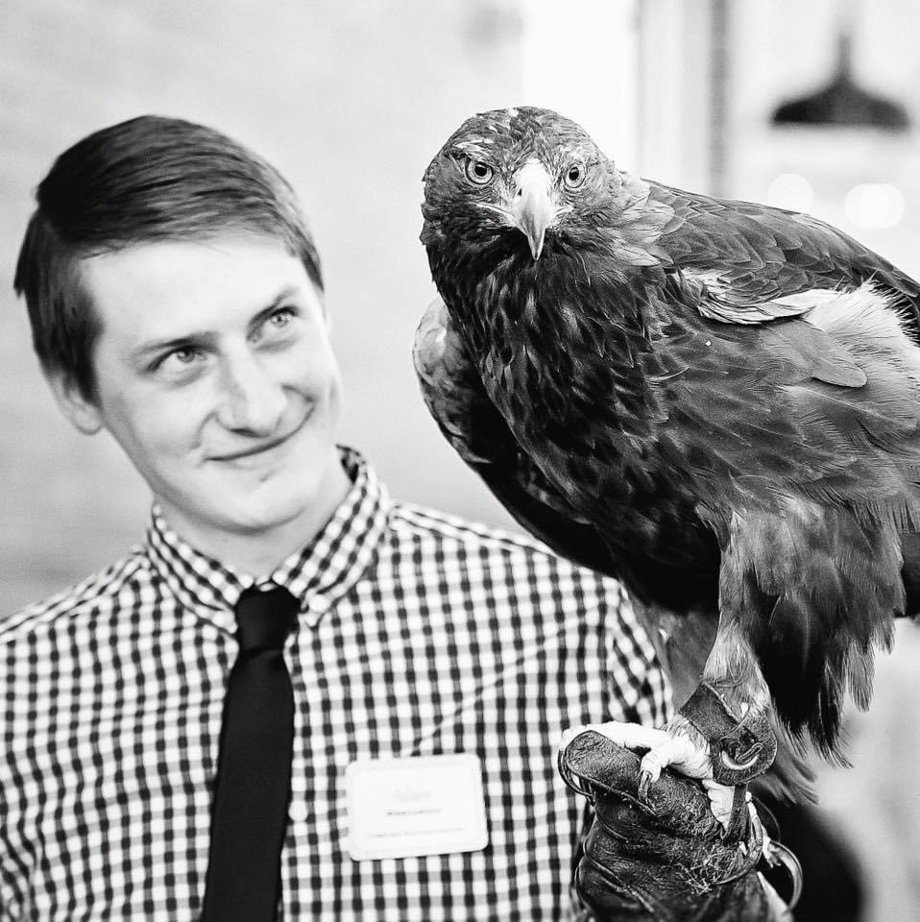
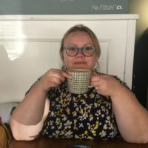
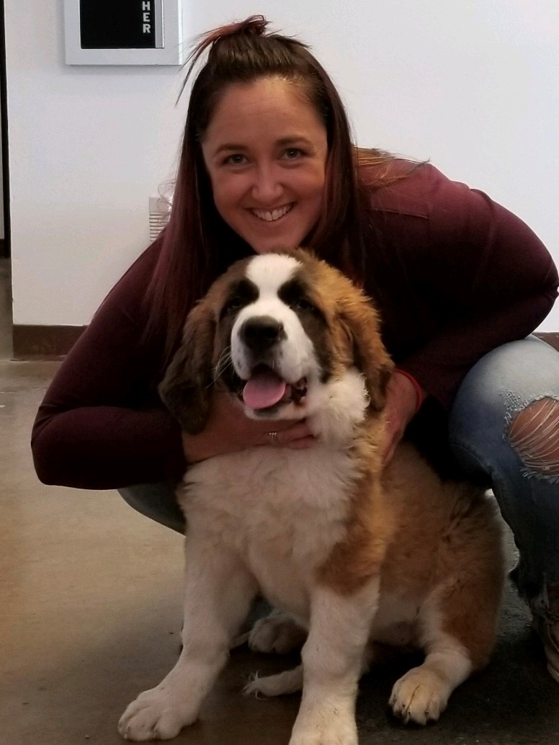
DEAI Working Group
Fernanda Mora
ZooMontana, MT
Adam Winegarden
Racine Zoo, WI
Shanna Hillard
Zoological Society of Milwaukee, WI
Andrea Tronson
Roosevelt Park Zoo, ND

Slide 33
DEAI working group
Why does this working group exist?
Address our second strategic learning question; "What are the intersections of empathy (and empathy for animals) and diversity, equity, inclusion, and justice (DEIJ) oriented futures in zoos and aquariums?"
What have we done so far?
Gathered input from Network Members.
Continue to ensure that the Network is an equitable space.
Facilitate the sharing of DEAI work being done across our Network.
Held 2 working group meetings to discuss these learnings.
Notes:
•Why does this working group exist?: We are all at different levels of our DEAI journey and come from facilities with different needs.
•What have we done so far?: Gathered input for Network members through asks on the discussion board, RIC #3 and the DEAI Learning Group Series #1 event to learn what would be beneficial for us to work on for the Network.

Slide 34
DEAI working group
Where are we going?
The trajectory of this working group is guided by the Network Members.
How can you get involved?
We encourage any Network Member to join and be a part of this working group!
Next meeting: October 18th at 10am PST
Have a 2-hour long meeting in November/December to determine the mission and vision of the working group.
Average of a 1-hour commitment monthly (like other committees).
Notes:
•Where are we going?
•The trajectory of this working group will be guided by the findings of the and continual input from Network Members.
•Give you what you need, not what we think you need.
•
•How can you get involved?
•FM to share ZooMT story, you do not have to be an expert to get involved, this is a learning opportunity and an opportunity to advocate for what you would like to see come out of this working group.
•If direct committee involvement is not possible, make sure you are giving us feedback and interacting with the discussion board posts and learning groups we may put out in the future.

Slide 35
Committee sign-ups
Steering Committee
Membership
Committee
Strategic Learning Committee
Communications Committee
DEAI Working Group

Slide 36
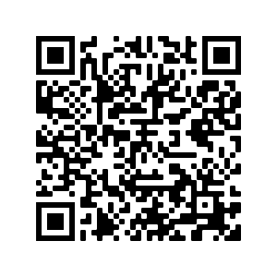
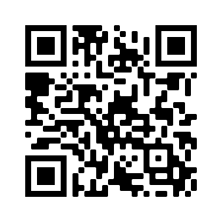
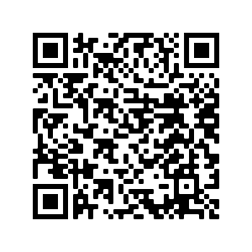
Upcoming events
November 15-17
Developing Empathy for Conservation Outcomes Conference @ Seattle Aquarium
October 28th @ 12-1pm PST
Learning Group: Conservation Calls to Action
November 10th @ 11am-12pm PST
Empathy Training Toolkit Listening Session #3
In person Summit
November: Date TBD
Learning Group: Empathy in Social Media
February 8-9th 2023 in Seattle, WA
Covering travel costs for 2 Members from each Institutional Partner.
If you one of the 2 allotted staff from your organization planning on attending the event, please fill out the Google Form in the chat by November 18th.
December: Date TBD
DEAI Learning Group Series #2
Notes:
Also drop baseline formative evaluative survey into the chat at this time

Slide 37
Please take the survey to let us know how we can improve future events!
empathy@zoo.org

