Slide 1
Living and Thriving
DAY ONE!

Slide 2
Basic Needs
What do all animals need
to survive?

Slide 3
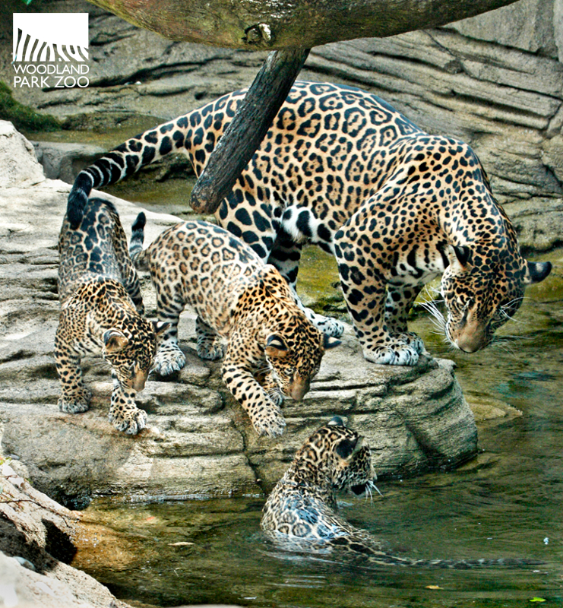
Basic Needs
Air
Water
Space
Food
Shelter

Slide 4

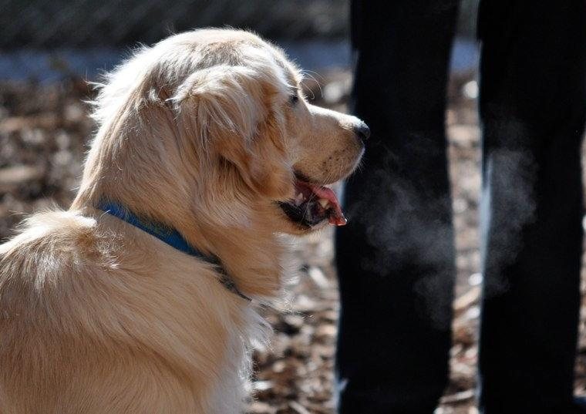
Air

Slide 5
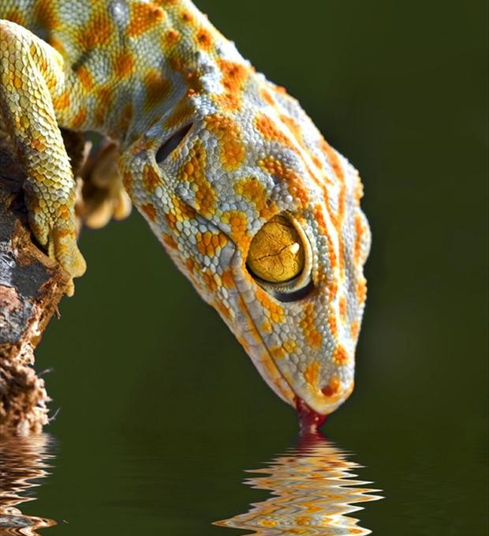
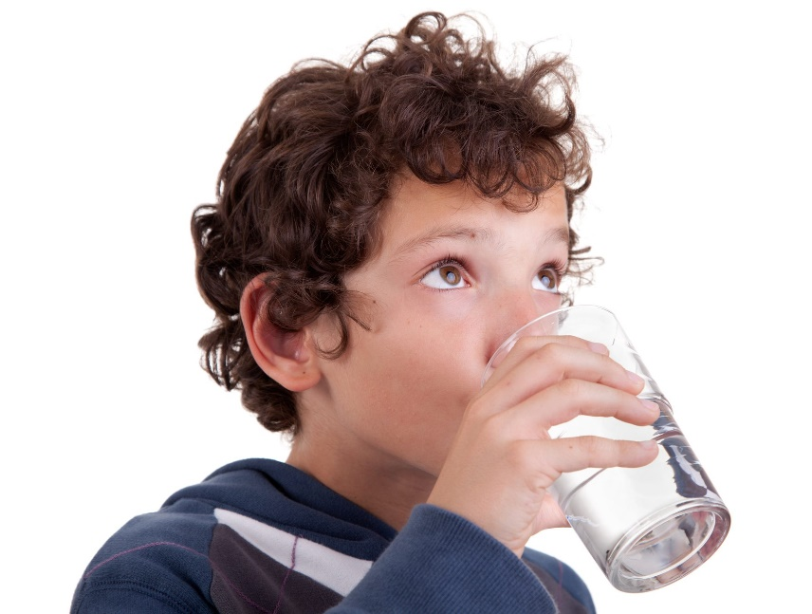
Water

Slide 6

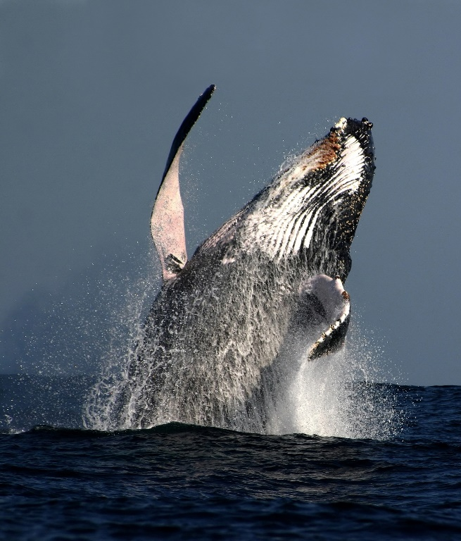
Space

Slide 7
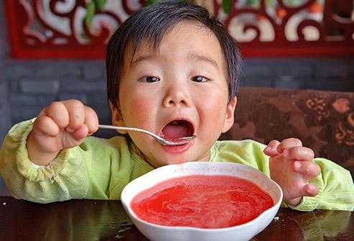
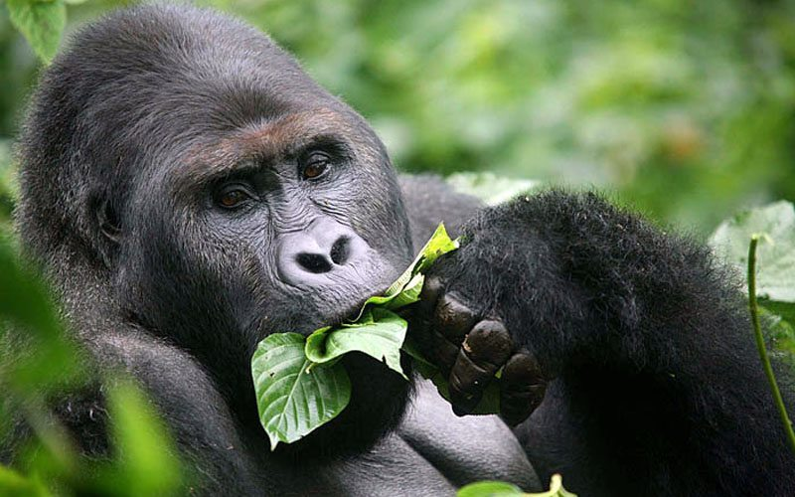
Food

Slide 8
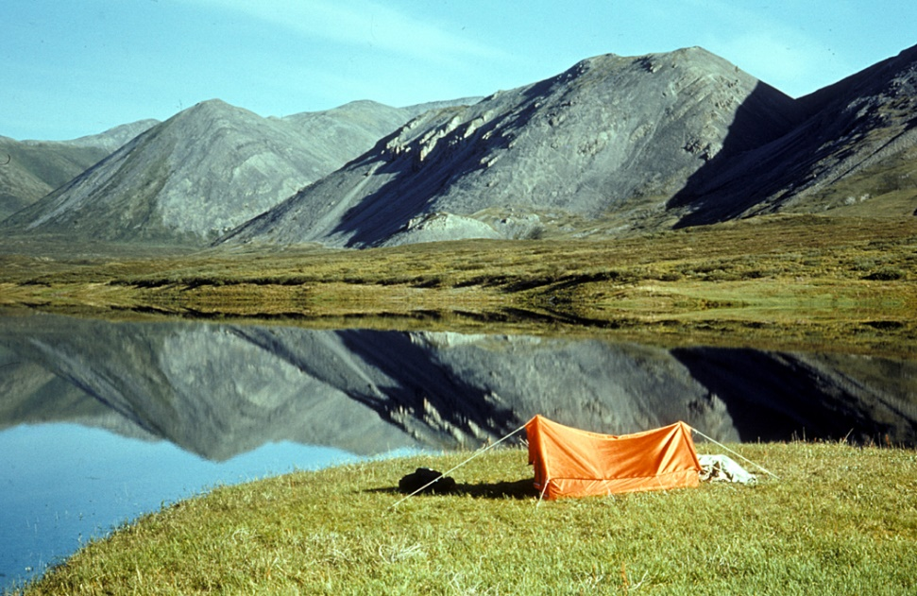
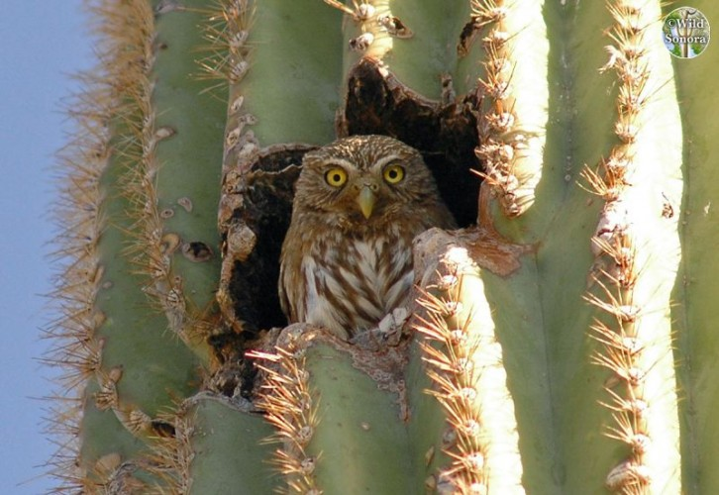
Shelter

Slide 9

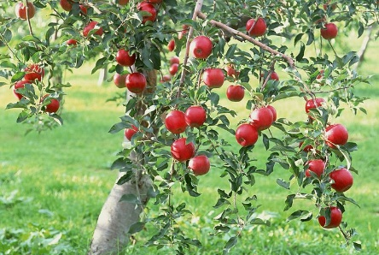
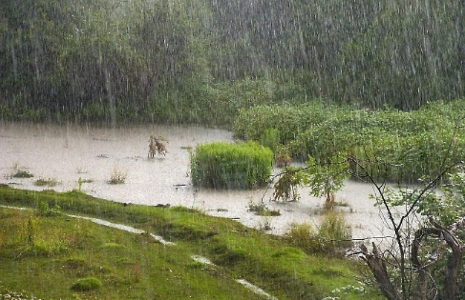
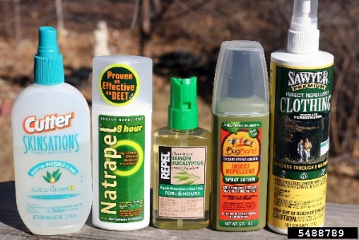
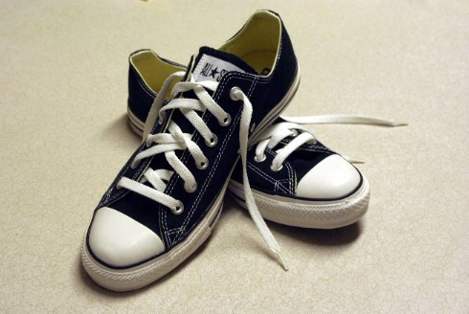
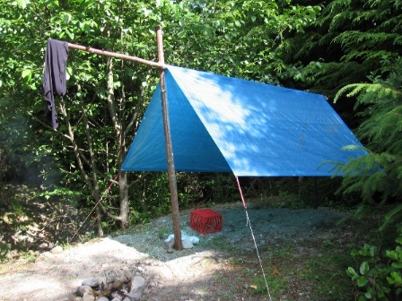

Slide 10
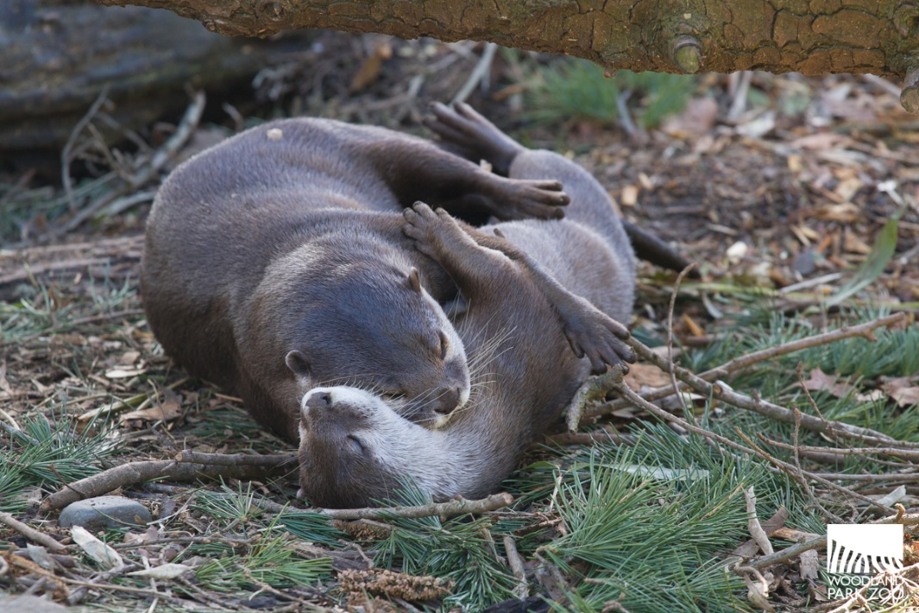
Secondary Needs
Secondary Needs
help us thrive
and stay healthy

Slide 11
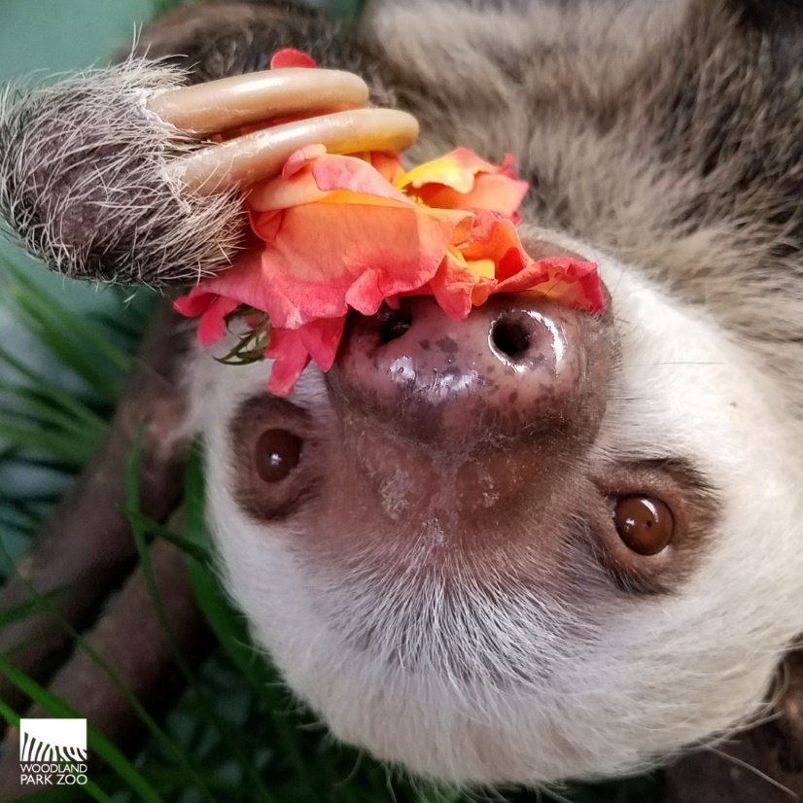
Wants
Wants are extras.
They make life more
fun or interesting.

Slide 12
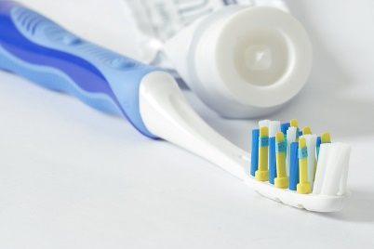

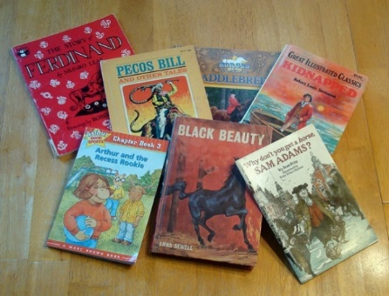




Slide 13
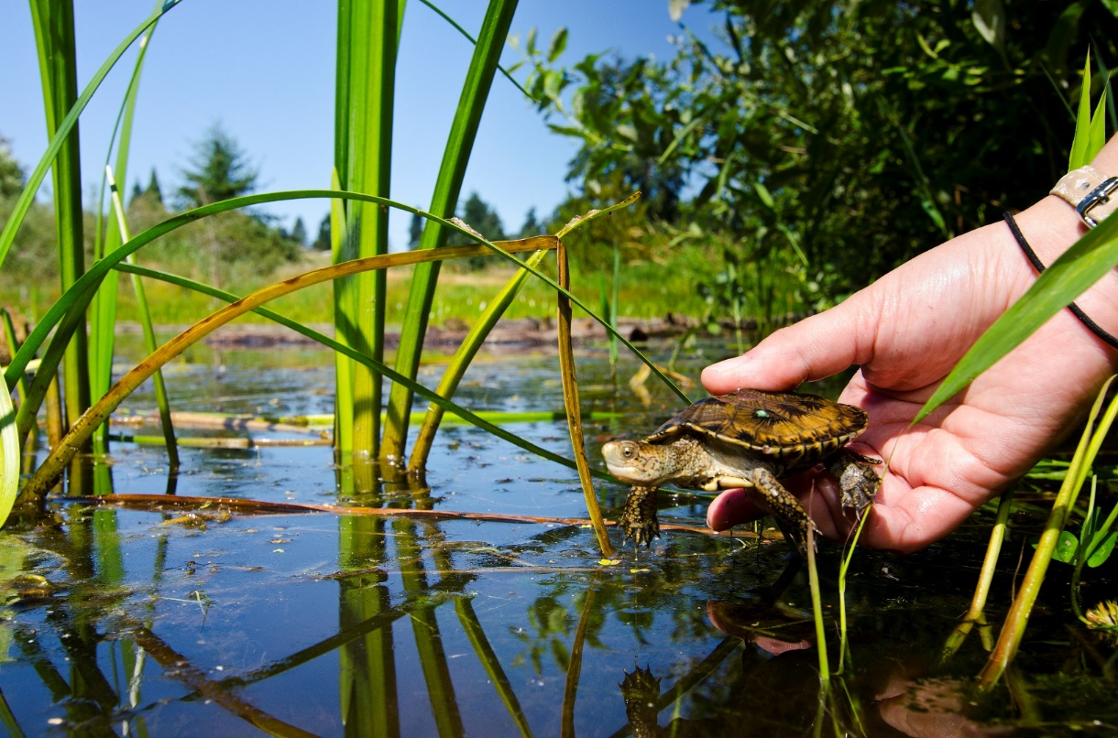
Is kindness is a want or a need?
What about respect?

Slide 14
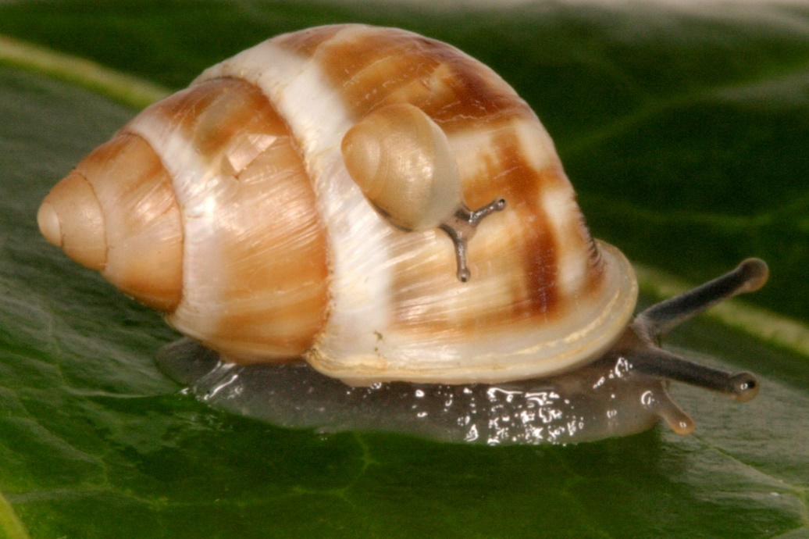
What are some
ways we can give
others kindness
and respect?

Slide 15
Living and Thriving
DAY TWO!

Slide 16
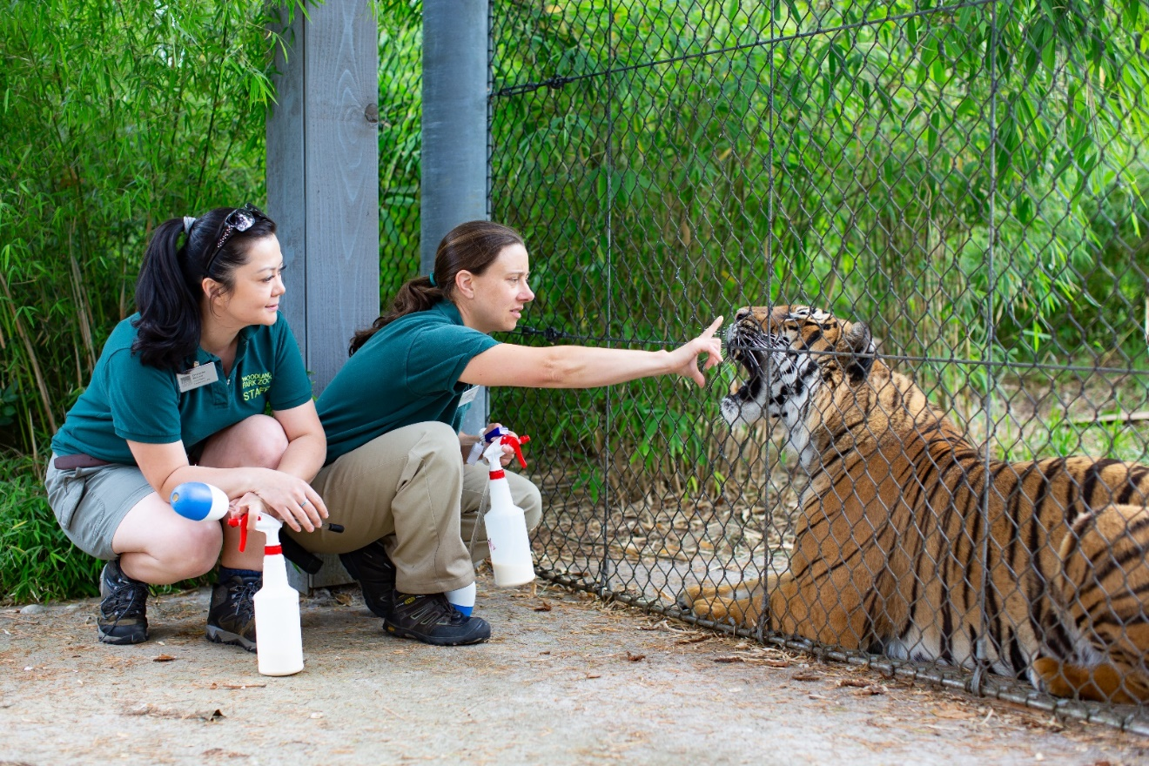
An animal keeper’s life for me

Slide 17
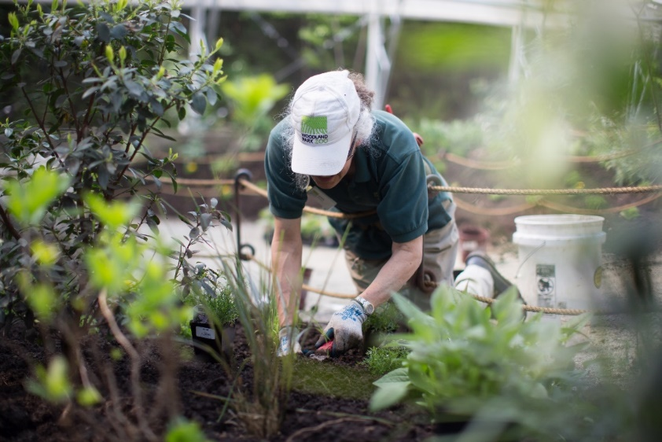
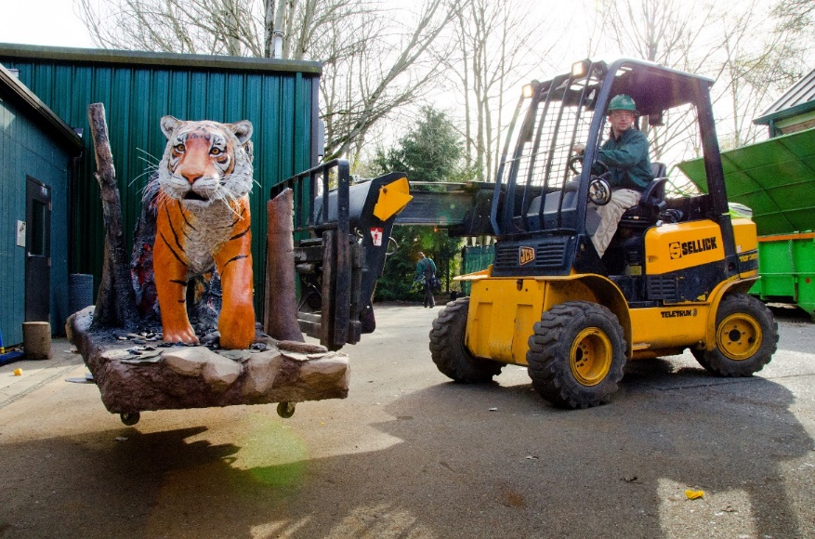
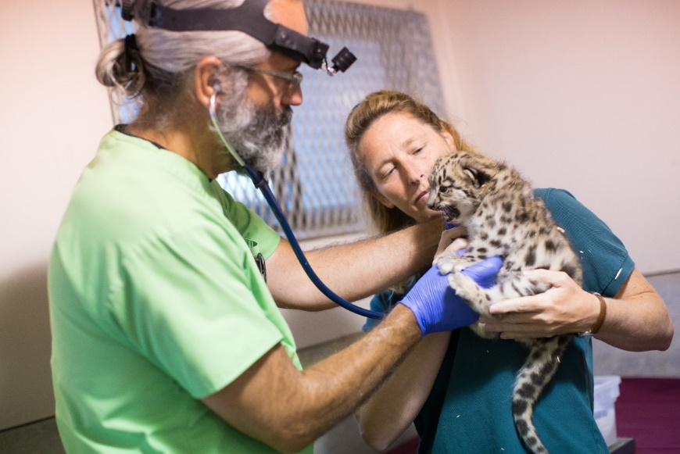
What would you like to do?

Slide 18
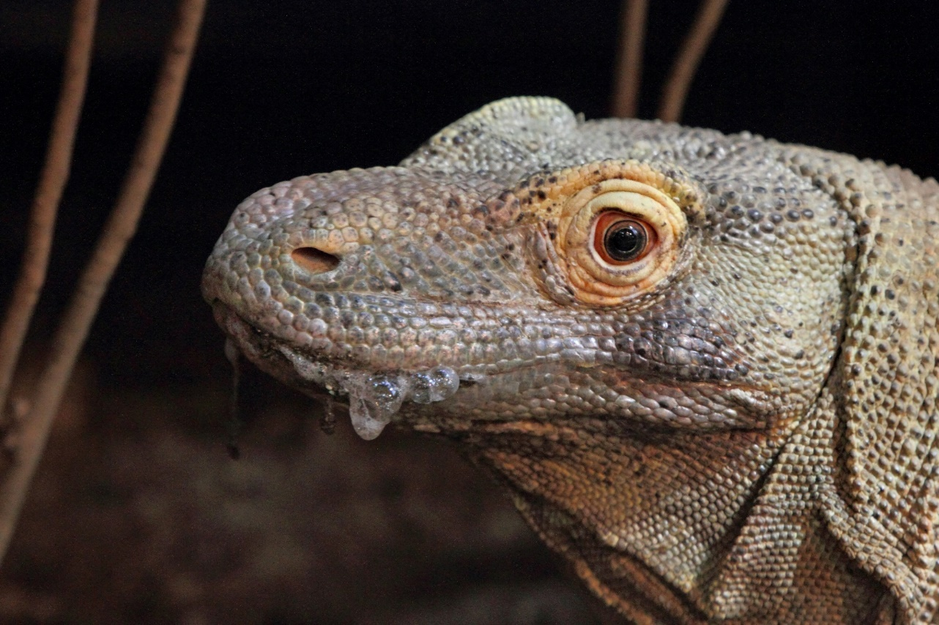
Animals are individuals

Slide 19
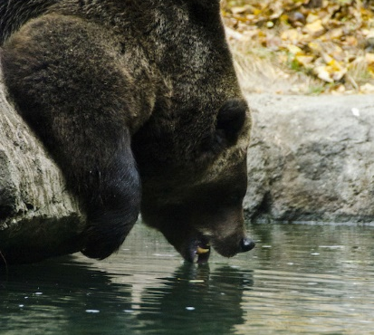
What do all animals need to survive?

Slide 20
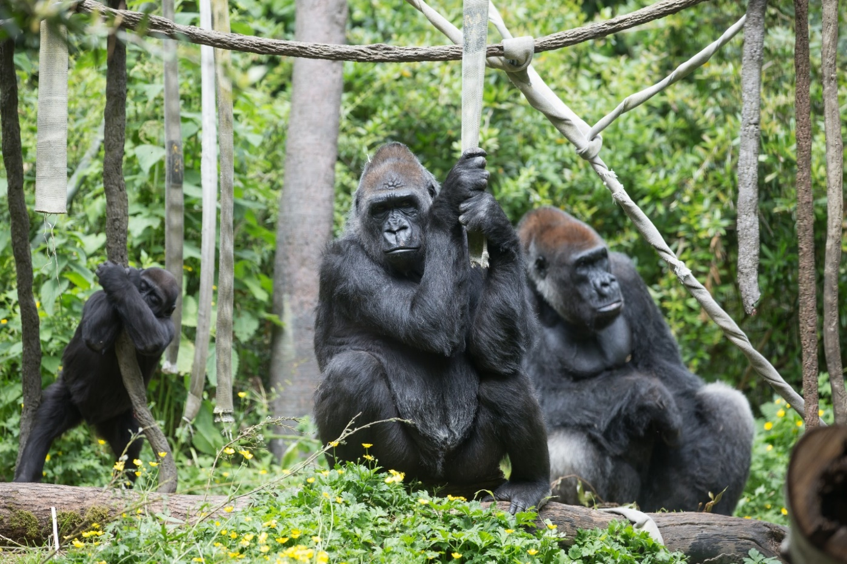
Secondary needs help animals thrive

Slide 21
Enrichment
Enrichment helps animals thrive

Slide 22
Meet an Ambassador Animal
Let’s help our animal guest feel comfortable.

Slide 23
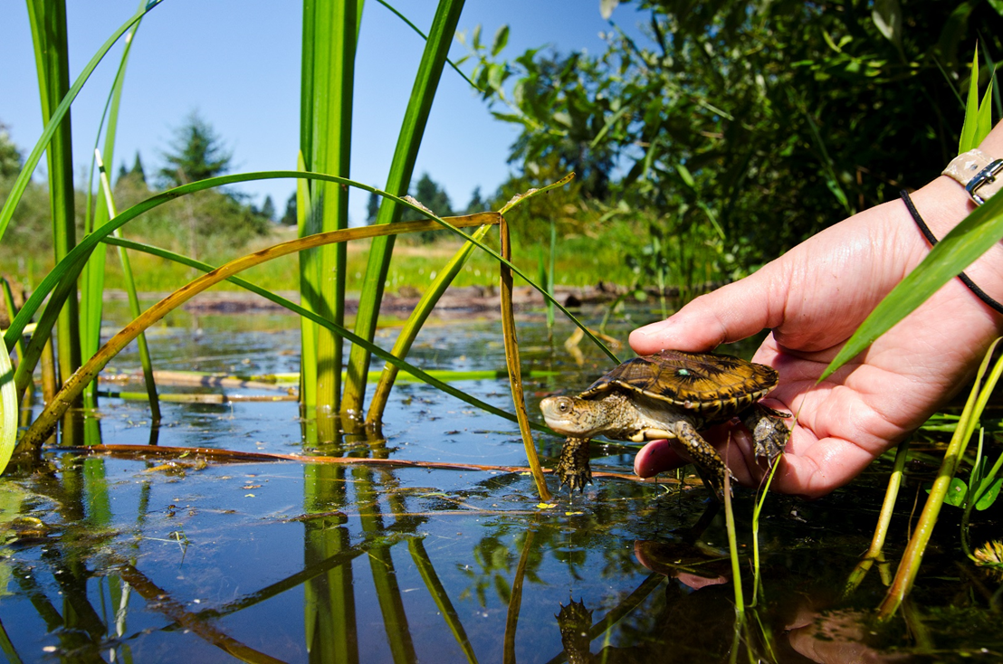
How will you help animals?

Slide 24
Living and Thriving
DAY THREE!

Slide 25
Enrichment
Enrichment is something given to an animal to encourage him or her to investigate, play, or exercise.
Enrichment helps animals stay healthy and happy.

Slide 26
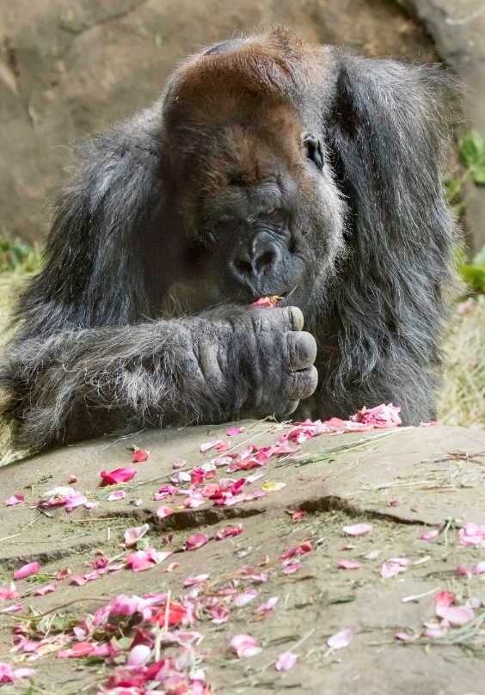
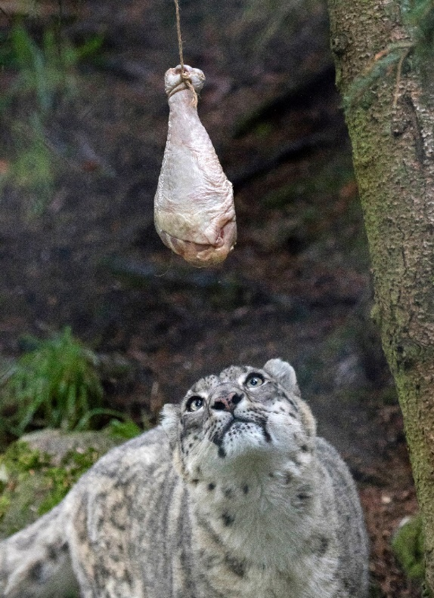
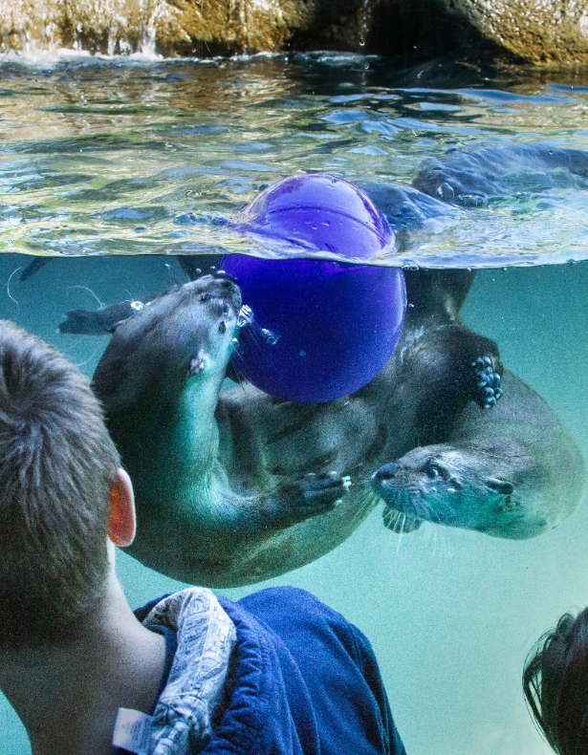
Enrichment must be safe and appropriate for the animal

Slide 27
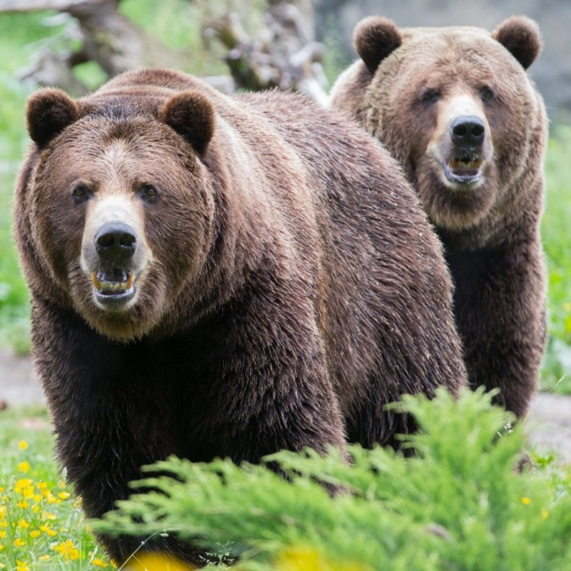
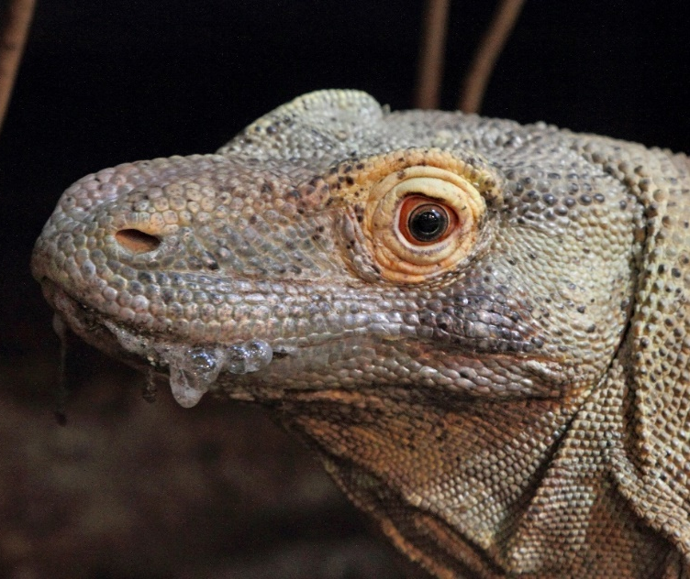
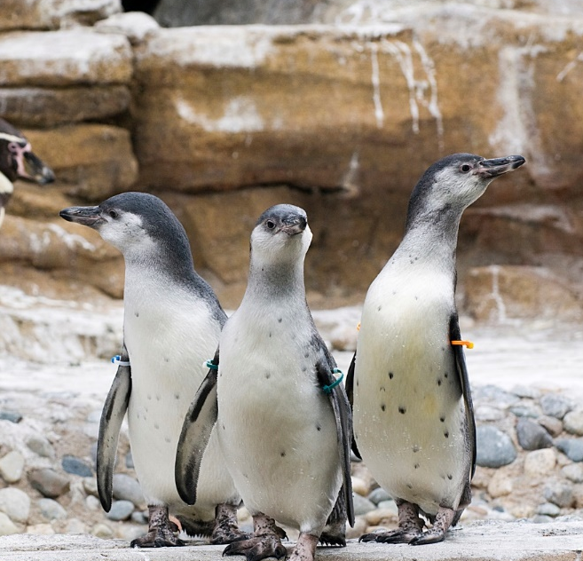
Choose your animal

