Slide 1
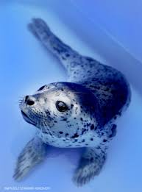


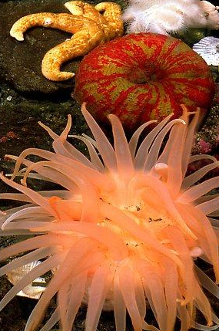
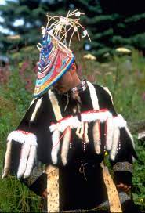
Fostering Empathy through Experiential Learning
(FEEL) Summer Day Camp
NMFS MMHSRP #18786-02
To provide tourist and community kids aged 8-14 the opportunity to build knowledge of Alaska’s marine animals, ecosystems, and Native culture through play, to build empathy and encourage pro-conservation action in a flexible and affordable format.

Slide 2
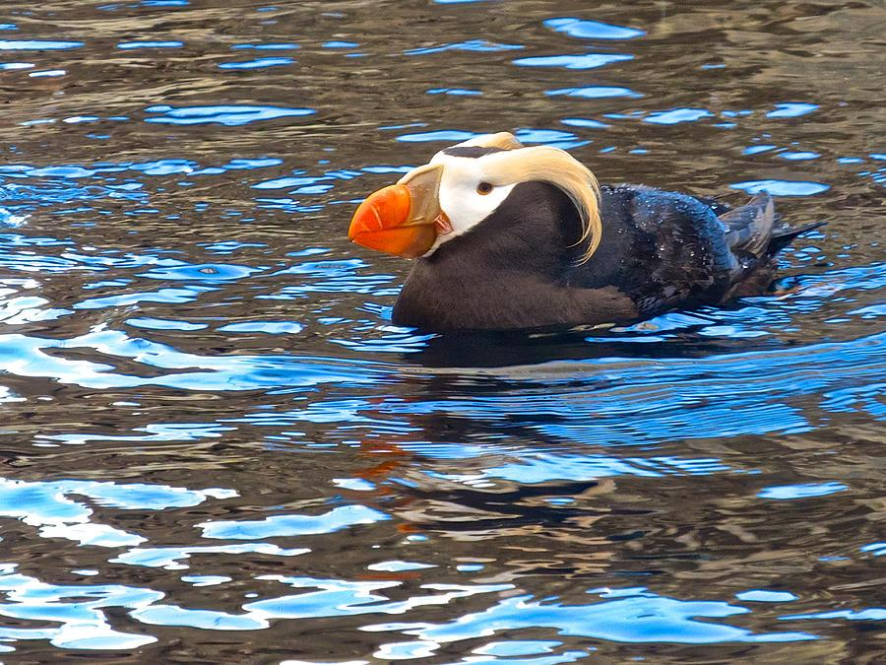
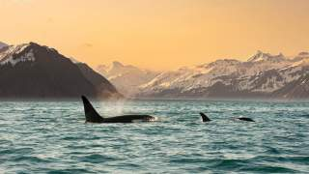
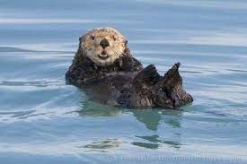
Empathy Summer Day Camp Goals:
Develop and implement empathy-focused curriculum.
Improve understanding of Alaska’s marine animals, ecosystems and Native culture.
Provide an inclusive learning environment.
Utilize learning through play, animal observation, and empathy exercises to introduce and evaluate empathy and pro-conservation behavior.
Wider audience reach and increased revenue.
Strengthen summer education intern program.
Improved empathy training for all education and interpretation staff, seasonals and interns.
Evaluation of curriculum for incorporation into other program offerings.

Slide 3
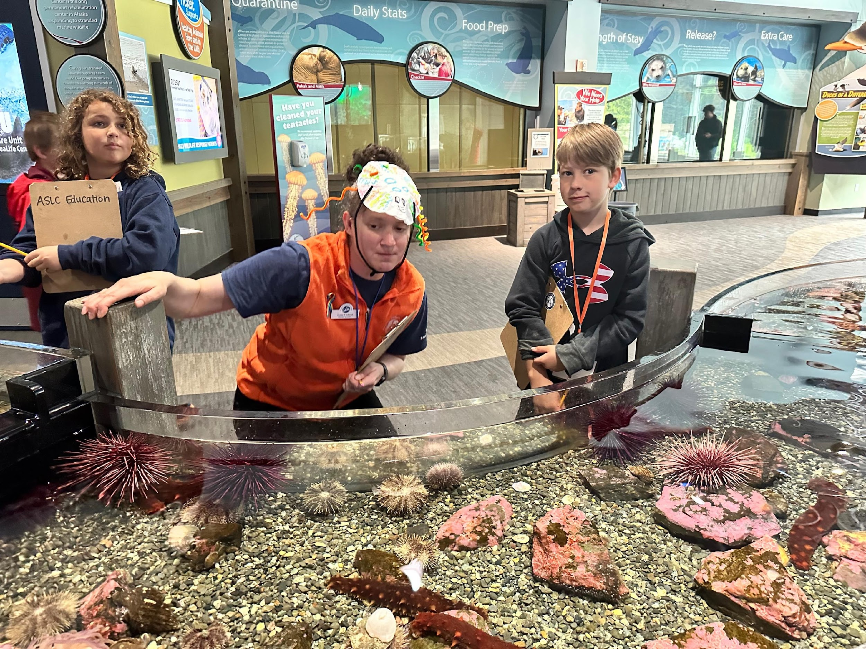
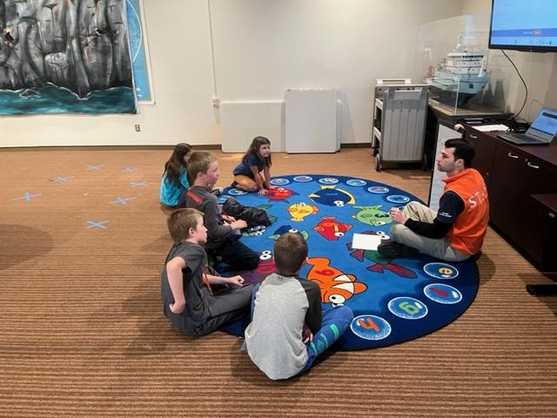
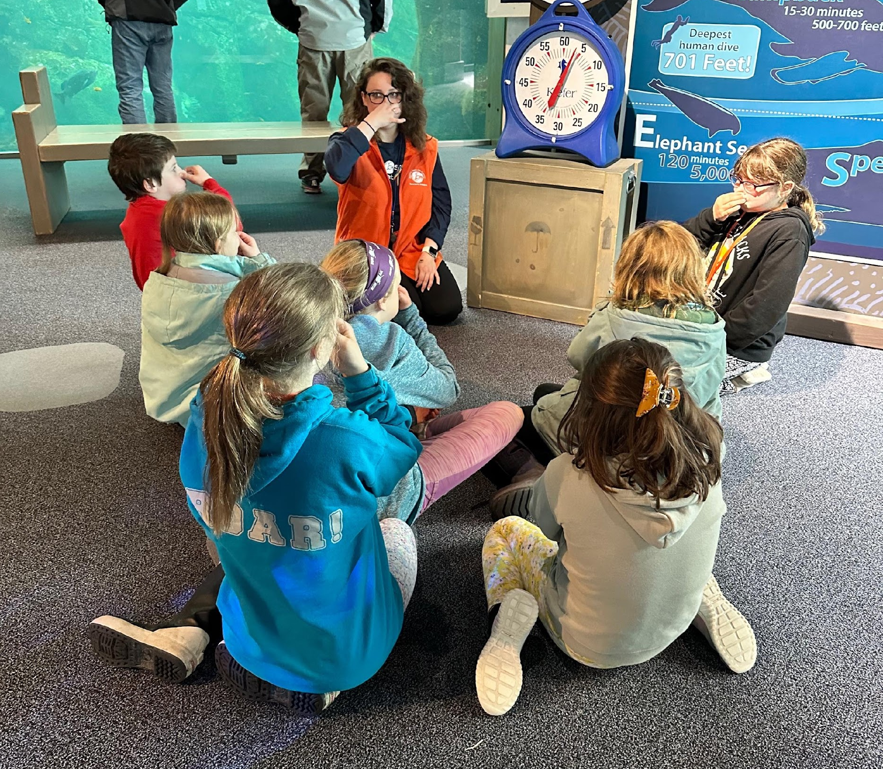
Program Development & Implementation
What : Day Camps – 2 session per day, 4 hours each
When: 7 days a week, 10 weeks
How:
Each camp consisted of:
Land acknowledgement
Experiential knowledge developmental activities
A visit to the aquarium
Wrap up discussion with empathy tracking exercises
Award of a “Conservation Agent” badge.
Curriculum developed specific to 7 categories.
  Total activities and exercises created, 32.
  Additional empathy and conservation interpretive programs developed for use throughout the facility.

Slide 4
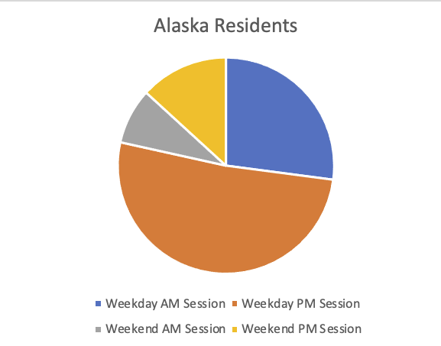
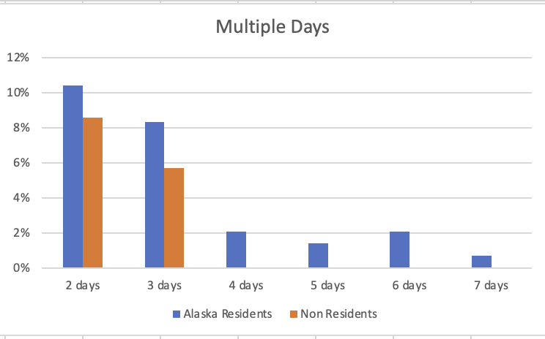

Camp Attendance
Alaska Residents : 72%
Non-Residents : 28%
65% preferred the weekday
70% preferred the pm session
(weekday or weekend)

Slide 5
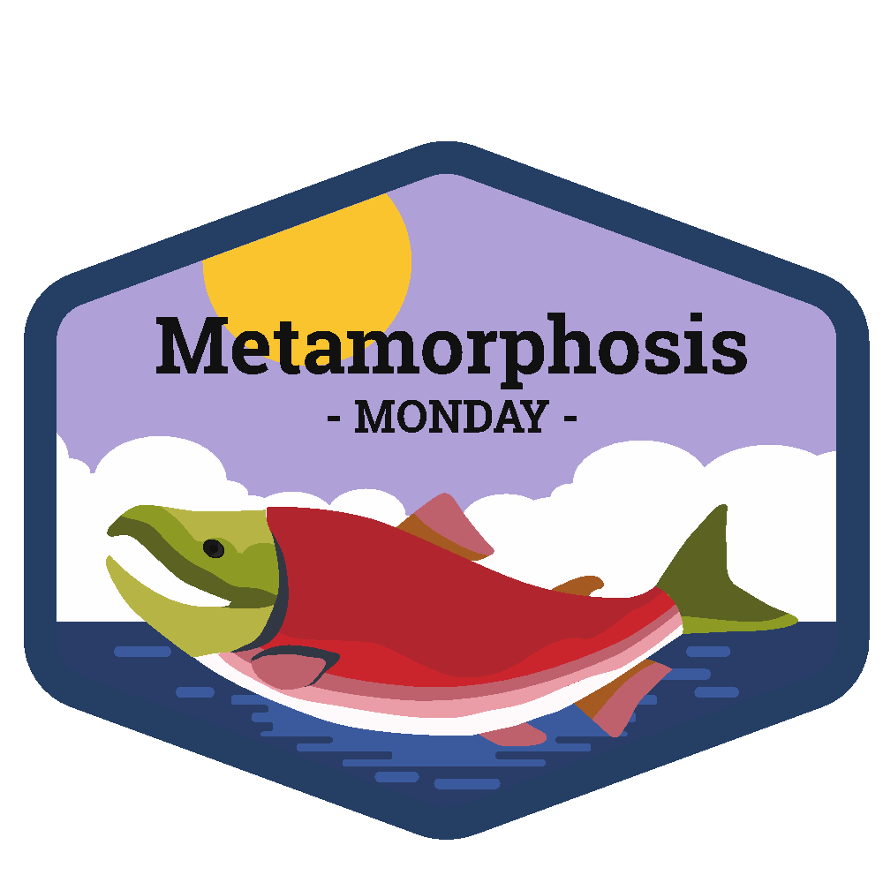



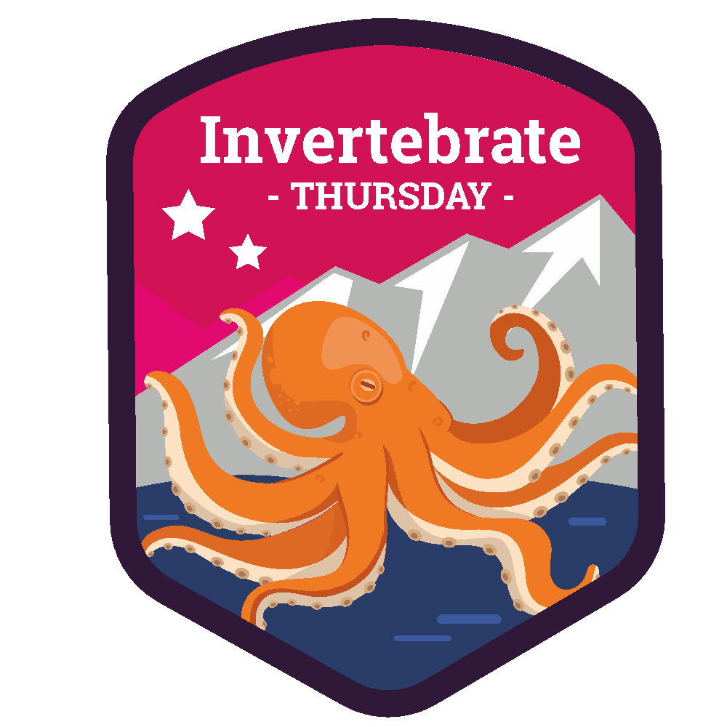


Program Topics and Flexibility
Topics were specific to each day of the week.
  Focused on resident animals, rescue animals or scientific research at ASLC.
  Daily topics allowed for families to build their own experience.
  Programs designed to accommodate a varied audience.
Some favorite exercises of the staff and campers:
  Growing Up Otter – Life-sized board game
  Coasts to Currents – Seabird Adaptation, Habitats, and Life Cycle
  Travel Tails, We Wish You Whale – Whale Migration

Slide 6
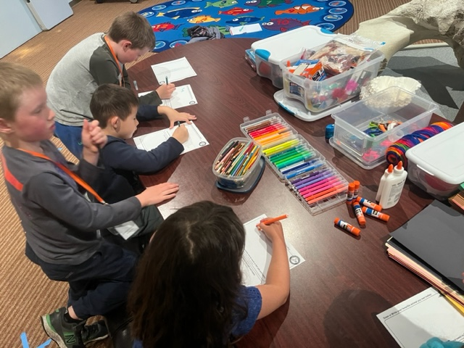
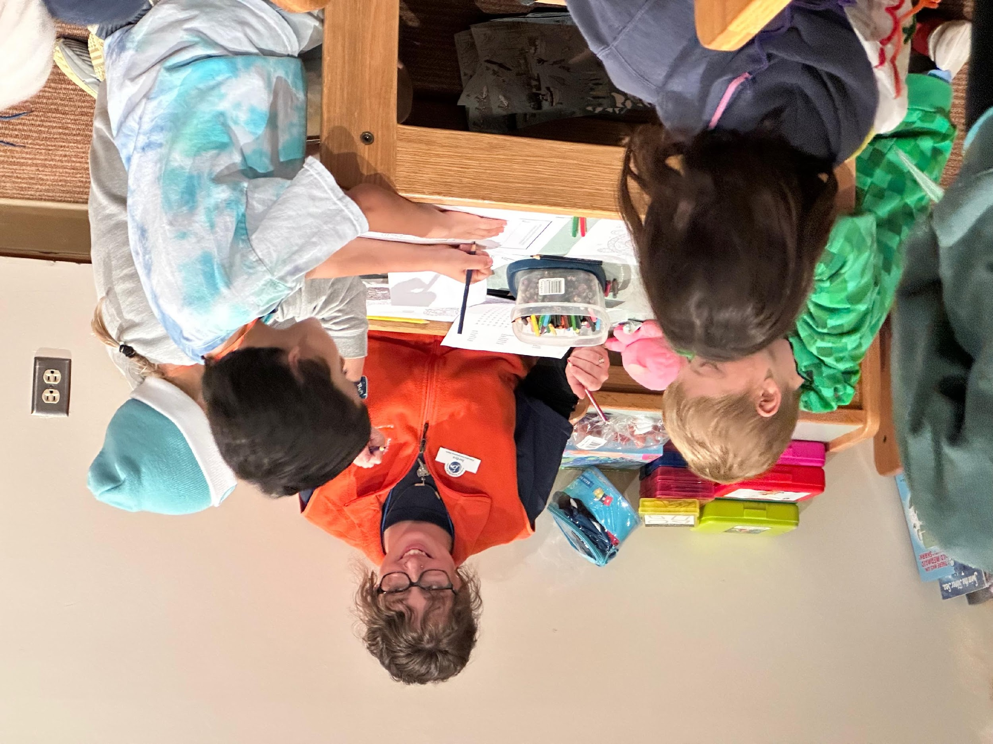
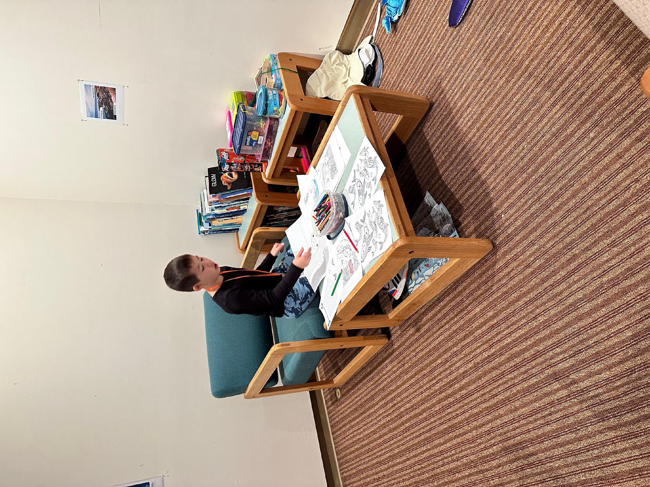
Providing an Inclusive Learning Experience
Equitable Access
  Programs easily adapted to accommodate various ages and learning levels.
  Affordable cost structure with scholarships available.
  Fostering kindness and acceptance throughout camp participation.
  Diverse program offerings for all interest levels: e.g., drawing, writing, acting.
  “Under the Sea” sensory corner
    Provide a quiet space.
    Offer activities and games in line with daily learning topic.
    Additional one-on-one support from an educator.

Slide 7
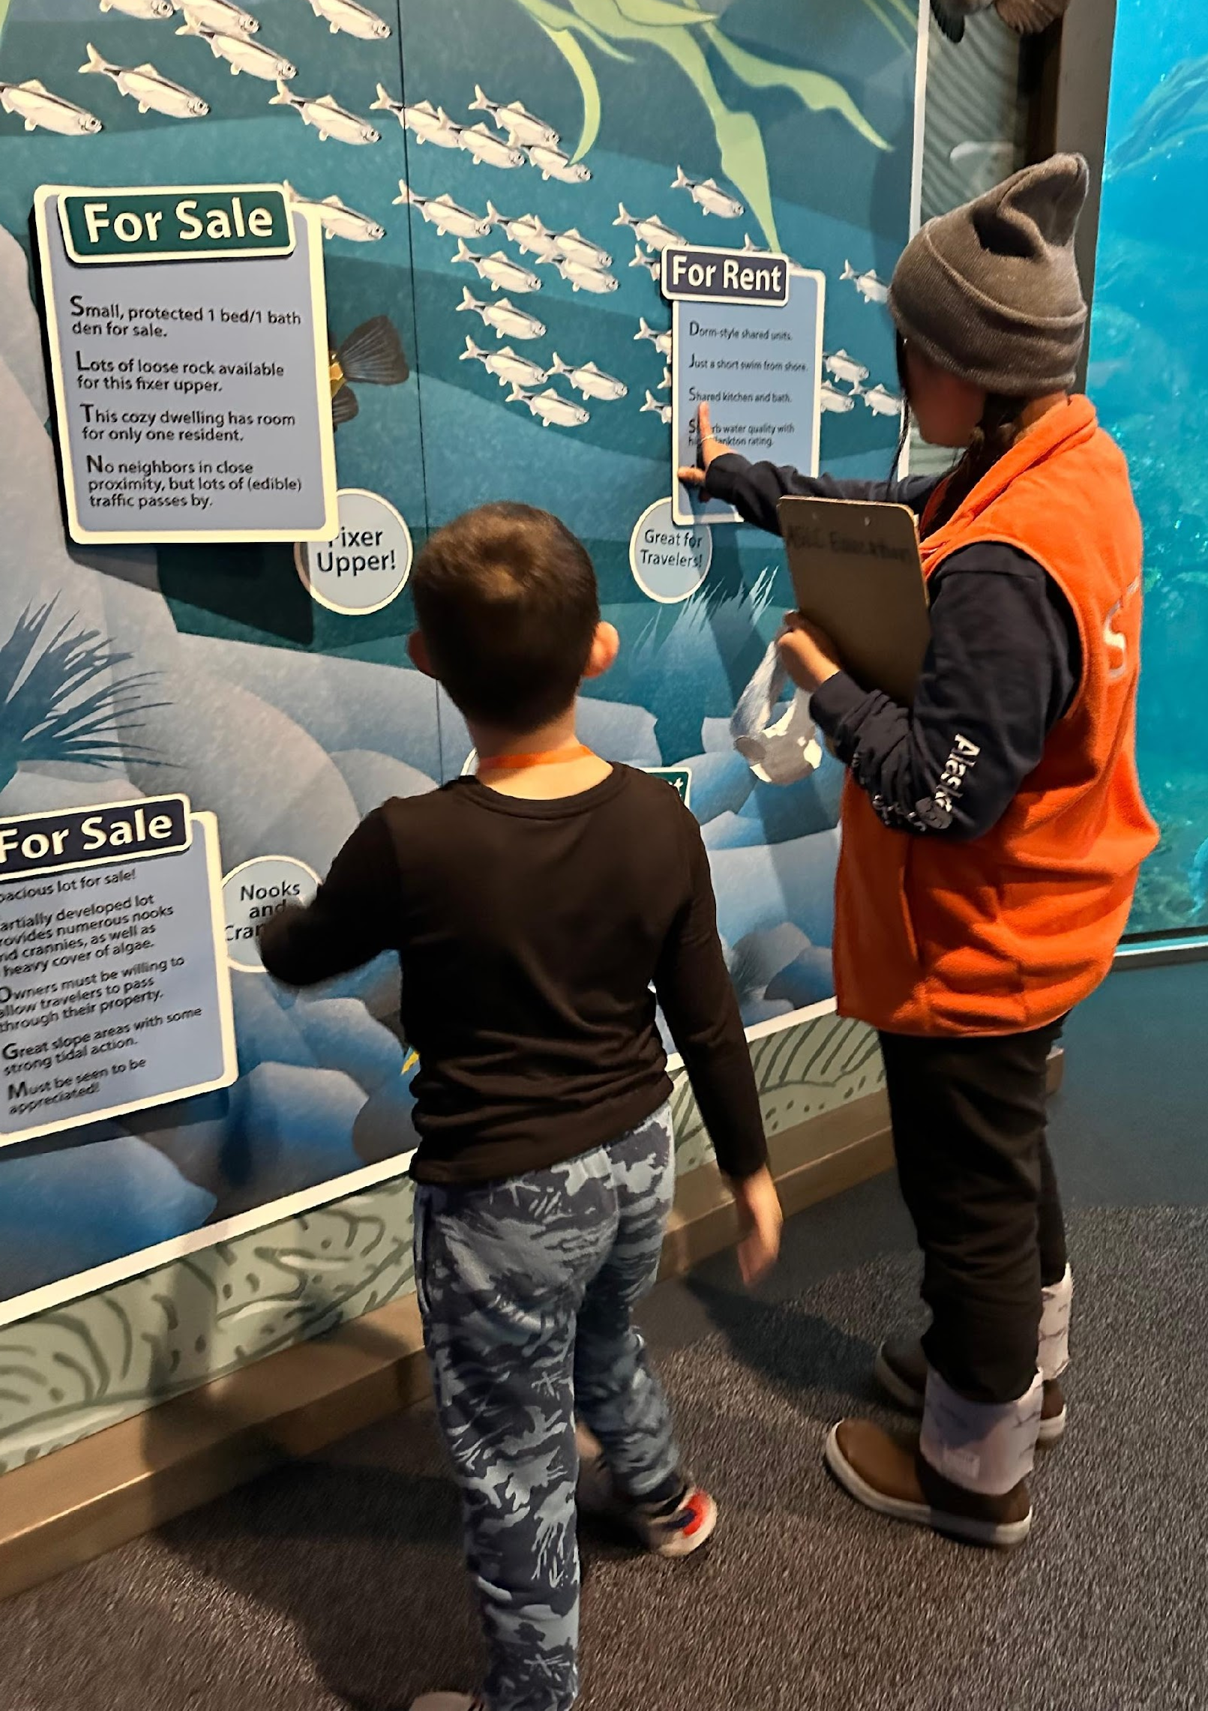
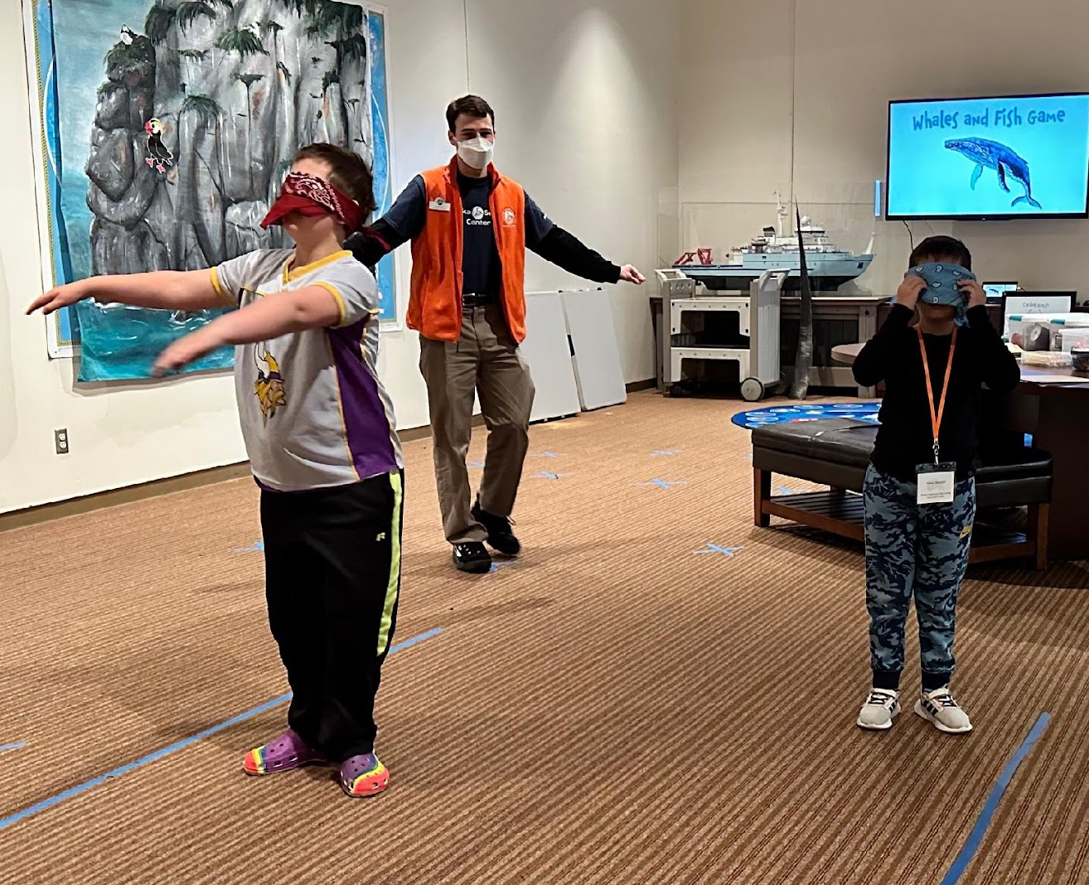
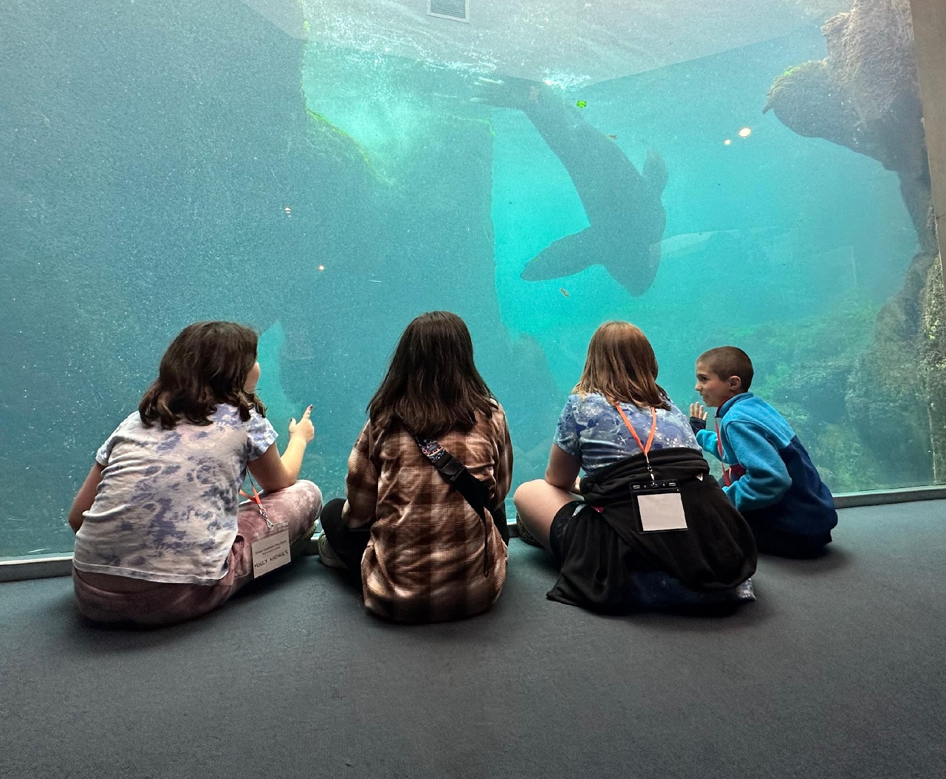
Empathy and Pro-Conservation Development
Learning through play
Animal observation
Empathy exercises to introduce and evaluate empathy
Pro-conservation behavior introduction and evaluation

Slide 8
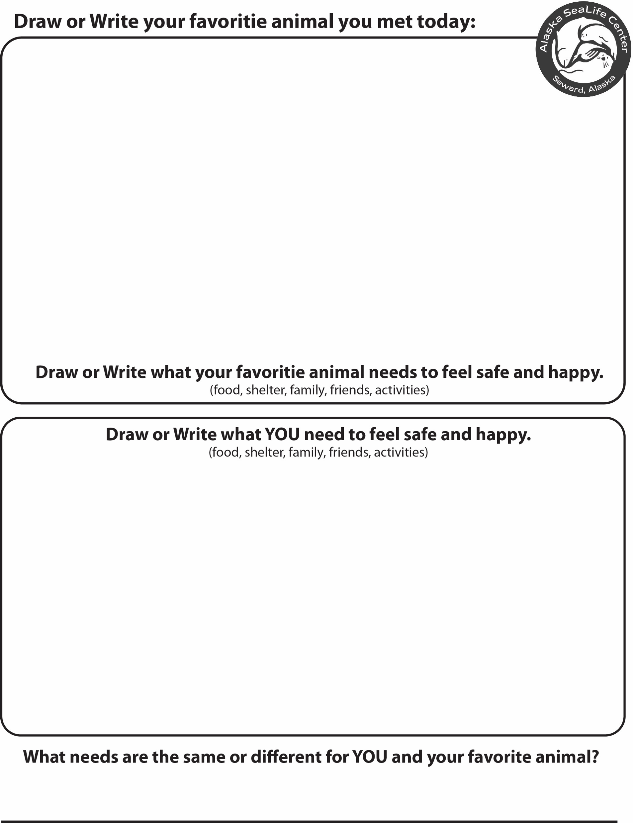
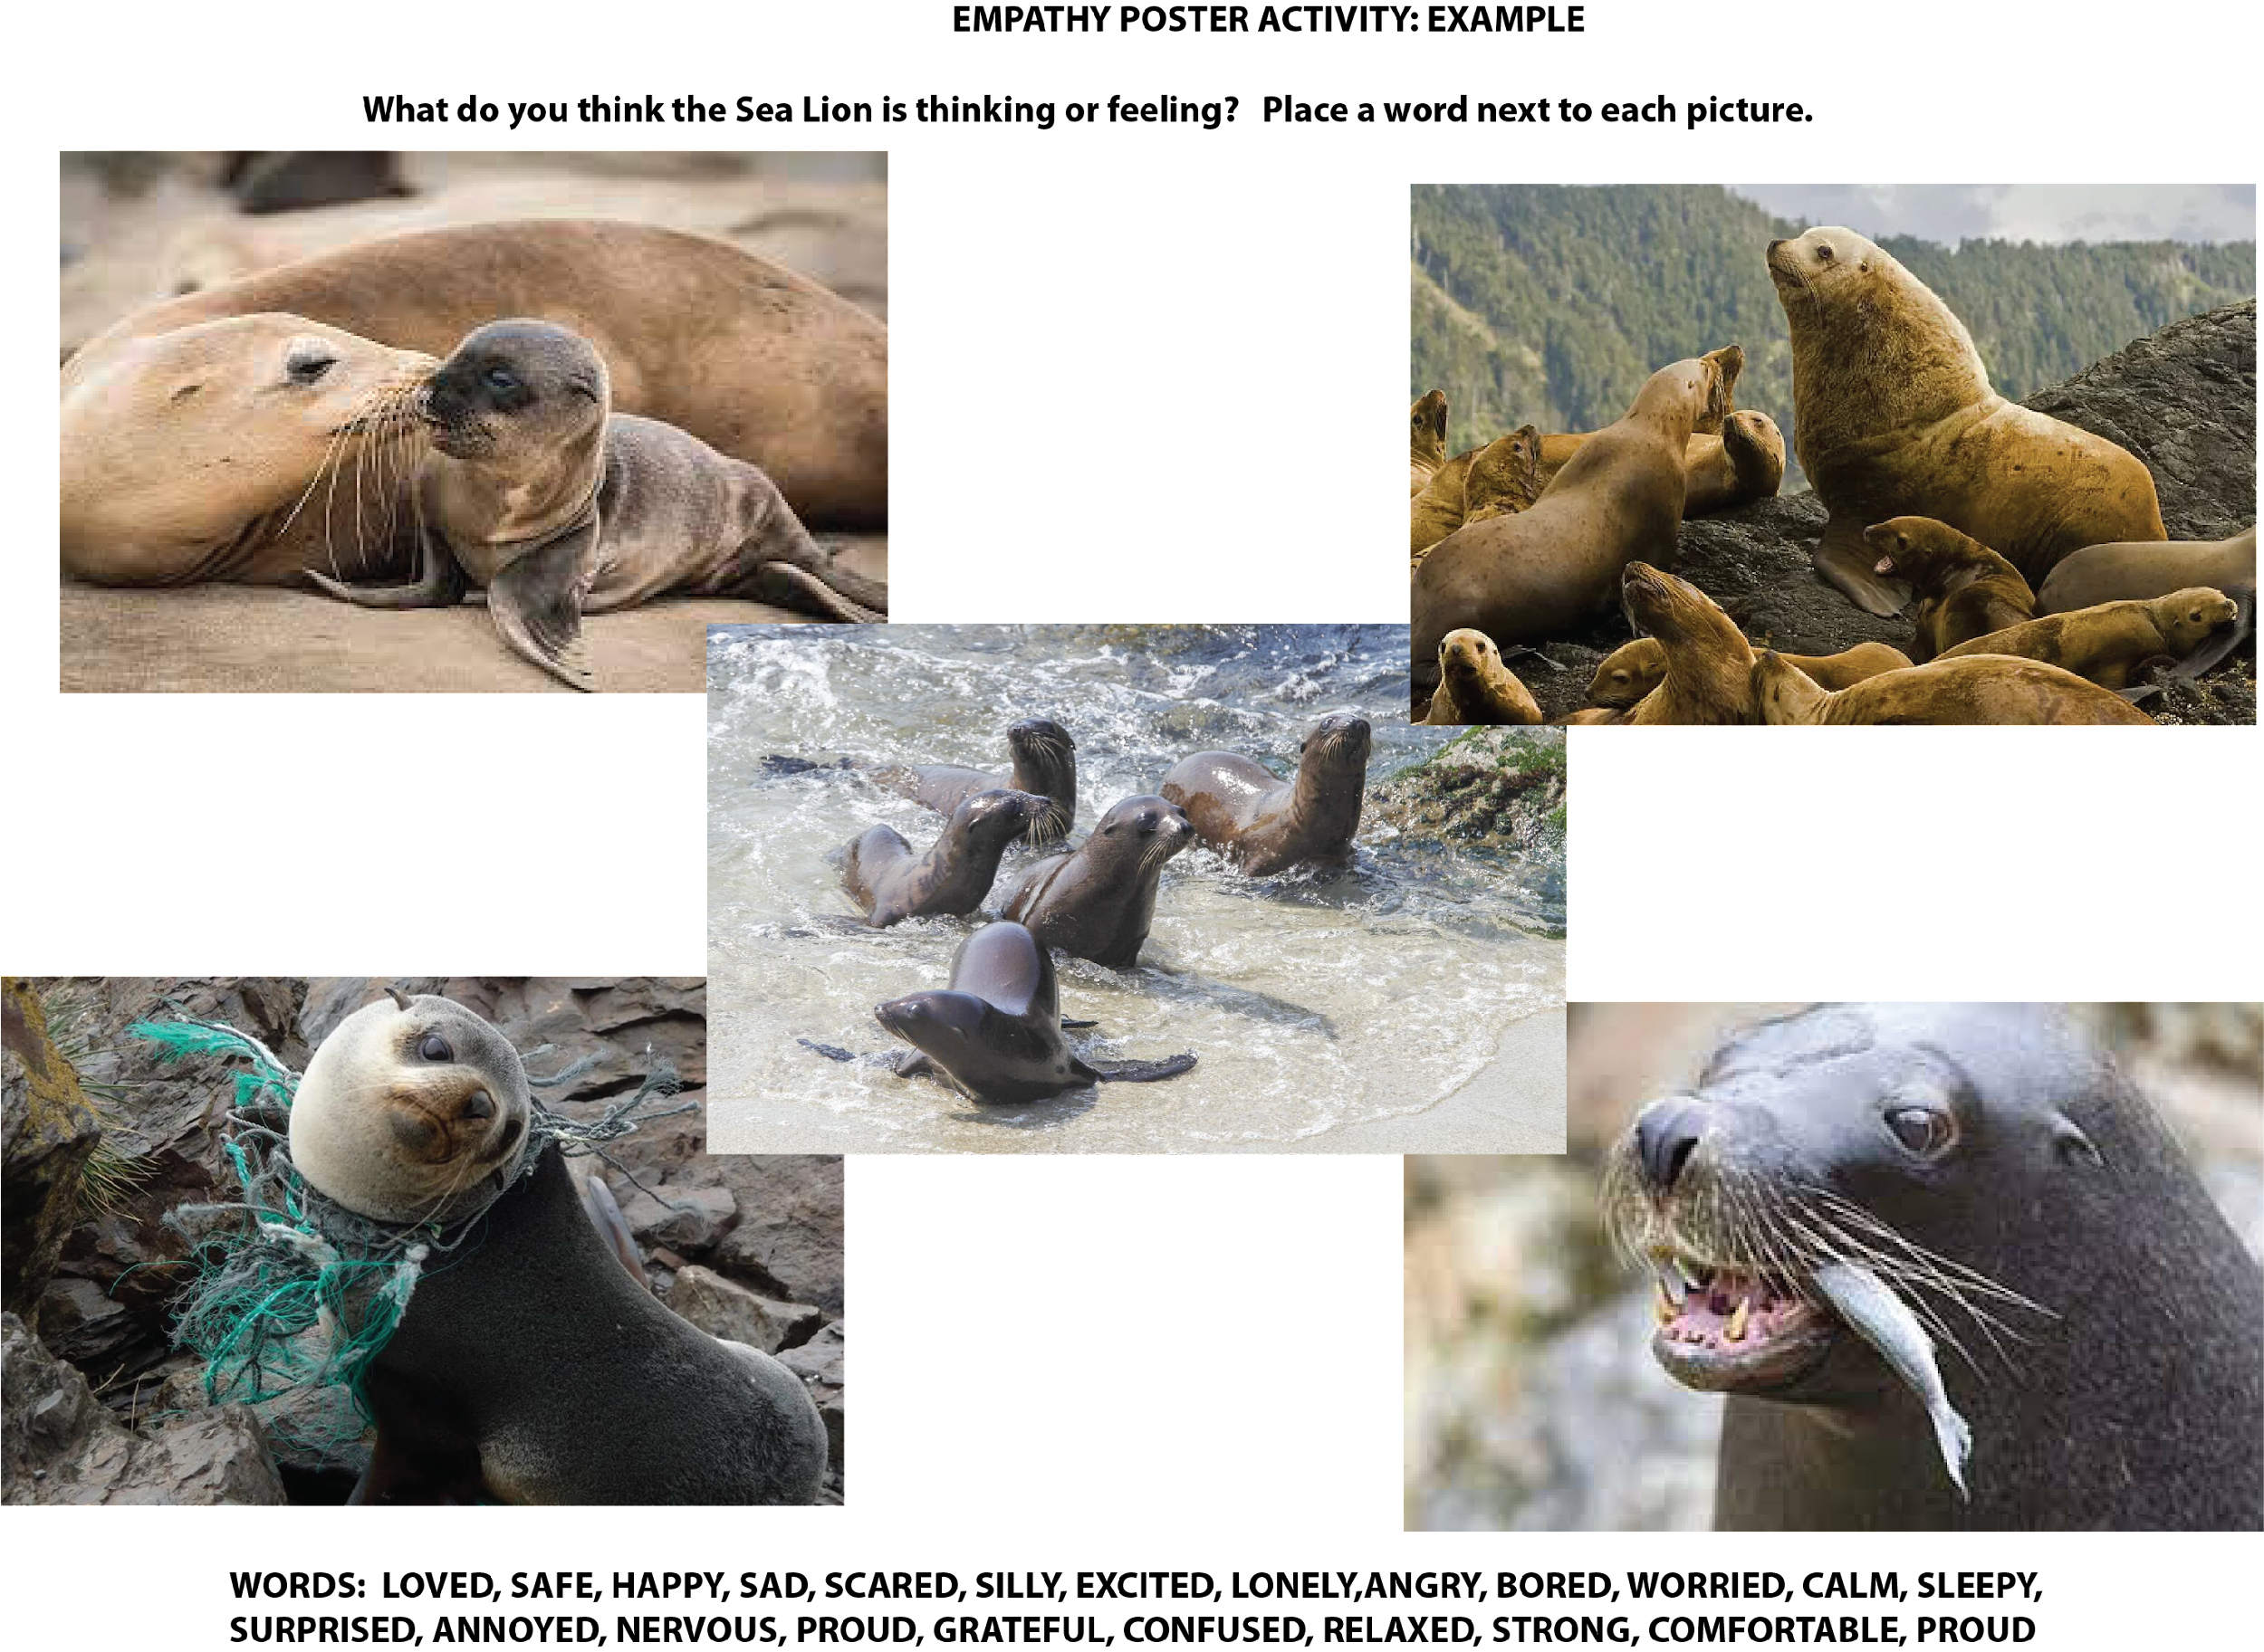
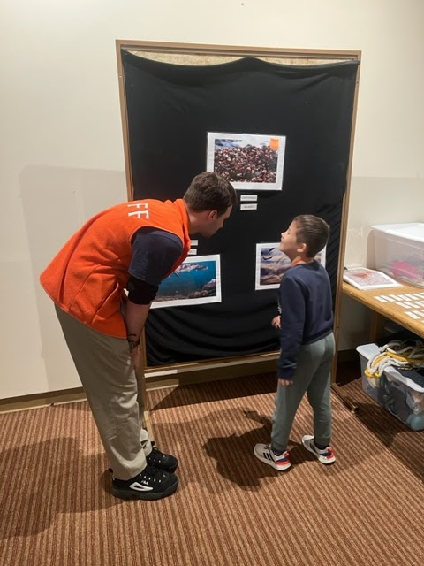
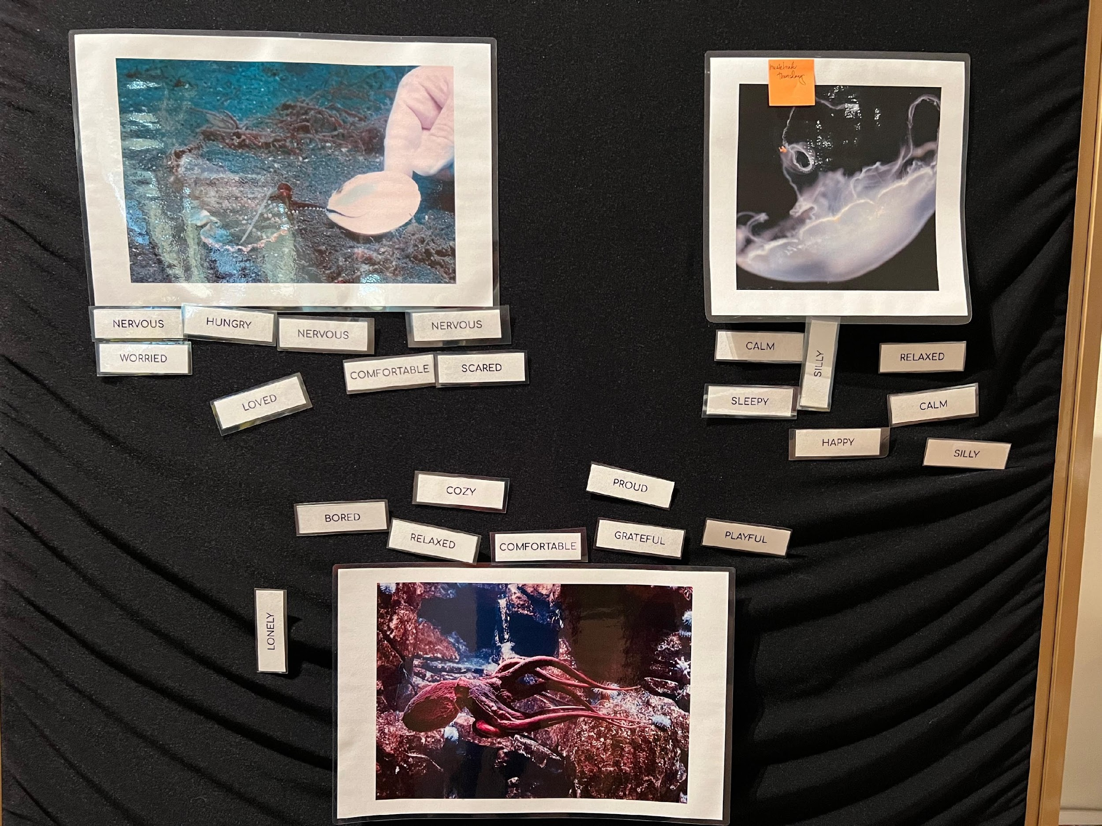
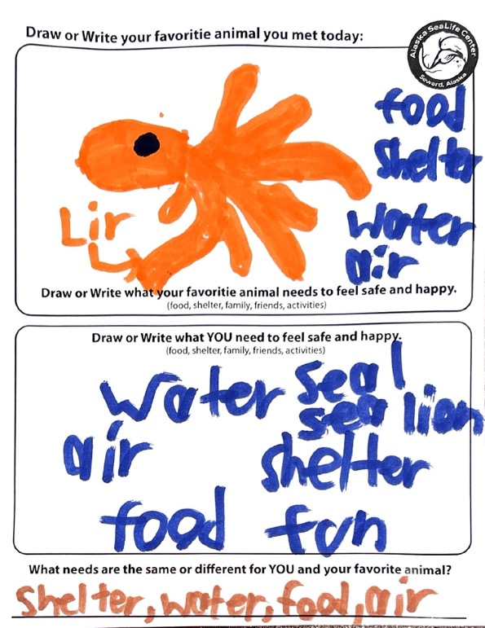
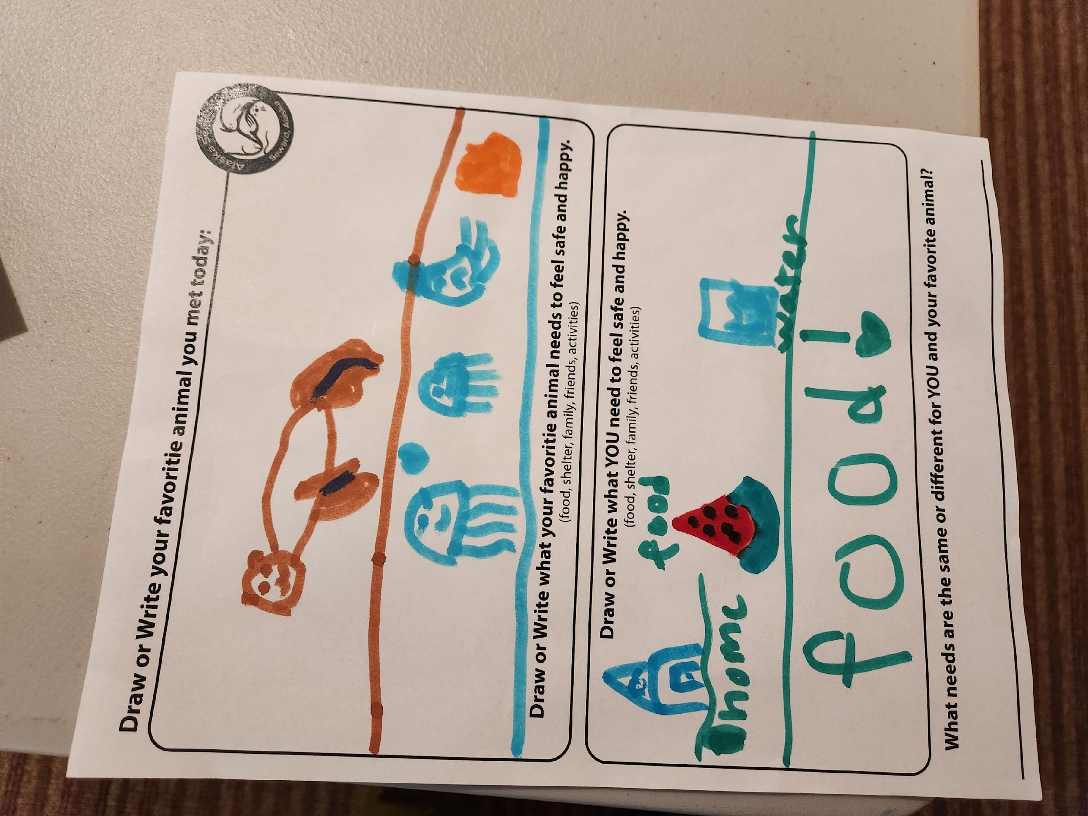
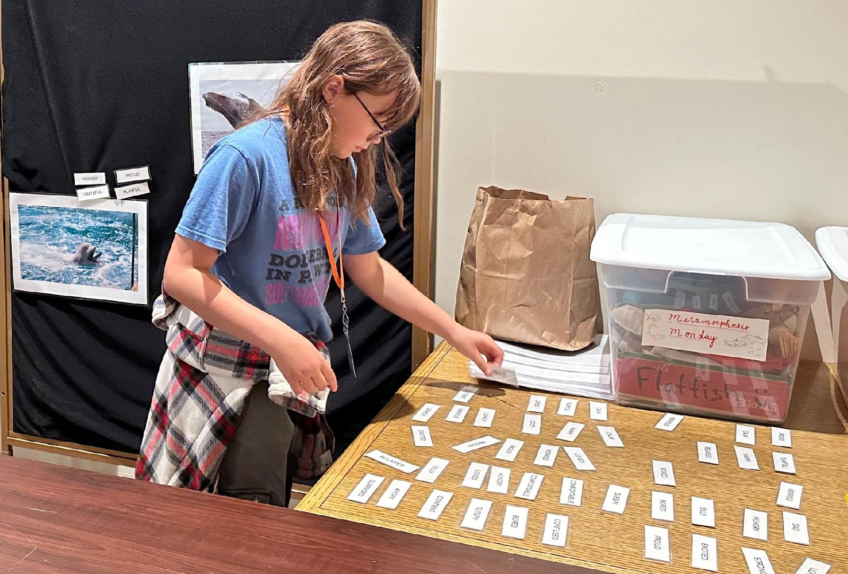
Empathy Evaluation Exercises
Association
Perspective Taking
Success
What we learned?
How to move forward?

Slide 9
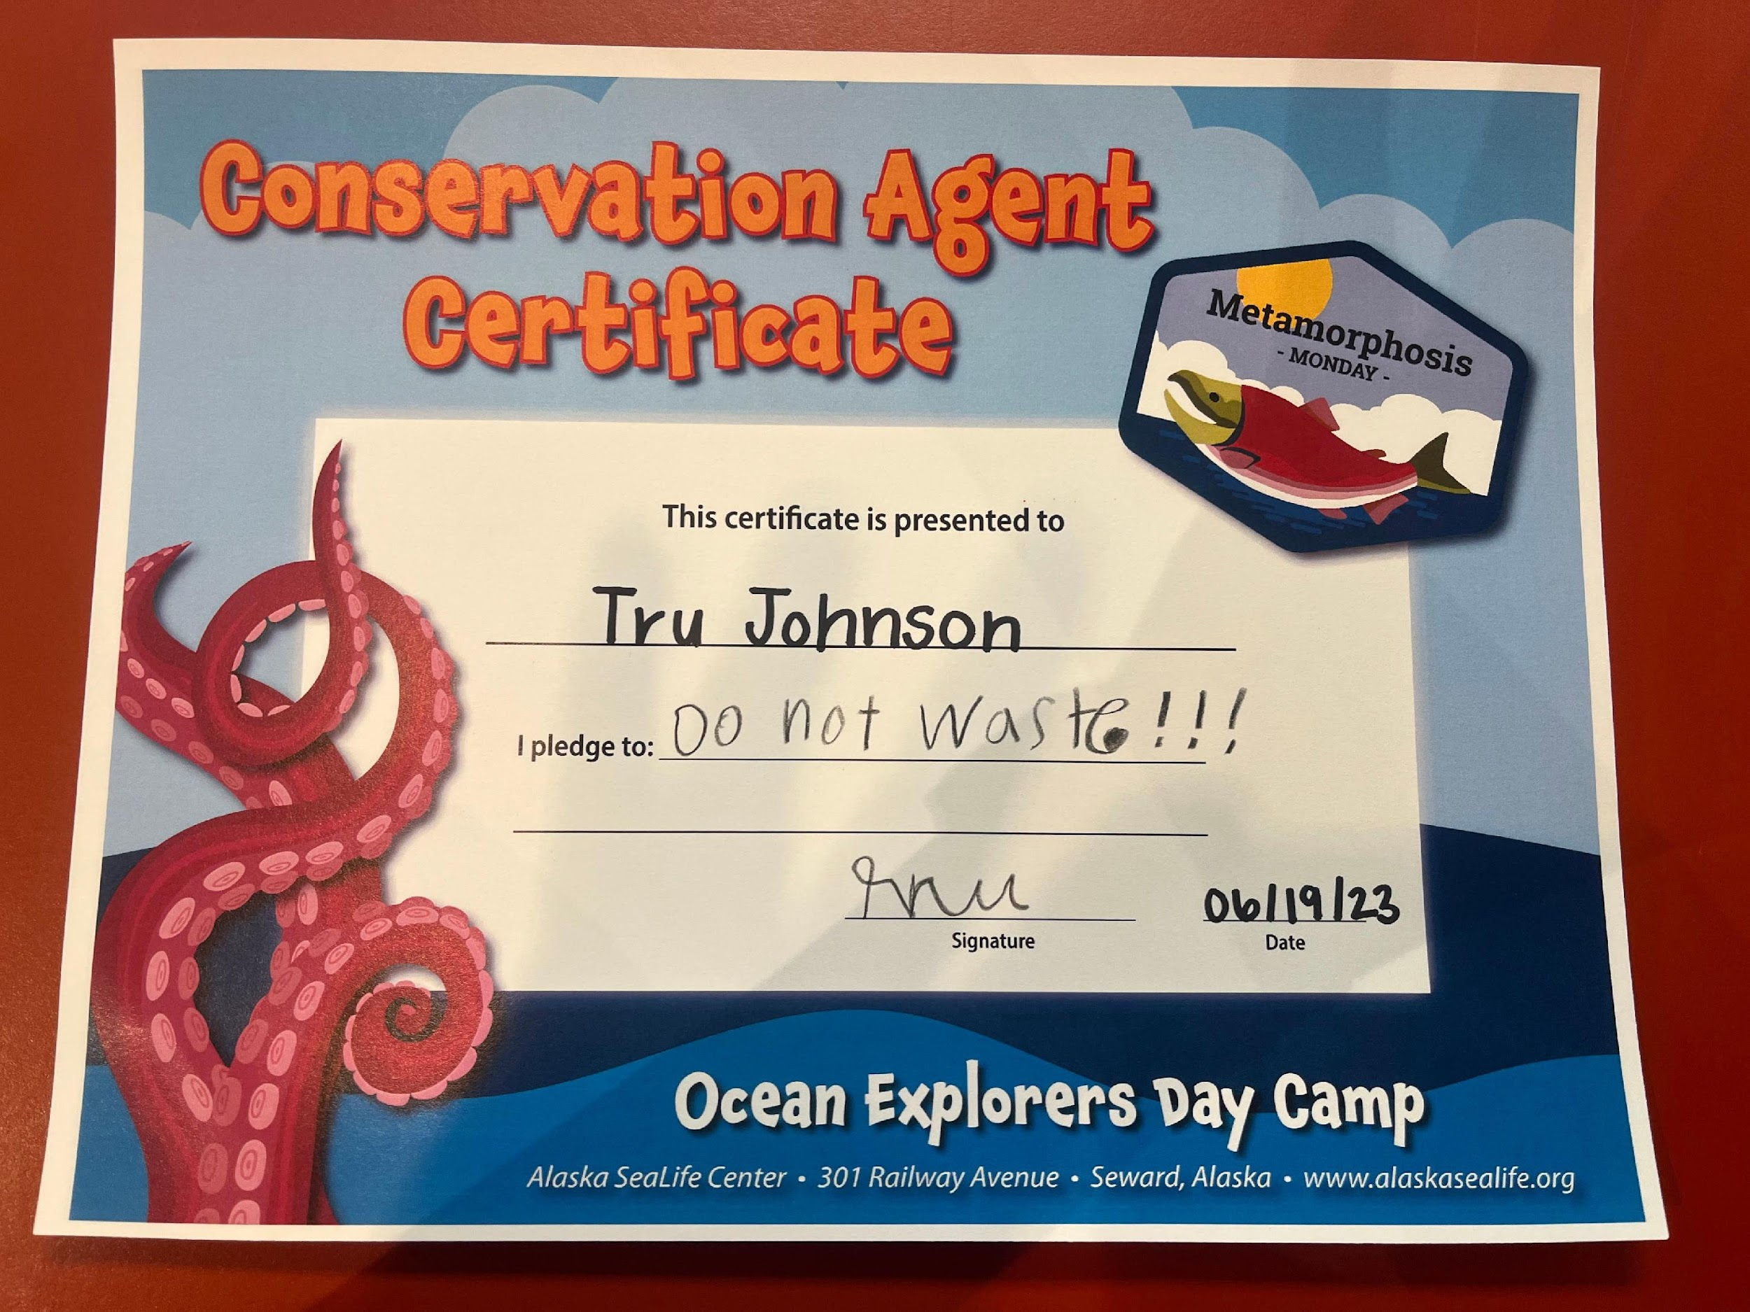
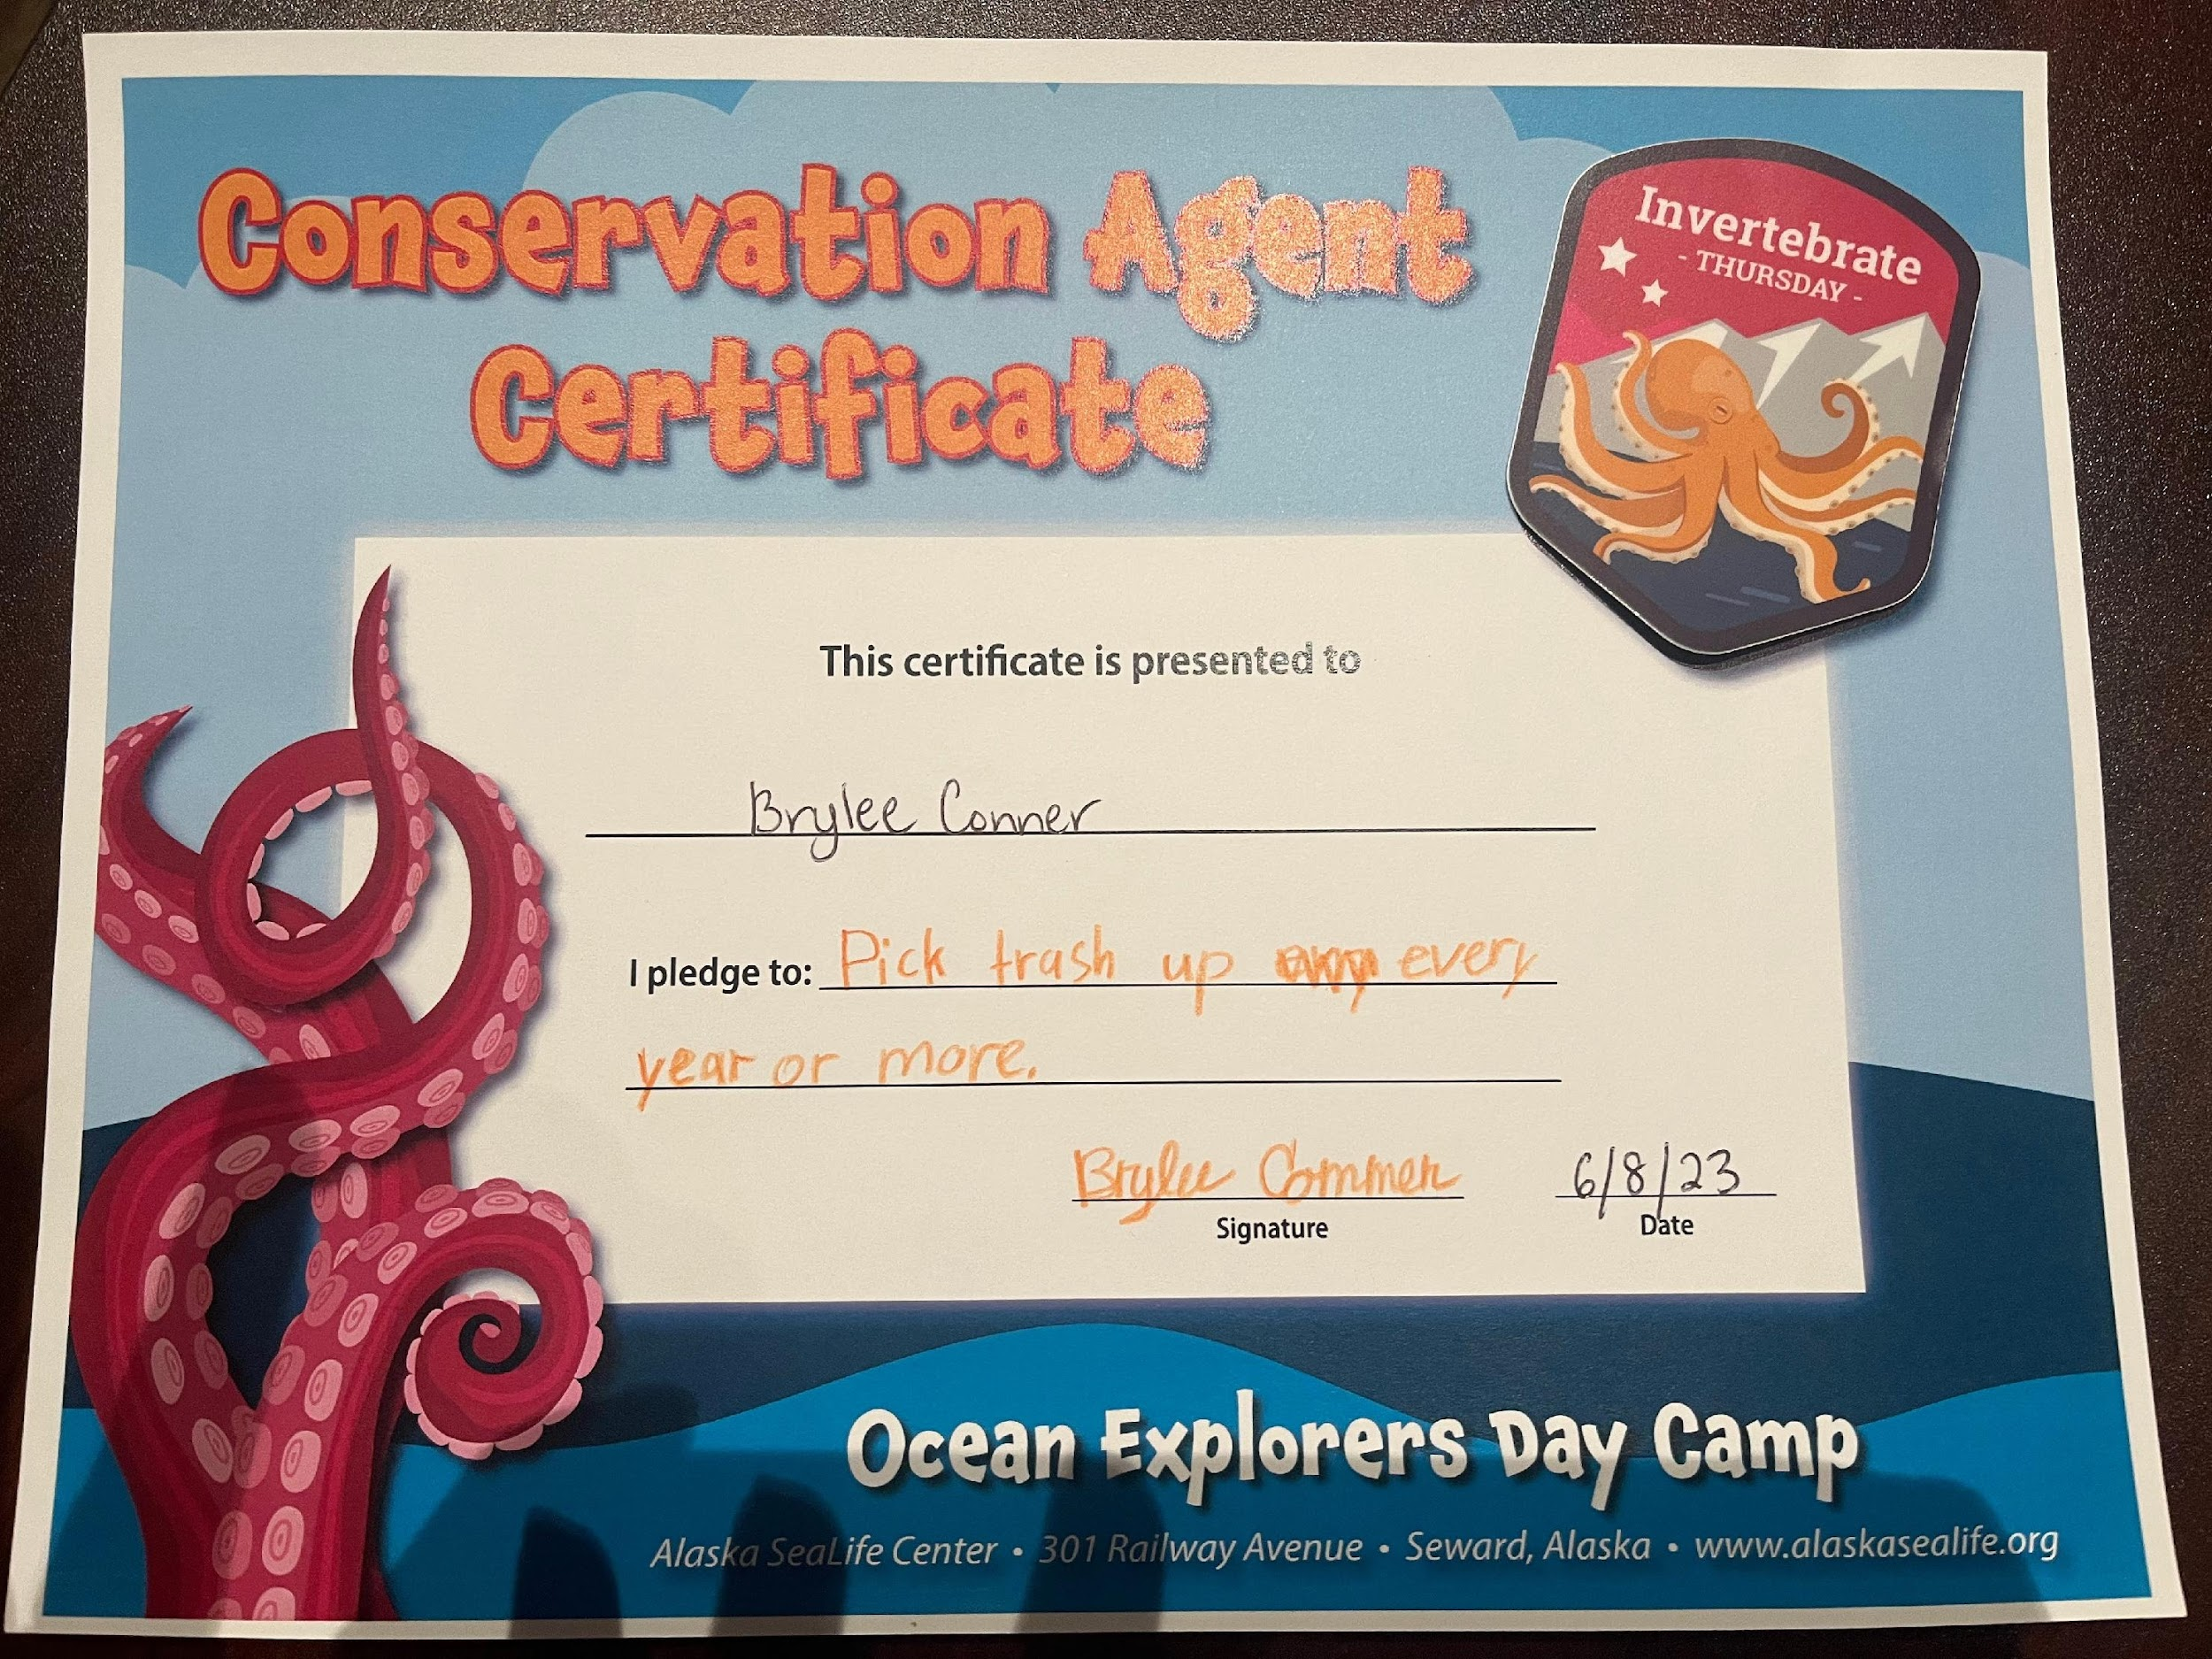
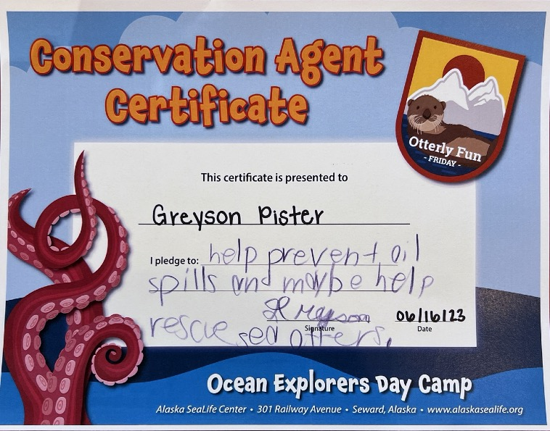
Conservation Messaging
Empathy as a tool for driving pro-conservation behaviors.
Challenge: Short timeline – difficult to confirm follow through
Ability to connect knowledge and concern for animals into understanding a need for conservation.
Desire to make a conservation pledge.
Creation of a conservation action.
Become a “Conservation Agent”

Slide 10
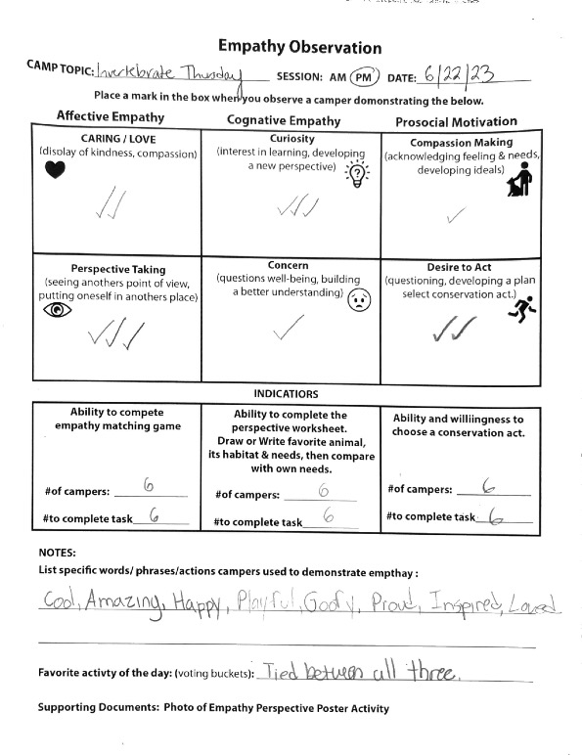
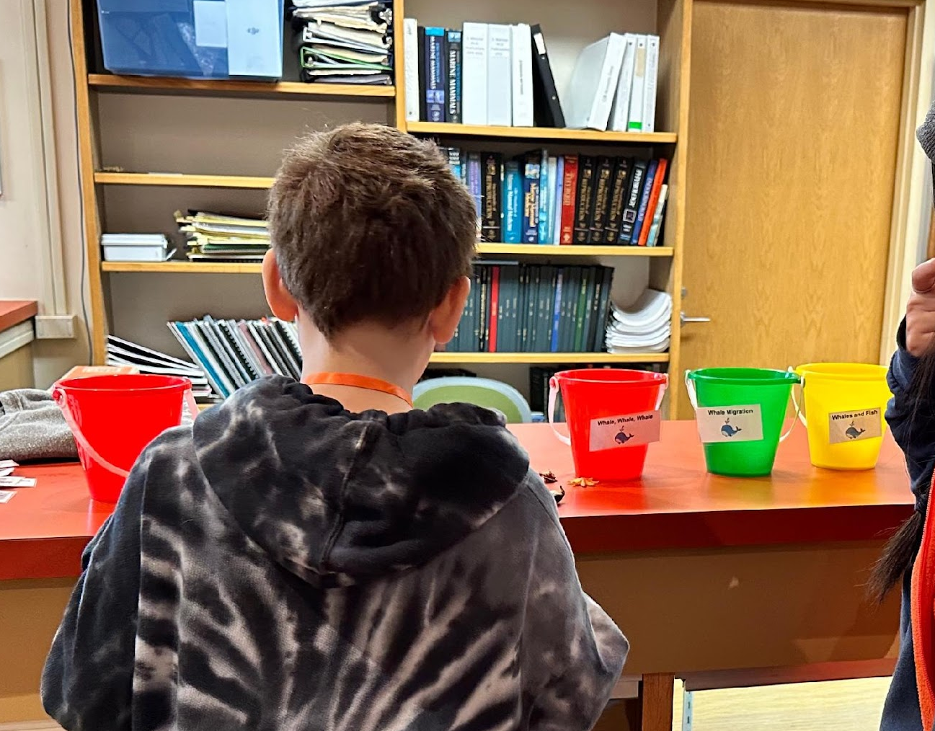
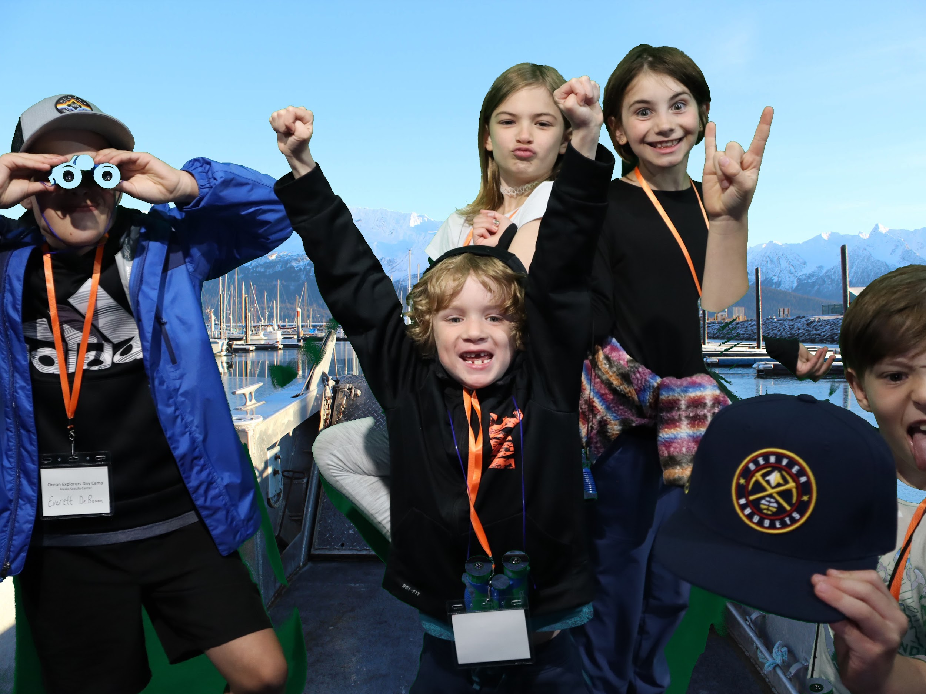
Evaluation Activities and Resources
Challenge:
  No baseline – Where did they start?
  How much empathy development was a direct result of camp activities.
Empathy Observation
  Affective, cognitive, pro-social motivations
  One observer per camp session
  Opportunity for skill development for interns and staff
Program Activity Evaluation
  Willingness to participate
  Voting buckets
Success
What we learned?
How to move forward?

Slide 11
Additional Benefits
Community and Collaboration
Coordination across departments
Partnering with Native organizations for land acknowledgement, language and cultural stories.
Partnering with University of Alaska, Fairbanks
  Use of space
  Coordination of science chats in evenings
More focused internship program
Development of observational analysis skills
Opportunity to define, track and process evaluation data
Program development and presentation

Slide 12
Additional Benefits
Program Development and Presentation
Development, execution and evaluation of new curriculum
  32 programs covering 7 topics
Integration of new programing into other education programs
  Experiential learning
  Empathy and conservation focus
  Inclusive
  Modular for adaptability
Improved Empathy Training
Expanded empathy training
  48 staff trained between March and August 2023
Development and presentation of empathy-focused guest programing
  10 guest experiences created and delivered daily

Slide 13
Program Review and Post-Camp Evaluation
Wrap up:
Review curriculum – what worked, what can be improved
Booking structure
Camp time frame
Recap of costs vs. revenue generated.
With Participants and Parents
Email survey post-summer vacation to parents
  Future planning
  Tracking of conservation actions
  Membership opportunity
Internal Statistics and Logistics Review

Slide 14
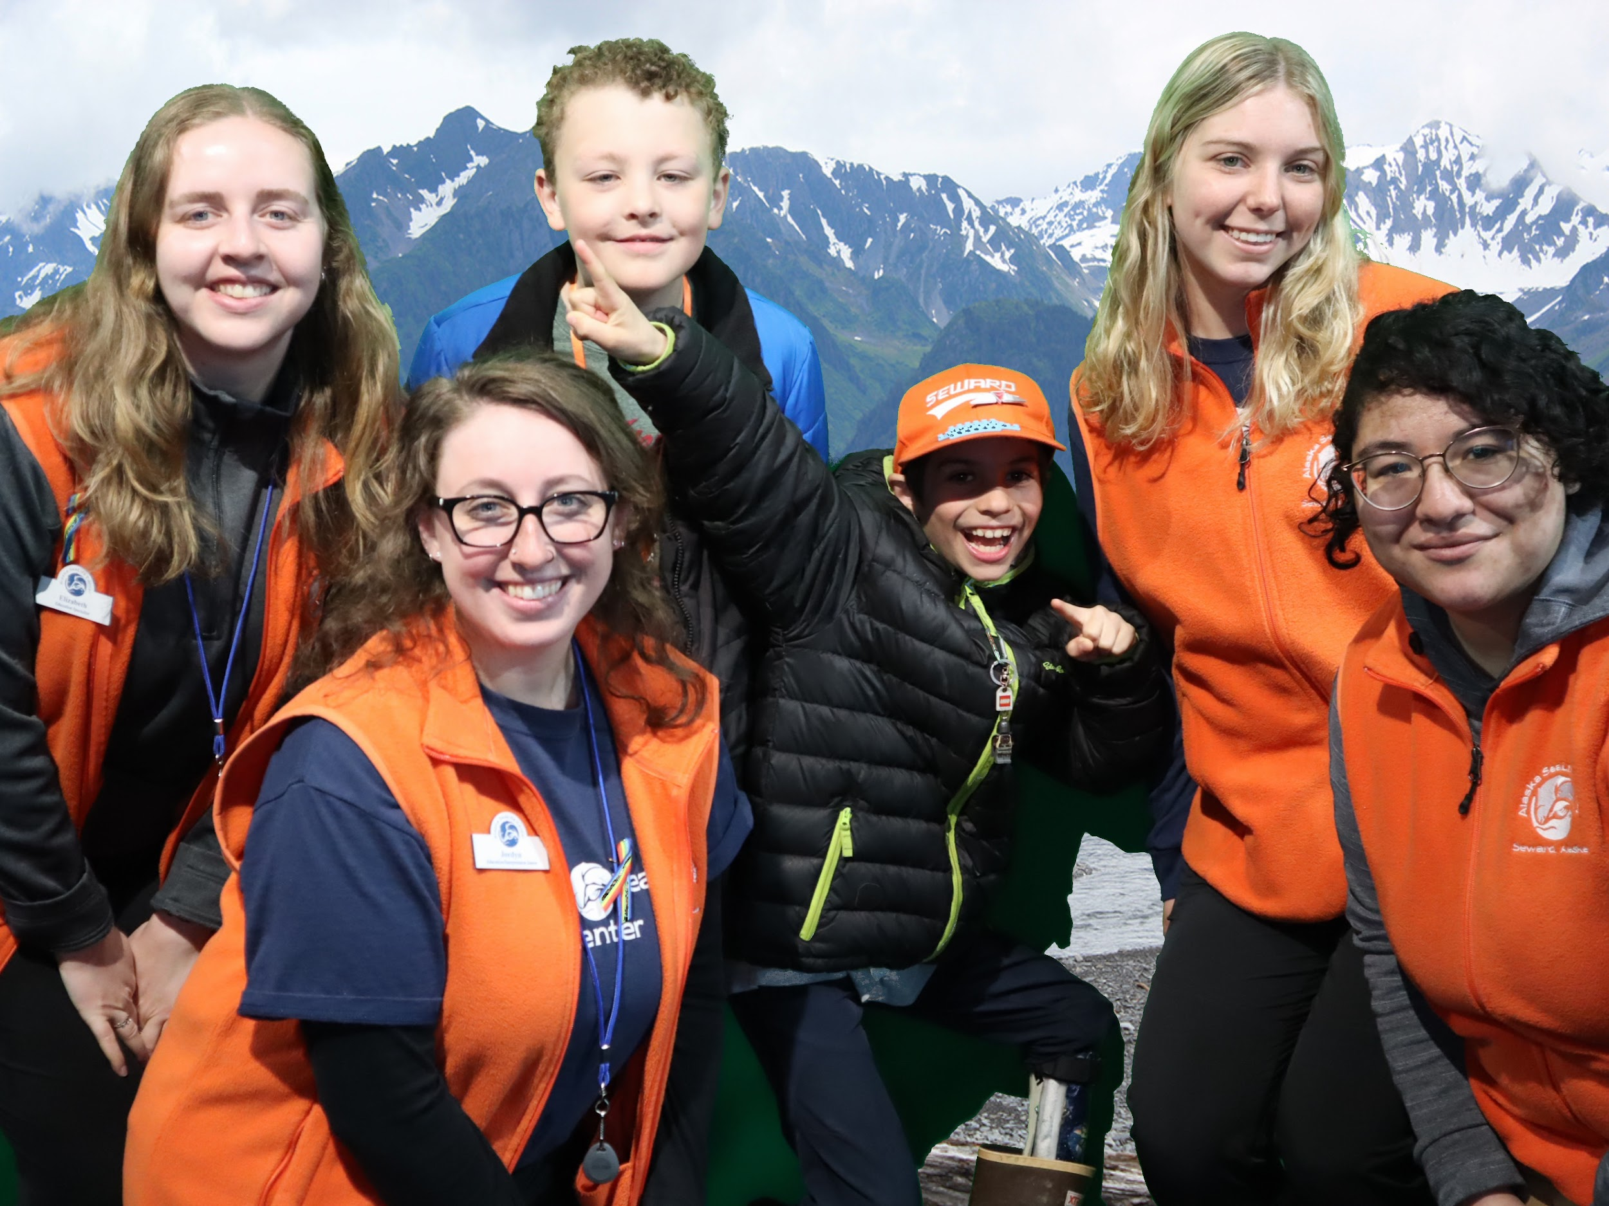
Fostering Empathy through Experiential Learning
(FEEL) Summer Day Camp
Coming Soon
  Creation of an empathy interpretive training program for all ASLC staff.
    Tools and techniques
    Linking conservation messaging
  Integration of modular programing utilizing experiential learning, empathy and inclusion into all education curriculum.
  Integration of empathy and inclusion into ASLC exhibits.
    Signage to include Native language
    Audio tour for increased accessibility
      Native stories from elders
Questions?

