Slide 1

Increasing Empathy for Animals Module 4: Continuity
Docent Training
Notes:
Hello again!
This is the final part of our 4-part series about Empathy, where we will be learning about empathic concern and talking about the characteristic of Continuity.
As usual, we’ll start off with a question to get us all thinking about empathy for animals.

Slide 2






Which animal or biofact are you most excited to share with zoo visitors using an empathy approach?
Notes:
Let’s list in the chat box (or share aloud) an animal or an exhibit area or a biofact that you think you’ll be excited to tell guests about using some of the empathy language and techniques we’ve been learning.
[Give people time to think and type responses. Ask people to say more about why they selected that item.]

Slide 3
Empathy Abilities
Affective Empathy – feeling another’s feelings
Cognitive Empathy - understanding another’s feelings
Empathic Concern – acting in response to another’s feelings
EMPATHIC CONCERN =
MOTIVATIONAL EMPATHY =
COMPASSION
Notes:
Remember that feeling empathy for another person or animal is built around three abilities, which researchers call Affective, Cognitive, and Empathic Concern.
Affective empathy is when we see another being showing an emotion and it causes us to feel that way too.
Cognitive empathy is when we can really imagine ourselves in the shoes of another being, and by taking that perspective we understand their feelings.
Both affective and cognitive empathy are important building blocks to inspiring conservation action.
But Empathic Concern is the subcategory of empathy that is most closely linked to taking action.
Empathic Concern is also sometimes called Motivational empathy, or we can think of it simply as Compassion.

Slide 4






Empathic Concern: Acting in response to another’s feelings
Notes:
So empathic concern, or compassion, asks that someone take action, often in response to another's suffering.
This is the level of empathy that is being tapped into by TV commercials showing images of starving children or abused puppies and soliciting donations to relieve their suffering.
When another being’s emotions touch us in a way that triggers our empathic concern, we are inspired to take action.
For example, when you pass someone on the highway whose car is broken down in the rain, and you decide to stop and help, you have empathic concern. In that instance, you aren’t motivated by anything other than empathy. You don’t expect to get anything in return. In fact, it’s probably a major inconvenience for you. But your empathic concern causes you to act anyway.
Applying this to an animal example, if a bee has fallen into a swimming pool and is at risk of drowning, your empathic concern response might be to swoosh it out of the water. Again, you’re motivated by the desire to relieve the bee’s suffering, even if you risk getting stung in the process.
In zoos, it’s not uncommon for a visitor to be concerned about the welfare of an particular animal that they believe is suffering. Our animal care staff frequently fields questions about the tiger who is assumed by some visitors to be lonely because he lives alone. Of course you can help correct the misperception, by explaining that tigers are solitary creatures, but you can also help inspire empathic concern based on positive experiences, rather than suffering.

Slide 5
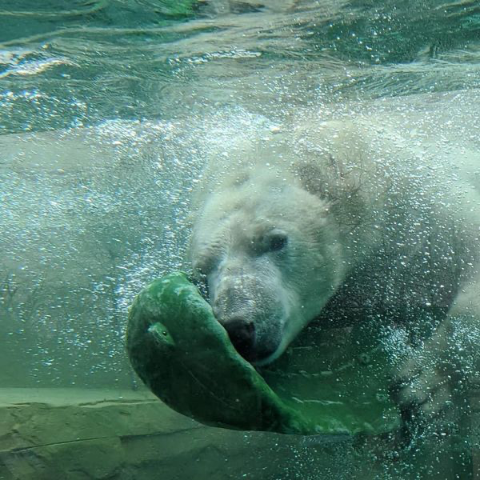
Positive Empathic Concern: Joyful emotional response leading to action
Notes:
The research around positive empathy is growing, and has important implications for zoos. It’s the idea that people are encouraged to act positively toward others, after experiencing empathic concern in response to a joyful emotional response. In contrast to the action inspired by an animal’s suffering, positive empathic concern occurs by noticing good feelings such as playfulness, joy, and comfort felt by the animal.
To promote positive empathic concern, you want to direct a person’s attention to the good emotions associated with an animal at the zoo, and projecting that feeling towards motivation to help sustain or extend a similar positive state for other zoo animals or for their counterparts in the wild.
For instance, a zoo guest might donate money to purchase enrichment items for the polar bears because they love watching them play when they visit the zoo and they want to help the polar bears experience the positive outcomes related to enrichment, such as curiosity, activity, or fulfillment of social and biological needs.
From a conservation standpoint, our messages might focus on how we can help preserve and improve the lives of wild animals by fostering visitors’ understanding of what make these animals happy or thrive.

Slide 6
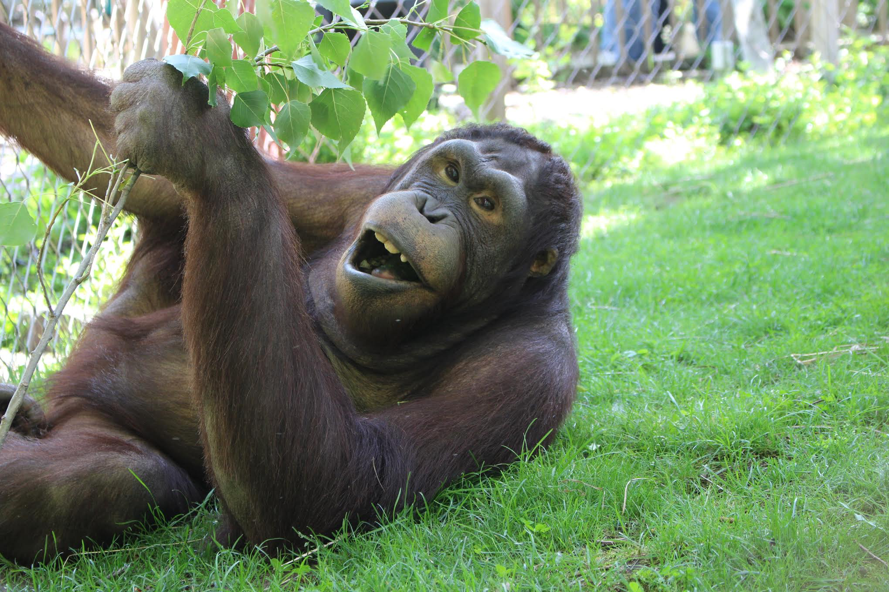
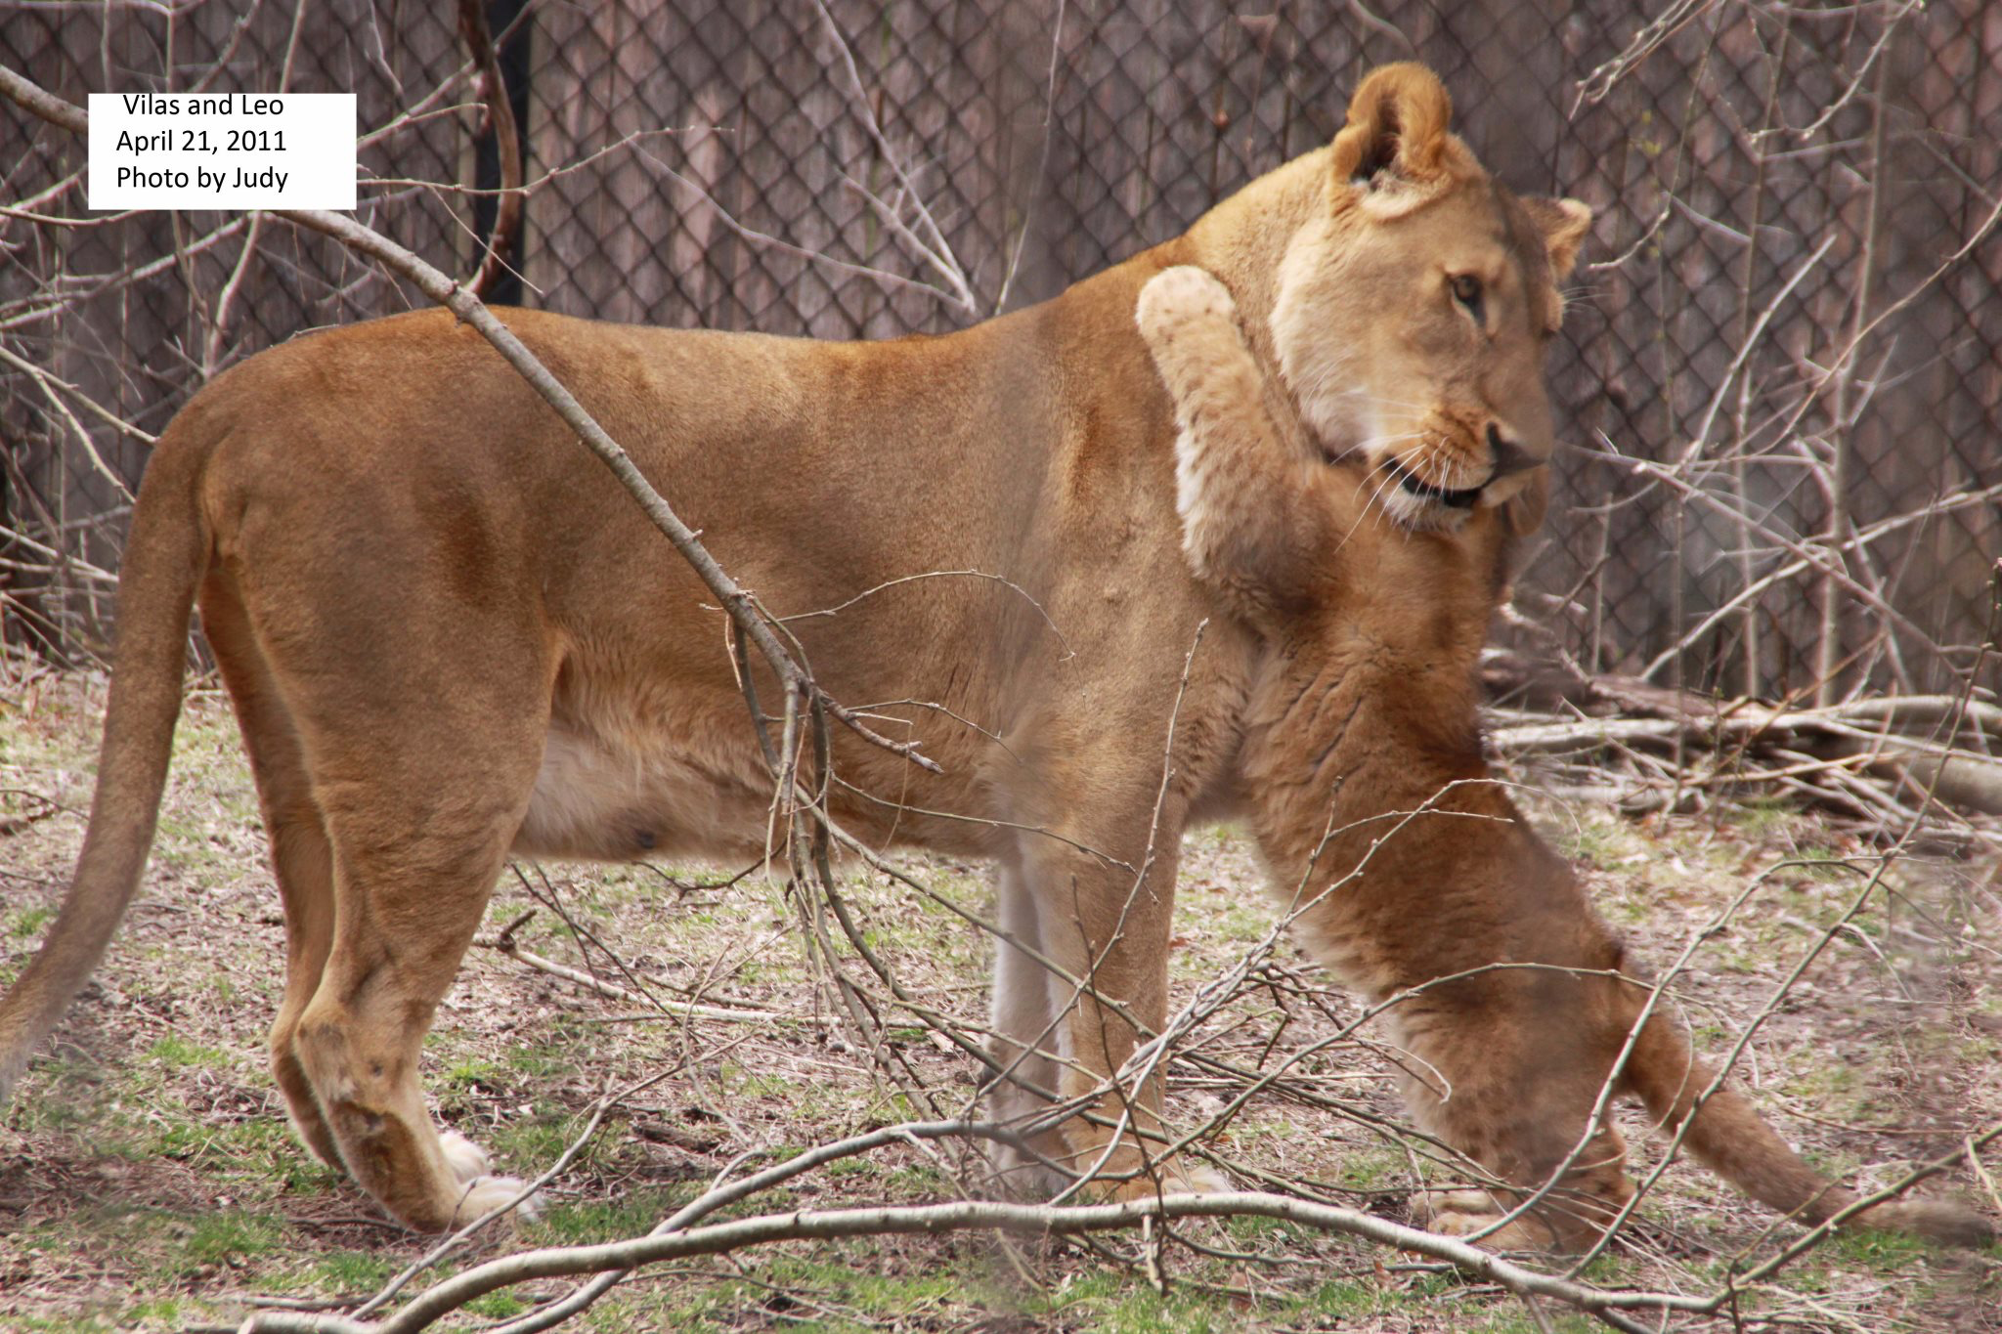
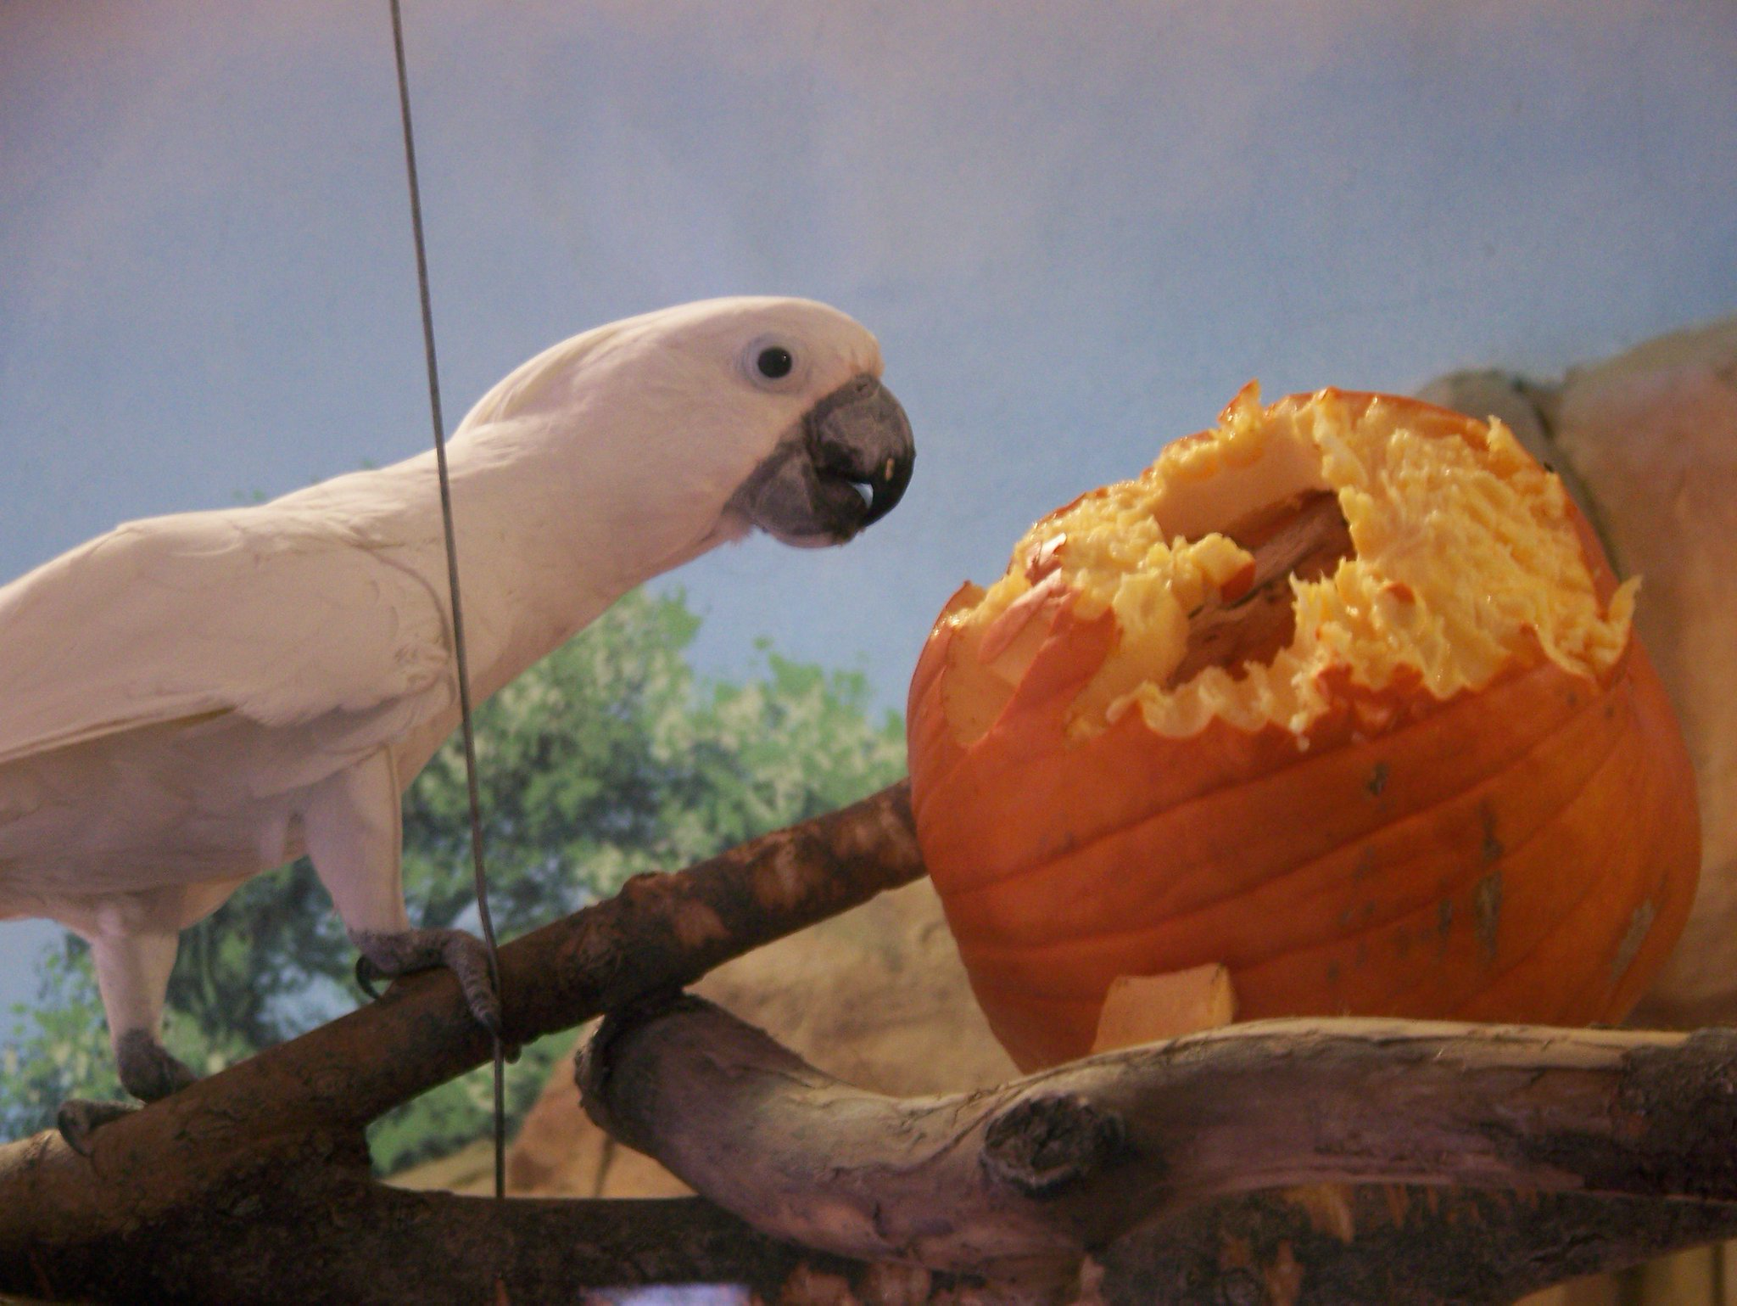
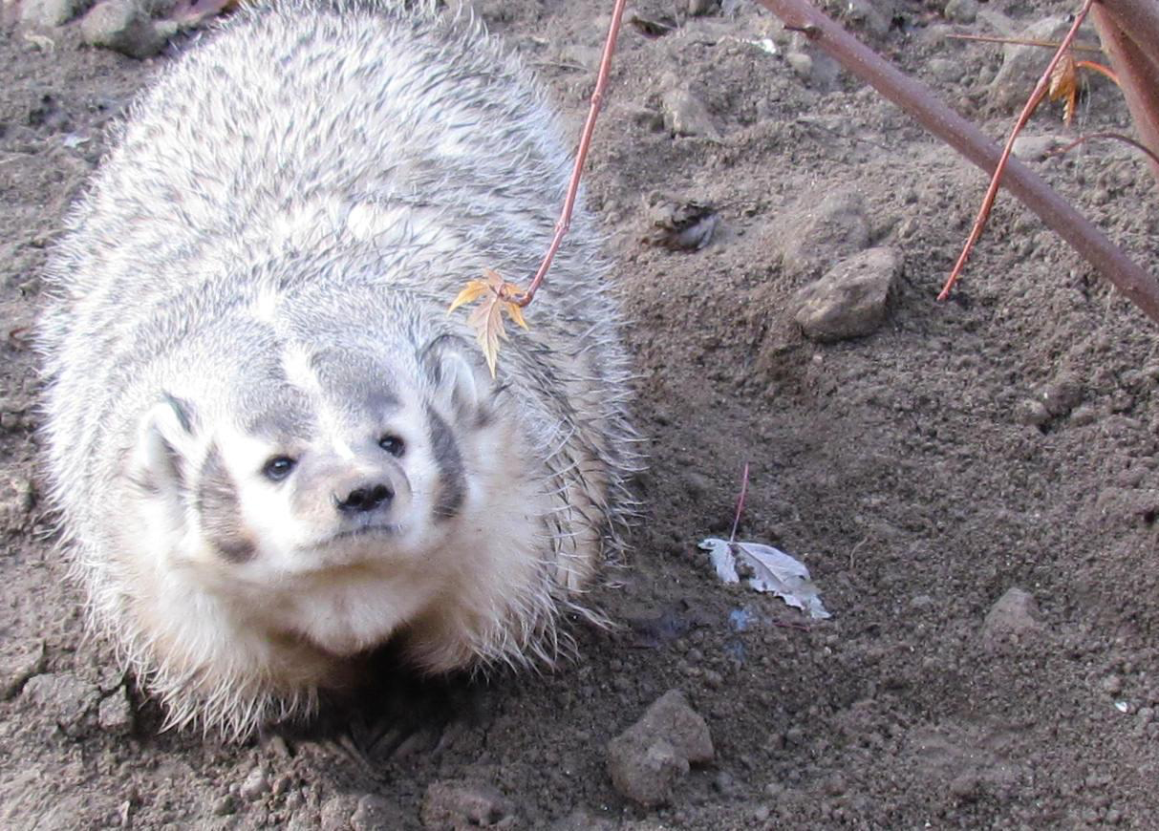
Inspiring Action through Positive Empathic Concern
A
B
C
D
Notes:
Here are four images of animals from our collection. How can we highlight positive empathy for these animals? What can we talk about at these exhibits that would foster a visitor’s understanding of what make the animals happy or thrive?
Let’s take the orangutan in Picture A. You could describe what their favorite playtime activities are, and mention how these play behaviors are also observed in the wild.
Who wants to try Picture B? (Ask for examples.)
…
Great. To really be successful in our zoo education efforts, we are always striving to foster empathic concern for animals in the wild, not just for the animals in our care. So as much as possible, we want to be referring visitors back to the species as a whole, while using the individuals on exhibit to elicit positive empathic concern.
Research on positive empathy suggests that people are more likely to feel positive empathy for individuals with whom they have a close relationship…which brings us to the final part of our empathy training – looking at the characteristic of Continuity.

Slide 7




Why do some animals elicit more empathy?
AFFECTIVITY
AGENCY
CONTINUITY
COHERENCE
Notes:
Here again are the four factors which contribute to an animal’s likelihood of eliciting empathy from people.
Agency
Affectivity
Coherence
Continuity
These four characteristics, taken together, determine the likelihood that we feel empathy towards an animal.
All animals present different variations of agency, affectivity, coherence, and continuity that influence how we relate to them.

Slide 8

Continuity: how much time we spend with the animal
CONTINUITY
Notes:
Continuity refers to the total time spent with an animal.
As a zoo docent, you may find that you feel greater empathy for the animals that you spend the most time interpreting. As you spend more and more time around an animal, an individual that maybe seemed a little dull in its behavior or lacking in personality can develop a richer set of traits. Through continuity, your empathy for the animal increases.
By spending time with animals, we begin to notice their individual preferences, attitudes, and responses to stimuli. The longer we spend, the more we notice, and this feeds into the characteristic of continuity that increases empathy.
Anything you can do to increase the time that visitors spend at an exhibit can boost the continuity factor for that animal.
This element of empathy research is especially important for our repeat visitors who actually have the chance to build continuity with specific animals in our zoo.

Slide 9


CONTINUITY
Capitalize on the empathy that visitors naturally feel for some animals!
Encourage visitors to spend more time at exhibits where they don’t normally linger
Notes:
While you are interacting with guests, you can promote continuity for animals in exhibits where visitors commonly spend a lot of time. Particularly for young children who bond with a certain zoo animal, encouraging that bond and fostering long periods of observation is great.
Your continuity challenge is at exhibits where visitors tend to skip past quickly. Think about ways to encourage them to linger longer. It might start with offering to take their photo, and using the opportunity to point out why the animal is worth photographing – pointing out unique traits or facts and inviting them to look more closely.
What are some other tricks you all use to extend the time visitors stick around? (Invite examples).
Great. These techniques are helping to increase the characteristic of continuity, thereby contributing to the empathy a visitors feels, and ultimately increasing their willingness to take action for wildlife conservation.

Slide 10
Ways to Increase Continuity?
With family groups including young children
With school field trip groups
With adult couples
With solo visitors
With teenagers
Notes:
Let’s keeping thinking of ways to increase the continuity that different types of visitors have with our zoo animals. We of course want to respect people’s visitation styles, so it’s equally important to take that into consideration as well. But more often than not, visitors are eager to experience something special even if it takes a moment longer than they would have spent on their own.
[Give time for participants to think and share.]

Slide 11
Summary: Module 4
3 Empathic Abilities:
Affective Empathy – feeling another’s feelings
Cognitive Empathy - understanding another’s feelings
Empathic Concern – acting in response to another’s feelings
Positive Empathic Concern
Notes:
To summarize, what we have learned is that there are three ways to experience empathy: Affective, Cognitive, and through Empathic Concern. Our focus in this session was on Empathic Concern, or the action taken in response to another’s feelings.
With empathic concern, we are especially interested in positive empathic concern, which involves a reaction in response to joyful emotional as someone observes or interacts with an animal, rather than a response based on the belief that an animal might be suffering. This joyful positive empathic concern is certainly an appropriate focus for the zoo and our mission.

Slide 12
Summary: Module 4 (cont.)
Empathy for animals is influenced by 4 characteristics:
Agency
Affectivity
Coherence
Continuity - how much time we spend with the animal
Increasing continuity for different audiences
Notes:
We also talked again about the 4 characteristics of animals that influence how much empathy they naturally elicit, focusing this time on Continuity which is the cumulative time spent with an animal.
We thought about ways to increase continuity for our zoo visitors, engaging them for longer so that they have the chance to experience heightened empathy for the animals.

Slide 13


Empathy is teachable and learnable!
CONTINUITY
Notes:
In this series on empathy, we have talked a lot about the value of empathy for animals as it relates to wildlife conservation.
Empathy, while a natural instinct, is also teachable and learnable, through interactions about animals and relationships with them. It’s important to make empathy a habit, but it takes time – just like it takes time to build your own habits of talking about the animals and exhibits at the Zoo with an empathy lens.
The more opportunities we can give our visitors to spend time in and with nature and animals, the more their empathy muscles will be strengthened. You can make a big difference during someone’s visit to the zoo by helping them practice responding to their experiences with the animals in a way that demonstrates empathy and inspires conservation action.

Slide 14


The best way to learn is through practice!
Notes:
Talk about next steps and open up for questions…

