Slide 1

Increasing Empathy for Animals
Module 3: Coherence
Docent Training
Notes:
Hello and welcome back!
This is the third in our 4-part series about Empathy. Before we get started, does anyone have any thoughts or questions to raise?
…
During the last session, we defined affective empathy and talked about the characteristic of affectivity as a driver of people’s empathy towards animals.
Today we will be looking at cognitive empathy and getting into the characteristic of coherence.
First, let’s do a quick warm up activity!

Slide 2






Which animal have you been thinking about differently in light of our empathy training?
Notes:
Let’s list in the chat box (or share aloud) the animals that we are thinking about a little differently since starting these conversations about empathy. It could be a specific individual, a species, or a whole group of animals, like snakes maybe.
[Give people time to think and type responses]
Would anyone like to share more about their shifting perspective?
…
Today’s session is actually going to focus a lot on shifting our perspective to that of an animal, as a way to garner empathy for it. But first, let’s review what we already know about empathy.

Slide 3
Quick Review!
Affective Empathy – feeling another’s feelings
Cognitive Empathy - understanding another’s feelings
Empathic Concern –
acting in response to another’s feelings
Empathy is a stimulated emotional state that relies on the ability to perceive, understand, and care about the experiences or perspectives of another person or animal.
Notes:
Remember that Empathy is a stimulated emotional state that relies on the ability to perceive, understand, and care about the experiences or perspectives of another person or animal.
And that there are three empathic abilities which can be used to take the perspective of an animal: Affective Empathy, Cognitive Empathy, and Empathic Concern.
Earlier we looked at affective empathy as the ability to sense the emotions of another being.
Today we will dive into Cognitive Empathy, and in the last session, we will explore Empathic Concern.

Slide 4





Cognitive Empathy
Notes:
Cognitive empathy refers to the ability to understand the experiences of others by imagining yourself in their reality. This is often described as putting ourselves in another’s shoes.
Let’s say, for example, that your good friend doesn’t get a job they interviewed for and they call you to express their disappointment. Your reaction could be to jump immediately into a cheerleading role, ensuring your friend that they’re very talented and will soon get another chance at a great job. This response makes you a caring friend, but it does not show cognitive empathy. If, instead, you take a moment to really imagine being the rejected interviewee, maybe by remembering your own feelings in a similar situation, then you are tapping into the part of the brain that triggers cognitive empathy. You can then comfort your friend by letting them know you understand their sadness and disappointment, and talk about ways to handle difficult questions that might come up in a future interview.
For an animal example, you might imagine what it is like to be a cat in a home where 3 youngsters are playing with nerf guns and racing around the furniture. If the cat were another kid, it would probably want to join in. But from the cat’s perspective, you can easily imagine why it’s a perfect time to run and hide. The ability to assess the situation from the cat’s point of view is an example of cognitive empathy.
At the Zoo, when you see a rhino wallowing in the mud, your first instinct might be – “YUCK! What a mess. I would not want to be covered in stinky mud. And I certainly wouldn’t let my children get dirty like that!” But if instead you think – OH, that rhino must be loving the sensation of cool mud on its skin – then you are seeing the situation from a perspective other than your own. That is cognitive empathy.

Slide 5
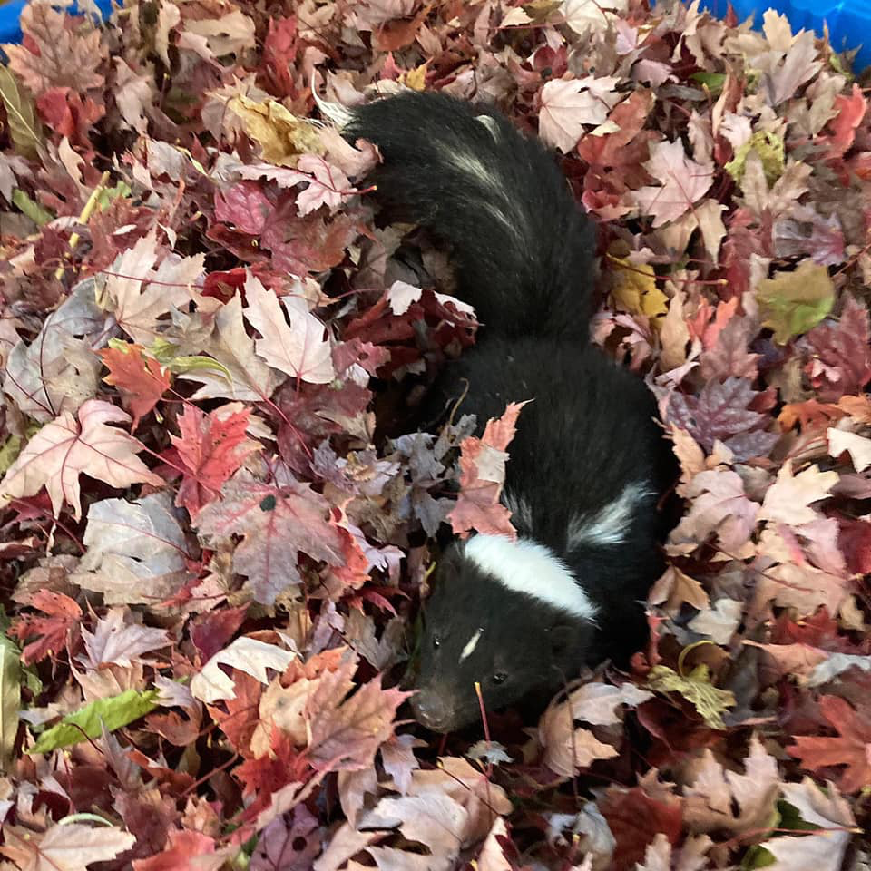
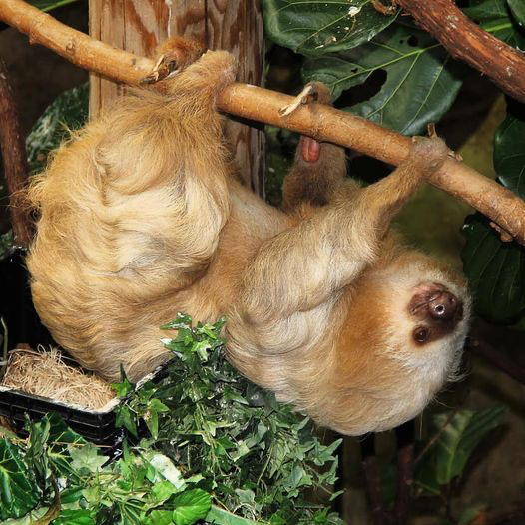
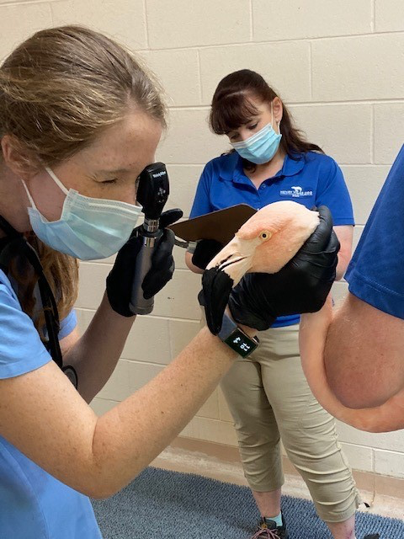
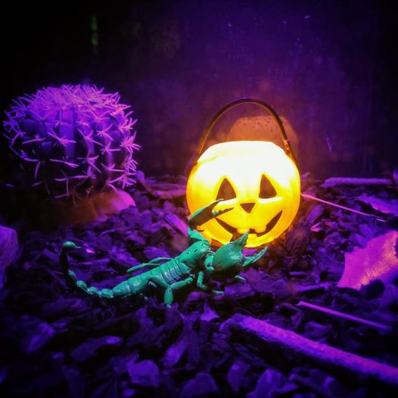
Practicing Cognitive Empathy
A
B
C
D
Notes:
Here are four images of animals from our collection. Let’s practice tapping into cognitive empathy with each of them.
For example, looking at the skunk in picture A, we might try to imagine what it would feel like to find ourselves in a pile of dry, crunchy leaves. We all know what that experience is like for ourselves. But what about for a skunk? While we cannot know exactly what the skunk is feeling, we can consider the circumstance from a skunk’s perspective. Is there anything threatening or stress-inducing for a skunk about the leaf pile? Would the smells in the leaves be attractive to a skunk? Are the leaves sharp enough to poke through the skunk’s thick fur, or would they serve as a comfortable scratching post? Although we cannot be certain, it seems like this experience would overall feel pleasant for a skunk.
In picture B, we see the sloth clinging upside down to a branch. As a human performing this maneuver, we can imagine the blood rushing to our head and our arm muscles tiring quickly. But we can presume that is not the experience of a sloth. Who would like to try to describe this situation from a sloth’s perspective?
…
Ok, looking at the flamingo undergoing an exam in picture C, what might that circumstance possibly be like for the bird? (Invite one or more people to describe it.)
And for the scorpion in letter D, who is being spotlighted with a UV light, what can you imagine from the scorpion’s perspective? (Invite one or more people to describe it.)

Slide 6



How does the octopus feel?
Notes:
As before when we explored Affective Empathy, there seems to be a fine line between anthropomorphizing and soliciting Cognitive Empathy.
The distinction can be tricky so I want to give you some examples where the approach to making a cognitive empathy link is supported by knowledge of animal biology and natural history, rather than relying on imagined emotions alone.
One good example, if you know anything about octopuses, is that they are generally solitary animals. Visitors to an aquarium will often express sadness for an octopus housed in a small exhibit alone. As social beings that require and enjoy space, we struggle to accurately empathize with the needs of an octopus who, when given the choice, prefers to live alone and in small confined spaces. Cognitive empathy builds on our knowledge of an animal's individual natural history, so that we can imagine life as a solo octopus not feeling lonely at all.

Slide 7
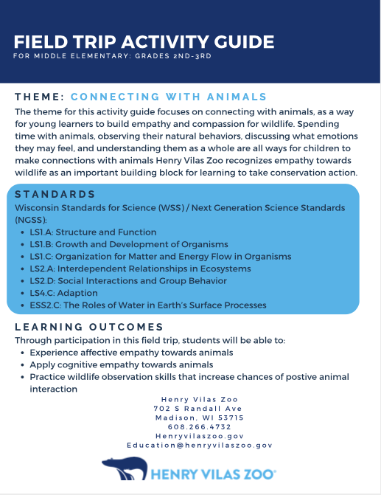
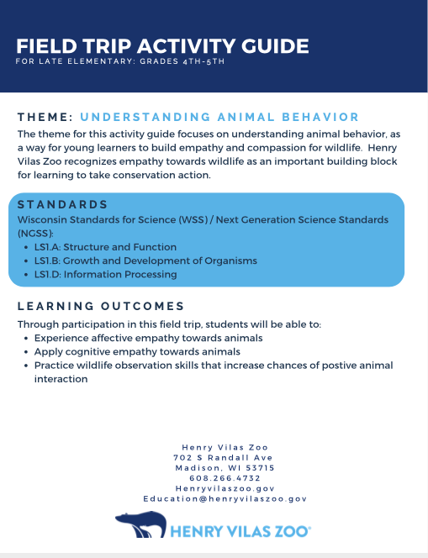
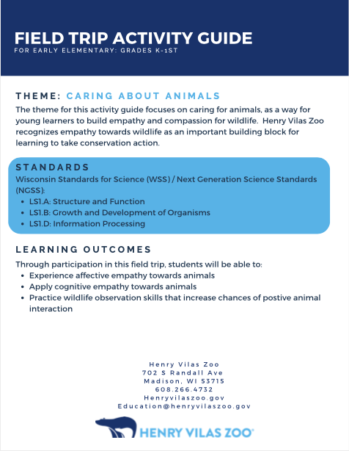
Empathy-based Field Trip Activity Guides
Notes:
You’ll recall that the Zoo has a set of new Field Trip Activity Guides which help teachers and chaperones facilitate empathy-building.
Some of the activities are similar to the octopus example, where animal facts are paired with emotion questions, in a way that drives cognitive empathy without relying entirely on anthropomorphism.
I’ll give you some specific examples from each activity guide.

Slide 8
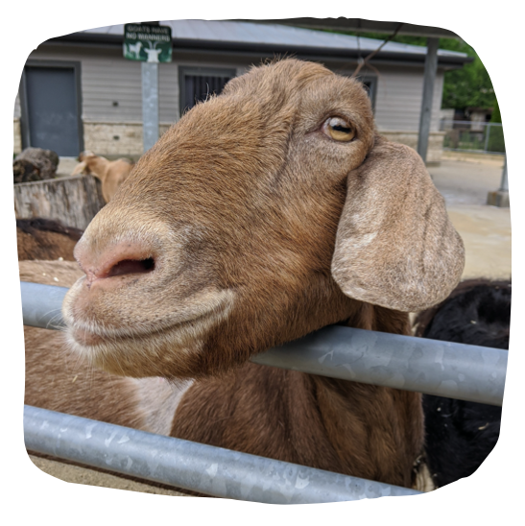
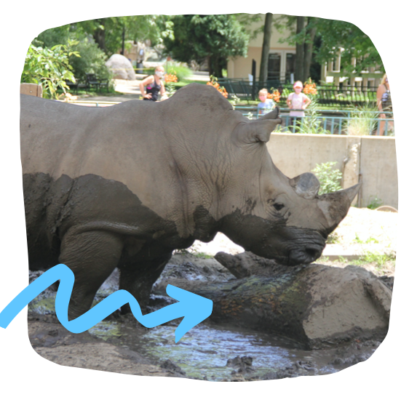
Examples in K-1st Field Trip Activity Guide
Notes:
In the K-1st grade Field Trip Activity Guide, a couple of the activities work really well to promote cognitive empathy.
At the Children’s Zoo, students are invited to brush the goats and are asked: How does brushing the goats make you feel? And then: How do you think it feels for them? This exchange goes beyond the standard petting zoo scenario of talking about importance of animal care and welfare and taps into empathy by having students imagine what the experience is like for the goats.
At the white rhino exhibit, the guiding question is: How can a big, tough rhino still be sensitive? This activity leads to students learning the typical facts about rhino skin, but from a slightly nuanced angle that promotes cognitive empathy as students imagine what it is like to be a rhino.

Slide 9
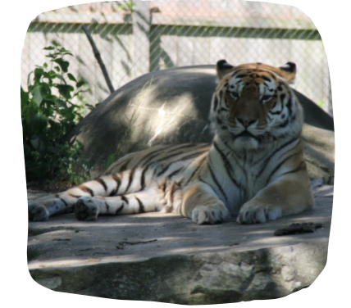
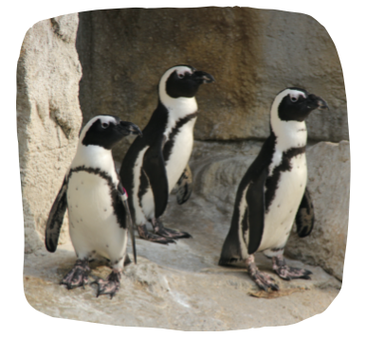
Examples in 2nd-3rd Field Trip Activity Guide
Notes:
In the Field Trip Activity Guide for 2nd and 3rd graders, the students are invited to think about this question: What makes a tiger feel lucky? Presented in the context of the Wheel of Survival interactive, students learn what the tigers eat and how often their hunts might be successful, but also consider the experience of hunting from the perspective a tiger.
At the penguin exhibit, the question presented is: How do African penguins stay comfortable in the heat and cold? Again, while this addresses the physiology of the animal, it also elicits cognitive empathy when students are asked to imagine themselves as a penguin seeking comfort.

Slide 10
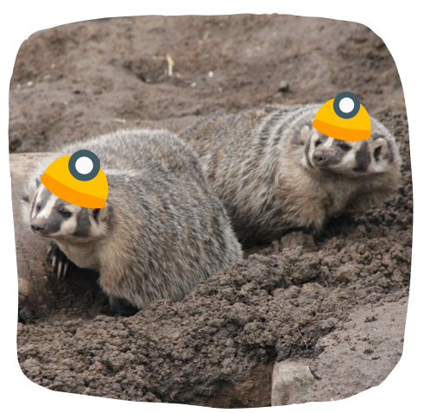
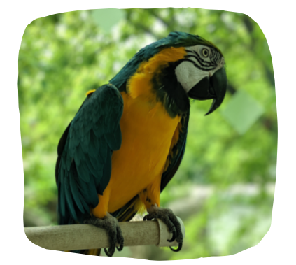
Examples in 4th-5th Field Trip Activity Guide
Notes:
Finally, in the 4th-5th grade Activity Guide, students encounter cognitive empathy triggers at the badger exhibit and in the aviary.
While learning that badgers go into torpor to survive the cold winter, they are asked whether the badgers seem lively or listless today, prompting them to observe the animals and consider what might influence their behavior. Then they role-play digging like a badger and being a badger in torpor, imagining what it would feel like to be a lively badger or a listless badger.
Before entering the aviary, students’ attention is drawn to the idea that their behavior as a group will influence the birds’ behaviors. They are asked to think about how they would feel if rambunctious visitors entered their home, putting them in the place of the birds living in the aviary. After learning that the blue-and-gold macaws are capable of mimicking human words, students are invited to imagine what the birds might say to us.
These few examples of sparking imagination around an animal’s experience can be applied to many of the exhibits at the Zoo. Especially when you are talking to young visitors, it is a highly effective way to promote cognitive empathy while also sharing the usual interesting animal facts.

Slide 11
Other Examples of Cognitive Empathy?
Understanding another’s feelings based on animal biology/natural history
Solitary vs Social Lifestyles
Maternal Instincts
Territoriality
Mating Behaviors
Feeding Strategies
Notes:
Can you think of other examples where you could make a cognitive empathy connection supported by your knowledge of animal biology and natural history?
Try this: Think of a fun fact you like to share about an animal that fits into one of these categories. Then picture yourself telling a visitor about this animal fact, and try to put a cognitive empathy spin on it - helping them to imagine themselves in that animal’s world and taking their perspective.
[Give time for participants to think and share.]

Slide 12




Why do some animals elicit more empathy?
AFFECTIVITY
AGENCY
CONTINUITY
COHERENCE
Notes:
Here again are the four factors which contribute to an animal’s likelihood of eliciting empathy from people.
Agency
Affectivity
Coherence
Continuity
We’ve learned that Agency refers to the extent to which an animal presents behaviors similar to human behaviors.
And Affectivity is the variance in an animal’s levels of arousal, or modes of vitality.
The third one, Coherence, is the degree to which an animal is easily recognized as an animal. For instance, with arms, legs, a body, and – most importantly – a face with eyes.

Slide 13
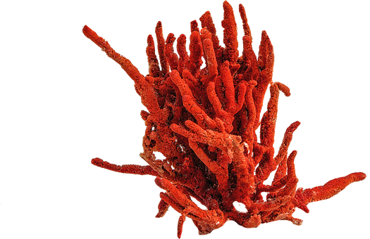
Coherence: recognition of an animal as an animal
WHERE IS ITS FACE?
COHERENCE
Notes:
Coherence, in this context, is really about recognizing the animal as a living thing. The most impactful element is the presence of a face, especially eyes. Mammalian faces are usually highly recognizable, so they rank higher on the coherence scale.
In contrast, an animal with very low coherence is coral, which of course many people don’t even realize are living animals.
Other animals with low coherence include those lacking a backbone as well as being faceless, like sea slugs, lampreys, and jellies. These animals are all disadvantaged in the empathy game, and therefore may not elicit as much conservation concern.

Slide 14


COHERENCE
Capitalize on the empathy that visitors naturally feel for some animals!
Help visitors associate with non-mammal body structures; (e.g., relate wings to arms)
Notes:
To foster more conservation concern, you can do your part by helping visitors bring more coherence to the animals that are, let’s say, shaped funny.
As with agency and affectivity, you should take advantage of the empathy that naturally occurs when visitors observe animals that demonstrate high coherence, like the primates, red pandas, and otters. All of these species not only have friendly-looking faces, but also use their hands in very recognizable ways.
Your challenge, on the other hand, is to highlight elements of coherence that may not be as obvious in some animals. Comparing the wings of a bird or a bat to arms brings more coherence to these appendages.

Slide 15

Notes:
When scientists first discovered the platypus, they did not readily accept it as a real animal because it appeared to be made from the parts of several different known animals. In other words, its coherence, or recognition as an animal, was confusing!
By talking about how animals use whatever appendages they have, and relating features to familiar parts of species, you are increasing the visitors’ perceptions of coherence.

Slide 16
Other Examples of Coherence?
Familiar body structures
Wings compared to arms
Beaks compared to mouths
Tails used for balance, like human arms
Spines - how many vertebrae?
Numbers of toes on hands and feet
Opposable thumbs
Other?
Notes:
Can you think of other examples from the zoo’s collection, or just animals in general, where you could highlight an animal’s coherence?
[Give time for participants to think and share.]

Slide 17
Summary: Module 3
3 Empathic Abilities:
Affective Empathy – feeling another’s feelings
Cognitive Empathy - understanding another’s feelings
Empathic Concern – acting in response to another’s feelings
Taking an animal’s perspective
Knowledge of biology/natural history is key
Notes:
To summarize, what we have learned is that there are three ways to experience empathy: Affective, Cognitive, and through Empathic Concern. Our focus in this session was on Cognitive Empathy, or the ability to understand the emotions of another being.
With cognitive empathy, we are allowing ourselves to take the perspective of another being. In the case of animals, it is important that this perspective is based on biological knowledge.

Slide 18
Summary: Module 3 (cont.)
Empathy for animals is influenced by 4 characteristics:
Agency
Affectivity
Coherence - recognition of an animal as an animal
Continuity
Familiar body parts
Notes:
We also talked again about the 4 characteristics of animals that influence how much empathy they naturally elicit, focusing this time on Coherence which is the degree to which an animal is easily recognized as an animal.
Features that are especially for this recognition are a face with eyes, and a lot of the typical mammalian features such as 2 arms and 2 legs.

Slide 19


Empathy is teachable and learnable!
COHERENCE
Notes:
When talking with children or adults, be aware of the coherence of the animals they are looking at influences their natural tendency to feel empathy.
The techniques from the activity guides we talked about earlier should also help support your efforts to increase students’ cognitive empathy for the animals at the Zoo.
Your understanding of empathy as something that can be learned is really important to the Zoo’s mission of increasing conservation concern and action for wildlife.

Slide 20


The best way to learn is through practice!
Notes:
Talk about next steps and open up for questions…

