Slide 1

Promoting Wildlife Conservation through Empathy for Animals Module 2: Affectivity
Docent Training
Notes:
Hello and welcome back!
This is the second in our 4-part series about Empathy, a topic that the Zoo is really excited to bring into our education programming. Before we get started, does anyone have any thoughts or questions to raise?
…
During the last session, we explored what empathy means, how it contributes to conservation action, and what types of animal behavior, or agency, elicit empathy.
Today we will be expanding on the definition of empathy and talking about the characteristic of affectivity as a driver of people’s empathy towards animals.
First, let’s do a quick warm up activity!

Slide 2






Which animals at the Zoo do visitors show a lot of empathy for?
Notes:
Let’s list in the chat box some animals in our collection that you have seen visitors show empathy towards. It could be at the zoo, or if you don’t have that as a good frame of reference, think about how people respond to animals on TV, in social media, or in any part of your life. [Can use chat box or share aloud.]

Slide 3
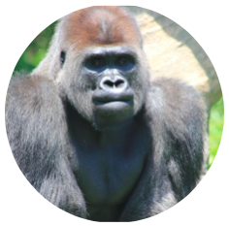
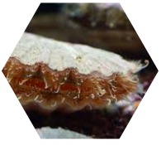
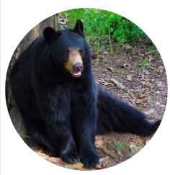
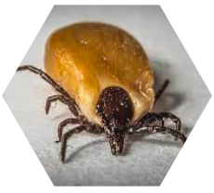
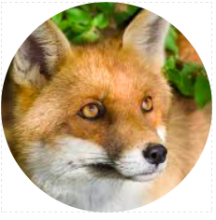
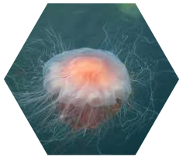
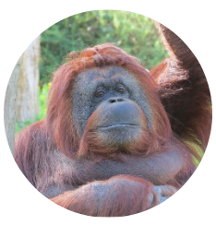
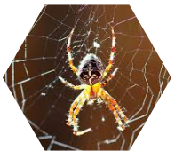
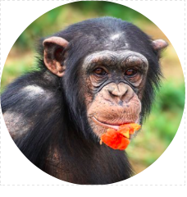
Notes:
As it happens, actual research has been done on which animals are most and least likely to generate empathy from people.
On the left, we have the high-empathy animals: highest on the list is orangutan, followed by gorilla, chimpanzee, bears, and foxes. On the right are the lowest-empathy animals: scallops, jellies and spiders, and the least empathy-inspiring animal of all – the tick!
These feelings are pretty much universal, but the good news is, once we understand WHY people do or don’t feel empathy towards a species, we can communicate more clearly in a way that increases empathy for animals overall.

Slide 4
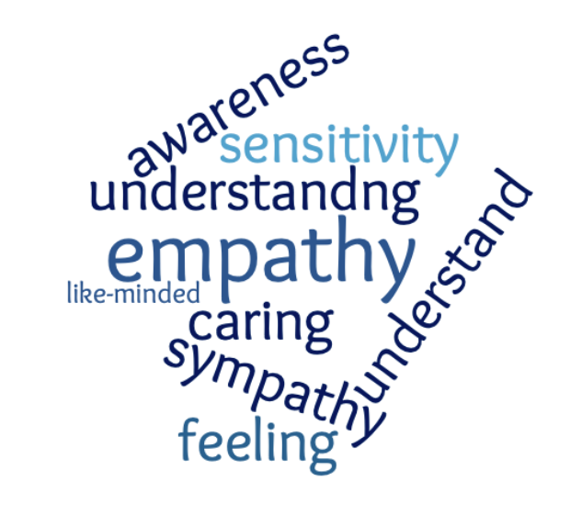
Empathic Abilities
Affective Empathy – feeling another’s feelings
Cognitive Empathy - understanding another’s feelings
Empathic Concern – acting in response to another’s feelings
Notes:
When we looked at the definition of empathy in the first session, we agreed that it involved being aware of another’s feelings, caring about others, and seeing things from another’s perspective.
Digging deeper into this definition, the research on empathy describes 3 what we call “empathic abilities.” Each of these processes occurs in separate parts of the brain but can all be used to take the perspective of an animal.
The three empathic abilities are: Affective Empathy, Cognitive Empathy, and Empathic Concern. Don’t let the jargon here get in your way of learning how this applies to your work as a docent! We are going to spend a little bit of time understanding Affective Empathy today, and will get to the other pieces later.

Slide 5






Affective Empathy
Notes:
Affective Empathy is the ability to sense the emotions of another being. When affective empathy is really strong, you actually feel another’s emotion even when the experience is not your own.
For instance, when you see a child drop her ice cream cone and begin to cry, and you feel her disappointment in your own heart, that is affective empathy.
When you see a dog cowering in fear as its owner scolds it, and you sense how scared the dog is, that is affective empathy.
At the zoo, when you see a tiger stretched out in the sun having a big yawn, and you feel a comfortable laziness in your own bones, that is affective empathy.

Slide 6
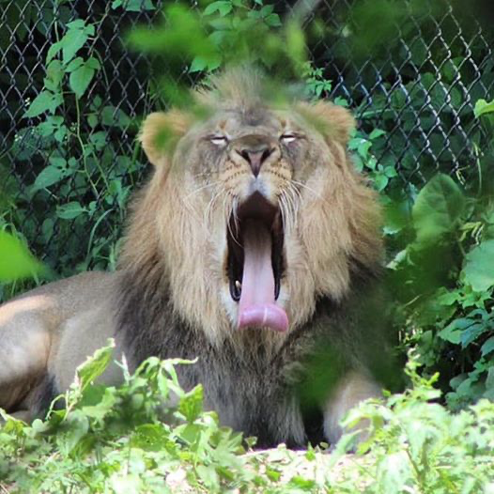
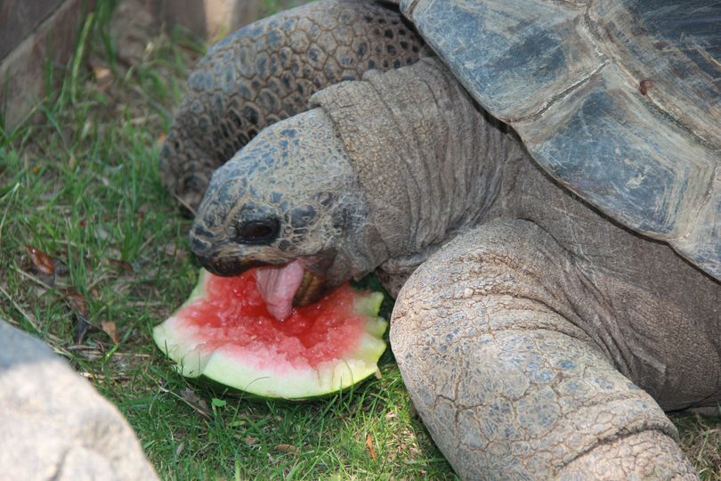
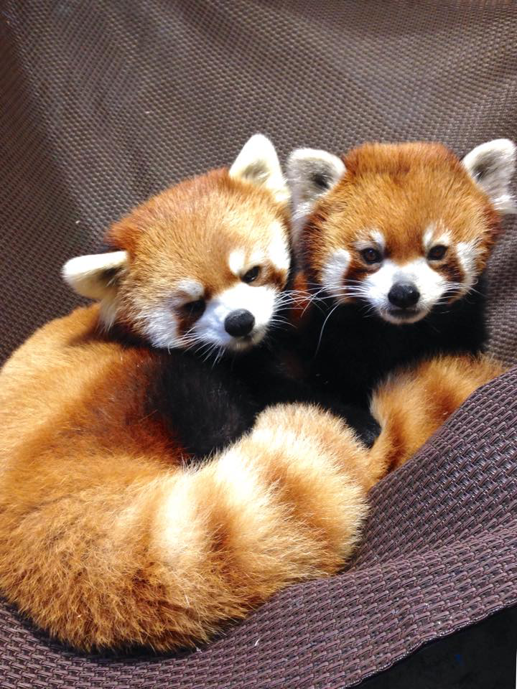
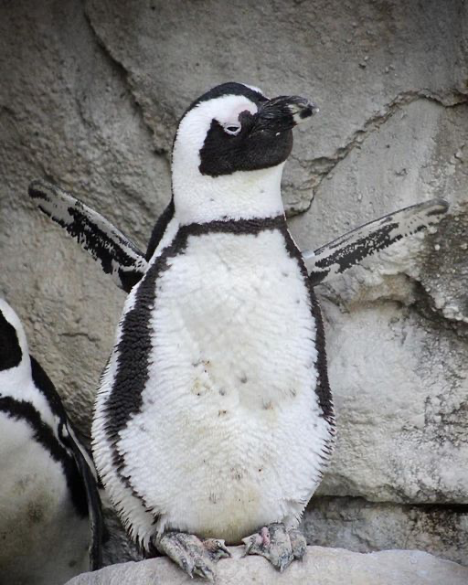
How does Affective Empathy relate to Anthropomorphism?
A
B
C
D
Notes:
Here are four images of animals from our collection, each showing expressions that we might interpret as a particular emotion. Now, you are probably thinking – wait a minute, I thought we weren’t supposed to anthropomorphize the animals!
Let’s pause and talk about how anthropomorphism fits into the topic of empathy for animals. An important distinction to make is that we are not necessarily attributing the emotion to the animal, but we are feeling an emotional response to what we observe.
For example, with picture A, instead of stating that the lion feels tired, you might say something like, “Boy, that big yawn sure makes me feel sleepy!” We cannot claim to know with certainty what an animal is feeling, but we can know how their circumstance makes US feel. And by making the connection to the human emotion, you are triggering the parts of the brain that increase empathy for the animal. Does that make sense? [Ask participants to show you a thumbs up, down, or sideways.]
It is a fine line, and not always an easy one to distinguish. When using affectivity as a component of tapping into people’s empathy for animals, you need to be careful that you are asking them what their emotions are in response to seeing an animal, as opposed to stating that an animal is itself feeling that emotion.
Let’s try it with the other animals shown here. Ask for volunteers to describe their emotional response to the animals.
Possible answers:
B (Aldabra tortoise) - If I were chomping on my favorite snack, I would feel very delighted!
C (Red pandas) - Snuggling up with a friend always makes me feel cozy.
D (African penguin) – When I was the age of this youngster, my parents made me feel like I could do anything - even fly!
It takes practice to get this phrasing right. Don’t worry if you slip sometimes – we all do! It’s natural to attribute emotions to animals when we observe them. Whereas most zoo scientists used to feel strongly that anthropomorphism should be avoided, research on empathy explains why it can be a useful tool for zoo education.
The important point here is that, when people feel an emotion themselves as they interpret what an animal is feeling, they are experiencing affective empathy – which is a key to moving them towards conservation action.

Slide 7




Why do some animals elicit more empathy?
AFFECTIVITY
AGENCY
CONTINUITY
COHERENCE

Slide 8
Why do some animals elicit more empathy?
AFFECTIVITY
AGENCY
CONTINUITY
COHERENCE
Notes:
Remember, there are 4 characteristics of animals that contribute to how much empathy people generally feel:
Agency
Affectivity
Coherence
Continuity
Agency was covered in the first module and referred to the extent to which an animal presents behaviors similar to human behaviors.
The second one, Affectivity, is – you guessed it – closely related to Affective Empathy. Affectivity is also sometimes called the vitality affect.

Slide 9
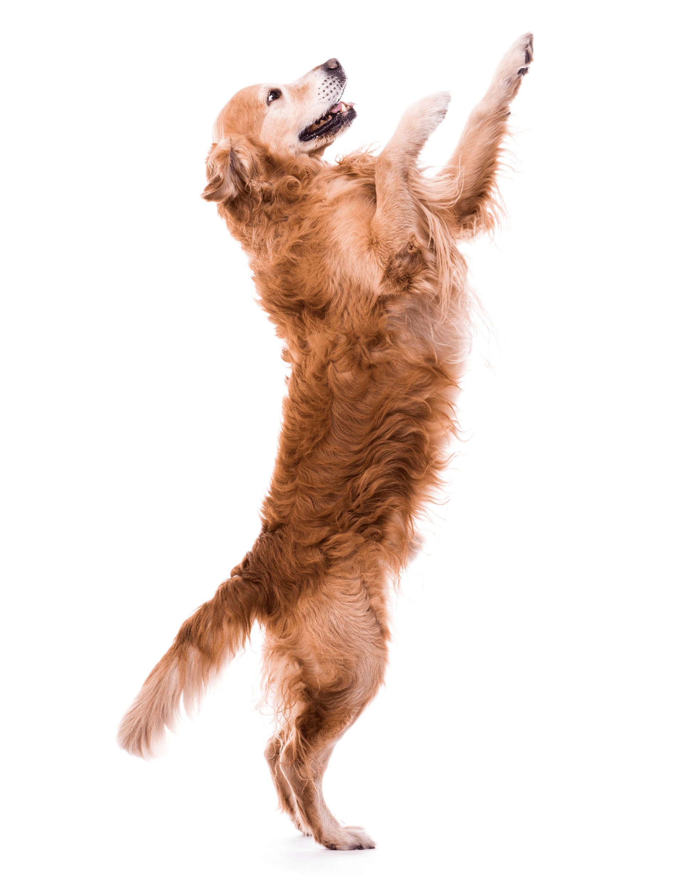
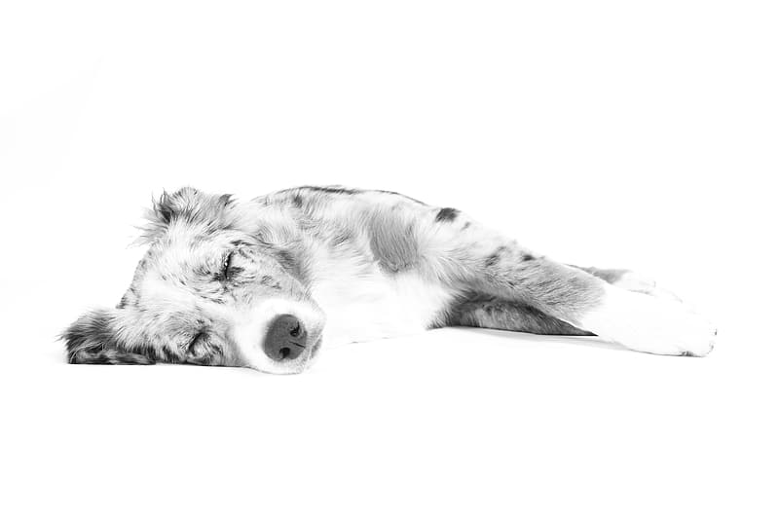
Affectivity: the animal experiences different vitality “modes,” which we interpret as emotions
AFFECTIVITY
QUALITIES OF AROUSAL – low to high
PATTERNS OF AROUSAL - variable
Notes:
If you think about an animal showing a lot of vitality, what do you picture? Energy! Liveliness! Animation! Spirit! Exuberance!
At the opposite extreme is an animal with low vitality: Low energy; Passive; Immobile.
Animals that exhibit a wider range of affectivity – those that can go between extreme high and low vitality levels – are more likely to engender empathy.

Slide 10


AFFECTIVITY
Capitalize on the empathy that visitors naturally feel for some animals!
Describe the inherent vitality in animals that do not elicit empathy as readily!
Notes:
As a zoo docent, then, knowing that affectivity is a key to empathy can make you a better interpreter!
Just like with agency, you can take advantage of the empathy that naturally occurs when visitors observe animals that show extremes of high and low vitality patterns and qualities. For example, the lemurs that go from springing wildly around their habitat to posing peacefully in the sun. Their affectivity makes them easy to feel empathy for. Capitalize on the relatability of this range of vitality, most familiar to those with young children.
Your challenge, on the other hand, is to identify affectivity that may not be as obvious in some animals. I’ll give you one example and then we can brainstorm some more.

Slide 11

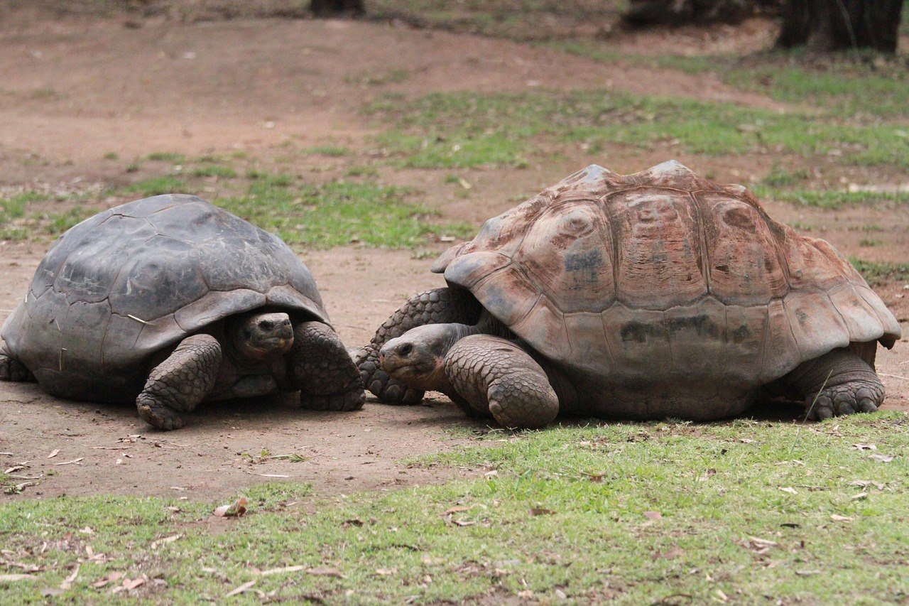


Notes:
Going back to our Aldabra tortoise, an animal that doesn’t exhibit a wide range of affectivity, you might share with visitors the fact that tortoises can follow the gaze of another tortoise. This is a trait that not all animals, and certainly not many reptiles, are known to possess. So when a tortoise is seemingly just staring blankly into the distance, it may in fact be communicating something with a family member and sharing important information about their surroundings. That’s pretty neat! And demonstrates a level of vitality that isn’t obvious from its generally low-key behavior.
What other examples of animals with a limited range of vitality can you think of, and how might you describe it in a way that increases visitors’ empathy towards that animal? Think about low-energy animals or ones that don’t have the ability to move quickly or far. [Give docents a moment to think, then share their examples aloud, or type them in the chat box.]

Slide 12
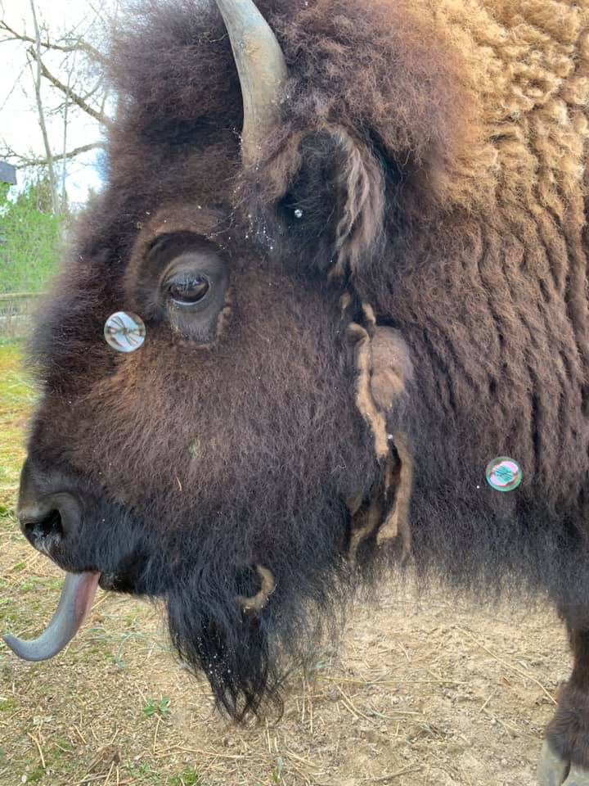
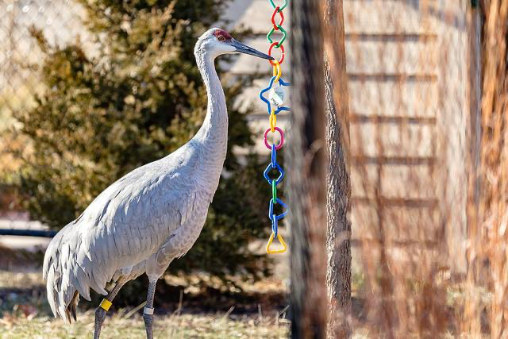
Using Enrichment to Increase Affectivity
Notes:
One way that zoo keepers promote an animal’s natural vitality is through behavioral enrichment. Enrichment activities are prime times to highlight affectivity.
A normally sedate bison becomes animated in response to bubbles.
The sandhill crane, though its facial expression doesn’t change, suddenly becomes playful around a toy.

Slide 13
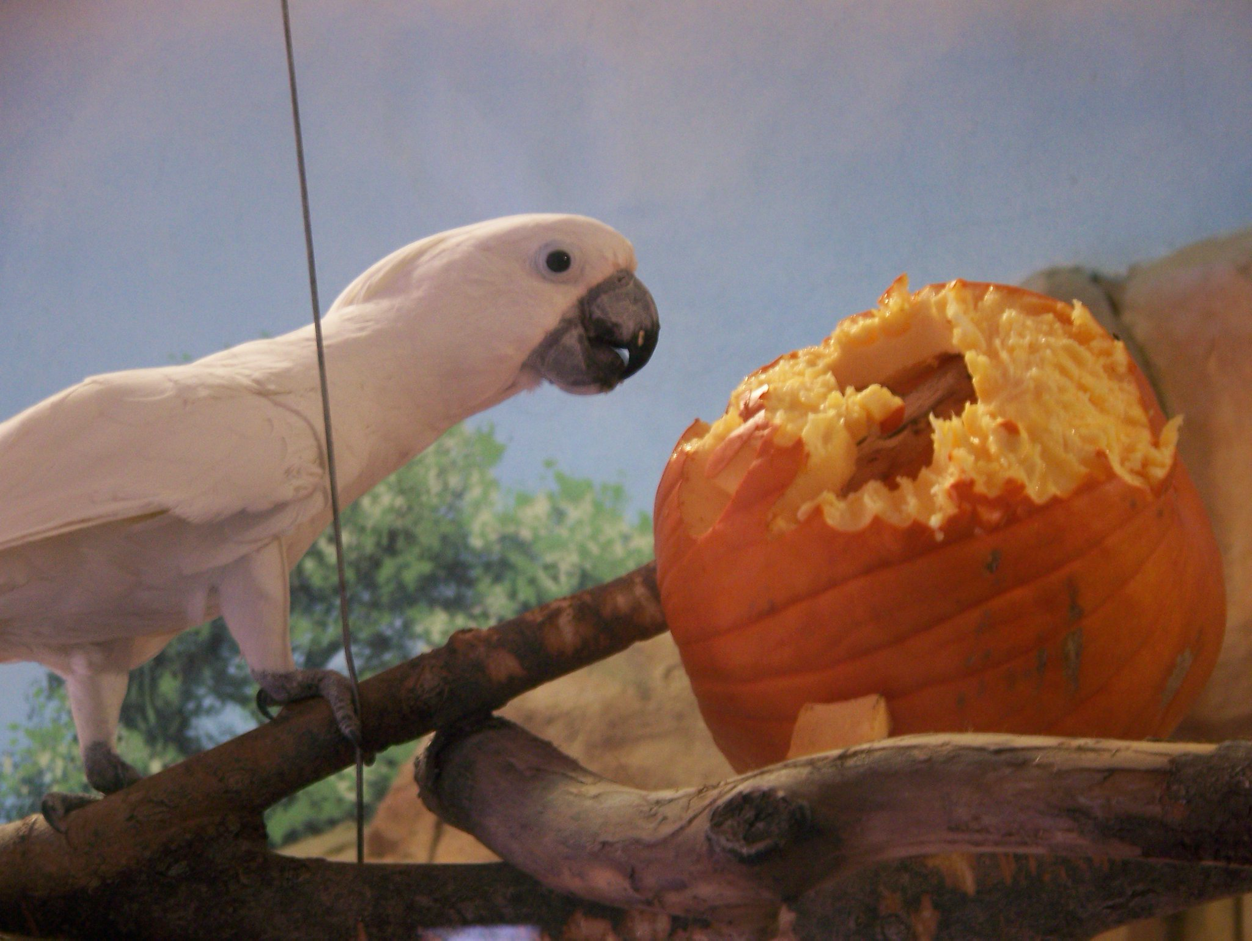
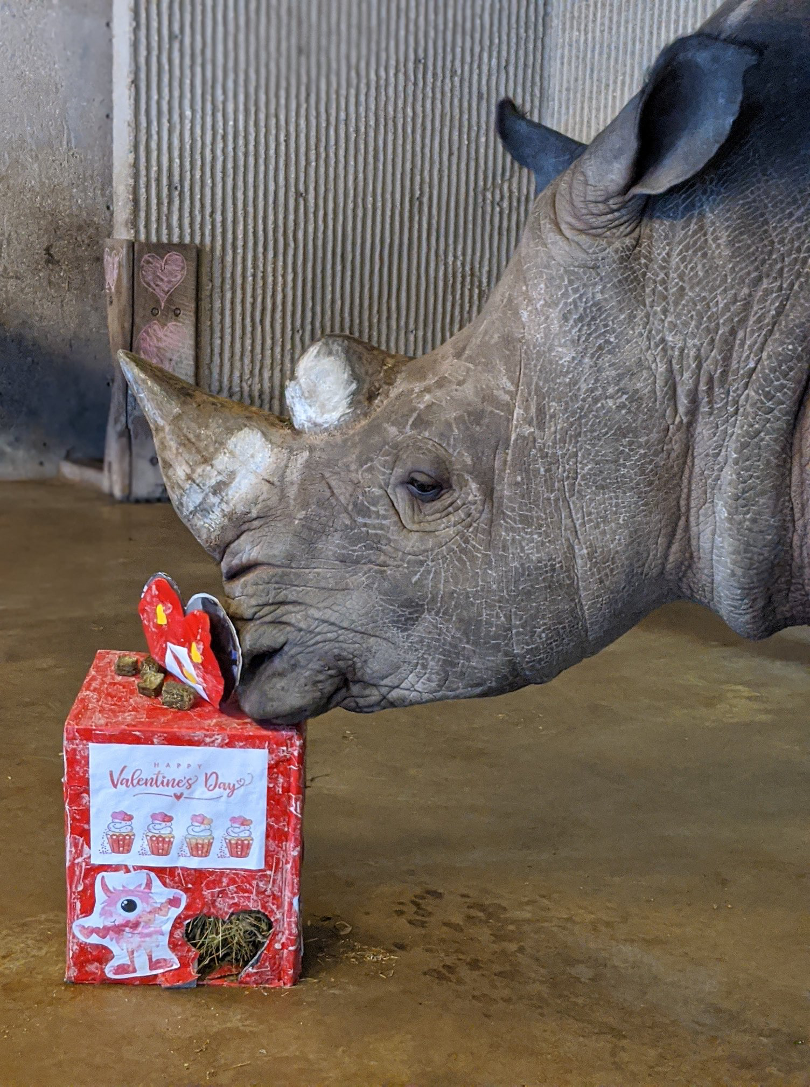
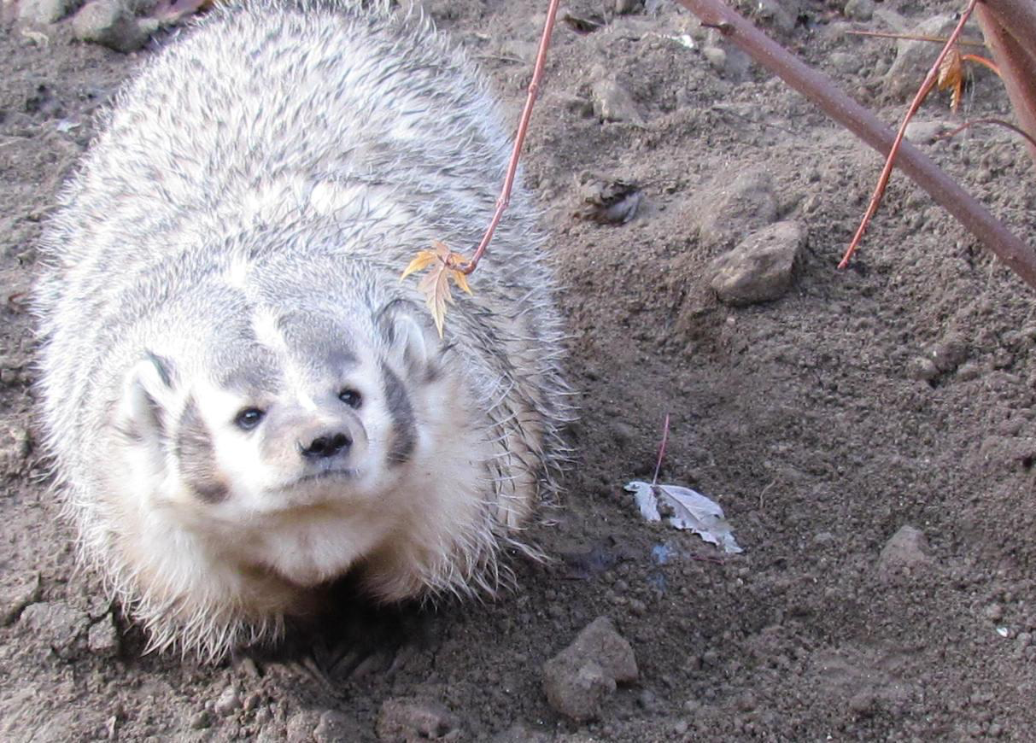
Notes:
Every holiday inspires enrichment activities and provides great opportunities for you to highlight the affectivity in animals that may often be hidden.
But you don’t have to wait for a zoo keeper to introduce enrichment into the habitat. Animals find enrichment in their natural surroundings. For example, this badger being intrigued by a fluttering leaf. Observing these special moments, and pointing them out to visitors, can help them make empathy connections.

Slide 14
Other Examples of Affectivity?
QUALITIES OF AROUSAL – low to high
PATTERNS OF AROUSAL - variable
Notes:
Now that you’ve heard some more examples, can you think of additional exhibits or animals where you could highlight affectivity? Where can zoo visitors observe or learn about examples of animal’s vitality - however that might be displayed for that particular species?
[Give time for participants to think and share.]

Slide 15
Summary: Module 2
3 Empathic Abilities:
Affective Empathy – feeling another’s feelings
Cognitive Empathy - understanding another’s feelings
Empathic Concern – acting in response to another’s feelings
Empathy for animals is influenced by 4 characteristics:
Agency
Affectivity - differing vitality “modes” of an animal
Coherence
Continuity
Notes:
To summarize, what we have learned is that there are three ways to experience empathy: Affective, Cognitive, and through Empathic Concern. Our focus in this session was on Affective Empathy, or the ability to sense the emotions or another being
We also reminded ourselves that empathy for animals is influenced by 4 characteristics, focusing this time on Affectivity which is the varying modes of vitality or patterns of arousal exhibited by an animal. The greater those variations in vitality, the higher the affectivity and the more empathy the animal attracts.

Slide 16
Summary: Module 2 (cont.)
People’s empathy for animals is an important building block toward conservation action
Supporting the zoo’s mission
Docents are an important piece of the zoo’s education initiatives!
Notes:
We of course want to remember why this work around empathy is important. Research on this topic shows that an increase in empathy for animals at a young age contributes to a willingness to take action for wildlife later in life.
In other words, if we want our visitors to contribute to our mission of conserving wildlife, then it’s important that they first develop a sense of empathy for those species.
The Zoo is committed to building organizational capacity for empathy practices in all of its education programs and YOU are a critical piece of our ability to educate visitors.

Slide 17


Empathy is teachable and learnable!
AFFECTIVITY
Notes:
You can make it a goal when talking with guests to increase the AFFECTIVITY they observe in the animals in our exhibits. By doing that, you are triggering their empathy, which contributes to their desire and willingness to support the conservation of its species.
This is the end of the second module on this topic. In the next 2 sessions, we will continue to explore what empathy means and how we can foster it with different techniques.

Slide 18


The best way to learn is through practice!
Notes:
Talk about next steps and open up for questions…

