Slide 1

Promoting Wildlife Conservation through Empathy for Animals
Module 1: Agency
Docent Training
Notes:
Hello! I’m Courtney…[introduce self]
This is the first in a 4-part series about Empathy, a topic that the Zoo has been incorporating more and more into our education programs – for good reason!
Since 2018 Henry Vilas Zoo has been part of a national effort to apply new research that shows how young people’s empathy for animals is an important building block in their becoming conservation-minded adults.
Zoo education staff have been participating in conferences and workshops devoted to exploring empathy research and we are working on ways to apply that research to the practice of zoo education.
The Zoo is committed to building organizational capacity for empathy practices, and that commitment extends to you – our docents!
We will get into our definition of empathy as it relates to conservation education in a moment. First, let’s do a quick warm up activity!

Slide 2






Which animal at the Zoo do you think is the most underrated?
Why?
Notes:
To get us started in today’s training, I want you to pick the animal at the Zoo that YOU feel is the most underrated. I’ll give you a minute to think about it. There are no wrong answers, of course. In your opinion, which animal in our collection doesn’t get enough credit?
Let everyone respond to the icebreaker question. A good way to make sure everyone is heard is to choose someone to start, ask them to give their answer, then have them choose the next person, iin until everyone has had a turn.
Some of the underrated animals you all mentioned are those that our visitors may not feel a lot of empathy towards.
Why is it important for children to develop empathy towards these underrated animals? Remember: young people’s empathy for animals is an important building block in their becoming conservation-minded adults.
But what really do we mean when we talk about empathy?

Slide 3


Defining Empathy
Notes:
What synonyms or related words and phrases come to mind when you hear the word “empathy”? [Ask trainees to type their responses into the chat box.]
You can type one or more responses. Feel free to repeat a word someone else has posted, if you agree. Again, no wrong answers here. It’s just what the word “empathy” makes you think about.
Some common answers may include:
Caring
Understanding
Feeling the same as someone else
Kindness
Great! You already have a really good sense of what this word means and how to use it.

Slide 4
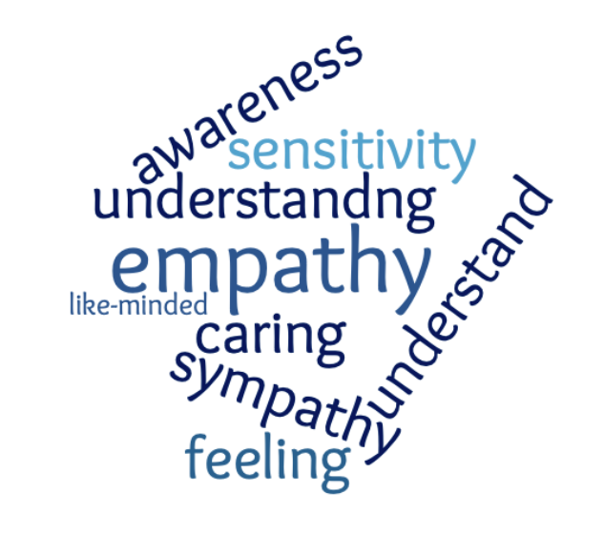
Empathy is a stimulated emotional state that relies on the ability to perceive, understand, and care about the experiences or perspectives of another person or animal.
Notes:
For our purposes, we are using this definition of empathy. It is pulled from a Seattle Aquarium publication written as part of a larger empathy research project in zoos and aquariums.
[Read the definition aloud, or ask someone else to read it]: Empathy is a stimulated emotional state that relies on the ability to perceive, understand, and care about the experiences or perspectives of another person or animal.
Don’t worry - You do NOT need to commit this definition to memory. But it’s helpful when we are talking about empathy that we have a general sense of a common definition.
You already identified the core elements of the definition: being aware of another’s feelings, caring about others, and seeing things from another’s perspective.

Slide 5







Notes:
There has been a generational decline in empathy - concern for other people as well as concern for the environment - that seems to be connected to the decline in time spent in nature. The Zoo is a place where people can spend time enjoying nature, so just by coming here, they are more likely to feel concern for the environment. And that is something we can build on in our interpretive encounters.

Slide 6
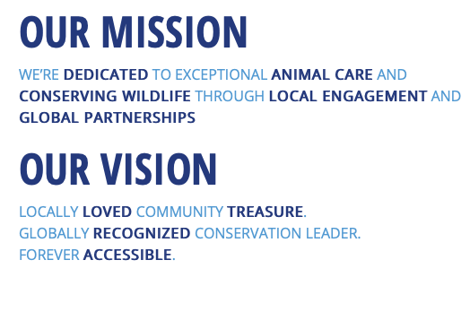
Notes:
The concept of building empathy for animals is directly in line with the Zoo’s mission.
Research shows people are likely to want to help animals that they feel greater empathy for.
If we want our visitors to contribute to our mission of conserving wildlife, then it’s important that they first develop a sense of empathy for those species.

Slide 7




Communicating Empathy
Notes:
As a zoo docent, you have the power to bring empathy into your conversations with visitors.
By asking questions that have an intentional empathy spin, you can draw people into making connections to the animals in a way that increases their empathy for them.
By pointing out particular features of animals, you can draw their attention to things that naturally elicit greater empathy.
Simply by using pronouns to refer to animals as “she” or “he,” you can alter the degree of empathy a visitor feels towards it…or, rather, towards him or her. ☺
During this training series, we are going to explore some of the communication techniques for increasing people’s empathy for animals.

Slide 8
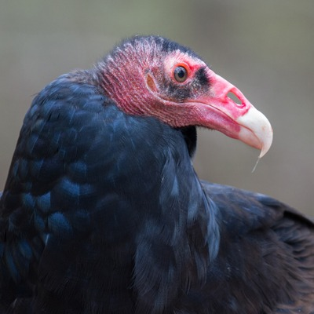
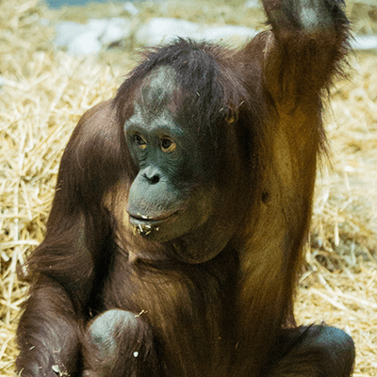
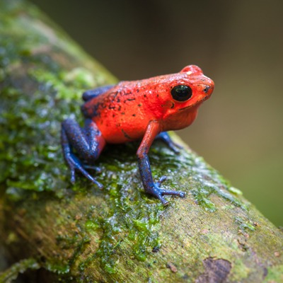
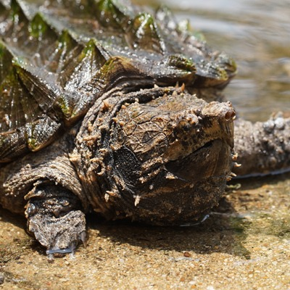
Which animal elicits the most empathy?
A
B
C
D
Notes:
Here are four images of animals from our collection. Which of these – A, B, C, or D – do you think elicits the most empathy from zoo visitors? [Have them type their answers into the chat box or say them aloud.]
Definitely the orangutan most readily elicits empathy from the majority of zoo visitors, compared to a turkey vulture, a poison dart frog, or an alligator snapping turtle! You personally may have an affinity towards one of these other creatures, but the typical visitor is always going to go for orangutan.
Some animals naturally elicit more empathy than others. In general, the more an animal is “like us”, the more empathetic humans are towards it. While this might seem unfair, there are valid, research-based reasons for it.

Slide 9



Why do some animals elicit more empathy?
AFFECTIVITY
AGENCY
CONTINUITY
COHERENCE
Notes:
In fact, there are four more vocabulary words in the empathy research that describe factors which contribute to an animal’s likelihood of eliciting empathy from people. Empathy researchers talk about these four types of characteristics:
Agency
Affectivity
Coherence
Continuity
Today we will focus on the first one – Agency – and I’ll be introducing the others in the next 3 modules.

Slide 10
Agency: the animal has behaviors that are similar to our human behaviors
MOVING - Walks bipedally; Uses hands to manipulate objects
EATING – Eats an omnivore diet; Feeds itself with its hands
PLAYING – Plays with objects; Chases
SOCIAL INTERACTIONS - Mother-child relationships; Family groups
AGENCY
Notes:
Agency refers to the extent to which an animal presents behaviors similar to human behaviors. These behaviors include moving, eating, playing, and social interactions.
A gorilla is high in the agency category. Gorillas move like us. They can walk on two legs. They use their hands – which have an opposable thumb like us – to pick up objects and explore. Gorillas are omnivores, like us (although they primarily choose to eat plant matter), and they feed themselves in a similar way to humans. Gorillas are playful in a way that resembles human play. They chase each other, tickle, wrestle, and hide. There is a strong family bond, familiar to human families, with an especially important relationship between mother and offspring. These characteristics of gorillas, so similar to our human behaviors, influences how we relate to them.
So, when we talk about an animal’s agency, we are referring to the type of behaviors it has that are similar to our own human behaviors. The more similar those behaviors, the greater the agency, and the higher the likelihood that a person feels empathy towards it.

Slide 11


AGENCY
Capitalize on the empathy that visitors naturally feel for some animals!
Point out human-like behaviors in animals that do not elicit empathy as readily!
Notes:
As a zoo docent, then, knowing that agency is a key to empathy gives you a secret weapon and a fun challenge.
Your secret weapon is the ability to take advantage of the empathy that naturally occurs when visitors observe animal behavior that is similar to human behavior – moving, eating, playing, or social interactions.
Your fun challenge is to identify human-like behaviors that may not be as obvious in some animals. I’ll give you one example and then we will brainstorm some more.
Going back to our strawberry poison dart frog, an animal that at first glance doesn’t seem to have any behaviors in common with humans, you might share with visitors the fact that strawberry poison dart frog parents are very protective of their young – just like human parents! The father protects the eggs and keeps them moist while the tadpoles develop. After they hatch, the mother carries her babies piggy-back style to small pools of water in bromeliad plants. She deposits each tadpole its own baby pool. And for the next six weeks, she feeds them each in turn. By sharing this description of the frog’s behavior and pointing out parallels to human behavior, you are increasing the visitors’ empathy towards strawberry poison dart frogs….which ultimately leads to a greater likelihood that they will want to take conservation action in support of this species.
What other examples of animal behavior can you think of, that might increase a visitors’ empathy towards that animal? Think about moving, eating, playing, and social interactions. [Give docents a moment to think, then share their examples aloud, or type them in the chat box.]
See, wasn’t that a fun challenge? Keep doing that when you are talking to zoo visitors during your next shift!

Slide 12
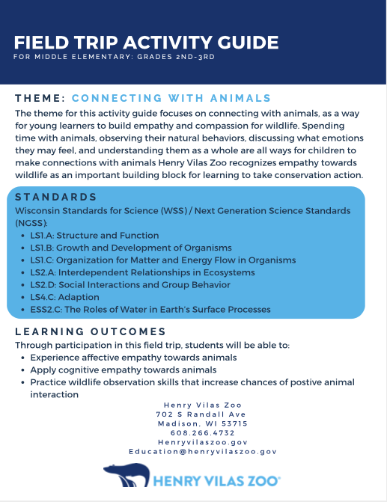
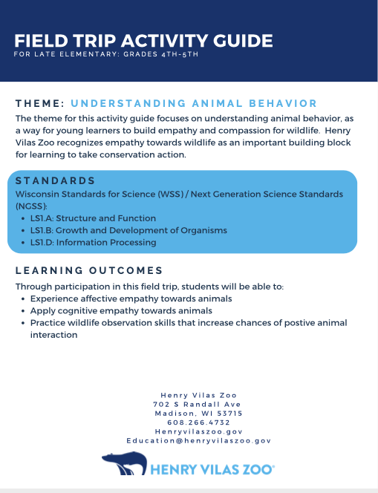
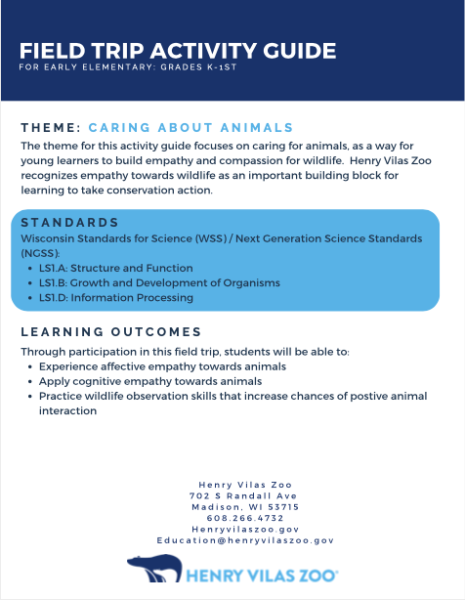
Empathy-based Field Trip Activity Guides
Notes:
But you are not alone out there! Another way the Zoo is incorporating the empathy best practices is through newly designed Field Trip Activity Guides, which teachers and chaperones are encouraged to utilize during self-guided field trips.
There are 3 Activity Guides that have been designed, structured around best practices in empathy education. [Mention whether/when they can be downloaded from the website.]
As you encounter field trip groups using the Activity Guides, you can reinforce those empathy messages by using specific examples and methods to connect with the kids.
You should check out the Activity Guides in your spare time, but I’ll give you a few specific examples from the Guides that relate to this concept of Agency we have been learning about.

Slide 13
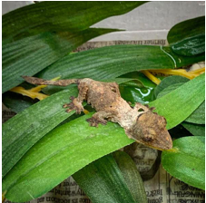
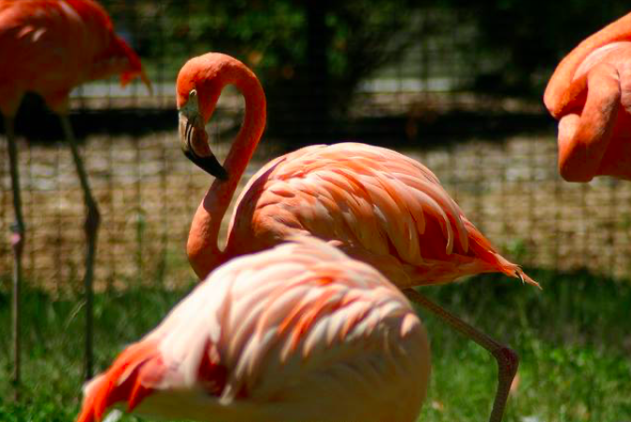
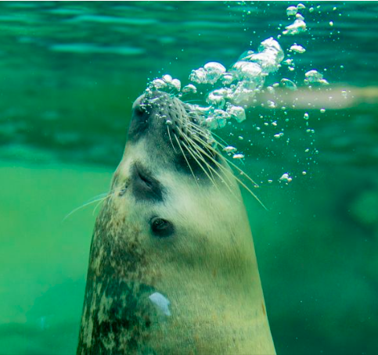
Examples in K-1st Field Trip Activity Guide
CLIMBING!
PLAYING!
MOVING!
SOCIAL INTERACTIONS!
Brett Anderson Photography
Notes:
In the K-1st grade Field Trip Activity Guide, there are 3 excellent examples of animal behaviors that are similar to human kid behaviors. The first is an activity about the lichenose leaf-tailed gecko – not necessarily an animal you would think elicits a lot of empathy. But they are excellent climbers, and kids love to climb, too! So that’s a simple way to increase the agency factor for geckos.
Another activity in the guide talks about harbor seals blowing bubbles – again, a fun behavior that kids also like to do underwater.
And then there is an activity about the Chilean flamingo, which addresses social interactions in a large flock. This is an opportunity to compare flamingo friendships with human friendships.

Slide 14
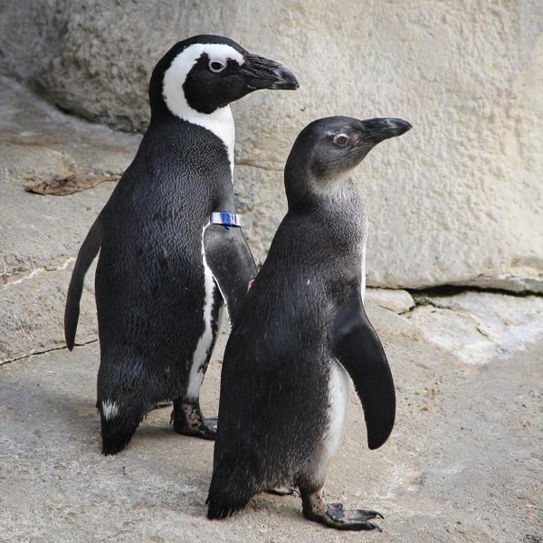
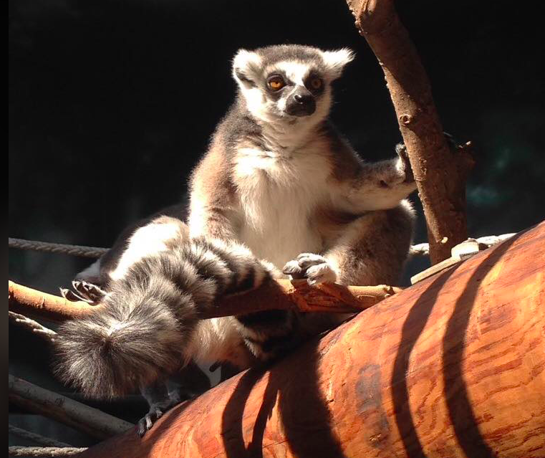
Examples in 2nd-3rd Field Trip Activity Guide
MOVING TO SEEK COMFORT!
Notes:
In the Field Trip Activity Guide for 2nd-3rd grades, the best agency-focused examples are with lemurs and penguins, which both position themselves in sun or shade according to their temperature preferences. You can help draw that parallel between the animal’s behavior and our own - seeking comfort by moving to a warmer or cooler spot.

Slide 15
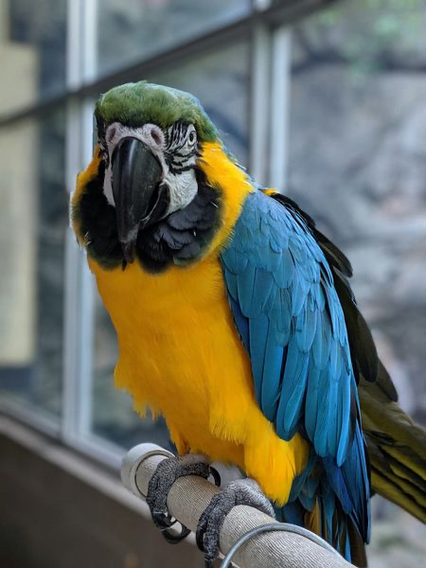
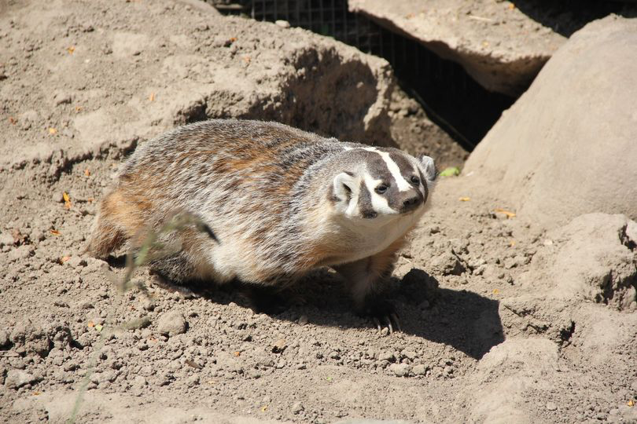
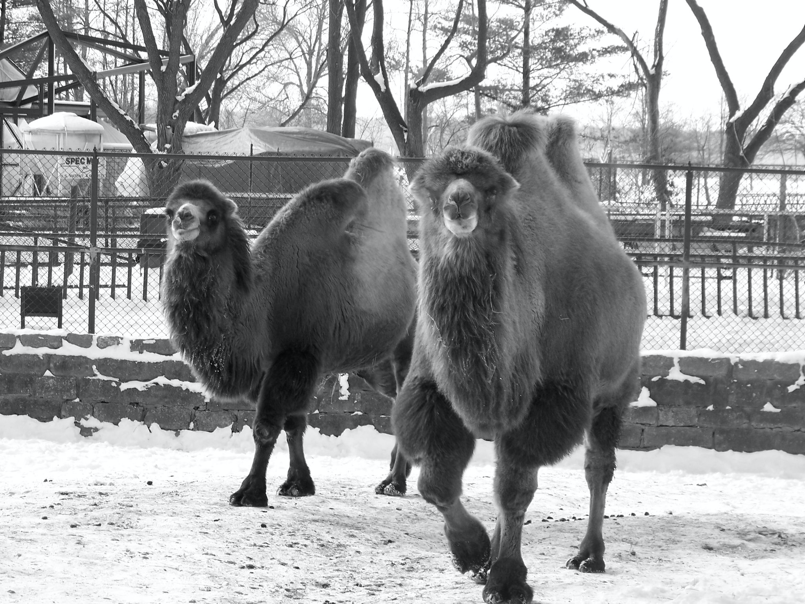
Examples in 4th-5th Field Trip Activity Guide
TALKING!
DIGGING!
WALKING!
Notes:
And the 4th-5th grade Field Trip Activity Guide provides activities about badgers digging, camels walking, and macaws talking – all behaviors that, when recognized as being similar to human behaviors, can help kids develop empathy towards those animals.

Slide 16
Other Examples of Agency?
MOVING - Walks bipedally; Uses hands to manipulate objects
EATING – Eats an omnivore diet; Feeds itself with its hands
PLAYING – Plays with objects; Chases
SOCIAL INTERACTIONS - Mother-child relationships; Family groups
Notes:
Can you think of other examples from the zoo’s collection, or just animals in general, where you could highlight an animal’s agency? Where can zoo visitors observe examples of these types of behaviors that you might call out?
[Give time for participants to think and share.]

Slide 17
Summary: Module 1
Definition of empathy - a stimulated emotional state that relies on the ability to perceive, understand, and care about the experiences or perspectives of another person or animal
People’s empathy for animals is an important building block toward conservation action
Focusing on empathy supports the zoo’s mission
Notes:
To summarize, what we have learned is that empathy is a stimulated emotional state that relies on the ability to perceive, understand, and care about the experiences or perspectives of another person or animal.
The reason we care about developing empathy at Henry Vilas Zoo is because research shows that young people’s empathy for animals is an important building block in their becoming conservation-minded adults.
So, by using techniques that increase visitors’ empathy for animals, we are helping to supports the zoo’s mission.
As a zoo docent, you really do have the power to increase conservation action, simply by bringing empathy into your conversations with visitors.

Slide 18
Summary: Module 1 (cont.)
Empathy for animals is influenced by four characteristics:
Agency - the extent to which an animal presents behaviors similar to human behaviors.
Affectivity
Coherence
Continuity
Use interpretive techniques to increase an animal’s agency
Pull examples from the Field Trip Activity Guides
Notes:
We also learned that some animals naturally elicit more empathy than others due to 4 key characteristics:
Agency
Affectivity
Coherence
Continuity
Agency refers to the extent to which an animal presents behaviors similar to human behaviors. These behaviors include moving, eating, playing, and social interactions.
We will tackle the other characteristics in the next sessions. In the meantime,, you can already start using interpretive techniques to point out human-like behaviors in animals, especially in those that do not elicit empathy as readily!
And be sure to check out the Field Trip Activity Guides and pull from their excellent examples that highlight agency in certain animals.

Slide 19


Empathy is teachable and learnable!
AGENCY
Notes:
If you see groups of students using the activity guides, you should tap into that teachable moment around empathy. But all guests can benefit from learning empathy for animals.
You can make it a goal when talking with guests to increase the AGENCY they observe in the animals in our exhibits. By doing that, you are triggering their empathy, which which contributes to their desire and willingness to support the conservation of its species.
This is the end of the first module on this topic. In the next 3 sessions, we will continue to explore what empathy means and how we can foster it with different techniques.

Slide 20


The best way to learn is through practice!
Notes:
Talk about next steps and open up for questions…

