Slide 1
Care for Animals

Slide 2
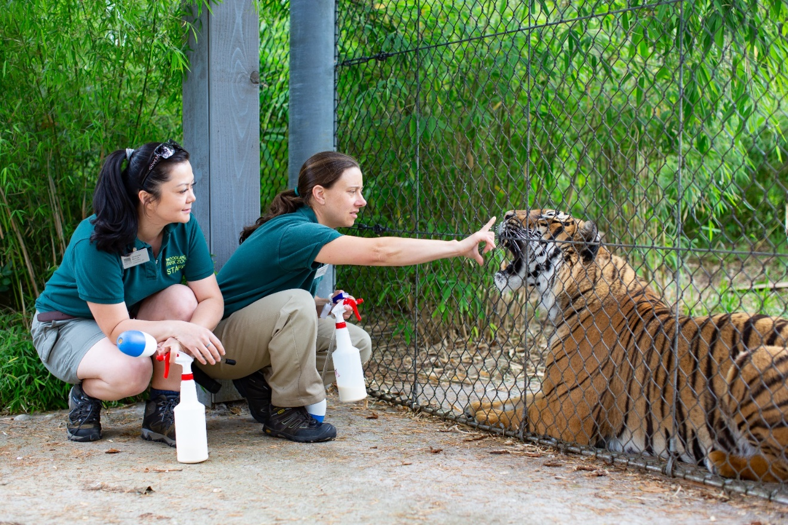
An animal keeper’s life for me

Slide 3
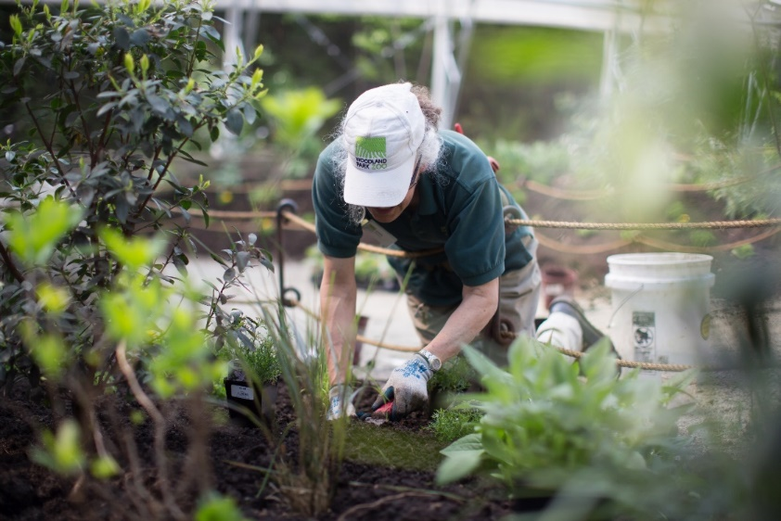
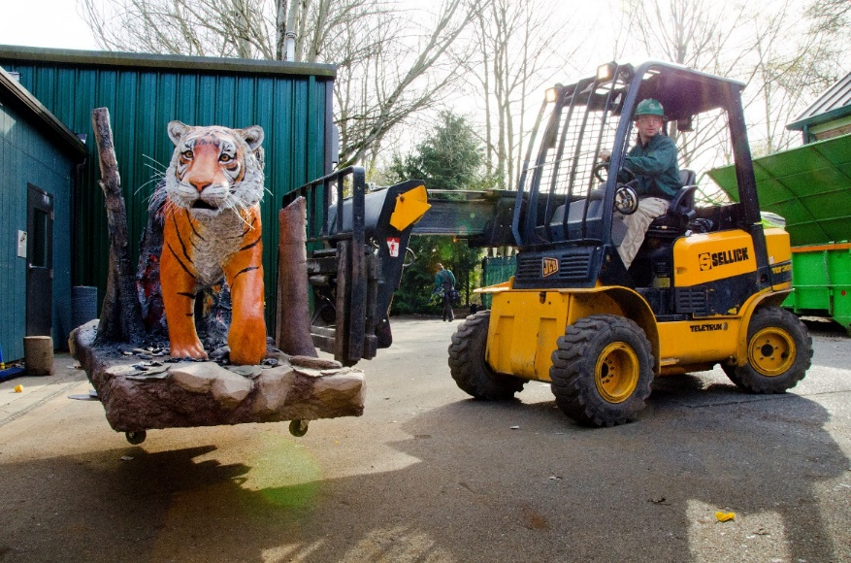
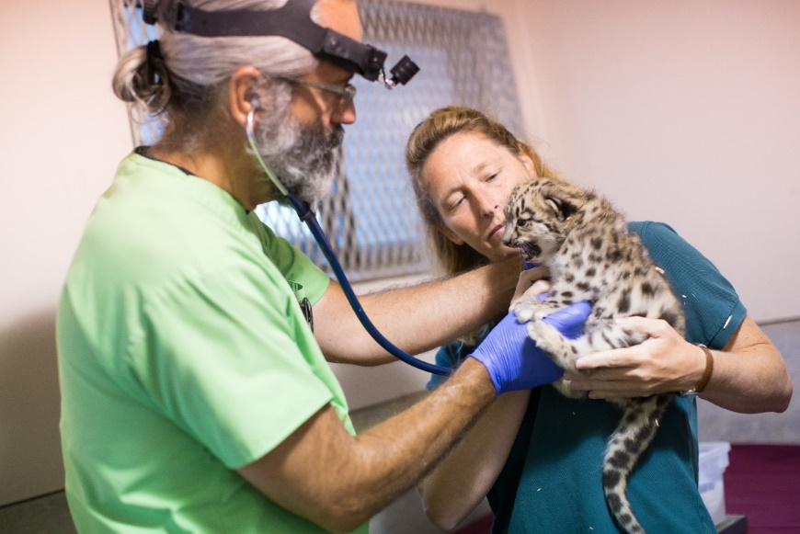
What about you? What kind of job would you like?

Slide 4
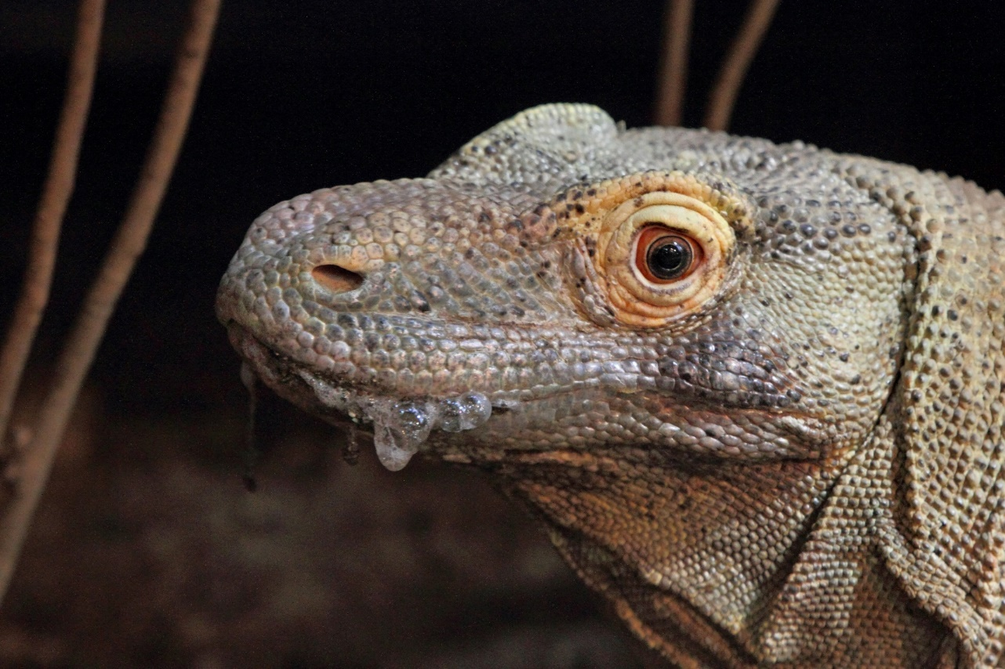
Animals are individuals, too

Slide 5
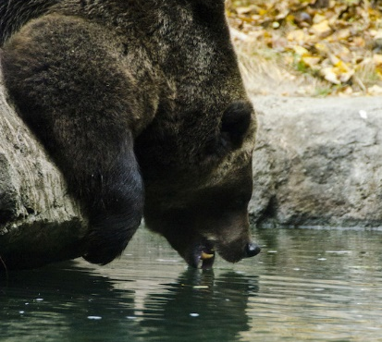
What do all animals need to survive?

Slide 6
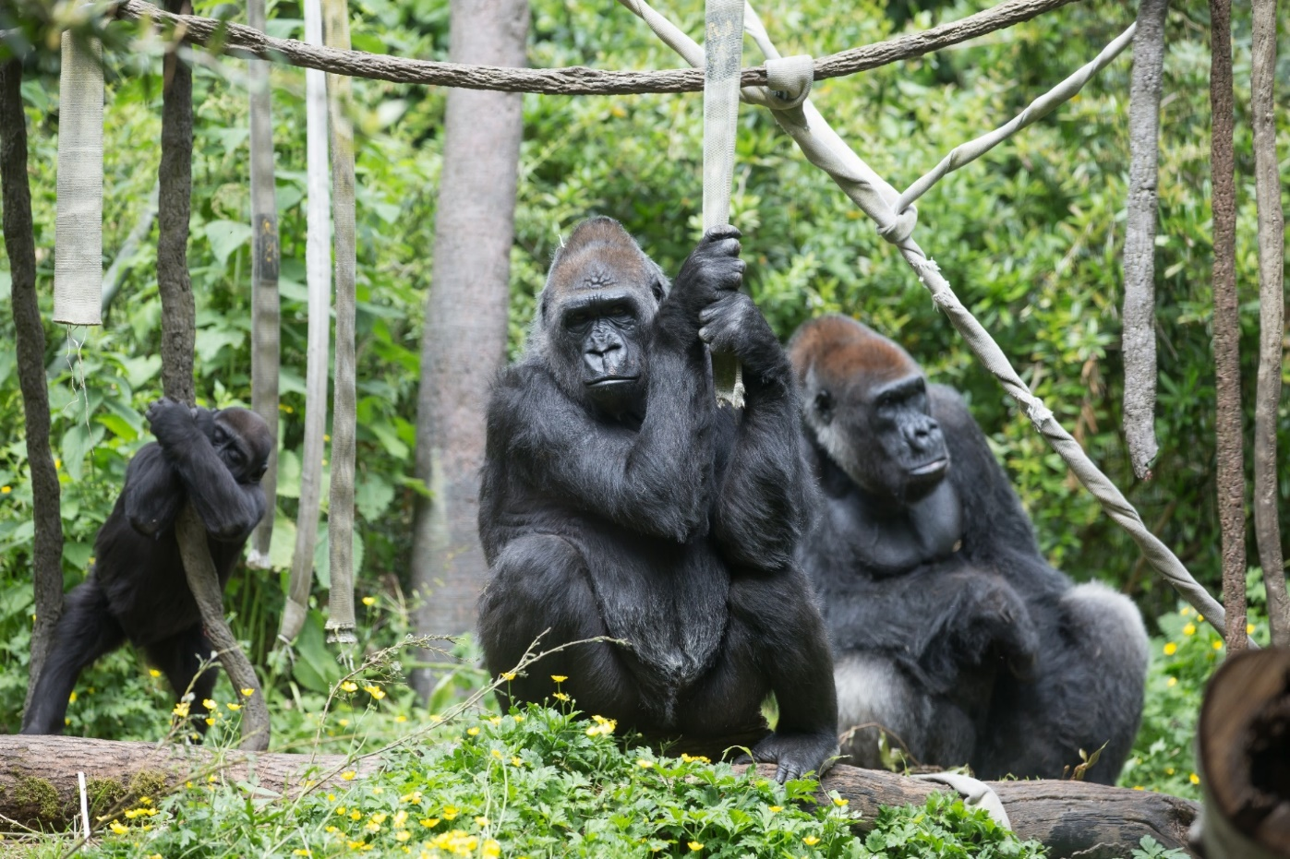
Animals thrive when their secondary needs are met

Slide 7
Enrichment
Enrichment helps animals thrive

Slide 8
Meet an Ambassador Animal
Let’s help our animal guest feel comfortable

Slide 9
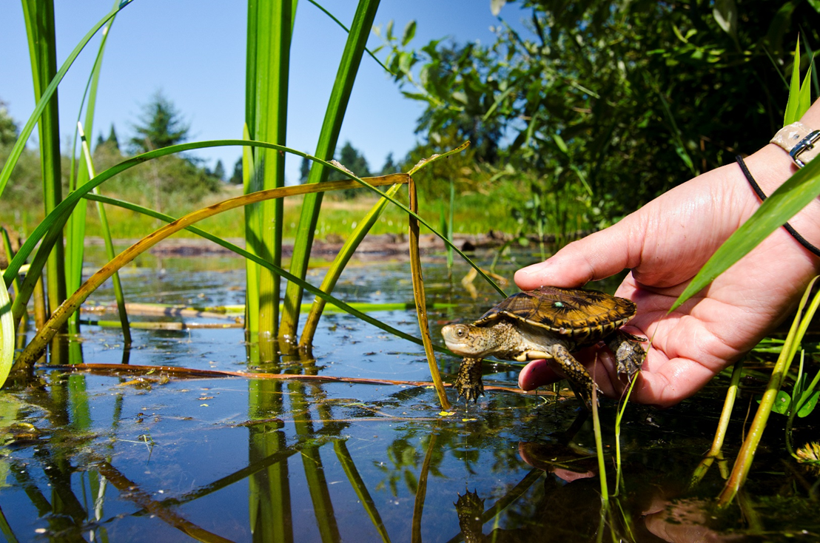
How will you help animals?

